Slide 1
OFDM PHY Proposal
Date: 2010-05-01
Author(s):
Name | Company | Address | Phone | email
Abu-Surra, Shadi | Samsung |  |  | sasurra@sta.samsung.com
Ban, Koichiro | Toshiba |  |  | koichiro.ban@toshiba.co.jp
Banerjea, Raja | Marvell |  |  | rajab@marvell.com
Basson, Gal | Wilocity |  |  | gal.basson@wilocity.com
Blanksby, Andrew | Broadcom |  |  | andrew.blanksby@broadcom.com
Borges, Daniel | Apple |  |  | drborges@apple.com
Borison, David | Ralink |  |  | david_borison@ralinktech.com
Chang, Kapseok | ETRI |  |  | kschang@etri.re.kr
Chu, Liwen | STMicroelectronics |  |  | Liwen.chu@st.com
Chung, Hyun Kyu | ETRI |  |  | hkchung@etri.re.kr
Coffey, Sean | Realtek |  |  | coffey@realtek.com
Cordeiro, Carlos | Intel |  |  | Carlos.Cordeiro@intel.com
Dorsey, John | Apple |  |  | jdorsey@apple.com
Elboim, Yaron | Wilocity |  |  | yaron.elboim@wilocity.com
Fischer, Matthew | Broadcom |  |  | mfischer@broadcom.com
Giraud, Claude | NXP |  |  | claude.giraud@nxp.com
Golan, Ziv | Wilocity |  |  | Ziv.golan@wilocity.com
Gong, Michelle | Intel |  |  | Michelle.x.gong@intel.com
Grieve, David | Agilent |  |  | david_grieve@agilent.com

Slide 2
Author(s):
Name | Company | Address | Phone | email
Grodzinsky, Mark | Wilocity |  |  | Mark.grodzinsky@wilocity.com
Hansen, Christopher | Broadcom |  |  | chansen@broadcom.com
Hart, Brian | Cisco |  |  | brianh@cisco.com
Hassan, Amer | Microsoft |  |  | amerh@microsoft.com
Hong, Seung Eun | ETRI |  |  | iptvguru@etri.re.kr
Hosoya, Kenichi | NEC |  |  | k-hosoya@ce.jp.nec.com
Hosur, Srinath | Texas Instruments |  |  | hosur@ti.com
Hsu, Alvin | MediaTek |  |  | alvin.hsu@mediatek.com
Hsu, Julan | Samsung |  |  | Julan.hsu@samsung.com
Hung, Kun-Chien | MediaTek |  |  | kc.hung@mediatek.com
Jain, Avinash | Qualcomm |  |  | avinashj@qualcomm.com
Jauh, Alan | MediaTek |  |  | alan.jauh@mediatek.com
Jeon, Paul | LGE |  |  | bjjeon@lge.com
Jin, Sunggeun | ETRI |  |  | sgjin@etri.re.kr
Jones, VK | Qualcomm |  |  | vkjones@qualcomm.com
Joseph, Stacy | Beam Networks |  |  | stacy@beamnetworks.com
Jun, Haeyoung | Samsung |  |  | Haeyoung.jun@samsung.com
Kaaja, Harald | Nokia |  |  | harald.kaaja@nokia.com
Kafle, Padam | Nokia |  |  | padam.kafle@nokia.com
Kakani, Naveen | Nokia |  |  | naveen.kakani@nokia.com
Kasher, Assaf | Intel |  |  | Assaf.kasher@intel.com
Kasslin, Mika | Nokia |  |  | mika.kasslin@nokia.com
Kim, Hodong | Samsung |  |  | hodong0803.kim@samsung.com
Kim, Yongsun | ETRI |  |  | doori@etri.re.kr
Kreifeldt, Rick | Harman International |  |  | rick.kreifeldt@harman.com
Kwon, Edwin | Samsung |  |  | cy.kwon@samsung.com
Kwon, Hyoungjin | ETRI |  |  | kwonjin@etri.re.kr
Kwon, Hyukchoon | Samsung |  |  | hyukchoon.kwon@samsung.com
Laine, Tuomas | Nokia |  |  | tuomas.laine@nokia.com

Slide 3
Author(s):
Name | Company | Address | Phone | email
Lakkis, Ismail | Tensorcom |  |  | ilakkis@tensorcom.com
Lee, Hoosung | ETRI |  |  | hslee@etri.re.kr
Lee, Keith | AMD |  |  | keith.lee@amd.com
Lee, Wooyong | ETRI |  |  | wylee@etri.re.kr
Liu, Yong | Marvell |  |  | yongliu@marvell.com
Lou, Hui-Ling | Marvell |  |  | hlou@marvell.com
Majkowski, Jakub | Nokia |  |  | jakub.majkowski@nokia.com
Marin, Janne | Nokia |  |  | janne.marin@nokia.com
Maruhashi, Kenichi | NEC |  |  | k-maruhashi@bl.jp.nec.com
Matsumoto, Taisuke | Panasonic |  |  | matsumoto.taisuke@jp.panasonic.com
Meerson, Yury | Wilocity |  |  | Yury.meerson@wilocity.com
Mese, Murat | Broadcom |  |  | mesem@broadcom.com
Montag, Bruce | Dell |  |  | bruce_montag@dell.com
Myles, Andrew | Cisco |  |  | amyles@cisco.com
Nandagopalan, Saishankar | Broadcom |  |  | nsai@broadcom.com
Ngo, Chiu | Samsung |  |  | Chiu.ngo@samsung.com
Nikula, Eero | Nokia |  |  | eero.nikula@nokia.com
Park, DS | Samsung |  |  | dspark@samsung.com
Park, Minyoung | Intel |  |  | Minyoung.park@intel.com
Pi, Zhouyue | Samsung |  |  | zpi@sta.samsung.com
Ponnampalam, Vish | MediaTek |  |  | vish.ponnampalam@mediatek.com
Prasad, Narayan | NEC |  |  | prasad@nec-labs.com
Prat, Gideon | Intel |  |  | Gideon.prat@intel.com
Ramachandran, Kishore | NEC |  |  | kishore@nec-labs.com
Raymond, Yu Zhan | Panasonic |  |  | Raymond.Yuz@sg.panasonic.com
Ronkin, Roee | Wilocity |  |  | Roee.ronkin@wilocity.com
Rozen, Ohad | Wilocity |  |  | Ohad.rozen@wilocity.com
Sachdev, Devang | NVIDIA |  |  | dsachdev@nvidia.com
Sadri, Ali | Intel |  |  | Ali.S.Sadri@intel.com
Sampath, Hemanth | Qualcomm |  |  | hsampath@qualcomm.com

Slide 4
Author(s):
Name | Company | Address | Phone | email
Sanderovich, Amichai | Wilocity |  |  | Amichai.sanderovich@wilocity.com
Sankaran, Sundar | Atheros |  |  | Sundar.Sankaran@Atheros.com
Scarpa, Vincenzo | STMicroelectronics |  |  | vincenzo.scarpa@st.com
Seok, Yongho | LGE |  |  | yongho.seok@lge.com
Shao, Huai-Rong | Samsung |  |  | hr.shao@samsung.com
Shen, Ba-Zhong | Broadcom |  |  | bzshen@broadcom.com
Sim, Michael | Panasonic |  |  | Michael.Simhc@sg.panasonic.com
Singh, Harkirat | Samsung |  |  | har.singh@sisa.samsung.com
Soffer, Menashe | Intel |  |  | Menashe.soffer@intel.com
Song, Seungho | SK Telecom |  |  | shsong@sktelecom.com
Sorin, Simha | Wilocity |  |  | Simha.sorin@wilocity.com
Smith, Matt | Atheros |  |  | matt.smith@atheros.com
Stacey, Robert | Intel |  |  | Robert.stacey@intel.com
Sutskover, Ilan | Intel |  |  | Ilan.sutskover@intel.com
Taghavi, Hossain | Qualcomm |  |  | mtaghavi@qualcomm.com
Takahashi, Kazuaki | Panasonic |  |  | takahashi.kazu@jp.panasonic.com
Trachewsky, Jason | Self |  |  | jtrachewsky@gmail.com
Trainin, Solomon | Intel |  |  | Solomon.trainin@intel.com
Usuki, Naoshi | Panasonic |  |  | usuki.naoshi@jp.panasonic.com
Varshney, Prabodh | Nokia |  |  | prabodh.varshney@nokia.com
Vertenten, Bart | NXP |  |  | bart.vertenten@nxp.com
Vlantis, George | STMicroelectronics |  |  | george.vlantis@st.com
Wang, Chao-Chun | MediaTek |  |  | chaochun.wang@mediatek.com
Wang, Homber | TMC |  |  | homber@emcite.com
Wang, James | MediaTek |  |  | james.wang@mediatek.com
Yee, James | MediaTek |  |  | james.yee@mediatek.com
Yucek, Tevfik | Atheros |  |  | Tevfik.Yucek@Atheros.com
Yong, Su Khiong | Marvell |  |  | skyong@marvell.com
Zhang, Hongyuan | Marvell |  |  | hongyuan@marvell.com

Slide 5
Proposal overview
This presentation is part and is in support of the complete proposal described in 802.11-10/432r0 (slides) and 802.11-10/433r0 (text) that:
  Supports data transmission rates up to 7 Gbps
  Supplements and extends the 802.11 MAC and is backward compatible with the IEEE 802.11 standard
  Enables both the low power and the high performance devices, guaranteeing interoperability and communication at gigabit rates
  Supports beamforming, enabling robust communication at distances beyond 10 meters
  Supports GCMP security and advanced power management
  Supports coexistence with other 60GHz systems
  Supports fast session transfer among 2.4GHz, 5GHz and 60GHz

Slide 6
OFDM PHY Characteristics
Supports data rates up to ~7 Gbps
  Modulation formats: SQPSK, QPSK, 16-QAM and 64-QAM
  LDPC Coding: rates ½, 5/8, ¾ and 13/16
Designed to operate in NLOS environments
  Fixed Guard Interval (GI) of ~48 ns
  Coding tolerant to significant frequency selectivity
Significant commonality with associated SC PHY
  Common preamble
  Common LDPC coding scheme etc

Slide 7
OFDM PHY MCS Table
coded bits per OFDM symbol
coded bits per subcarrrier
Info bits per OFDM symbol
MCS Index | Modulation | Code Rate | NBPSC | NCBPS | NDBPS | Data Rate (Mbps)
10 | SQPSK | 1/2 | 1 | 336 | 168 | 693.00
11 | SQPSK | 5/8 | 1 | 336 | 210 | 866.25
12 | QPSK | 1/2 | 2 | 672 | 336 | 1386.00
13 | QPSK | 5/8 | 2 | 672 | 420 | 1732.50
14 | QPSK | 3/4 | 2 | 672 | 504 | 2079.00
15 | 16-QAM | 1/2 | 4 | 1344 | 672 | 2772.00
16 | 16-QAM | 5/8 | 4 | 1344 | 840 | 3465.00
17 | 16-QAM | 3/4 | 4 | 1344 | 1008 | 4158.00
18 | 16-QAM | 13/16 | 4 | 1344 | 1092 | 4504.50
19 | 64-QAM | 5/8 | 6 | 2016 | 1260 | 5197.50
20 | 64-QAM | 3/4 | 6 | 2016 | 1512 | 6237.00
21 | 64-QAM | 13/16 | 6 | 2016 | 1638 | 6756.75

Slide 8
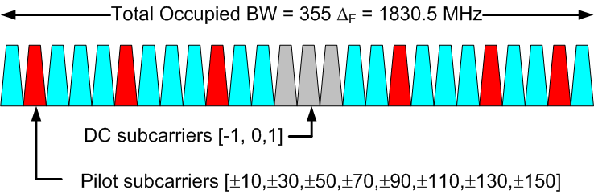
OFDM Parameters
Parameter | Notation | Value
FFT Size | N_{FFT} | 512
Number of data subcarriers | N_{SD} | 336
Number of pilot subcarriers | N_{SP} | 16
OFDM sampling frequency | F_{s} | 2640 MHz
Subcarrier frequency spacing | Δ_{F} | 5.16 MHz
Guard Interval/Cyclic Prefix | T_{GI} | 128/F_{s}= ~48ns

Slide 9
OFDM PPDU Format
Preamble
  Consists of STF and CEF
  Duration of ~1.09 us
Header
  carries 64 bits
    Includes 8-bit HCS and 8 reserved bits
  Fits into one OFDM symbol
    duration of ~ 242 ns
TRN-T/R Subfields (optional)
  Used for beamforming training/tracking

Slide 10
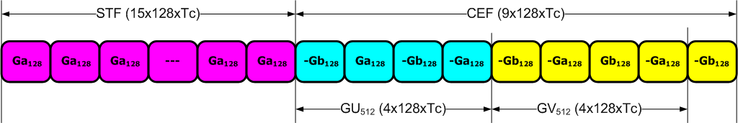
Preamble Format
Ga₁₂₈ and Gb₁₂₈ are 128-length Golay complimentary sequence pairs sampled at SC chip rate F_{s}=1760 MHz (T_{c} = 1/F_{s} ~ 57 ns)
  Allows common pre-amble processing for OFDM and SC PHYs
Short Training Field (STF)
  15x repetition of Ga₁₂₈ sequence
  Used for timing/frequency acquisition
Channel Estimation Field (CEF)
  Consists of two 512-length complementary sequence pairs (GU₅₁₂ and GV₅₁₂) and a cyclic post-fix (GV₁₂₈)
  Channel estimation in time or frequency domain
  Can auto-detect SC/OFDM PHY (different CEF formats employed)

Slide 11
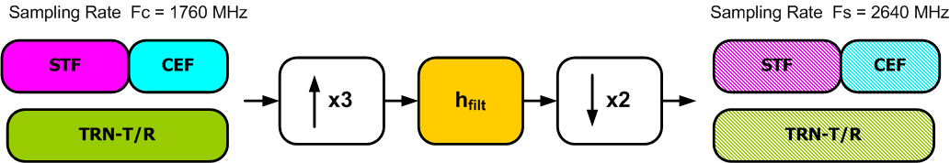
Preamble Re-sampling Filter
OFDM preamble sequences are defined at SC chip rate (F_{c}) to support common SC/OFDM preamble processing
3/2-rate re-sampling is required to convert from Fc = 1760 MHz to (nominal) OFDM sampling rate (F_{s} = 2640 MHz)
Re-sampling filter (73 taps) is specified so that Rx can undo filter response from channel estimate

Slide 12
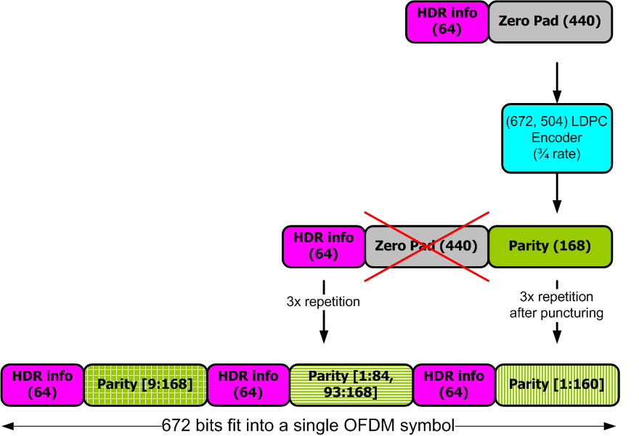
Header Coding & Modulation
Header contains 64 info bits
which are heavily protected
  168 parity bits generated by ¾ rate LDPC
  Info bits and parity repeated 3x
  Info bits not punctured
  Repetition of parity bits punctured differently
  Header mapped to OFDM symbol
  8-bit check sequence included

Slide 13
Payload Coding & Modulation
Scrambling
  Data scrambled using 7-th order m-sequence
  Scrambler initialization sequence is tx-ed in the PHY header
LDPC Encoding
  Zero padding to fit into OFDM symbols
  Parity bits generated
  Multiple code blocks are concatenated
Modulation
  SQPSK: each code block is mapped to two OFDM symbols
  QPSK: each code clock is mapped to a single OFDM symbol
  16-QAM: two code blocks are interleaved and mapped to a single OFDM symbol
  64-QAM: three code blocks are interleaved and mapped to a single OFDM symbol

Slide 14
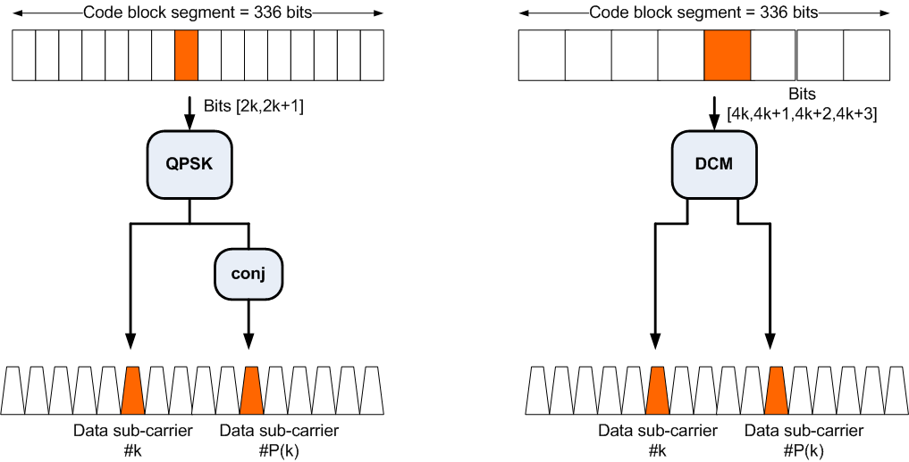
OFDM Tone Mapping (QPSK/SQPSK)
SQPSK
QPSK
Index P(k) is dependent on Dynamic/Static Tone Mapping
(a) when Static Tone Mapping (STP) is used P(k) = k+168
(b) when Dynamic Tone Mapping (DTP) is used P(k) is derived from feedback

Slide 15
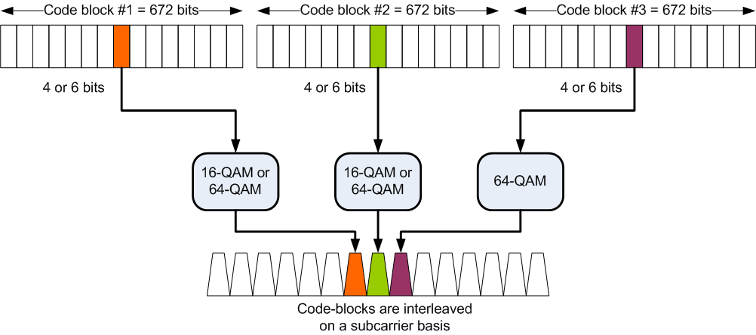
OFDM Tone Mapping (16-QAM/64-QAM)
Only for 64-QAM
For 16-QAM and 64-QAM, 2 and 3 code blocks are interleaved on a subcarrier basis, respectively.

Slide 16
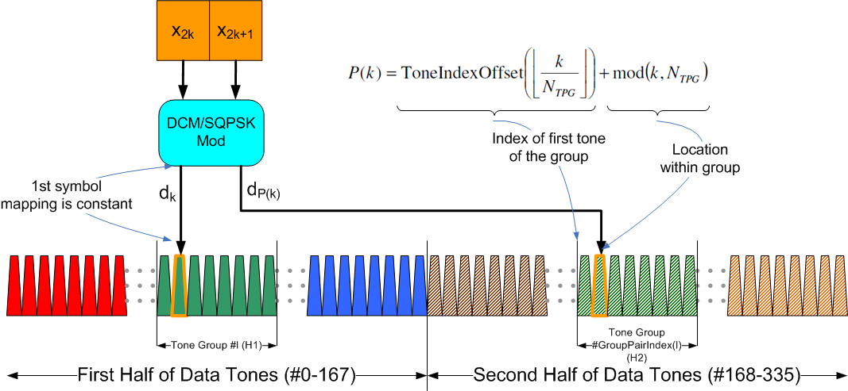
Dynamic Tone Pairing for
SQPSK and QPSK
First (N_{SD}/2=168) half of data tones are sliced to N_{G} (21 or 42 ) groups
  Each group consists of N_{TPG} tones
Second half of data tones are slices to N_{G} groups
Rx determines and feeds back pairings of groups
  l-th group of first half paired to GroupPairIndex(l)-th group of second half
Tx/Rx use fixed mapping of tone-pairs used within pairs of groups

Slide 17
Conclusions
OFDM PHY Mode has been proposed
  Part of complete proposal in 802.11-10/432r0 (slides) and 802.11-10/433r0
Main characteristics
  Significant commonality with SC Mode Proposal
    See IEEE 802.11-10-0429-00-00ad-NT-8
  Optimized for NLOS environment
  Provides up to 7 Gbps data rate
Performance evaluation as per EVM document
  Presented in IEEE 802.11-10-0431-00-00ad-CP-PHY

