Slide 1
CSI Report for Explicit Feedback Beamforming in Downlink MU-MIMO
Date: 2010-3-15
Authors:

Slide 2
Abstract
TGac may use MU-MIMO technology to improve the spectrum efficiency.
There are two beamforming methods defined in 11n.
  Implicit feedback beamforming
  Explicit feedback beamforming
TGac may address both beamforming methods.
Focusing on explicit feedback beamfroming, the amount of CSI report is examined for DL-MU-MIMO in TGac.
Our results suggest that changes in CSI report field may be required in TGac.

Slide 3
Requirements for CSI report in TGac
Transmission scheme
  Single-user (SU)-MIMO@11n
  SU-MIMO and MU-MIMO@TGac
Transmission parameters [1]
  The amount of CSI report may increase in TGac.
 | Maximum number of antennas | Maximum bandwidth
11n (SU-MIMO) | 4x4 | 40MHz
TGac (SU-MIMO) | 8x4 or 8x8 | 40MHz
TGac (MU-MIMO) | 8x1(nSTAs), 8x2(nSTAs), 8x4(nSTAs) | 40 or 80MHz

Slide 4
Effect of the CSI error in MU-MIMO
(a) SU-MIMO
(b) MU-MIMO
Simulation Conditions:
Numbers of antennas at AP and STA are 8 and 1, respectively.
Number of STAs is 4.
Mean square error (MSE) of the channel matrix [2] is -20dBc at CDF=90%.
Solid and dotted lines are without and with CSI error, respectively.
SINR performance of MU-MIMO for CSI error is more sensitive than that of SU-MIMO.
MU-MIMO requires higher accuracy in CSI because it needs to suppress interference among STAs.

Slide 5
CSI feedback error using 11n feedback scheme [3]
Nb=8
6
5
4
Channel
model B
Assuming a required CSI error of -30dBc at MSE=90%, our results suggest that at least 6-bit quantization is required for DL-MU-MIMO.

Slide 6
Example of simple CSI feedback flow in PHY
DL-MU-MIMO data
AP
Sounding
ACK #1
ACK #2
CTS
CSI report #1
SIFS
SIFS
STA #1
Header
CSI report #2
STA #2
SIFS
SIFS
Header
Time
SIFS
SIFS
CSI feedback duration
Time duration of CSI feedback is defined as the total of CSI report, SIFS, header of CSI report, and ACK.

Slide 7
Time duration of CSI report field for TGac
Maximum feedback amount of CSI report field in MU-MIMO can be estimated from the following parameters:
  SIFS: 16μs, ACK: 24μs
  11n: 40MHz (114 subcarriers), 4x4 antennas, 1 STA, 4-bit CSI quantization
    CSI report: 1.83 kByte
    CSI feedback duration in PHY: 128μs
    (@40MHz, 4 Tx antennas at STA, 64QAM, R=5/6, Header: 48μs)
  TGac: 80MHz (228 subcarriers), 8x1 antennas, 4 STAs, 6-bit CSI quantization
    CSI report: 2.74 kByte per STA
    CSI feedback duration in PHY: 680μs
    (@80MHz, 1 Tx antenna at STA, 64QAM, R=5/6, Header: 44μs)
Even with the best rate scheme in PHY, time duration of CSI feedback becomes 5.3 times as long as that in 11n.
CSI compression schemes are required to reduce CSI feedback in TGac.

Slide 8
CSI compression methodologies
 | Frequency-domain compression | Time-domain compression
Figure
Concept | CSI compression using channel correlation between adjacent subcarriers | CSI feedback based on channel impulse response
Pros | Direct compression (low complexity) Minor change from 11n | Expectation of high compressibility
Cons | Low compressibility | Increase in complexity at both side Major change from 11n
N_{S}
0
N_{S}
subc.
N_{T}
time

Slide 9
One example of CSI compression scheme in frequency domain
Segmentation is carried out that are similar to CSI feedback scheme in 11n.
A benchmark (BM) subcarrier is defined at each segment.
CSI differences between adjacent subcarrier are calculated and CSI of the other subcarrier is compressed.
CSI report comprises CSI at the BM subcarrier and CSI differences at the other subcarriers. They are scaled and quantized.
g-th segment
Subcarrier k
BM subcarrier: Q₁-bit quantization
Other subcarrier: Q₂-bit quantization

Slide 10
One example of CSI compression scheme in time domain
CSI is estimated in frequency domain.
CSI in frequency domain is converted to that in time domain using IDFT.
CSI components, whose power are larger than threshold level, are selected.
Selected CSI components are scaled and quantized.
Time-domain
conversion
N_{S}
subc.
N_{T}
time

Slide 11

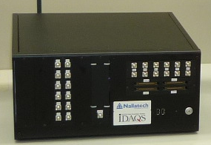
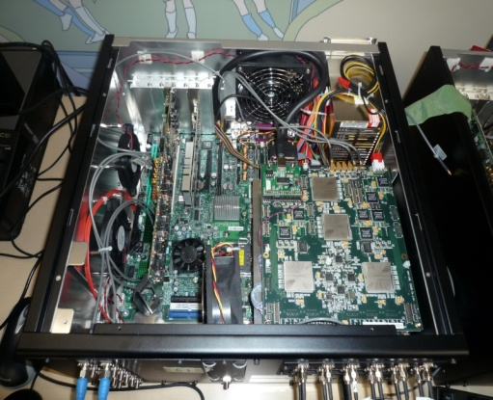
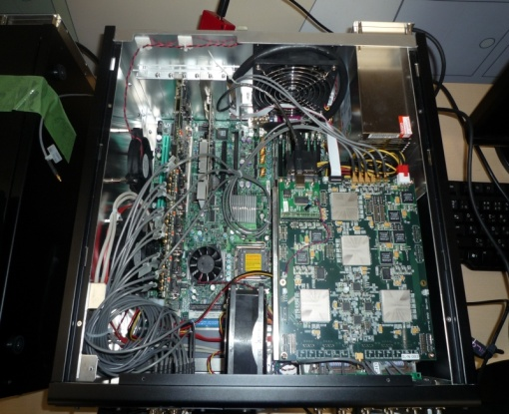
Our developed testbed
We developed testbed to evaluate DL-MU-MIMO in real time.
AP
CSI feedback
STAs
PC-server
DL-MU-MIMO
Video
Streaming
Specification
Rx
DATA
Rx
Tx
Tx
Number of STAs | 6 (max.)
Number of streams | 6(max.)
Band width | 80MHz (max.)
Data rate (PHY) at each stream | 270Mbit/s (max.)
Total data rate (PHY) | 1.62Gbit/s (max.)

Slide 12
Summary
We presented the difference in the requirements for CSI report field between 11n and TGac.
The amount of CSI report increases for MU-MIMO transmission to maintain the same transmission quality.
  Number of transmission parameters increases.
  MU-MIMO requires higher accuracy in CSI than that for SU-MIMO.
We also presented two possible approaches to reduce the amount of feedback information.

Slide 13
References
[1] IEEE802.11-09/0992r3: Specification Framework for TGac.
[2] R. Kudo, K. Ishihara, Y. Takatori, Measured Channel Variation and Coherence Time in NTT Lab., IEEE 802.11-10/0087r0, Jan. 18, 2010.
[3] IEEE Std 802.11nTM-2009.

Slide 14
Straw Poll
Do you think TGac needs to include CSI compression scheme in the specification framework document?
  Yes =
  No =
  Abstain =

