Slide 1
Heterogeneous wireless mesh network interworking
Date: 2010-03-16
Authors:
Name | Company | Address | Phone | Email
Tae Jin Lee | Broadwave Corp. | 203, NKIC Bdlg., 48-84 Hongeun-dong, Seodaemun-gu, Seoul, 120-100, Korea | +82-2-395-5651 | LTJ@broadwave.co.rk
Seung Yeup Lee | Broadwave Corp. | 203, NKIC Bdlg., 48-84 Hongeun-dong, Seodaemun-gu, Seoul, 120-100, Korea | +82-2-395-5651 | LSY@broadwave.co.kr
Notice: This document has been prepared to assist IEEE 802.11. It is offered as a basis for discussion and is not binding on the contributing individual(s) or organization(s). The material in this document is subject to change in form and content after further study. The contributor(s) reserve(s) the right to add, amend or withdraw material contained herein.
Release: The contributor grants a free, irrevocable license to the IEEE to incorporate material contained in this contribution, and any modifications thereof, in the creation of an IEEE Standards publication; to copyright in the IEEE’s name any IEEE Standards publication even though it may include portions of this contribution; and at the IEEE’s sole discretion to permit others to reproduce in whole or in part the resulting IEEE Standards publication. The contributor also acknowledges and accepts that this contribution may be made public by IEEE 802.11.
Patent Policy and Procedures: The contributor is familiar with the IEEE 802 Patent Policy and Procedures <http:// ieee802.org/guides/bylaws/sb-bylaws.pdf>, including the statement "IEEE standards may include the known use of patent(s), including patent applications, provided the IEEE receives assurance from the patent holder or applicant with respect to patents essential for compliance with both mandatory and optional portions of the standard." Early disclosure to the Working Group of patent information that might be relevant to the standard is essential to reduce the possibility for delays in the development process and increase the likelihood that the draft publication will be approved for publication. Please notify the Chair <stuart.kerry@philips.com> as early as possible, in written or electronic form, if patented technology (or technology under patent application) might be incorporated into a draft standard being developed within the IEEE 802.11 Working Group. If you have questions, contact the IEEE Patent Committee Administrator at <patcom@ieee.org>.

Slide 2
Abstract
We talk about interworking of heterogeneous wireless mesh network
  Homogeneous WMN based on TGs
  The status of WMN
  Problems
  Case of heterogeneous wireless mesh network
  Requirement of solution
  Conclusion

Slide 3
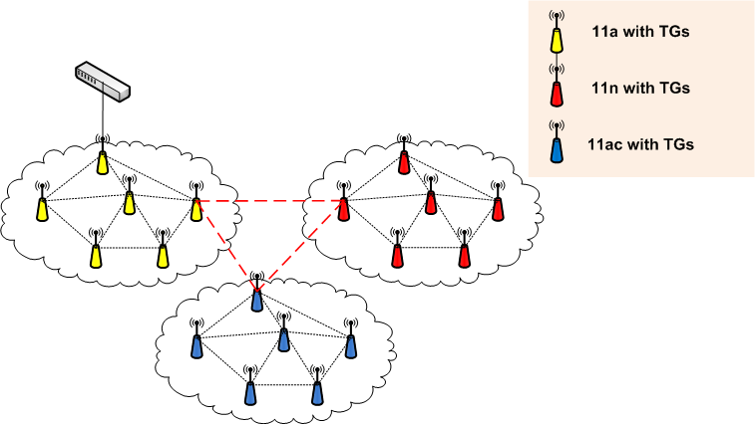
Homogeneous wireless mesh network with TGs
11a, 11n, 11ac based TGs
- Assume 11ac interoperability with 11a and 11n

Slide 4
The status of wireless mesh network
Multi-vendor Wireless Mesh Network
  Different Mesh Architecture
    Autonomous, Centralized, Distributed
    Different Routing Algorithm and Layer
    Different Security
Impossible to interworking with multi-vendor Mesh AP
    Roaming and Fast Handover
    Multi Radio Multi Channel or single Radio, Single Channel
    QoS
    VLAN, Multi-SSID etc.
    Network Management

Slide 5
Problems
Most of new 11n mesh AP don’t comply with TGs
  Interoperability with legacy product
  Product differentiation
Maybe heterogeneous WMN will apply to 11ac or 11ad
  Legacy product
  Different usage model
WMAN, WPAN also need heterogeneous WMN interworking solution
  802.15 and 802.16’s WMN is heterogeneous from 11’s WMN

Slide 6
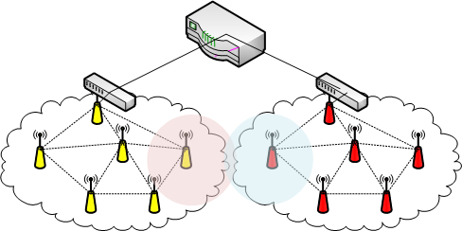
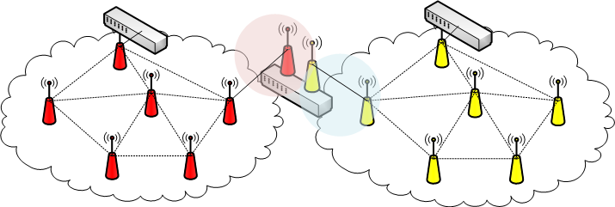
The consideration of heterogeneous wireless mesh networking
L3 interworking
L2 interworking
L3 Routing interworking
Router interconnect with heterogeneous WMN subnet
WM-AP has IP gateway function
Using bridge protocol(eg. 802.1D)
Create logical layer 2 subnet LAN
spanning heterogeneous WMN
Assume heterogeneous WMN has the same subnet

Slide 7
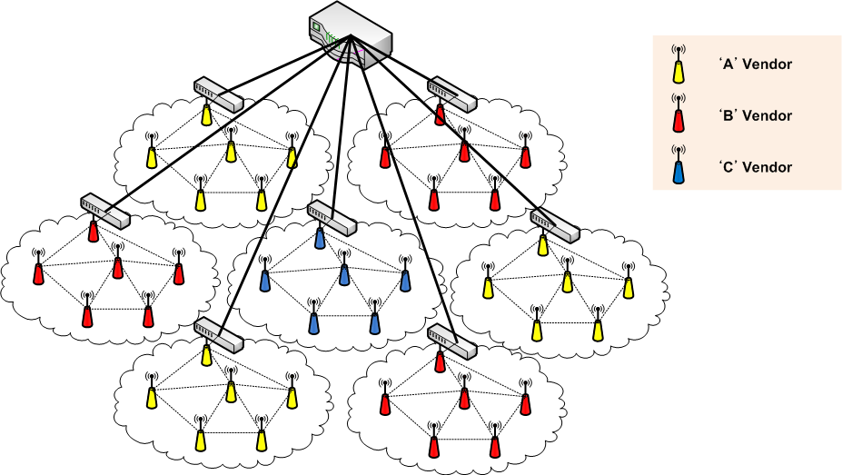
Heterogeneous Wireless Mesh Network
Case 1 : 11a network
Can not interconnect each other directly

Slide 8
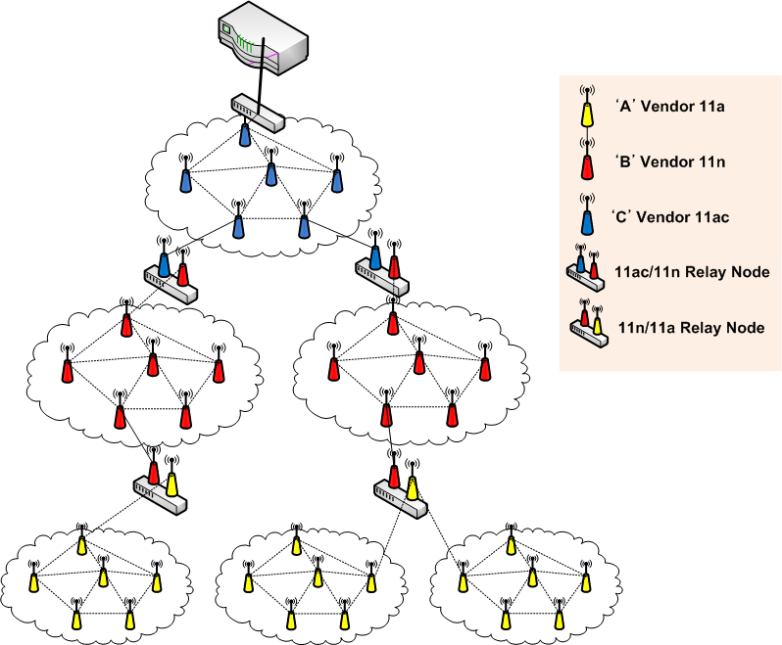
Heterogeneous Wireless Mesh Network
Case 2 : 11ac, 11n, 11a network
Interworking with existing WMN (11a or 11n)
Also, 11n or 11ac’s WMN could be heterogeneous
Relay node has heterogeneous WM-AP and inter-MAC function.

Slide 9
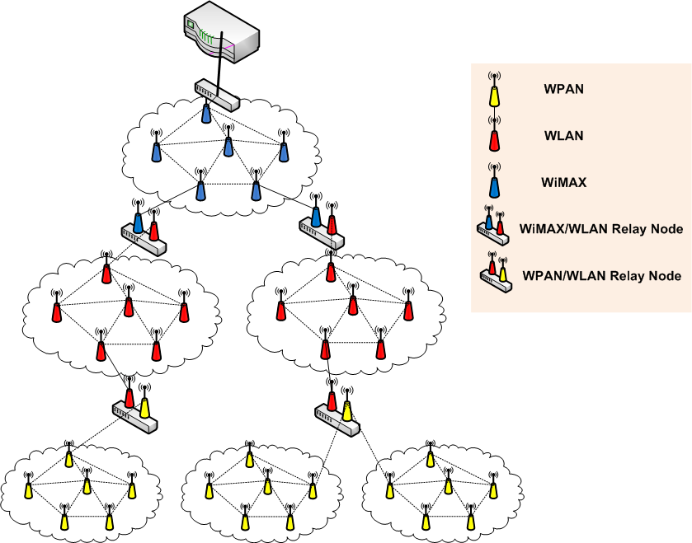
Heterogeneous Wireless Mesh Network
Case 3 : WMAN, WPAN, WLAN network
The case of WiMAX, WPAN, WLAN is same as a heterogeneous WMN
Relay Node also has heterogeneous physical media and inter-MAC function

Slide 10
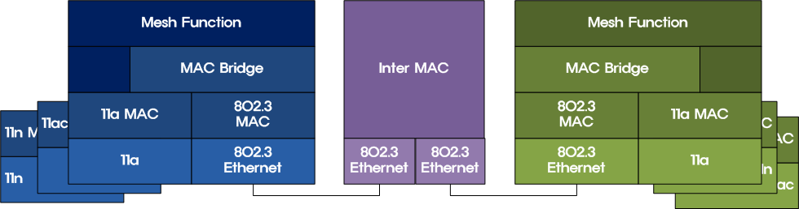
Inter-MAC Function
Multi Radio Support
  11a/g/n/ac/ad
  15/16 or etc.(Optional)
Mobility Support
  Seamless mobility
QoS support
  Admission control for flow
  Help for different QoS type
Management
  Interworking NMS(SNMP etc.)
  -

Slide 11
Conclusion
In the field, the most of WMN did not comply with TGs.
Also 11n and 11ac/11ad will be the same case.
Therefore, in order to interworking with heterogeneous WMN, interworking function is needed.
Interworking function support multi-radio and inter-MAC function.

Slide 12
Questions & Comments

