Slide 1
Distributed Measurement Report Period for Interference Detection in 802.11af MAC
Authors:

Slide 2
Summary
This document summarizes FCC rules
for interference avoidance and protection
introduces
required actions of 11af WLAN after detecting TV signal
MAC issue in 802.11af standardization : Measurement Report Failure
and provides
a solution of measurement report failure: Measurement Report Period (MRP)

Slide 3
FCC Rules: Interference Avoidance & Protection Mechanisms
Interference Avoidance Mechanisms in FCC
Geo-Location Database
Spectrum Sensing
After detecting TV signal, all transmissions by the TVBD must cease within 2 seconds.
One of Interference Protection Mechanisms in FCC
Required separation distance
Antenna Height of Unlicensed Device | Required Separation (km) From Digital or Analog TV (Full Service or Low Power) Protected Contour
 | Co-channel | Adjacent Channel
Less than 3 meters | 6.0 km | 0.1 km
3 – Less than 10 meters | 8.0 km | 0.1 km
10 – 30 meters | 14.4 km | 0.74 km

Slide 4
MAC Issues in 802.11af (1/2) - Background -
11af WLAN after detecting TV signal should change channel or stop network
In infrastructure mode, Access Point (AP) has all functionalities of channel switching and network termination
AP should collect the channel measurement results reported by STAs in order to determined to switch channel or stop network

Slide 5
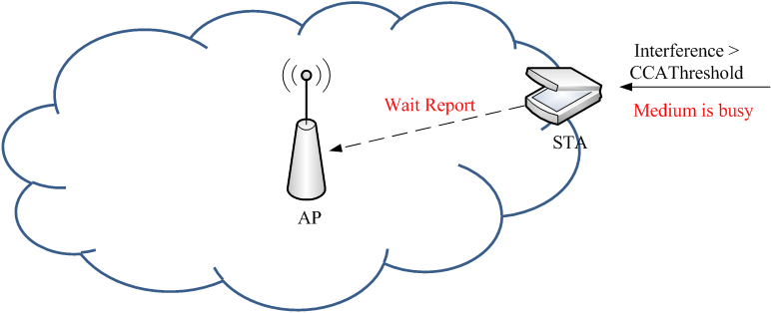
MAC Issue in 802.11af (2/2) - Problem to tackle-
Measurement Report Failure
If interference is higher than CCA Threshold (i.e., medium is busy), STA can not report the channel measurement result since STA should wait transmission until medium becomes idle
AP has no information of STA’s interference, then the 11af network may interfere with TV broadcasting
11af Network

Slide 6
A Solution for Measurement Report Failure
Measurement Report Failure is a critical MAC issue that should be solved for 802.11af standardization
Solution
Measurement Report Period (MRP) is newly defined to report measurement result from STA to AP that should be worked on Contention-Free
Each STA should report the channel measurement result during its MRP
AP determines action of channel switching or network termination from based on the report
If AP does not receive the report during either of MRPs, AP should do action of channel switching or network termination since it is possible for STAs to be under interference

Slide 7
Example of Distributed Measurement Report Period (DMRP)
AP broadcasts Quiet Period (QP) for channel measurement, and Measurement Report Period (MRP) for measurement result report by using Beacon or Probe frame
STA reports the measurement result to AP during Measurement Report Period

Slide 8
Measurement Report Period (MRP) element format (1/2)
MRP element format
Address : the address of the STA that shall report channel measurement. IEEE 802 MAC address
MRP Count : the number of TBTTs until the beacon interval during which the next MRP interval shall start.
MRP Period : the number of beacon intervals between the start of regularly scheduled MRP intervals defined by this MRP element.
MRP Duration : the duration of the measurement report interval
MRP Offset : the offset of the start of the MRP interval from the TBTT

Slide 9
Measurement Report Period (MRP) element format (2/2)
The MRP element may be included in Beacon frames, and Probe Response frames
Necessary changes in 802.11-2007
7.2.3.1 Beacon frame format
newly define MRP in Beacon frame body
7.2.3.9 Probe Response frame format
newly define MRP in Probe Response frame body
7.3.2 Information elements
newly define MRP information element
11.9 DFS procedures
Add a MRP procedure

Slide 10
Conclusions
This document summarizes
interference avoidance and protection described in FCC
introduces
required actions of 11af WLAN after detecting TV signal
MAC issue in 802.11af standardization : Measurement Report Failure
and provides
a solution of measurement report failure: Measurement Report Period (MRP)

