Slide 1
Distributed Measurement Report Period for Interference Detection in 802.11af MAC
Authors:

Slide 2
Summary
This document describes
  interference avoidance and protection in FCC, and
  Action of 11af WLAN after sensing TV signal
introduces
  MAC Issues in 802.11af standardization including
    Critical MAC issue and Performance MAC issue
and provides
  a solution for the critical MAC issue of interference : detection: Distributed Measurement Report Period (DMRP)

Slide 3
Interference Avoidance & Protection Mechanisms in FCC
Interference Avoidance Mechanisms in FCC
  Geo-Location Database
  Spectrum Sensing
One of Interference Protection Mechanisms in FCC
  Required separation distance
Action of 11af WLAN after sensing TV signal
  11af WLAN should change channel or stop network
Antenna Height of Unlicensed Device | Required Separation (km) From Digital or Analog TV (Full Service or Low Power) Protected Contour
 | Co-channel | Adjacent Channel
Less than 3 meters | 6.0 km | 0.1 km
3 – Less than 10 meters | 8.0 km | 0.1 km
10 – 30 meters | 14.4 km | 0.74 km

Slide 4
MAC Issues in 802.11af (1/3)
In infrastructure mode, Access Point (AP) has all functionalities of channel switching and network termination
It means that
  AP should collect the sensing results reported by STAs in order to determined to switch channel or stop network

Slide 5
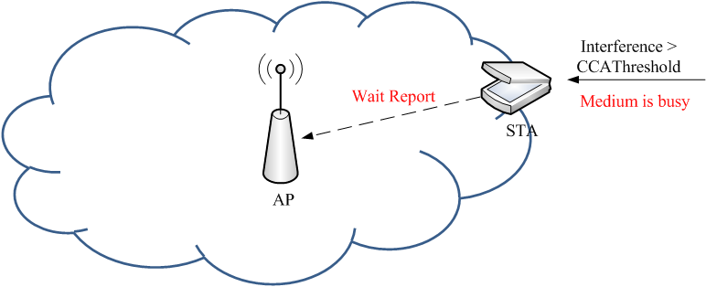
MAC Issues in 802.11af (2/3)
Unable Measurement Report
  If interference is higher than CCA Threshold (i.e., medium is busy), STA can not report the channel measurement result since STA should wait transmission until medium becomes idle
  AP has no information of interference, then the network may continue to interfere
  Critical MAC Issue

Slide 6
MAC Issues in 802.11af (3/3)
No information for interference types
  STA may sense interference during quiet period, but STA may not decode interference types, e.g., TV signal, 802.22 signal or others
  It means that AP should change channel or stop network whenever STA senses any interference above CCA
  MAC Performance Issue
  This issue may rely on implementation

Slide 7
A Solution for Unsuccessful Measurement Report
Unenable Measurement Report is a critical MAC issue that should be solved for 802.11af standardization
Solution
  Define Measurement Report Period (MRP), which purposes to report measurement result from STA to AP, that should be worked on Contention-Free
  Each STA should report the channel measurement result during it MRPs
  AP determines action of channel switching or network termination from based on the report
    If AP does not receive the report during either of MRPs, AP should do action of channel switching or network termination since it is possible for STAs to be under interference

Slide 8
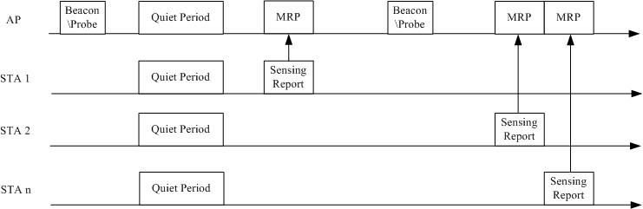
Example of Distributed Measurement Report Period (DMRP)
AP broadcasts Quiet Period (QP) for channel measurement, and Measurement Report Period (MRP) for measurement result report by using Beacon or Probe frame
Measurement Report Period may include more than one contention-free time slot for STA to report the measurement result

Slide 9
Conclusions
This document describes
  Interference avoidance and protection in FCC, and
  Action of 11af WLAN after sensing TV signal
introduces
  MAC Issues in 802.11af standardization including
    Critical MAC issue and Performance MAC issue
And provides
  Solution for the critical MAC issue
  Measurement Report Period (MRP)

