Slide 1
UL MU-MIMO for 11ac
Richard Van Nee, rvannee@qualcomm.com
Hemanth Sampath, hsampath@qualcomm.com
Santosh Abraham, sabraham@qualcomm.com
VK Jones, vkjones@qualcomm.com
Minho Cheong, minho@etri.re.kr
Yasushi Takatori, takatori.yasushi@lab.ntt.co.jp
Yongho Seok, yhseok@lge.com
Seyeong Choi, seyeong.choi@lge.com
Phillipe Chambelin, philippe.chambelin@thomson.net
John Benko, john.benk@orange.com
Andre Bourdoux, andre.bourdoux@imec.be

Slide 2
Motivation
Proliferation of UL data/video traffic from small-form factor devices that can only support 1-2 spatial streams:
  Smartphones, netbooks, camcorders, video surveillance cams.
  Several use-cases across home, enterprise and hotspot scenarios.
UL MU-MIMO offers significant network throughput advantages over SU-MIMO.
  Ensures high network throughput, even with 1-2 SS devices.
  Ensures high network throughput, even if 80 MHz bandwidth is unavailable due to OBSS.
Preliminary analysis indicates minimal cost and complexity increase on clients.

Slide 3
Required Changes for UL-SDMA (1)
Synchronization
  Clients needs to respond to an AP uplink start indication with a timing accuracy in the order of 100 ns
    This should not be a problem, several current 11n products already have this accuracy in their SIFS response
    May also use 800 ns long guard interval only for uplink SDMA to get 400 ns guard time to absorb timing errors + round trip delay differences between uplink clients.
  Clients need to correct uplink transmissions for the frequency offset relative to the AP
    Frequency error is already measured on every AP packet with a typical accuracy in the order of a kHz or better for SNR>10dB
    Frequency correction requires a phase rotation per subcarrier which adds only a small fraction of gates relative to the entire TX chain

Slide 4
Required Changes for UL-SDMA (2)
Power Correction
  Clients may need to apply some power correction provided by the AP
  Preliminary estimate is that dynamic range may be 30 dB with a rather coarse accuracy of +/- 3 dB, to allow close-in users to back-off power.
  Clients that are too strong or too weak such that they cannot meet the power control range can potentially be excluded from UL-SDMA by AP.
Slide 4
Notes:
doc.: IEEE 802.11-yy/xxxxr0
Month Year
John Doe, Some Company
Page 4

Slide 5
Required Changes for UL-SDMA (3)
Frame format
  Clients need to transmit on spatial stream numbers assigned by AP
  Separate uplink SDMA preamble
    Could use 11n preamble with a separate VHT-SIG after HT-LTF
    Extend preamble to 8 (or 16?) spatial streams
AP complexity
  Decoding complexity similar to SU-MIMO
    Maximum number of spatial streams larger than 11n, up to 8 or maybe 16
  UL common phase estimation performed on a per-client basis
    accounts for different phase noise and residual frequency error per client
    No change to pilot tone allocation required
Slide 5
Notes:
doc.: IEEE 802.11-yy/xxxxr0
Month Year
John Doe, Some Company
Page 5

Slide 6
UL MU-MIMO MAC Protocol
Assign SS
UL MU-MIMO
Transmission
ACK
Transmission
(DL-MU-MIMO or serial)
EDCA Access
RMA
BA
AP
STA 1
Protected by RMA NAV
MU-MIMO DATA
STA 2
MU-MIMO DATA
STA 3
MU-MIMO DATA

Slide 7

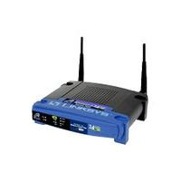
Throughput with UL MU-MIMO
2 antenna clients (8)
UL Throughput (Mb/s) 23dB
1200
11n
1000
11ac
800
11n: 2 antenna AP
11ac: 16 antenna AP
600
400
Spreadsheet Analysis Assumptions
200
* Moderate Rx SNR = 23dB for all clients
* 40 MHz BW, D-NLOS channel.
* Include all MAC overhead, CWMin =15
* Full-Buffer traffic
* AP using MMSE receiver.
0
1
2
4
Data Tx Time
~ 5.5x MAC throughput improvement over 11n for 4ms packet size

Slide 8
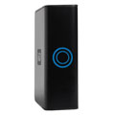
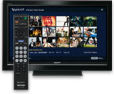

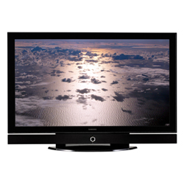
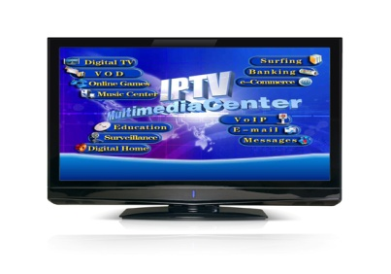
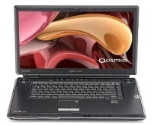

Example Networked Home Scenario
Cable
Modem
WLAN Bridge
NAS
Drive
IPTV Box
e.g. Roku
Surveillance Video Cam
HDTV IPTV Content (75 dB PL)
Surveillance Monitor
SDTV Quality (100 dB PL)
Netbook
DTV1
HD Content (90 dB PL)
Bluray Content (90 dB PL)
DTV2
STB-1

Slide 9
Example Networked Home Scenario:
Network efficiency of UL MU-MIMO
Assumptions:
  4 clients (2 antennas each) with UL traffic
    2 HD traffic flows with PL = {70,90} dB
    1 blu-ray traffic flows with PL = {90} dB
    1 SD flow with PL = 100 dB.
  11ac AP with 8 antennas, 11n AP with 2 antennas.
  40 MHz BW, D-NLOS channel model
  Include all MAC overhead
  AP using MMSE receiver.
Result:
Preliminary spreadsheet analysis shows that
11n network almost saturates with such UL traffic load
11ac with UL-MU MIMO uses < 45% network capacity.

Slide 10
Conclusion
UL MU-MIMO offers significant network throughput advantages over SU-MIMO.
  Ensures high network throughput, even with 1-2 SS devices.
  Ensures high network throughput, even if 80 MHz bandwidth is unavailable due to OBSS.
Minimal cost and complexity increase on clients.
Recommend that 11ac incorporate UL MU-MIMO in specification framework.

