Slide 1
IEEE MAC Model – Data Plane
Date: 2009-07-13
Authors:

Slide 2
Abstract
This submission is the first in a series of Functional Analysis System Technique (FAST) diagrams which depict the IEEE 802.11 MAC functional breakdown work in the 802.11 ARC standing committee. The functions of the MAC are being represented with three initial diagrams: Data, Control and Management Planes, with a final diagrams depicting the interactions between the three functional areas within the MAC.

Slide 3
Outline
Recap of prior MAC component and FAST WIP
Intro to Functional Analysis
WLAN Functional Breakdown - History
Next Steps
References

Slide 4
Intro to Functional Analysis
Function Analysis Systems Technique (F.A.S.T.) is a formal method of functional analysis.
FAST is “a means of explicitly representing something, a means of analyzing a system”
Knowing the components, a FAST analysis proceeds by asking a series of WHY, HOW questions to uncover the corresponding functions and the relations between those functions.
The functions are arranged as entries or blocks on a diagram with WHY answers on the left and HOW answers on the right.
Functions are described using simple verb-noun phrases.
Relationship lines connect the functional blocks together in a way that captures the relations between the functions.

Slide 5
FAST Example
Lightbulb components:
Filament
Glass bulb
Support wires
Lead-in wires
Heat deflecting disc
Stem
Stem press
Base rim
Insulation
Center contact

Slide 6
FAST Example - Light Bulb Functions
HOW
WHY
Provide Luminous Energy
Product Light
Convert Energy
Heat Filament
Supply Power
Conduct Current
Connect Wires
Prevent Oxidation
Confine Filament
Exclude Oxygen

Slide 7
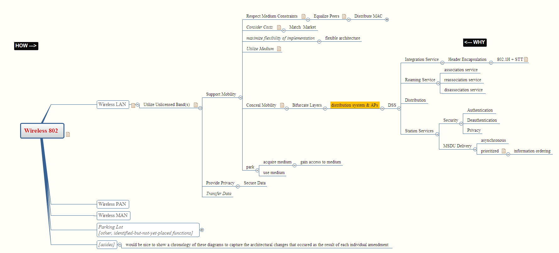
WLAN Functional Breakdown rev 20090312
This is a FAST functional analysis diagram, beginning to examine the underlying functions of the MAC and the relationships between those functions.
http://tinyurl.com/ARC-SC-MAC-func-20090312-png

Slide 8
The Mindomo Tool
A mind map is not ideal for drawing FAST diagrams, but it’s close and quick and easy to use, with capable online tool versions available that allow for effective collaborative work efforts.
Mindomo is one such mind map tool. See www.mindomo.com

Slide 9
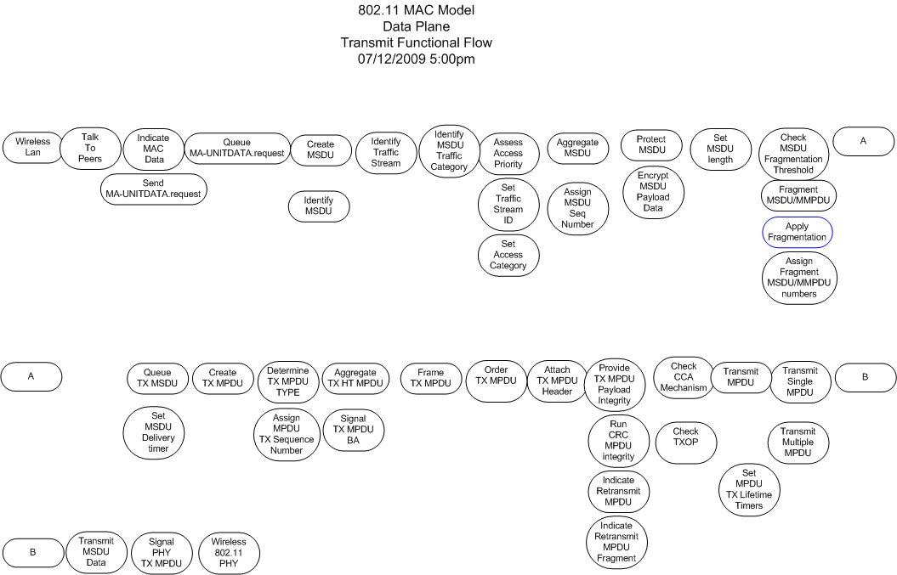

Slide 10
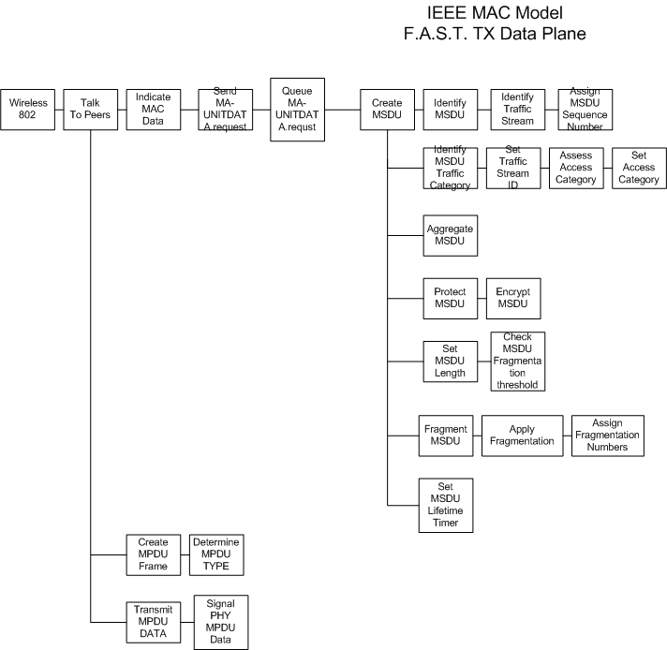

Slide 11
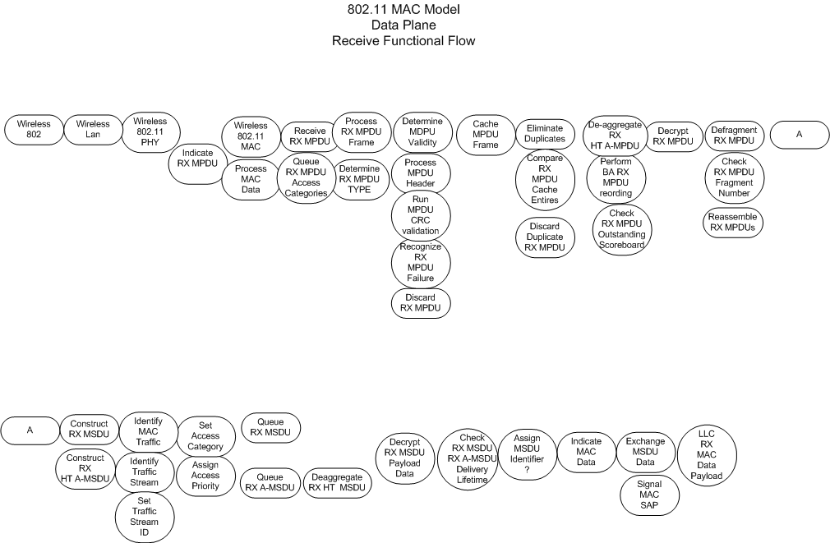

Slide 12
Next Steps
If group feels current direction proposed for MAC functional breakdown is correct approach then continue with model work for each of the distinct areas.
As each of the areas (data/control/management planes) complete, migrate them to Mindomo tool that Darwin proposed in March 2009 meeting.
Continue with proposed breakdown of function to service primitives? (what level do we take the functions down …in order to provide the MLME blocks?)

Slide 13
References
1. IEEE Std. 802.11-2007
Cl. 5 General Description
5.2.5 Integration with non-802.11 LANs
Figure 5.6 Connecting to other IEEE 802 LANs [shows portal]
Annex N AP Functional Description
Figure N.4 High-level UML entity diagram for the WLAN system
Figure N.5 AP UML composition diagram (alternate syntax)
2. 11-04-1225-08 AP Function Summary
3. 11-08-0496-01-000v-merged-access-unit-framework.ppt, Engwer, April 2008
4. 11-05-1606-00-0apf-ap-functions-diagram.ppt, Engwer, Jan 2005
5. 11-08-0867-01-0arc-MAC-Component-Breakdown-Topics-for-Discussion.ppt
6. 11-08-0869-00-0arc-minutes-arc-sc-July-2008.doc
7. 11-08-0949-04-0arc-MAC-Component-Breakdown-WIP.ppt
8. 11-08-1298-01-0arc-MAC-component-breakdown.doc

Slide 14
References for 2008-12-16 → 2009-03-03 conference calls and live meetings
2008-12-16:
JPG image of MLME component breakdown of BSS Management
http://tinyurl.com/bss-manage-1
2009-01-13:
JPG image of WLAN functional breakdown map rev1 2009-01-12
http://tinyurl.com/bss-manage-2
2009-02-03:
PNG image of WLAN functional breakdown map 20090203
http://tinyurl.com/ARC-SC-MAC-func-20090203-png
Mindomo map share link
http://www.mindomo.com/edit.htm?m=2fe04de3d0804f7ba5d634f592f6262f
2009-02-17:
PNG image of WLAN functional breakdown map 20090217
http://tinyurl.com/ARC-SC-MAC-func-20090217-png
Mindomo map share link
http://www.mindomo.com/edit.htm?m=f32575505e594a728e16b87458ce8481
2009-03-12
PNG image of WLAN functional breakdown map 20090312
http://tinyurl.com/ARC-SC-MAC-func-20090312-png
Mindomo map share link
http://www.mindomo.com/edit.htm?m=ccd51a96718f40ac8bb4cbc24ffbf74f

