Slide 1
IEEE MAC Model – Data Plane
Date: 2009-07-12
Authors:

Slide 2
Abstract
This submission is the first in a series of Functional Analysis System Technique (FAST) diagrams which depict the IEEE 802.11 MAC functional breakdown work in the 802.11 ARC standing committee. The functions of the MAC are being represented with three initial diagrams: Data, Control and Management Planes, with a final diagrams depicting the interactions between the three functional areas within the MAC.

Slide 3
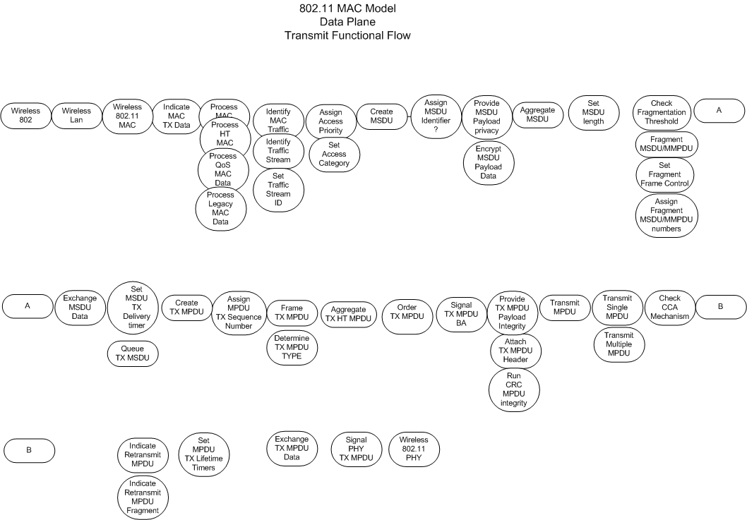

Slide 4
