Slide 1
Efficient Error Control Using Network Coding for Multicast Transmission
Date: 2009-1-22
Authors:
Notes:
November 2007

Slide 2
Abstract
This contribution proposes a packet error control scheme for multicast transmission using network coding.
Notes:
November 2007

Slide 3
Outlines
Problems of multicast error control in 802.11
Brief overview of network coding
Multicast with network coding
Notes:
November 2007

Slide 4
Problems of multicast error control in 802.11
No error control mechanisms in the current standard.
Problems of unicast-like error control mechanism.
  Expensive packet error control overhead for packet retransmission.
    The more the receivers, the more the retransmissions.
    The more the number of packets, the more the retransmissions.
When multicast error rate is (ε × r),
and less than 1 with no error coincidence
- Ave. # of retransmissions = n × ε × r
When multicast error rate becomes 100%
- Ave. # of retransmissions = n
- A packet retransmission is required for every multicast
n packets
…
ε
…
multicast
r Receivers
n = # of packets in a block
ε = Packet error rate (unicast)
r = # of receivers

Slide 5
Brief overview of network coding
Packet p₁
Packet p₁
A A = 0
Packet p₂
Packet p₂
Packet p₃
Packet(1 2 … n)
Packet(1 ... n, except j)
…
Err Packet p_{j}
Packet p₄
…
…
Packet p_{n}
Packet p_{n}
Packet p_{j}
Receiver
Sender
We can recover the Packet_{i} by using XOR network coding

Slide 6


Multicast with network coding
-60-
Wireless multicast traffic error control

Slide 7
Multicast with network coding
-70-
Wireless multicast traffic error control
A
B
C
D

Slide 8
Multicast with network coding
-80-
Wireless multicast traffic error control
A
B
C
D

Slide 9
Multicast with network coding
-90-
Wireless multicast traffic error control
A
B
C
D
A
B
C
D
A
B
C
D
A
B
C
D

Slide 10
Multicast with network coding
-100-
Wireless multicast traffic error control
A
B
C
D
A
B
C
D
Packet Loss Information
Packet Loss Information
A
B
C
D
Packet Loss Information
A
B
C
D

Slide 11
Multicast with network coding
-110-
Wireless multicast traffic error control
A
B
C
D
A
B
C
D
Packet Loss Information
Packet Loss Information
Calculate
the coding condition
A
B
C
D
Packet Loss Information
A
B
C
D

Slide 12
Multicast with network coding
-120-
Wireless multicast traffic error control
A
B
C
D
A
B
C
D
A
B
C
D
A B C D
A
B
C
D

Slide 13
Multicast with network coding
-130-
Wireless multicast traffic error control
A
B
C
D
A
B
C
D
A B C D
A B C D
Unicast like error control requires 3 retransmissions.
However, network coding requires only 1 retransmission.
A
B
C
D
A
B
C
D
A B C D

Slide 14
Multicast with network coding
-140-
Wireless multicast traffic error control
A
B
C
D
A
C
D
B
B
C
A B C D
A B C D
A
B
C
D
A
A
B
C
D
A B C D

Slide 15
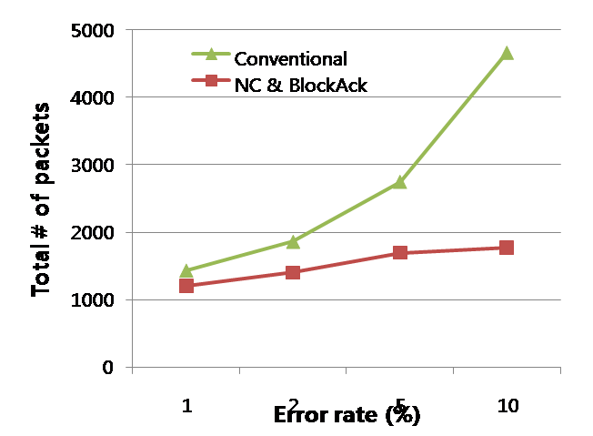
Multicast with network coding
-150-
Wireless multicast traffic error control
A
B
C
D
A
C
D
B
B
C
A B C D
A B C D
<Ideal NC application>
A
B
C
D
A
A
B
C
D
A B C D
# of transmitted data packet : 1024
# of receiver : 32

Slide 16
Multicast with network coding
Simple implementation
Transmit a set of multicast frames
Gather packet loss information from receivers
Find coding condition
Transmit error control frame coined by XOR operation of several frames

Slide 17
Multicast with network coding
Well harmonized with any kinds of Ack mechanisms.
  Our proposal is independent from Ack mechanisms. We can adopt any kinds of Ack mechanisms to find coding condition.
    Ack
    Block Ack
    M-Block Ack
    Nak
  Based on packet loss information provided by Ack mechanisms, we find coding condition and transmit efficient error control frame using network coding.

Slide 18
Conclusion & Proposal
Using network coding, at a packet error rate of 5%, network coding gain is approximately 30%. The higher the error rate, the higher the coding gain.
Further study issues are anticipated :
  How to gather packet loss information with low delay and overhead.
  More than 1 error in a set of packets per node.
  Non-uniform packet size.
To consider network coding error control scheme in 802.11aa.

Slide 19
Thank You!
Questions?

