Slide 1
Reference Delay Based One-way Delay Measurement
Presenter: Kehan Yao (China mobile)
IEEE Nendica

Slide 2
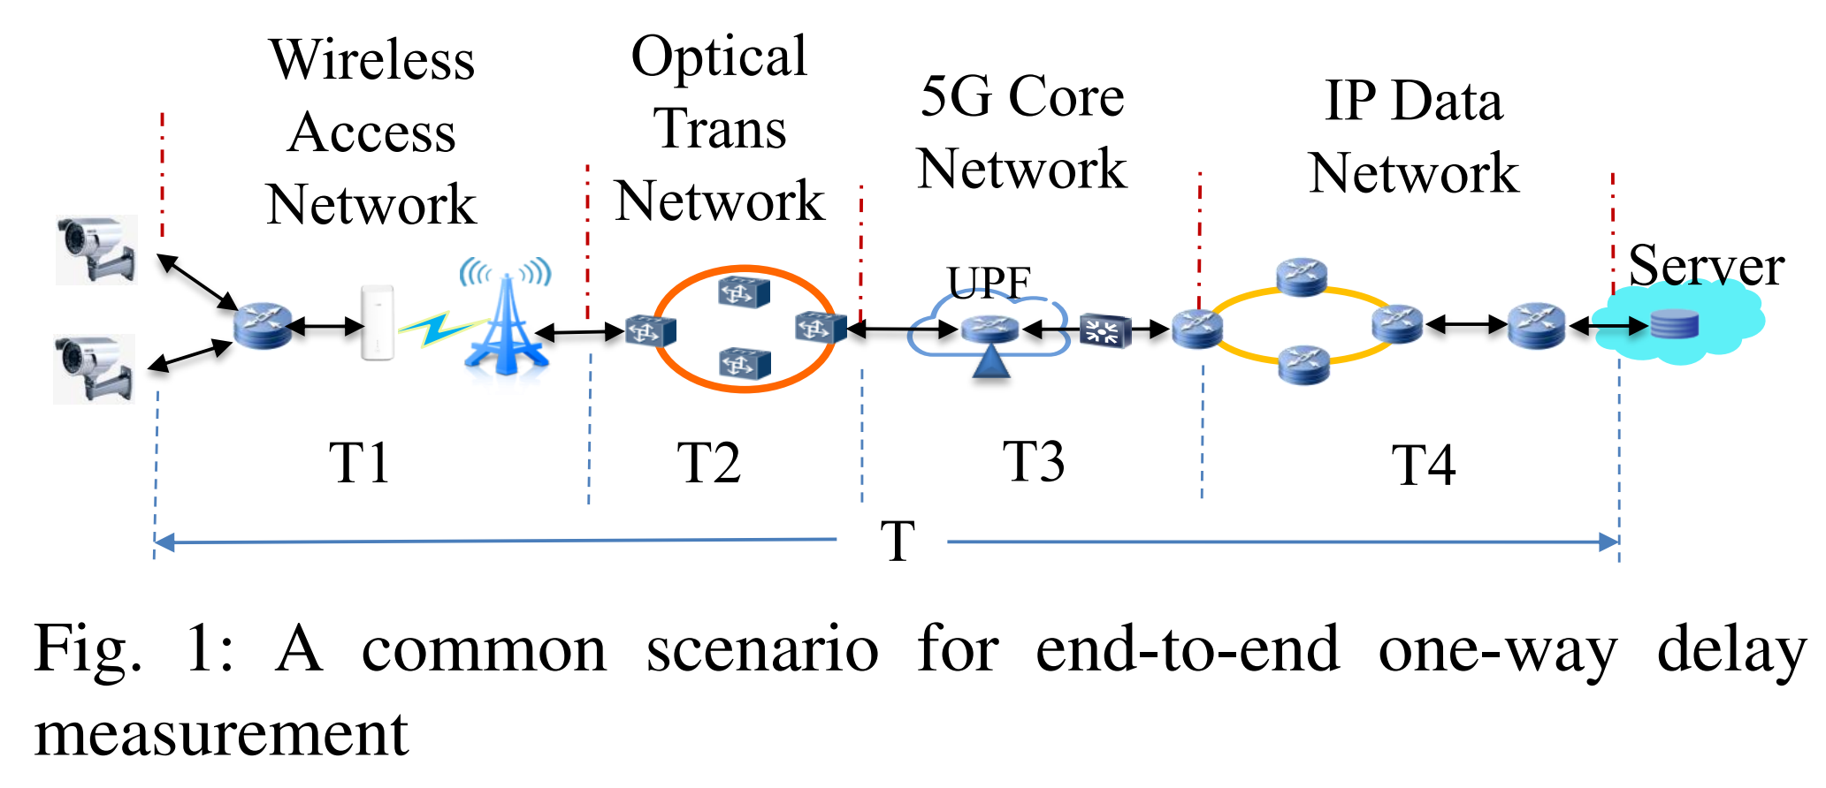
Introduction
End-to-end one-way delay (OWD) measurement
  E2E OWD is an important performance indicator for SLA guarantee
  E2E OWD measurement is of great significance, especially for some applications like bulk data transfers and multimedia streaming, depend on the OWD more than RTT
An example: HD video surveillance service scenario in 5G network
  The end-to-end one-way delay is the sum of T1+T2+T3+T4

Slide 3
Introduction
Existing methods^{[1]}
  End-to-end deployment of accurate clock synchronization, such as NTP, PTP or GPS; but the deployment cost is high.
  Round-trip delay (RTT) is used to estimate end-to-end one-way delay; Due to the delay asymmetry of the uplink and downlink, the accuracy is low.
[1] DJALEL CHEFROUR, One-Way Delay Measurement From Traditional Networks to SDN: A Survey, ACM Comput. Surv, 2021.

Slide 4
Introduction
A new method
  This document introduces a new method to accurately measure end-to-end one-way delay using reference delay without deploying clock synchronization.
  But we assume that there is a deterministic network link is co-deployed with other normal links, that means we can take advantage of the characteristics of detnet to measure the OWD of normal services.
  In detnet, end-to-end delay is bounded and has low jitter. An example can be found in deterministic networking[RFC8655].

Slide 5





RD-OWD Scenario
Local Clock i
Global Clock
Local Clock g
Sender i
Receiver g
Deterministic Link
Normal Link
At TRUE Time T_{0 ：}（maintained by a virtual global clock）
Sender i shows h_{i}(T₀)
Receiver g shows h_{g}(T₀)
clock i and clock g are not time synchronized.
clock i and clock g are TSN grade clocks, satisfying the requirements for stability and bounded jitter.
Normal Router
Normal Path
time offset exists between
two clocks at any time
TSN Router
Detnet Path

Slide 6
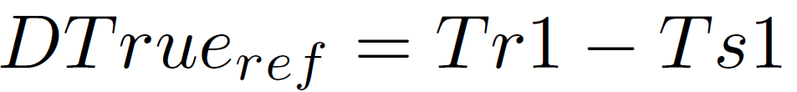
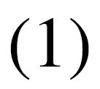
RD-OWD Measurement Procedure
Local Clock i
Global Clock
Local Clock g
Sender i
Receiver g
Reference Packet
Deterministic Link
Normal Link
At TRUE Time T_{S1} ：（maintained by a virtual global clock）
Sender i sends Reference Packet out, and clock i shows h_{i}(T_{S1})
The Reference Packet is transmitted through the deterministic link, and arrived at Receiver g. At the moment,the TRUE Time is T_{r1} , and clock g shows h_{g}(T_{r1}).
The TRUE Reference delay is:

Slide 7

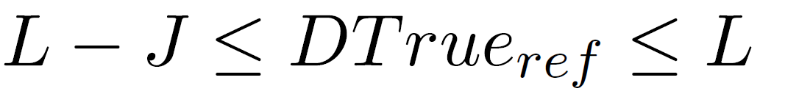
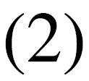
RD-OWD Measurement Procedure
For , it satisfies^{[2]}:
Where L is the upper bound of deterministic link delay, J is the maximum value of jitter, which is the difference of the delay upper bound and delay lower bound.
[2]Ludovic Thomas and Jean-Yves Le Boudec. 2020. On Time Synchronization Issues in Time-Sensitive Networks with Regulators and Nonideal Clocks. Proc. ACM Meas. Anal. Comput. Syst. 4, 2, Article 27 (June 2020), 41 pages. https://doi.org/10.1145/3392145

Slide 8
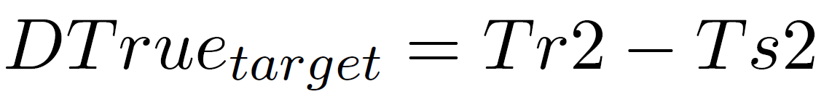

RD-OWD Measurement Procedure
Local Clock i
Global Clock
Target Packet
Local Clock g
Sender i
Receiver g
Reference Packet
Deterministic Link
Normal Link
At TRUE Time T_{S2} ：（maintained by a virtual global clock）
Sender i sends Target Packet out, and clock i shows h_{i}(T_{S2})
The Target Packet is transmitted through normal links, and arrived at Receiver g. At the moment,the TRUE Time is T_{r2} , and clock g shows h_{g}(T_{r2}).
The TRUE Target delay is:

Slide 9
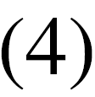



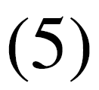
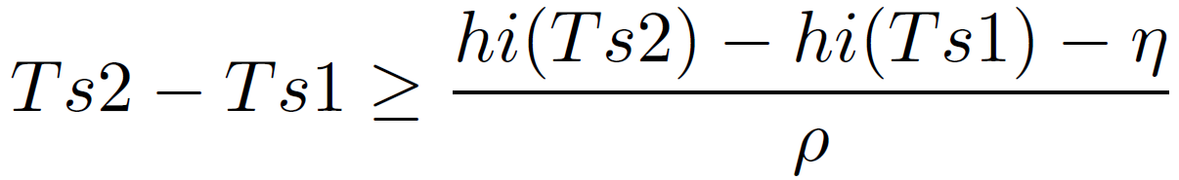
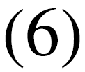
RD-OWD Measurement Procedure
For , it could be rewritten to be:
the first part represents the delay of the arrival time of Reference packet and Target packet, measured at clock g
the second part represents the TRUE delay of Reference packet, that is formula .
the third part represents the delay of the departure time of Reference packet and Target packet.
Refer to the Non-ideal clock model defined in^{[2]}, clock i satisfies:
clock i:
[2]Ludovic Thomas and Jean-Yves Le Boudec. 2020. On Time Synchronization Issues in Time-Sensitive Networks with Regulators and Nonideal Clocks. Proc. ACM Meas. Anal. Comput. Syst. 4, 2, Article 27 (June 2020), 41 pages. https://doi.org/10.1145/3392145

Slide 10
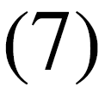
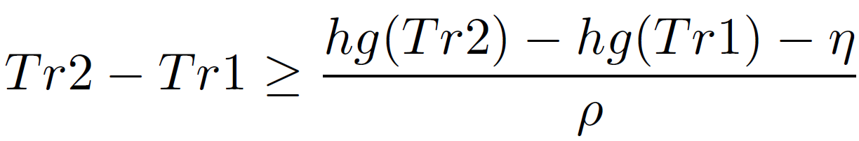

RD-OWD Measurement Procedure
clock g:
Where represents the stability of the TSN grade clock, represents the upper bound of Peak-to-Peak value of jitter.
According to the reference ^{[3]}, Annex B.1.1 and B.1.3， is (1+100 ppm)， is 2ns
The detailed derivation can be seen in^{[2]} (Ⅳ.System model - B. The Non-Synchronized Time-Model)
[2]Ludovic Thomas and Jean-Yves Le Boudec. 2020. On Time Synchronization Issues in Time-Sensitive Networks with Regulators and Nonideal Clocks. Proc. ACM Meas. Anal. Comput. Syst. 4, 2, Article 27 (June 2020), 41 pages. https://doi.org/10.1145/3392145
[3]"IEEE Standard for Local and Metropolitan Area Networks--Timing and Synchronization for Time-Sensitive Applications," in IEEE Std 802.1AS-2020 (Revision of IEEE Std 802.1AS-2011) , vol., no., pp.1-421, 19 June 2020, doi: 10.1109/IEEESTD.2020.9121845.

Slide 11





RD-OWD Measurement Procedure
Given（2）、（5）、（6）、（7）、（8），formula（4）satisfies：
and
According to derivations(See Appendix)，we can get the upper and lower bound of :
The point estimate and error of ：
and

Slide 12


Analysis
For ，in formula（11），the precision of the first four items is1*10^(-9)，the same as
for the last two items, the precision is defined by detnet initialized synchronized time precision. Assume it is 1*10^(-7)，about 100ns grade，therefore，the precision of is 100ns.
For ，the precision of the first item is 1*10^(-7)
In the second item, is 1*10^(-9)， is 1*10^(-4)，totally it is 1*10^(-5)
In the last item, the precision of the first part is 1*10^(-9), the latter part is 1*10^(-4)，totally it is 1*10^(-13)
Therefore, the overal time precision is 1*10^(-5)，about 10μs.
Theoretically，the precision of the estimated OWD of target packet is 10μs，and it can reach the common precision of PTP.

Slide 13
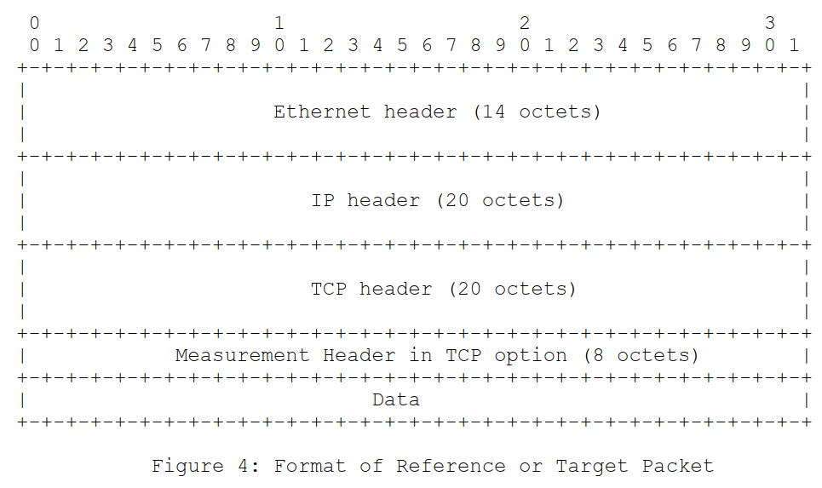
Packet Header Format
The sender encapsulates timestamp information and sender-receiver pair information in the Measurement Header of the sent packet.
The position of the Measurement Header is in the option field of the TCP protocol header.
Measurement Header in TCP option (8 octets)

Slide 14
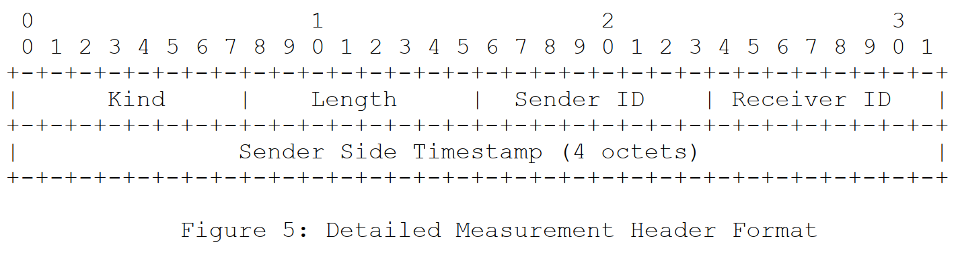
Measurement Header Format in Detail
The Kind value can be 253 or 254, and the Length value is 8, which is in accordance with TCP option [RFC4727].
The sender ID is one octet, and the receiver ID is also one octet.
The sender side timestamp is 4 octets, which can store accurate timestamp information.

Slide 15
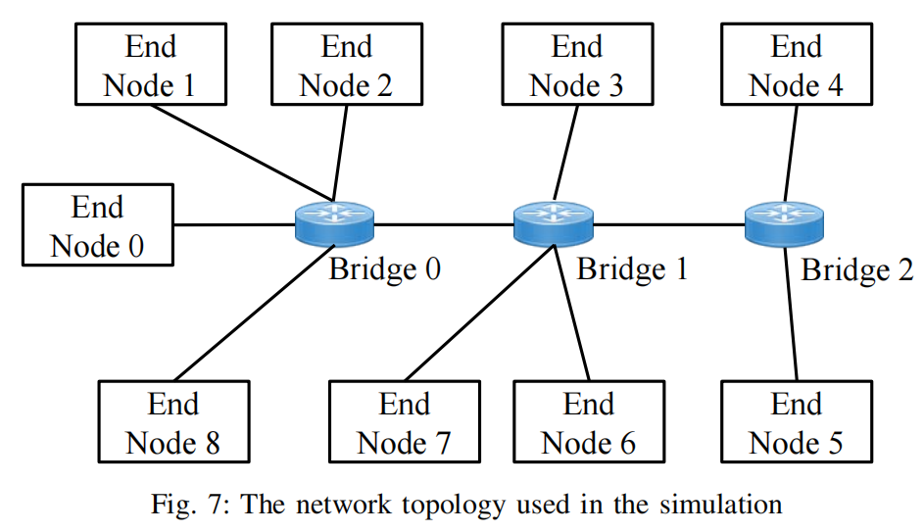
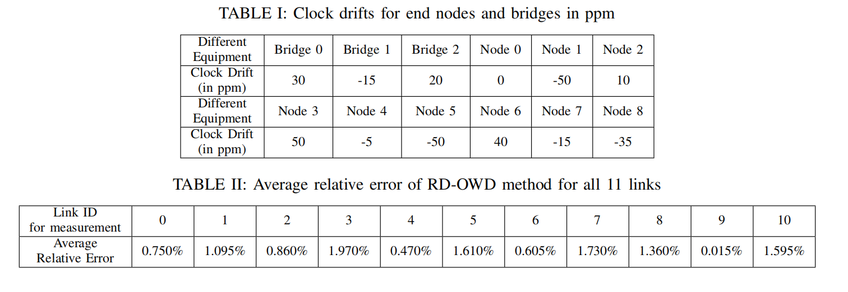
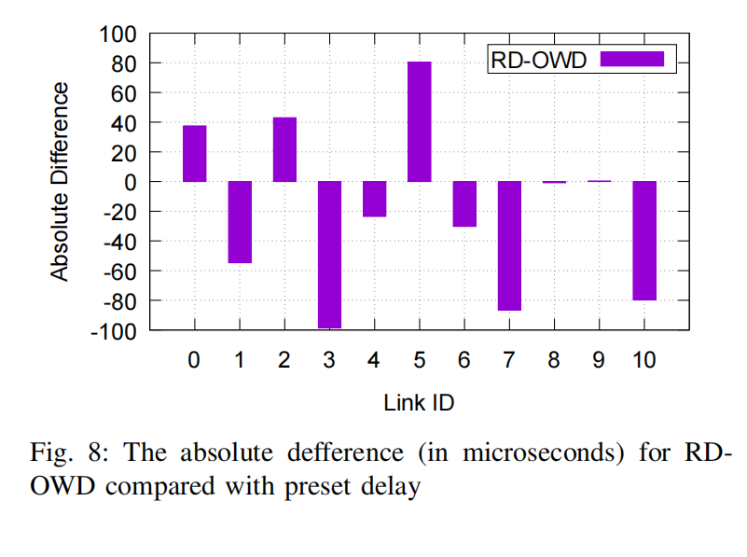
Simulations
RD-OWD is accurate in one-way delay measurement and the average relative error is below 2%.
the maximum value of absolute difference is about -100 µs(Y-axis in Figure 8), which is relatively small when compared with the preset delay of 5 ms.

Slide 16
Advantages
No need to deploy time synchronization
  There is no need to deploy end-to-end accurate time synchronization, which reduces the deployment cost of accurate one-way delay measurement.
No impact on intermediate network devices
  Leveraging reference delay for assistance, only time stamping is required at the sender and receiver. So there is no extra configuration for intermediate network devices.

Slide 17
Considerations
Are the scenarios in this case reasonable?
Currently implemented in Simulations, will consider deploy in hardware-assisted environment.
Any questions?

Slide 18
Thanks!

Slide 19
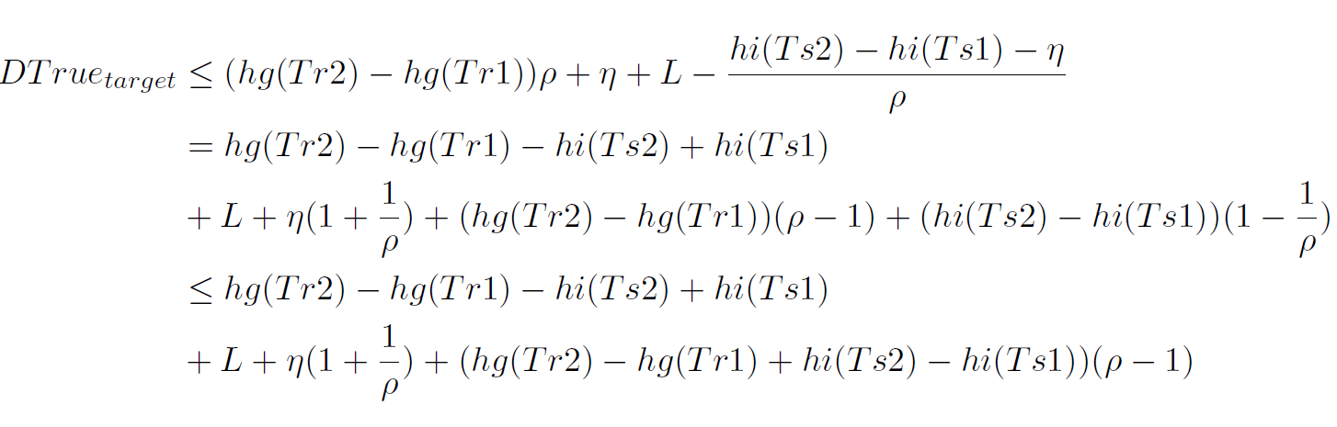
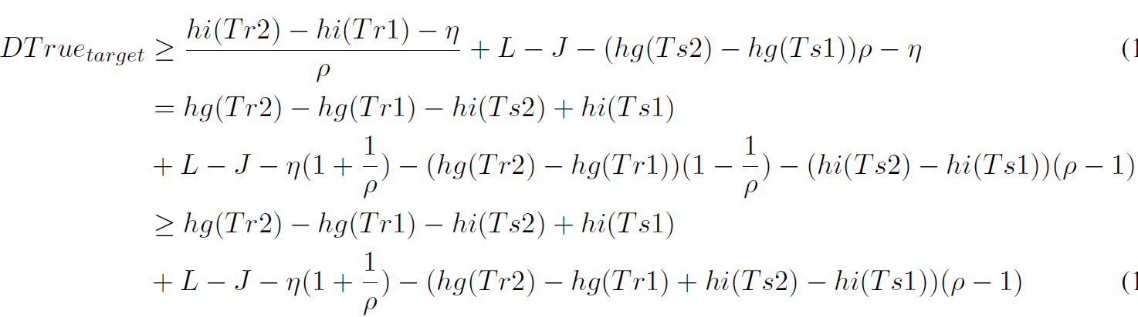
Appendix: the derivation of formula (9) and (10)

