Slide 1
Requirements for AI Fabric

Slide 2
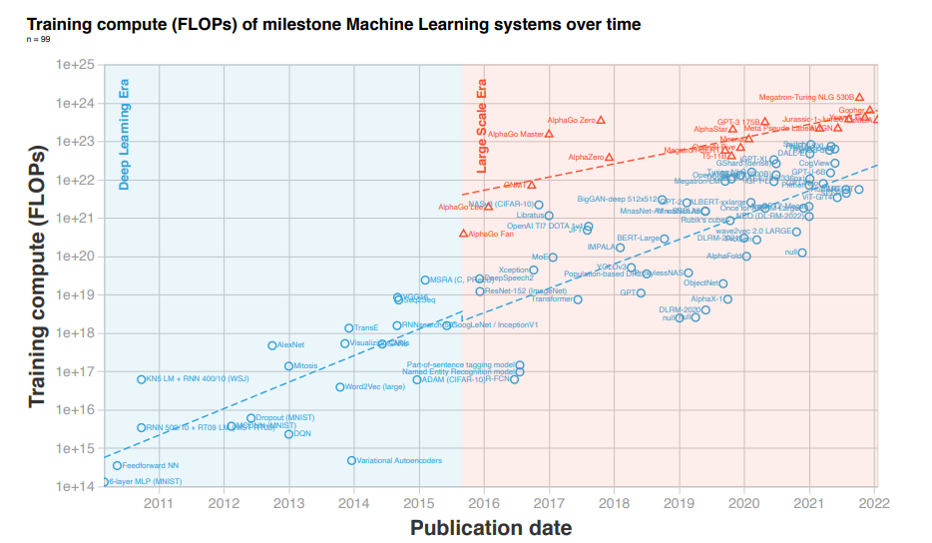
Rise of Large-Scale AI Models
Large-scale AI models represent a bifurcation of the Deep Learning Era (regular-scale models) trend.
Large-scale AI models started with AlphaGo in late 2015
The training compute is significantly higher than previous models.
Doubling time of large-scale model is roughly every 10 months, much faster than Moore’s law (roughly every 2 years)
Source： 2022 International Joint Conference on Neural Networks (IJCNN), 2022， “Compute Trends Across Three Eras of Machine Learning”
ChatGPT draws strong attention to LLM
”We’ve trained a model called ChatGPT which interacts in a conversational way. The dialogue format makes it possible for ChatGPT to answer followup questions, admit its mistakes, challenge incorrect premises, and reject inappropriate requests.“ -- OpenAI
ChatGPT is a Large Language Model (LLM) based on GPT-3.5 series.
ChatGPT spreads to over one million users in 5 days from its release in 2022.

Slide 3
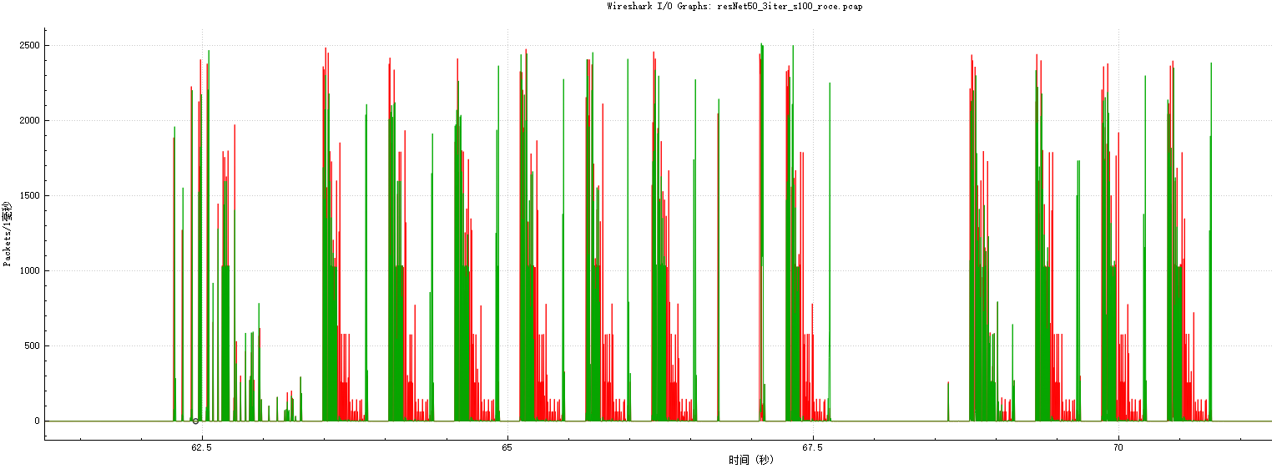
Communications in Large Models (1/2)
Periodical communication
Communication time
Communication time
Communication
Communication
AI training procedure consists of computing and communication. The computation tasks and communication are carried out periodically
…….
Forward computation
Backward computation
Forward computation
Backward computation
GPU idle time
GPU idle time
$1^{st}$ iteration
$N^{th}$ iteration
One iteration
Burst traffic
Communication remains consistent in each iteration, showing an ‘on-off’ type of burst traffic pattern
Traffic pattern

Slide 4
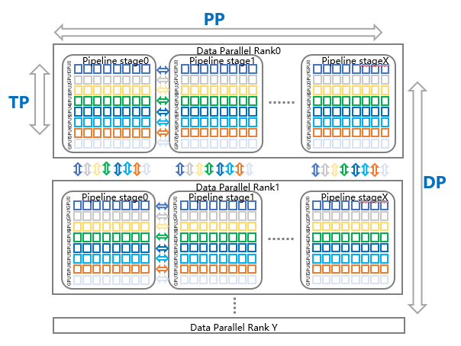
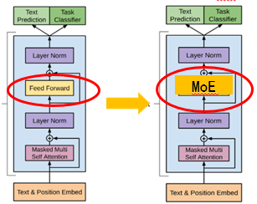
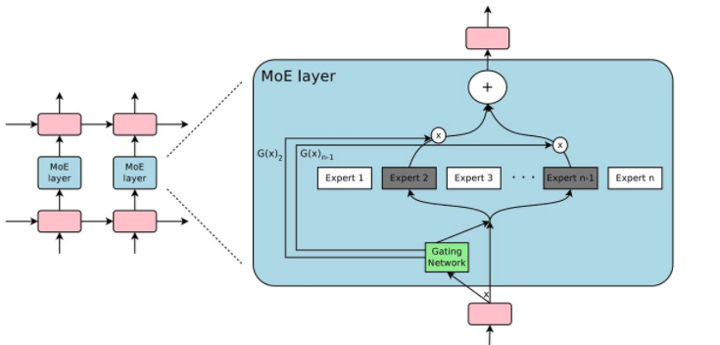
Communications in Large Models (2/2)
High bandwidth required with a small number of flows
Data parallelism: The training data is split into multiple mini-batches and trained in parallel on multiple AI chips
Inter nodes communication (AllReduce)
GB level traffic
Bandwidth requirement:
Tensor parallelism: Split the model into multiple sub-layers to run on multiple AI chips
Intra node communication (AllReduce)
100s GB level traffic
Bandwidth requirement:
Pipeline parallelism: Different layers of the model run on different AI chips
Inter nodes communication (send/recv)
100s MB ~ GB level traffic
Bandwidth requirement:
MOE: sparsely-gated Mixture-of Experts layer replaces FFN to efficiently expand large model parameters
Inter nodes communication (AlltoAll/AllReduce)
GB level traffic
Bandwidth requirement:

Slide 5
Shortening Communication Time is Key to LM Training
The completion of communication between all devices in each iteration pushes the computation tasks moving forward.
Reducing communication time and overhead reduces GPU waiting time, thereby increasing computation efficiency.
Waiting
Waiting
Computation
Computation
Computation
Communication
Communication
Communication
Communication time breakdown
Host processing
(e.g. memory copy, protocol stack processing)
Serialization
= Data amount/effective BW
Switch processing
(e.g. forwarding, pipeline, queuing)
Link transmission

Slide 6
Requirements of AI Fabric to Shorten Communication Time
Communication time
High throughput and low tail latency AI fabric is needed, providing high efficient transportation, high bandwidth and new topology to assist computing.
High efficient transportation
High BW
Computing-affined topology
Direct topology
(e.g. torus, dragonfly)
OXC
RDMA
LB
FC/CC
B400G
Technologies to meet AI fabric requirements must consider following communication characteristics.
Periodic communication is consistent in each iteration with burst traffic pattern
Small number of traffic flows with large size for a single flow
GE~100s GE level communication for each iteration
Notes:
全调度以太网（GSE）推进计划研究范畴：
• 物理层：低时延Phy、PhySEC、故障快速检测、B400G高速光接口、光交换等
• 链路层：基于报文分发和重组机制、调度技术、链路级安全及容错等
• 网络层：新型组网拓扑、新型组播/任播协议等;
• 传输层：改进的RDMA、新型拥塞控制等
• 应用层：在网计算、存储加速、开放API框架等
• 管理和运维体系：网络可视化、可调试能力、多维自动化能力

Slide 7
Load Balancing Challenges in AI Fabric
Flow based ECMP is poor of handling asymmetric AI traffic.
Imbalanced load traffic leads to congestion and low throughput.
Local collision:
5 tuple based hash algorithm may output the same hash-key for different flows, resulting multiple flows to be forwarded to the same path causing local collision.
Downstream collision:
The local decision-making mechanism lacks of global view of the fabric ( e.g. downstream nodes status) which may select multiple flows forwarded to the same downstream path, causing downstream collision.
Notes:
AI训练的流特征是流数量少但单流带宽大，传统流级负载均衡极易造成多个流哈希到同一条链路，造成部分链路拥塞，部分空闲，网络利用率低，无法应对突发的网络流量

Slide 8
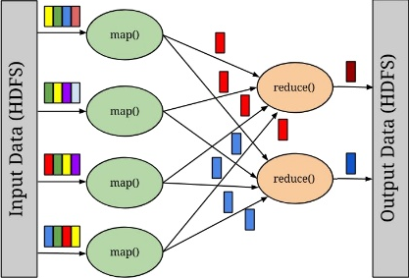
FC/CC Challenges in AI Fabric
In-cast
In-cast traffic (‘reduce’ operation) exists in AI fabric and can easily create congestion.
Current solution
Major issue
Sender push traffic into network until notification of congestion is received , then sender adjust sending rate
End-to-end congestion control (e.g. DCQCN)
Hop-by-hop flow control(e.g. PFC)
Passive control of congested flows may cause GPU to idle, thus waste GPU resource

Slide 9
Summary
Introduce communication pattern in large-scale AI model
Analyze AI fabric requirements in order to shorten communication time.
Notes: Besides communication time, AI fabric has additional requirements in other aspects, such as reliability, security and maintainability. Those are not covered in this presentation.
List key technologies to meet AI fabric requirements
Focus on current LB/CC/FC challenges when considering AI communication characteristics

Slide 10
Thank You !

