Slide 1
RDMA NIC In Lossless Network
Qingchun Song

Slide 2
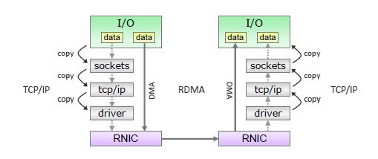
Background
Microsoft forecast in 2002
  To reach 10Gb/s line rate with TCP, request 5 CPUs in Tx side and 12 CPUs in Rx side
Dedicated processor/FPGA offloads TCP
  Add extra cost
  Increased the software develop workload
New protocol – RDMA(Remote Direct Memory Access)/RoCE(RDMA Over Converged Ethernet)
  CPU offload
  Kernel bypass

Slide 3
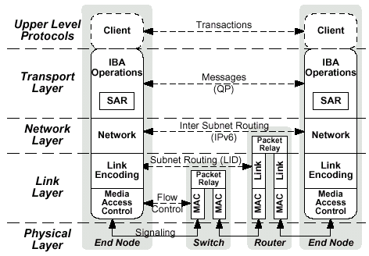
RoCE NIC(Network Interface Controller) Full Stack
RoCE NIC is an extension of regular NIC. Besides support the Ethernet specification, it should support RoCE specification, too.
Upper level protocols- application layer
  RDMA is message based transaction
Transport layer - The most important layer
  The transport header
  Queue Pair(QP) includes a send work queue and a receive work queue
  Verbs as the abstract layer of RDMA protocol
  The shim layer between verbs and other interface
Network layer - Traditional kernel layer
  Unicast and multicast operations
Link layer
  Packet relay in same subnet
  Flow control, error detection and switching…
Physical layer(RDMA NIC + cable + switch)
  Link width
  Data encoding, voltage
  …
RDMA NIC
RDMA NIC

Slide 4
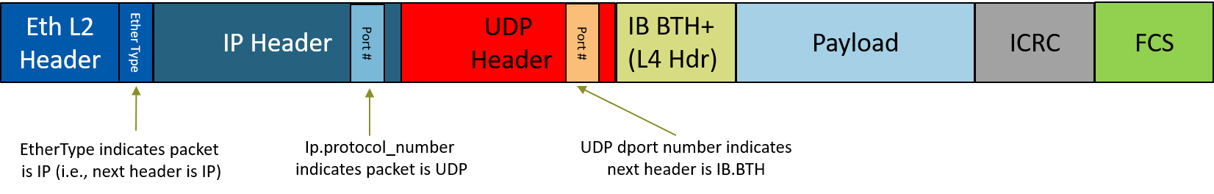
Ethernet RoCE RDMA Data Format
For RoCE packet, IBTA defined to use InfiniBand BTH+ and payload as the payload of RoCE
The BTH+ includes the definition of datagram, RDMA operation type, acknowledge of RDMA operation, Destination QP(queue pair), and so on
IB transport layer guarantees the data reliability from hardware
RoCE payload use UDP port to connect to UDP/IP header

Slide 5
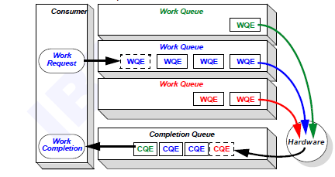
The Working Principles Of RDMA NIC
RDMA NIC

Slide 6
The Transport Type Of RDMA NIC
 | UD (Unreliable Datagram + Non-Connected) | UC (Unreliable Datagram + Connected) | RC (Reliable Datagram + Connected)
Send / Receive | Yes | Yes | Yes
RDMA Write | No | Yes | Yes
RDMA Read / Atomic | No | No | Yes

Slide 7
The Operation Of RDMA NIC
RDMA NIC
RDMA NIC
RDMA NIC
RDMA NIC
Requester
Responder
Requester
Responder
sync
Post RR
Post SR
data
Post SR
data + addr + rkey
ACK
Poll CQ
ACK
Poll CQ
Poll CQ
Send/Receive
RDMA Write

Slide 8
The Operation Of RDMA NIC
RDMA NIC
RDMA NIC
RDMA NIC
RDMA NIC
Requester
Responder
Requester
Responder
Post SR
addr + rkey
Post SR
data + addr + rkey
data
data
Poll CQ
Poll CQ
RDMA Read
RDMA Atomic

Slide 9
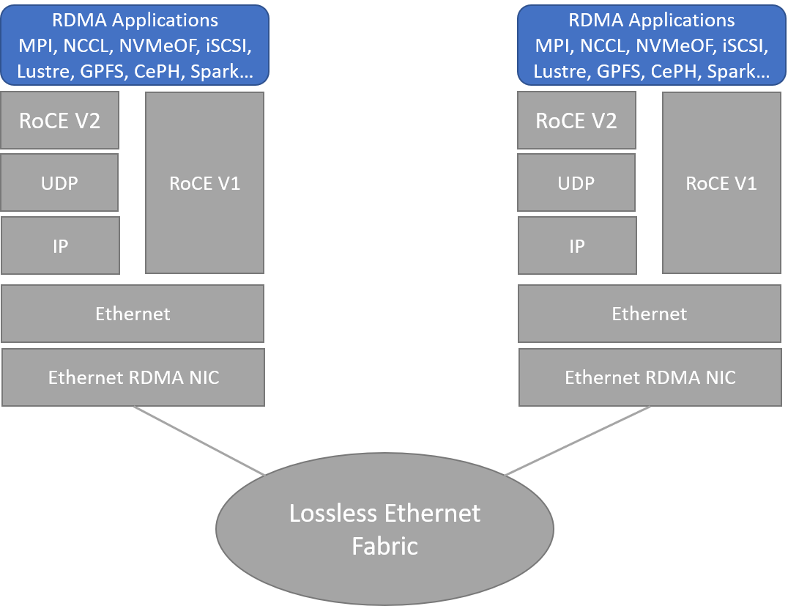
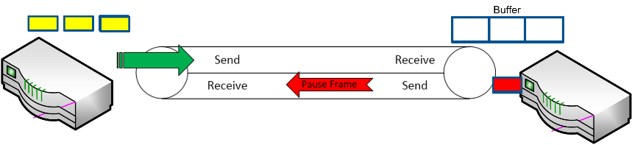
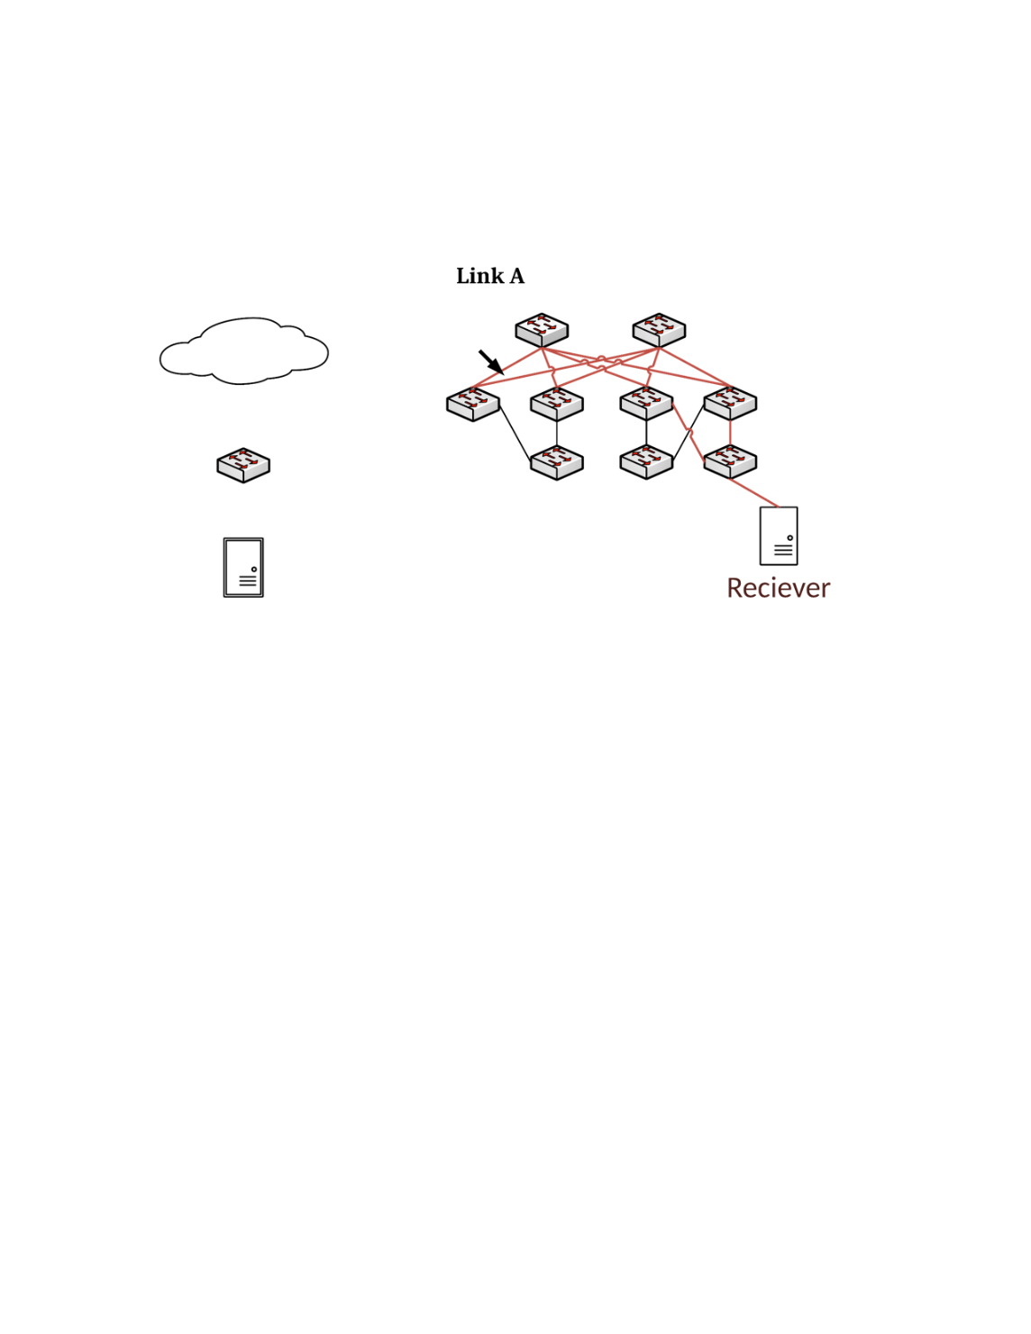
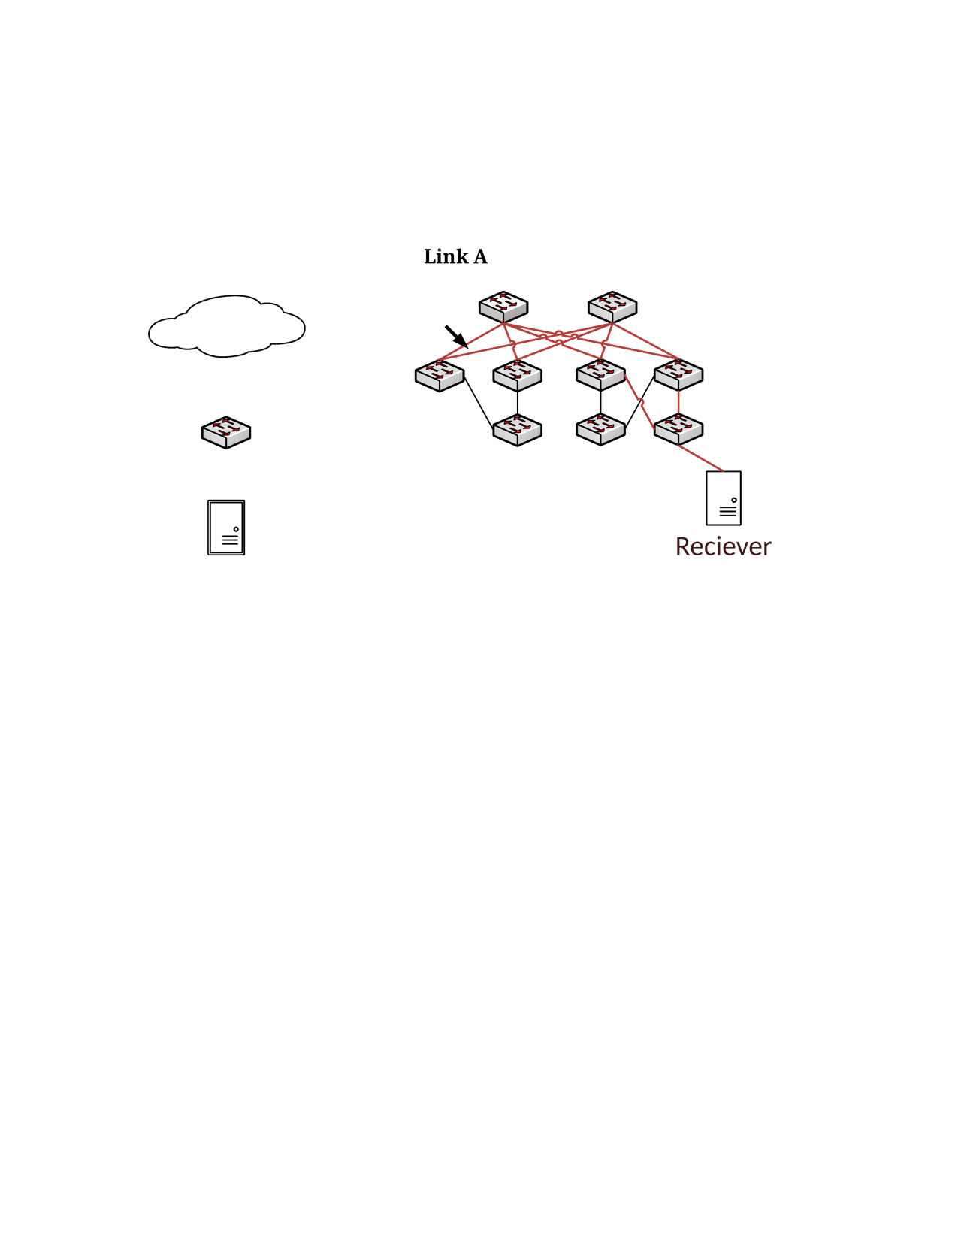
The Lossless Network For RoCE
Congested Traffic
Congested Traffic
(ECN marked)
Congestion Notification
Sender RDMA NIC
Reaction Point (RP)
Switch
Congestion Point (CP)
Receiver RDMA NIC
Notification Point (NP)

Slide 10
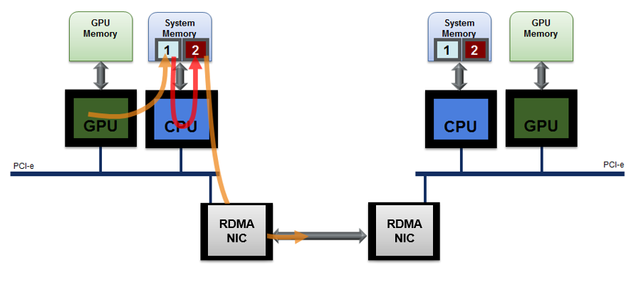
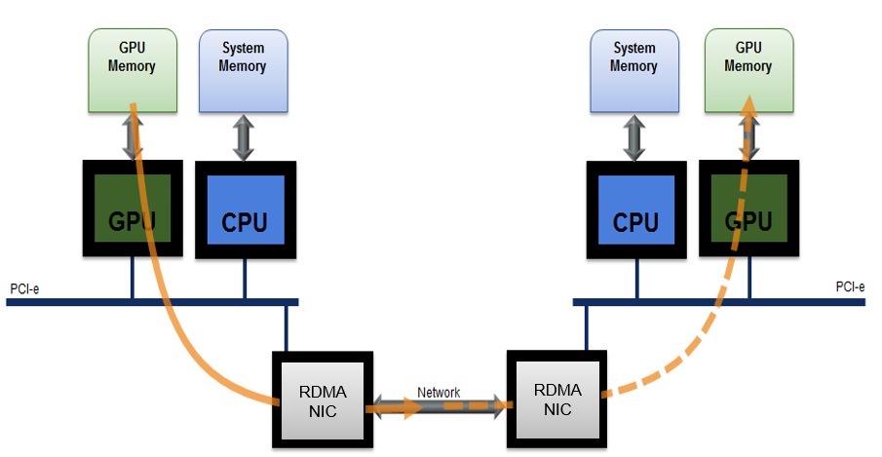
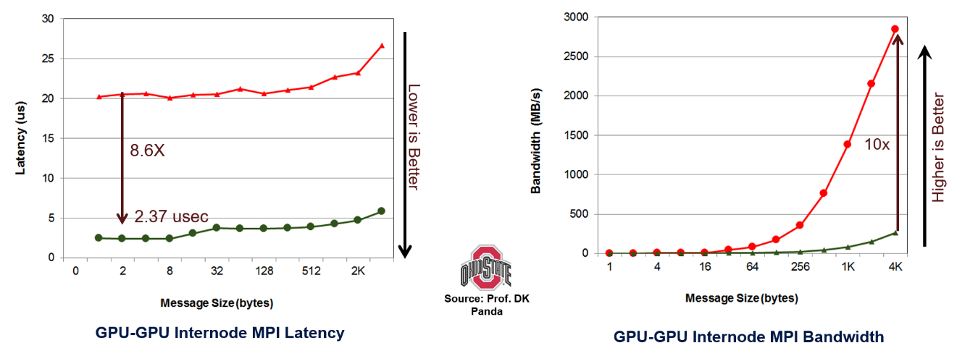
GPU DirectRDMA
RDMA NIC was de-facto NIC
Green Line: GPU Direct RDMA Latency
Red Line: Without GPU Direct RDMA Latency
Green Line: Without GPU Direct RDMA Bandwidth
Red Line: GPU Direct RDMA Bandwidth

Slide 11
NVMeOF
NVMe: Non-volatile Memory Express over PCI Express
An efficient programming interface for accessing NVM devices over a PCIe bus
Lock-free multi thread/process NVM access
NVMeOF: Non-volatile Memory Express over Fabrics
RDMA NIC was de-facto NIC

Slide 12
Conclusion
RDMA: A game changer for large scale system
Makes the data-centric computing to become the reality
The ideal network in more and more data center, AI center and HPC center

Slide 13
Thank You

