Slide 1
Programmable SmartNIC
Qingchun Song
IEEE 802 Nendica
Atlanta􀀂USA
March 2020

Slide 2
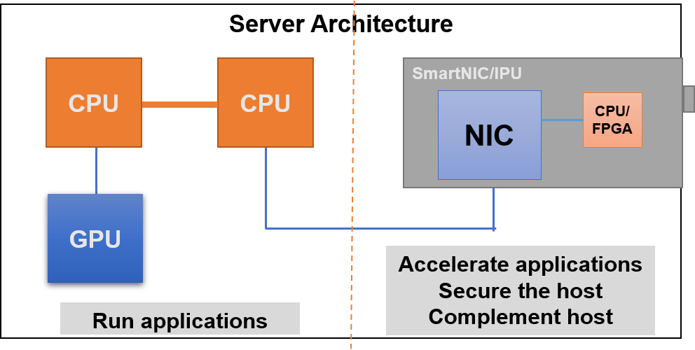
SmartNIC Architecture
What SmartNIC is:
SmartNIC is a NIC
  Has all NIC function regardless CPU/FPGA
  Major host CPU accelerator
  Host OS only request a NIC driver
SmartNIC is a computer
  Has independent OS
  Can run independent application
    OVS(Open Virtual Switch)
    Security
    Acceleration engines to complement NIC
  Separate management
SmartNIC is programmable
  Open source software, major Linux
  Easy to program, no special request for programmer
SmartNIC is the complement of CPU/GPU
  Computer in front of computer
  Offload CPU/GPU & accelerate applications
  Secure CPU & GPU
What SmartNIC is not:
SmartNIC is not the replacement of CPU and GPU
  Major applications are still running on CPU/GPU
SmartNIC is not proprietary NIC
  One NIC fits many applications
  Easy for user to program

Slide 3
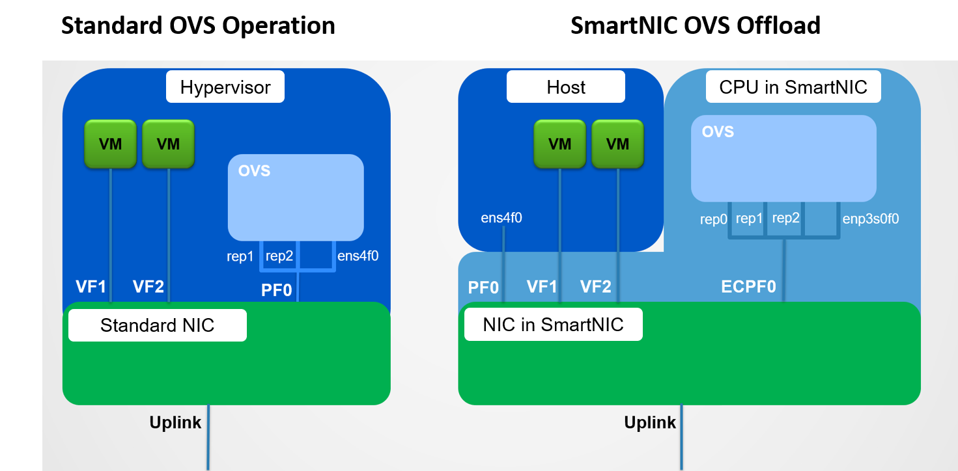
SmartNIC Application – OVS Offload
SmartNIC OVS Offload
VMs running in host CPU
OVS running in SmartNIC CPU
Allow Control pass and Data pass separation
SmartNIC OVS does flow classification and action
  Packet Classification/Forwarding/Dropping, Encap/Decap, QoS and more
No network driver in guest OS or bare-metal host
SmartNIC OVS/DPDK Offload
VirtIO acceleration
  Zero Host CPU consumption on data path
  Support live migration
    No guest awareness
  Control plane and Data plane offload
  Isolation of Control plane
SRIOV acceleration

Slide 4
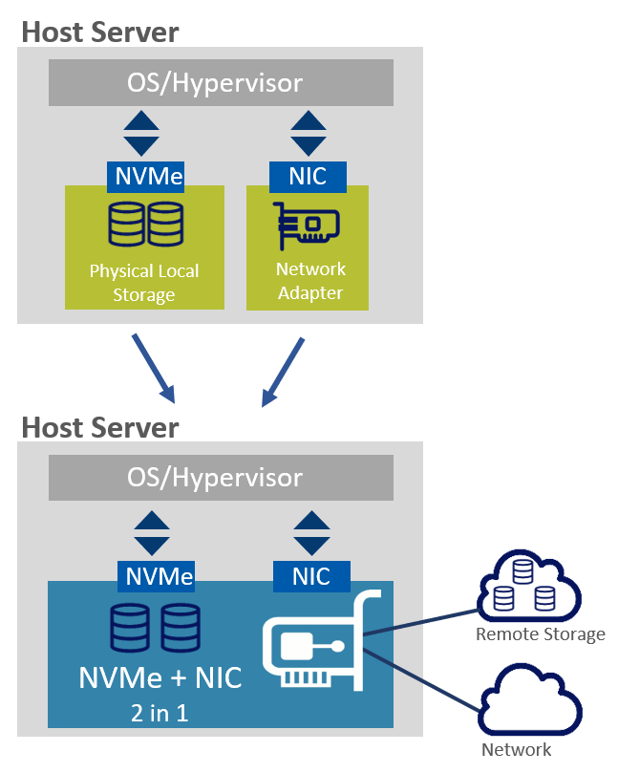
SmartNIC Application – PCIe Device Emulation
NVMe(Non-Volatile Memory express) Device Emulation
Serving both Bare-Metal and Hypervisor/VMs
      Optimize to efficient cloud storage
      Give Bare-Metal cloud same flexibility as virtualized cloud
      Bring an OS-Agnostic storage solution to the enterprise
Serving as Smart NIC and Emulating the Local-Storage
  Host CPU/OS or Hypervisor see both NIC and local NVMe drive
OS Agnostic
  SmartNIC is exposing NVMe interface as physical NVMe SSD for host
  Implement NVMe-oF(NVMe Over Fabric) in adapter
    Bare-Mental: No NVMe-oF driver required on Host OS
    Virtualized: No NVMe-oF driver required on in Hypervisor
  Leveraging standard NVMe driver which is available on all major OSs
  Supports all network transport types
    NVMe-Of
    iSCSI（Internet Small Computer System Interface）
    iSER (iSCSI RDMA Protocol)
    Even proprietary protocol
Also be able to be emulated to other PCIe devices

Slide 5
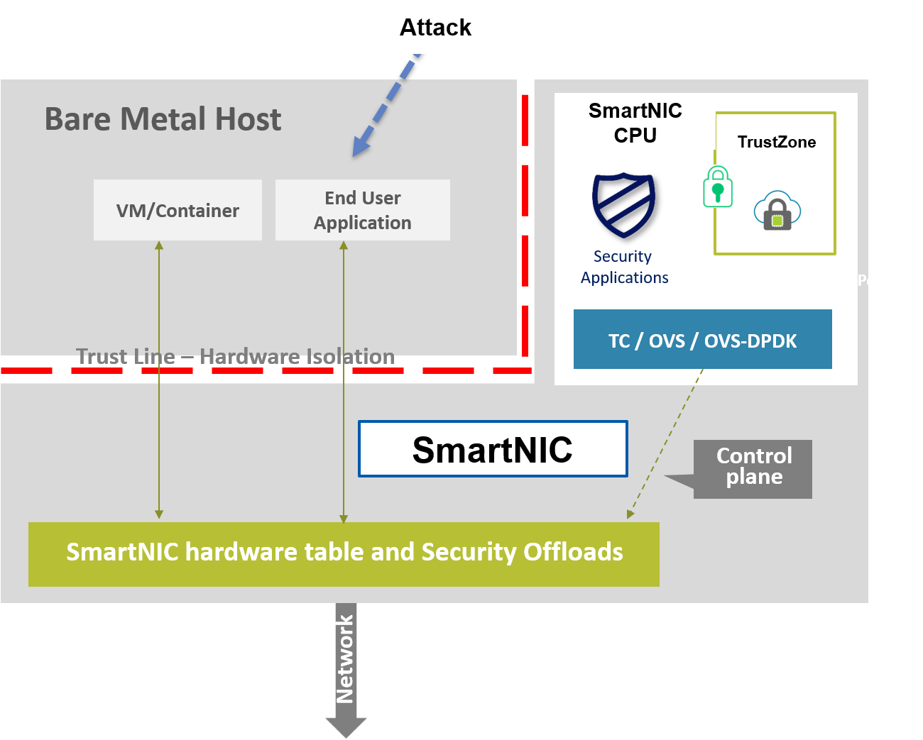
SmartNIC Application – Security Offload
Security Offload
SmartNIC Security Offload
  Accelerated connection tracking, check TCP connection state in hardware in real-time
  Deep packet inspection
  Intrusion detection/prevention
  Hardware inline encryption: Ipsec(Internet Protocol Security) \ TLS(Transport Layer Security)
  Hardware storage encryption: AES-XTS(Advanced Encryption Standard - XEX Tweak + Ciphertext Stealing）
  Hardware public key acceleration
  Ability to run privacy and authentication algorithms
  Protect the host from attacks in wire speed
  Bare Mental Security
  Trust shift to SmartNIC CPU
  CPU intensive security tasks are offloaded to the SmartNIC CPU and hardware accelerators
  Host access to SmartNIC can be blocked by hardware
  Enables agentless end point protection schemes
Secure Boot
  Hardware Root-of-Trust

Slide 6
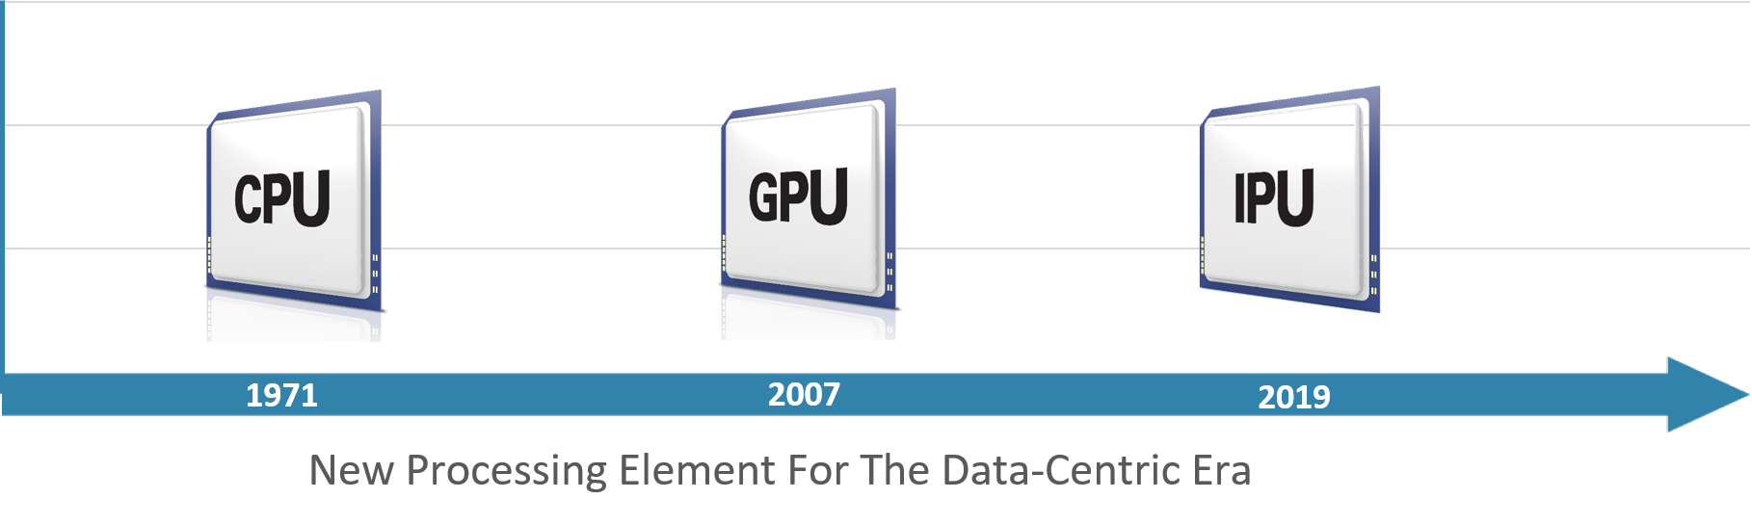
SmartNIC As IPU(I/O Processing Unit)
Transition of data center architecture from CPU-centric to become data-centric
IPU is designed to complement the CPU and GPU
The IPU processes data as it moves in and out of the server in real-time
IPU moves computing to where the data reside instead of traditional paradigm of data-movement to where compute is
The co-processing capabilities complement the main CPU, acting as a “computer in front of a computer”

Slide 7
Reference Documents
https://www.mellanox.com/products/bluefield2-overview
https://www.mellanox.com/related-docs/prod_adapter_cards/PB_BlueField-2_IPU.pdf
https://docs.openstack.org/neutron/latest/admin/config-ovs-offload.html
https://www.mellanox.com/reports/it-pros-want-smartnics
https://www.mellanox.com/products/software/nvme-snap
https://www.mellanox.com/sites/default/files/related-docs/solutions/SB_Mellanox_NVMe_SNAP.pdf
https://blog.mellanox.com/2019/08/mellanox-introduces-revolutionary-smartnics-for-making-secure-cloud-possible/
https://blog.mellanox.com/2019/02/mellanox-turns-zero-trust-to-hero-trust/
https://blog.mellanox.com/2019/05/an-out-of-band-malware-detection-with-mellanox-bluefield/
https://www.mellanox.com/related-docs/products/SB_asap2.pdf

Slide 8
Thanks

