Slide 1

FFIoT Status Report – IEEE 802 Nendica
Mentor DCN IEEE802.1-20-0019-00-ICne
Nader Zein (NEC Europe Ltd - NLE)
IEEE 802.1
2020-02-20

Slide 2
Outline
  Outcome from Recirculation Call for Comments on Draft FFIOT report
  Status of Consolidated Comments resolution
  Plan

Slide 3
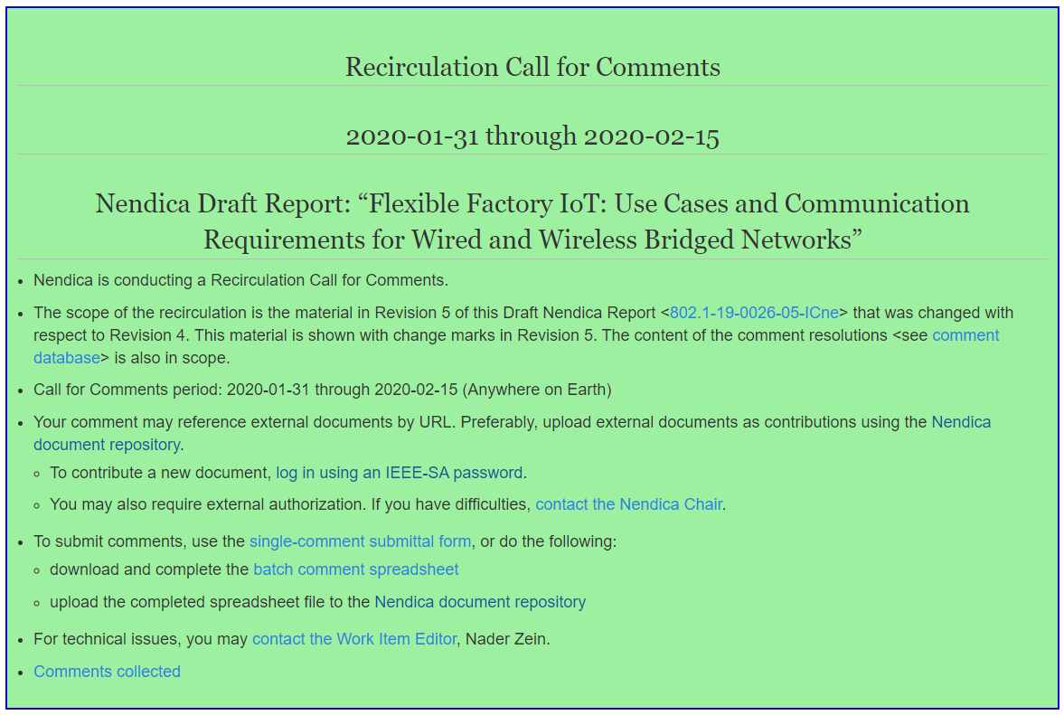
Recirculation Call for Comments on Draft FFIoT Report
Outcome from the Recirculation call for comments is in 1-20-0018-00-Icne-consolidated-ffiot-recirculation-comments.xlsx
4 comments from 1 commenter of which :
  2 Editorials
  2 Technical (1 does not propose modification but rather follow up discussion in future work)
Editor proposes to accept all with one open for discussion.

Slide 4
Plan
Produce new draft 6 of the FFIOT report and ask Nendica Chair to forward to IEEE802.1 WG for confirmation at the IEEE802.1 Plenary, Atlanta week 2020-03-21

