Slide 1
Use Cases and Requirements for Managed LAN as a Service (MLaaS)
Wei Qiu, Huawei
Ron Insler, RAD
Nov 2019, Nendica

Slide 2
Presentation Objectives
Outline initial use cases and requirements of Managed LAN as a Service
Discuss current gaps and expectations

Slide 3
Making MLaaS Business Case
Managed LAN as a Service (MLaaS)
LAN is planned, implemented, operated & maintained by a remote service provider.
A natural expansion of Managed Service Provider (MSP) business
Key factors to make MLAAS profitable
LAN deployment efficiency improvement (use case 1)
Build more sites within the same time
Require less skilled personal on sites
WLAN manageability (use case 2)
Wireline-like user experience
Capable of ‘zero-touch’ deployment and scalability

Slide 4
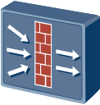
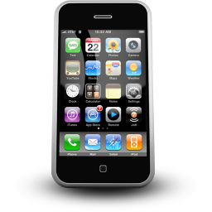
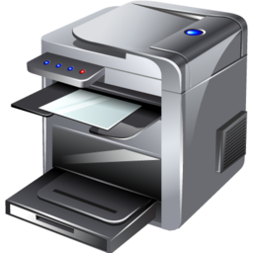
Use Case 1 – LAN deployment efficiency improvement
Deploying an overlay is an emerging technology for Campus LAN.
NMS
Core
Core Switch
Controller
L3
WLAN AC
FW
Overlay
Aggregation
L2
Agg Switch
Access Switch
Core/Agg
Underlay
Access
AP
Access
Traditional network
Policy is correlated with port location, VLAN, subnets, ACL
Lack of flexibility and difficult for policy automation, slow network deployment and change.
Typically L2 based below core layer, inefficient network utilization and hard to support large-scale network.
Overlay Network
Create a virtual network (overlay) to provide flexible functionality and services, such as segmentation and information flow control
Underlay only provides simple and high available connectivity and forwarding.
Have the benefits of L3 network while still support L2 extension. Easy for policy automation and support for large-scale network

Slide 5
Key for LAN deployment efficiency improvement : Underlay Network Automation
Configuration automation is key to reduce the cost for the Managed Service Provider for LAN deployment.
Both underlay and overlay configuration needs to be automated. The overlay configuration can be done remotely only if all on-site equipment can be managed remotely.
So the deployment efficiency depends on how easy such remote equipment management be provided.
Less skilled technician required on-site
Minimize on-site workload
The challenge: how to simplify underlay on-site configuration and make it manageable remotely.
NMS
Controller
Overlay
Core/Agg
Underlay
Access

Slide 6
Current Underlay Configuration Process
DHCP server
Controller/NMS
Step 1
Log in to the core switches with CLI, configure the management VLAN/IP address of core switch, IP address of controller/NMS so the they can be discovered by the controller/NMS (called controller hereafter).
Underlay configuration
Core Switch
Aggregation-1 Switch
Example:
# Management VLAN 100
# Management IP address 10.xx.xx.xx
# Controller IP address 20.xx.xx.xx.xx
…
…
Aggregation-2 Switch
Aggregation-n Switch
Access Switch /AP

Slide 7
Current Underlay Configuration Process
Controller/NMS
Step 2
At controller, plan and design your network including underlay VLAN , interface interconnection IP, IGP routing protocol (area), STP, Link aggregation etc.
Deliver the configurations to the core switches.
DHCP server
Underlay configuration
Core Switch
Aggregation-1 Switch
…
…
Aggregation-2 Switch
Aggregation-n Switch
Access Switch /AP

Slide 8
Current Underlay Configuration Process
Step 3
Core switches discover aggregation-1 switches with LLDP and propagate the information of management VLAN.
Aggregation-1 switches get the management IP address via DHCP and know the IP address of the controller from DHCP option field ). Broadcast will happen during the DHCP discover stage.
Aggregation-1 switches initiate registration to the controller. Since aggregation-1 switches and the controller are in different subnets, the aggregation-1 switches will send ARP broadcast to its gateway for requesting MAC address. Broadcast again!
Aggregation-1 switches complete the registration on the controller.
Controller/NMS
DHCP server
Underlay configuration
Core Switch
LLDP
LLDP
DHCP Discover(broadcast)
LLDP
Aggregation-1 Switch
…
…
Aggregation-2 Switch
Aggregation-n Switch
Access Switch /AP

Slide 9
Current Underlay Configuration Process
Step 4
At controller, plan and design your network for agg-1 switches(VLAN, VLANIF, IP address, Link aggregation etc. ).
Deliver the configuration to the core & agg-1 switches.
Repeat above for agg-2 switches and rest of switches.
There are more broadcast when configuring the switches that are more near terminal because the broadcast domain will become larger.
Consider the physical connection, STP should be enabled to prevent the loop. Since the network is quite large(consider thousands of nodes), the STP computation may take very long time and is very low efficient. After link aggregation is configured, the STP may need re-converge. How to tune the STP BPDU timer in such network could be very complex.
Controller/NMS
DHCP server
Underlay configuration
Core Switch
Aggregation-1 Switch
LLDP
LLDP
LLDP
broadcast
…
…
Aggregation-2 Switch
Aggregation-n Switch
Access Switch /AP

Slide 10
Current Gap and Expectations
Issues
Since the initial underlay(before the configuration is delivered from the controller) and management network are L2 based, it has potential L2 loop problem (i.e wrong physical connection) and broadcast storm during the DHCP process. STP could be enabled but it has its limitation on the large-scale network(slow convergence and timer tuning).
Still need complicated design and plan for VLAN, IP address, routing protocol area design for all nodes. Prone to human error.
Not plug & play and self-organized, needs human intervention for new nodes expansion and network change. Slow process, low efficiency.
When the LAN become large-scale (i.e. thousands of switches and APs), the above issues will become more serious.
Expectations
An enhanced L2 protocol to enable automatically configuring the physical underlay network with “zero touch” for large-scale network.
Topo-discovery, L2 forwarding path calculation, underlay VLAN/IP/IGP configuration
Self-organized, self-planning
Complete plug & play, no human invention

Slide 11
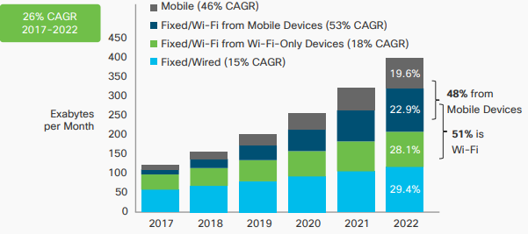
Use Case 2 – WLAN manageability
Wireless access is becoming dominant in LAN. When talking about managed LAN, Wi-Fi must be taken into consideration.
Wi-Fi traffic from both mobile devices and Wi-Fi-only devices together will account for more than half (51%) of total IP traffic by 2022, up from 43% percent in 2017.
Source: Cisco VNI Mobile, 2019
Volatile wireless environment is the biggest obstacle to provide managed service of WLAN.
User experience is impacted by collision and interference which also makes troubleshooting a tough task.
CSMA/CA based mechanism leads to unpredictable collision
Dense deployment further increase interference
Deployment & network expansion is high cost activity.
Much manual RF optimization work
Engineer with professional RF skills
Wired/Wireless(Wi-Fi) convergence should be considered
Single pane of glass management
Unified user policy
Notes:
challenges latency & reliability requirement of different applications.

Slide 12
Use Case 2 – WLAN manageability : Current Work
802.11 continuously work on improvement of WLAN user experience.
Wi-Fi 6 (802.11ax) has been commercialized.
Scope:
Focus on improvement in average throughput of per station in dense environment
Features:
OFDMA
UL MU-MIMO
Spatial Reuse
1024QAM
802.11 TGbe which might be Wi-Fi 7 is under development.
Scope:
Aim to achieve a maximum throughput of at least 30 Gbps.
Improved worst case latency and jitter is also within scope.
Candidate features:
320MHz bandwidth
16 spatial streams Multi-Access Point (AP) Coordination
HARQ
If needed, adaptation to regulatory rules specific to 6 GHz spectrum
Solutions from vendors start to address wired/wireless(Wi-Fi) convergence
But there are still gaps to meet service providers requirement to easily manage Wi-Fi.
Much improvement in intra BSS efficiency, enabling higher throughput and higher concurrency
Start to consider improvement in inter BSS performance
Able to support high bandwidth requested and/or low latency requested application, such as VR/AR.
Multi-AP coordination potentially has big improvement in the network efficiency and performance rather than a single BSS.

Slide 13
Use Case 2 – WLAN manageability : Gaps and Expectations
Gaps:
Wi-Fi is still a ‘best-effort’ network, non-deterministic, not able to support latency-sensitive or reliability-sensitive applications, such as live video (broadcast to a large number of users), various industrial applications.
Still much manual operation for RF optimization when deploying the network. Expansion of Wi-Fi network for more capacity almost requires a complete new network planning and optimization.
Large number of legacy stations exist in network, that may hold back expected network performance, preventing access point maximize its capability.
Expectation:
Investigate on not only peak throughput, but also features for latency and reliability.
E.g. further joint work with TSN, evaluating if current TSN mechanism could be re-used in Wi-Fi to meet the application requirement.
Keep exploring multi AP coordination to make the network self-optimizing, reduce deployment & expansion manual work.
Multi AP coordination is a potential way to reduce such complexity, such as D-MIMO(joint transmission) discussed in 11be. Study the requirement of Ethernet for different scale of multi AP, like possible architecture, requirement of bandwidth, frequency synchronization, latency etc.
Develop features which could also benefit legacy stations existed scenarios. Forward compatibility should be considered when develop new standard.
Only methodology mind-set, no specific technology proposed.
Coordinated Beamforming in 11be is a good example.

Slide 14
Summary
The presentation outlines two use cases and related technology requirement for Managed-LAN service.
Other use cases and requirements could be discussed and added on later.
Call for interest to join the discussion and study.

