Slide 1
RoCE Network Proposal
Qingchun Song
Qingchun@mellanox.com

Slide 2
Remote Direct Memory Access (RDMA) Benefits
Hardware based transport stack
Provides low latency, high throughput, low CPU usage.
Offloads CPU network processing (OS TCP/IP stack)
Avoids data copy between user space and kernel space
CPU is utilized for computation operations in high-performance computing applications.
High network throughput in storage applications.
Low latency in real time applications.
Server - Initiator
Server - Target
Server - Initiator
Server - Target
Buffer
Application
Application
Buffer
Buffer
Application
Application
Buffer
Buffer
Sockets
Sockets
Buffer
Buffer
Sockets
Sockets
Buffer
Buffer
Transport Protocol Driver
Transport Protocol Driver
Buffer
Buffer
Transport Protocol Driver
Transport Protocol Driver
Buffer
Buffer
NIC Driver
NIC Driver
Buffer
Buffer
NIC Driver
NIC Driver
Buffer
NIC
NIC
RNIC
RNIC
Buffer
Buffer
Buffer
Buffer
TCP/IP
RDMA

Slide 3
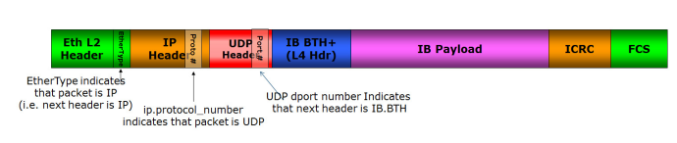
RoCE – RDMA Over Converged Ethernet
RoCEv2 Packet Format
ECN field in IP header is used to mark congestion (same as used for TCP)

Slide 4
Resilient RoCE Feature Progression
Software & Firmware based implementation of congestion control
Hardware support to catch ECN-marks and CNPs
Hardware-based congestion control
Hardware acceleration to support loss handling events
Hardware-based packet retransmission
Selective-Repeat based transport control

Slide 5
Optimizing Performance With Network QoS
High priority traffic class separation of CNPs (congestion notification packets)
  Fast propagation over the network. Bypassing congested queues.
RoCE traffic priority isolation from other traffic (eg. background TCP, UDP)
  Avoid co-existence problems with non-controlled (or differently controlled) traffic
Flow Control (lossless network)
  Better to pause packets than drop packets

Slide 6
RoCE CC (DCQCN) Convergence Analysis
Assume N synchronous flows in congestion point draining to one port. Initial flow rate is link rate (eg. 100Gbps).
Rate of each flow needs to be reduced to link rate/N. So the total sum of flow rates will be equal to link rate.
Every rate reduction event, throttles the flow rate to half of previous rate. new rate = 0.5 * old rate.
Hence, need log2(N) reduction events in order to converge.
The first reduction event arrives after first CNP arrives (RTT since start)
Following reduction events occur in periods configured by rate_reduce_period parameter.
  This is configurable parameter of DCQCN in the NIC
Hence, convergence time = RTT + log(N)*(rate_reduce_period-1)
Example:
    network propagation time = 9 us (estimated, including links and switches)
    NIC response time = 1 us
    Switch queue delay = ECN mark threshold / link_rate
    = 150KB (assuming switch configured to mark packets at 150KB) / 12.5GBps (= 100Gbps) = 12us
  RTT = network propagation time + NIC response time + queue delay = 9us + 1us + 12us = 22us
  Assume: number of flows N = 1024. All links are 100Gbps. Traffic arrives from 16 ports, draining to one port.
  Time to converge = 22us + log2(1024)*4 us = 62us.
Buffer needed = link rate * (num. incoming ports-1) * time to converge
        = 100Gbps* 15 ports * 62us = (100/8)*10^9* 15 * 62*10^(-6) = 11,625 KB.
Notes:
RTT: Round Trip Time

Slide 7
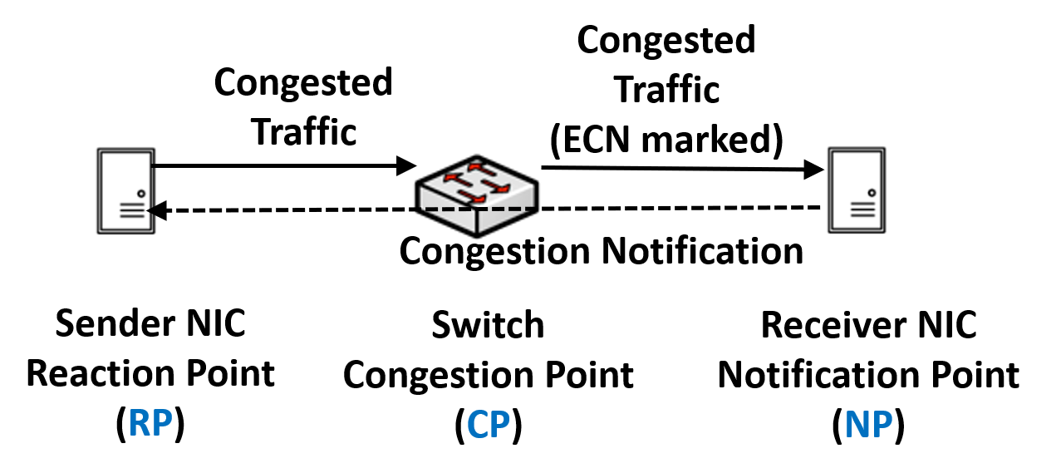
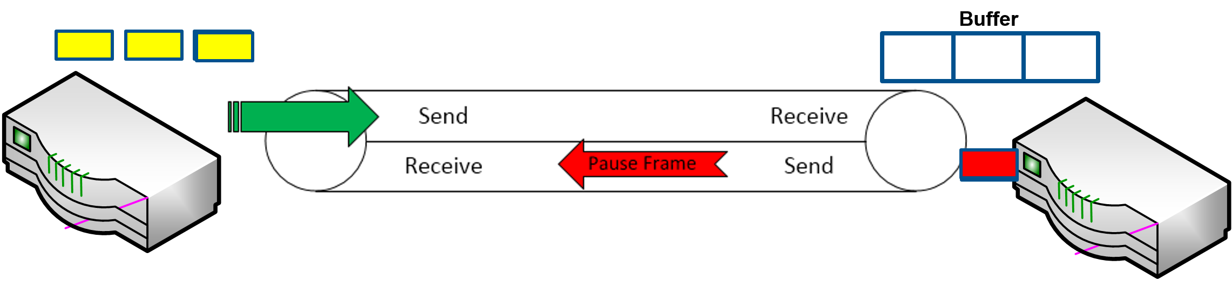
Lossless Configuration
Enable ECN and PFC in all switch and NIC
NIC receive (Rx) congestion may occur
  NIC cache misses
  PCI bottleneck
Switch congestion may occur
  Many to one communication
PFC may spread congestion to other switches
PFC may spread congestion to NIC transmit(Tx) side
  PCIe congestion control
Use and optimize ECN to avoid the PFC
  Buffer optimization in en-gress port
  Faster ECN mark in switch and faster response for CNP in NIC
PFC + ECN
PFC + ECN
PFC + ECN
PFC + ECN
switch
NIC

Slide 8
Semi-lossless Configuration
Address The Problem In Lossless:
NIC receive (Rx) congestion may occur
  NIC cache misses
  PCI bottleneck
PFC for NIC Congestion
  NIC Rx congestion is propagated to the switch
  Switch buffer absorbs the backpressure, congestion marked with ECN
PFC may spread congestion to other switches
Semi-Lossless network solves NIC congestion and prevents congestion spreading
  NIC to switch: Uni-directional PFC
  Switch to switch: no PFC
No PFC
No PFC
PFC from NIC to switch
No PFC from switch to NIC
PFC from NIC to switch
No PFC from switch to NIC
switch
NIC

Slide 9
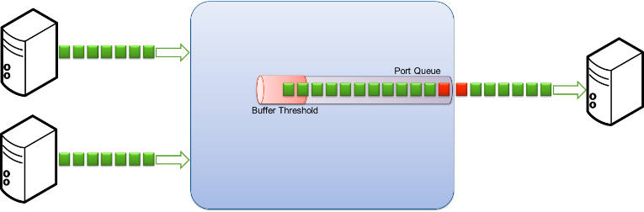
Lossy-1 Configuration
No PFC, End to End ECN only:
No PFC spread
Packet drop may happen
  Selective Repeat
Optimize ECN
  Buffer optimization in en-gress port
  Fast Congestion Notification
    Packets marked as they leave queue
    Reduces average queue depth
  Faster CNP creation in NIC receive
  Give the highest priority for CNP
  Faster reaction for CNP in NIC transmit
No PFC, ECN Only
No PFC, ECN Only
No PFC, ECN Only
No PFC, ECN Only
switch
NIC

Slide 10
Lossy-2 Configuration
No PFC, No ECN
No PFC spread
Packet drop may happen
  Selective Repeat
  Packet drop trigger the reaction in the NIC transmit(Tx)
No PFC, No ECN
No PFC, No ECN
No PFC, No ECN
No PFC, No ECN
switch
NIC

Slide 11
Traffic Classification
Required for setting:
  QoS
  Buffer management
  PFC
Indicated by
  DSCP (Differentiated Service Code Point, layer 3, in IP header).
  PCP (Priority Code Point, layer2, in Vlan tag).
DSCP is the recommended method.
Set by trust command.

Slide 12
Recommended Classification
RoCE
  Lossless / lossy
  Uses DSCP 26 / PCP 3. Mapped to switch-priority 3
CNP
  Lossy
  Uses DSCP 48 / PCP 6. Mapped to switch-priority 6
  Strict scheduling (highest priority)
Other traffic
  Untouched (default)
  Recommended to enable ECN for TCP as well

Slide 13
Host Ingress QoS Model
Packets are classified into internal priority according to the packets priority:
  PCP – Priority Code Point, layer 2 priority, located in the VLAN tag
  DSCP – Differentiated Service Code Point, layer 3 priority, located in the IP header
Internal priorities are mapped to buffer(s)
Buffer and priorities can be configured as
  lossy – when buffer is full, packets will be dropped
  Lossless – when buffer is almost full, a pause will be sent to the transmitter to stop transmission
    Can be either based on global pause or priority flow control (PFC)
In egress direction the device conform the packet priority
  Ethernet
    Trust PCP – according to WQE
    Trust DSCP – according to TCLASS
  UD
    Trust PCP – according to WQE
    Trust DSCP – according to TCLASS
  RC
    Trust PCP – according to QP’s eth prio
    Trust DSCP – according to QP’s TCLASS

Slide 14
Switch Priority Classification
Priority Group (PG) (Ingress Buffer)
(0-7)
DSCP (IP header) (0-63)
Default mapping:
3 MSB = priority
Default mapping:
All to 0
Used for:
Flow Control: xoff, xon
Shared buffer: alpha, reserved
Switch-priority
(0-7)
PCP (VLAN header) (0-7)
Traffic Class (TC) (Egress Queue)
(0-7)
Used for:
ETS Configuration: WRR, strict
ECN: min/max threshold
Shared buffer: alpha, reserved
Default mapping:
PCP = priority
Default mapping:
priority = traffic class

Slide 15
Standard RoCE Handling Packet Drops
Congestion control doesn’t guarantee packet drops avoidance.
RoCE uses InfiniBand transport semantics.
InfiniBand transport is reliable!
  Packets are marked with sequence numbers (PSN)
  On first packet arrived out of order, responder sends out-of-sequence (OOS) NACK.
  OOS NACK includes the PSN of the expected packet.
  Requestor handles OOS NACK by retransmitting all packets beginning from the expected PSN.

Slide 16
Selective Repeat
  Loss of a request:
    Upon receiving an OOS request the responder:
      Send immediate OOS NAK for the first one
      Store it using existing OOO placement mechanisms
    Upon receiving OOS NAK the requestor:
      Transmit only the NAKed packet, and wait for following acks
  Loss of a response:
    Upon receiving an OOS response packet:
      Store it using OOS placement mechanisms
      Issue a new read request for the missing ranges
      Then continue sending new requests
Loss of a request
  Loss of a response
Requestor
Responder
Requestor
Responder
1
2
3
4
5
6
7
Large read 1
X
Med response lost X
OOS NAK 3
3
8
9
10
Med read 1
Large read 2
Ack 7
Notes:
RTT(Round-Trip Time)
OOS(Out Of Sequence)

Slide 17
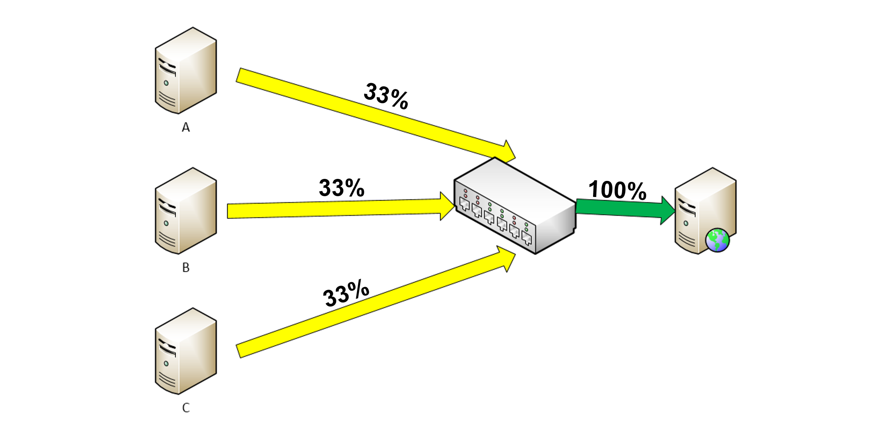
Ideal Data Traffic
Slow & constant transmission is better than retransmission
Use ECN to tune the speed per QP or flow
PFC may help to reduce the packet drop
Credit based flow control per hop

Slide 18



SmartNIC Application Example (NVMe Emulator)
Virtualized Cloud Storage
Bare-Metal Cloud Storage
Hypervisor
Cloud Storage
SmartNIC
Cloud Storage
Bare-Metal
Cloud Storage
SmartNIC
Bare-Metal Cloud Storage
Two solutions in one
Emulated NVMe PCIe device
  Emulating a local physical NVMe SSD drive to the Host
  Emulating via SR-IOV multiple NVMe SSD drives to VMs
NIC
  Up to line rate throughput
  Low latency (end-to-end)
  Native RDMA and RoCE
  Integrated hardware offloads
Guest VM
Guest VM
Guest VM
Guest VM
Bare Metal
x86 Server
Bare Metal
x86 Server
Storage Virtualization Driver
Hypervisor
Hypervisor
Storage Virtualization Driver
Physical
NVMe SSD Drive
Physical
NVMe SSD Drive
Storage Virtualization Driver
Storage Virtualization Driver
Network
Adapter
NVMe
Emulation Adapter
Network
Adapter
NVMe
Emulation Adapter
Remote Target
Storage
  OS Agnostic, Near-local performance, Secured, Any Ethernet wire protocol

Slide 19
Thanks

