Slide 1
Lossless Network
Jun Liu (johnliu@cisco.com)

Slide 2
Lossy vs Lossless
Lossy
  Example: TCP, iWARP, NVMe/TCP
  Tolerate packet drops in the transport
  TCP retransmit dropped packets
Traffic loss can be reduced by network
Storage Protocol | Network Protocol | Network Transport Requirements
iSCSI | TCP | Lossy
NVMe-oF | TCP | Lossy
 | RoCE/RoCEv2 | Lossless
 | iWARP (TCP) | Lossy
NFS | TCP | Lossy
SMB | RoCE/RoCEv2 | Lossless
 | iWARP (TCP) | Lossy
Object API | HTTP (TCP, UDP) | Lossy
Lossless
  Example: RoCE
  Does not tolerate traffic drops
  Requires lossless network transport
  Application retransmits dropped packets
Lossless transport requires network to support lossless Ethernet
In case of drop, whole block/SCSI exchange

Slide 3

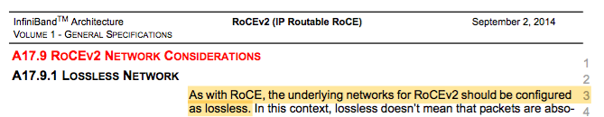
RoCEv2 End-To-End Lossless Behavior
Technologies used for Lossless Networks (RoCEv2): Flow control, Congestion control
To preserve lossless capabilities network require PFC to be enabled for RoCEv2 traffic
Traffic requires preservation of priority when transferred between Layer 2 and Layer 3 network
Configure ETS
  802.1Qaz ETS
  Packet/Flow identification follows standard practices of IP/Ethernet networks (i.e., DSCP/802.1Q)
  ECN
Consider AFD (Cisco)
Consider DPP (Cisco)

Slide 4




Approximate Fair Drop (AFD)
Increases Headroom, Reduces Latency
Maintain throughput while minimizing buffer consumption by elephant flows – keep buffer state as close to the ideal as possible
Higher-bandwidth elephants – higher AFD drop probability
Lower-bandwidth elephants – lower AFD drop probability
Distinguish elephant flows from other flows
Queue admission
N
Ideal depth exceeded?
AFD set?
Y
N
Y
Buffer
Non-elephants – no AFD

Slide 5
AFD Overview
AFD is an Active Queue Management (AQM) algorithm that acts on long lived large flows (elephant flows) in case of congestion and does not impact the short flows (mice flows).
As a result, improves flow based fairness, drops average queue occupancy and increases head-room for micro-bursts
Drop probability depends upon the arrival rate calculation of a flow at ingress.
In case of a congestion scenario, the AFD algorithm maintains the queue occupancy at the configured queue desired value by probabilistically dropping packets from the large elephant flows and not impacting small mice flows.

Slide 6
Elephant Trap
10 msec
Mechanism to identify large volume flows
  Identified based on 5-tuple
Elephant trap threshold is byte-count-based.
  When received packets in a flow exceeds the number of bytes specified by the threshold, the flow is considered an elephant flow
  Only elephant flows are submitted to AFD dropping algorithm. Mice flows are protected and not subject to AFD dropping
  Arriving data rate is measured on the ingress, and compared against a calculated fair rate on the egress port to decide dropping capability
E*
E*
packet
E* == Elephant Flow

Slide 7
AFD Comparison to WRED
Both AFD and WRED are Active Queue Management algorithms.
In case of congestion, WRED computes a random drop probability and drops the packets indiscriminately across all the flows in a class of traffic.
AFD computes drop probability based on arrival rate of incoming flows, compares it with the computed fair rate and drops the packets from the elephant flows while not impacting the mice flows.
Recommended values for queue-desired for different port speeds:
  10G: 150 kbytes
  40G: 600 kbytes
  100G: 1500 kbytes

Slide 8
DPP Introduction
Thanks to AFD, mice flows (micro-bursts) can use the large buffer headroom.
But this is still within their original queue, which is typically not set a strict priority, since it holds all kinds of flows including elephant.
There’s also other queues that can have equal or higher priority to us.
DPP dynamically classifies the first packets of a mice flow into a strict priority queue.

Slide 9
DPP (Dynamic Packet Prioritization)
Separate flows into short and long
Put short flows in high priority queue
Put long flows in low priority queue
Prioritization guarantees packet order
We want to prevent the drops of the mice, the incast and burst traffic
Benefits:
  For a short burst: it’s 100% prioritized
  For a longer flow: first few packets get prioritized. It’s still useful because the first packets of a TCP flow establish the TCP connection, increase the TCP window etc.
Prioritized Packets
Express Lane
Normal Lane
Egress
Queue

Slide 10
DPP looks for Any Burst: TCP, UDP, Multicast, ..
A Long-lived TCP Session An Elephant Flow
The elephant trap and DPP algorithm are not tracking only TCP sessions
The algorithm is 5-tuple based which means it can find TCP, UDP, Unicast and Multicast bursts
  A very long lived session that is quiet and then bursts will be prioritized for that burst
  Traffic arriving due to a link failure will be prioritized, etc …
One Long-lived Session
Source
Dest
Multiple Flowlets
Notes:
DPP is not just looking for the beginning of a TCP connection. It’s looking for the beginning of the flow activity. So there could be a long TCP flow that sends a lot of packets, then a big gap, and then a burst for that same flow, then the burst will be prioritized.

Slide 11
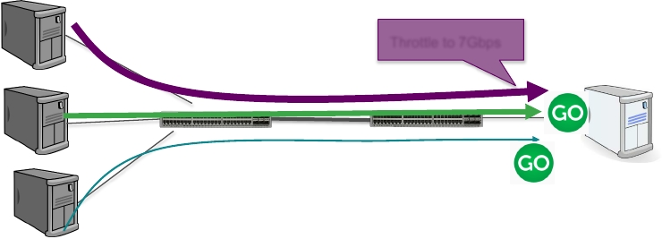
Testing Case
Traditional QoS is static. Hard to come up with QoS policy.
Nexus 9K-EX provides out-of-box behavior where a 1-line QoS config protects bursty traffic in real time, without having to define config to statically identify large flows vs small flows.
Burst traffic is protected thanks to DPP.
This is working real-time and adapts to the traffic patterns and rates. The fair share adjusts dynamically based on incoming rate.
Sender 1
8Gbps
Throttle to 7Gbps
10G
Sender 2
3Gbps
40/100G
10G
Sender 3
Bursty traffic
10G
Receiver
10G
Notes:
The 3Gbps flow is also protected: even though it belongs to elephant flows, it’s below the fair rate, so it will go through un-impacted. 8Gbps flow is throttled to 7Gbps.

Slide 12
Better Application Performance in an Incast Environment
Nexus 92160
Nexus 9272Q
Merchant (BCOM Dune 9GB)
https://miercom.com/cisco-systems-speeding-applications-in-data-center-networks/

Slide 13
Better Application Performance in an Incast Environment
Nexus 92160
Nexus 9272Q
Merchant (BCOM Dune 9GB)
https://miercom.com/cisco-systems-speeding-applications-in-data-center-networks/

Slide 14
Better Application Performance in an Incast Environment
Nexus 92160
Nexus 9272Q
Merchant (BCOM Dune 9GB)
https://miercom.com/cisco-systems-speeding-applications-in-data-center-networks/

Slide 15
Thank you!

