Slide 1
Update: Lossless Networks in ODCC
Liang Guo，ODCC(Chair of New Technology & Test WG)
Liyang Sun, ODCC(Vice Chair of New Technology & Test WG,
Project Manager of Lossless Network)
IEEE 802 Nendica
Hawaii，USA
Nov 2019

Slide 2

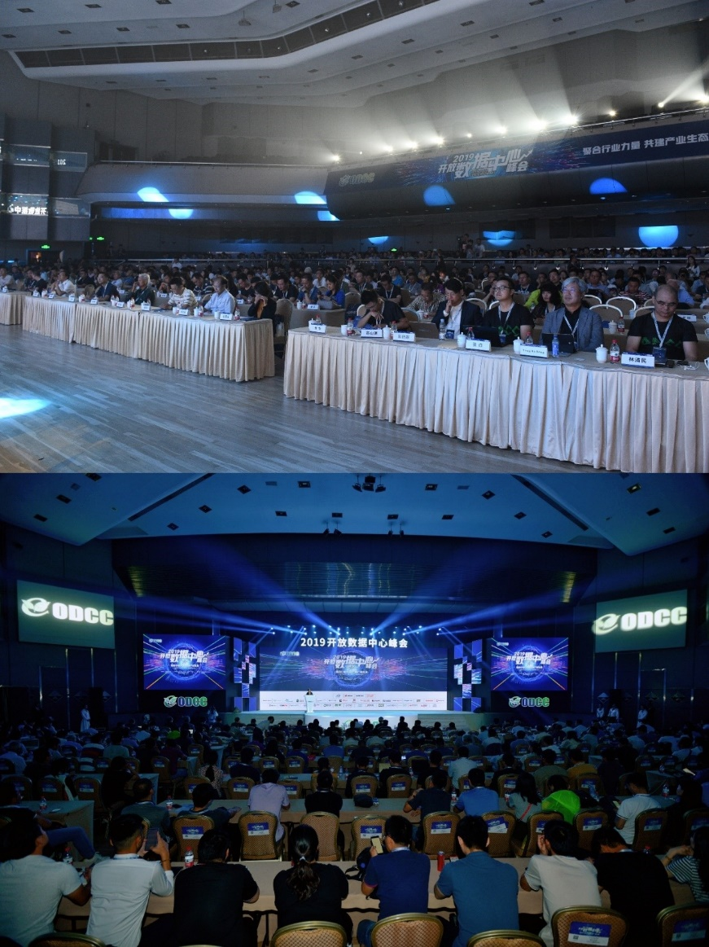

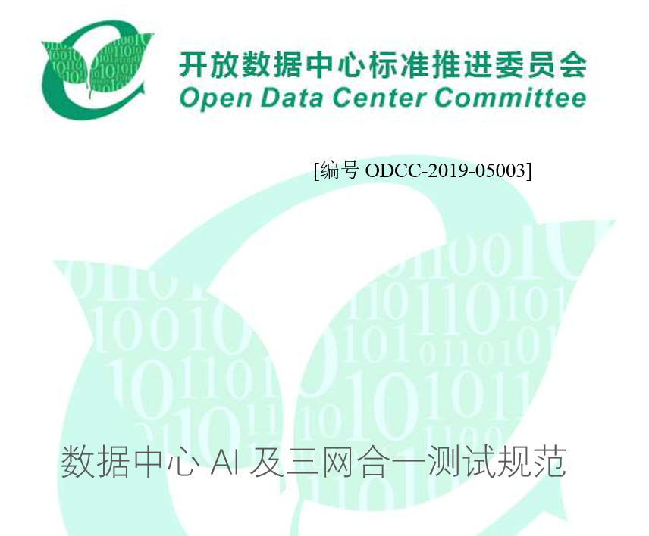
Achievements about Lossless Network on ODCC 2019 Summit
White Paper of Data center AI and Single Data Center Network (DCN)
Test Specification of AI and Single DCN
Test Specification of Lossless Network v2
All documents are published to more than 6,000+ people in the summit.
Notes:
9月3-4日，由开放数据中心标准推进委员会（ODCC）主办，百度、腾讯、阿里巴巴、中国电信、中国移动、中国信息通信研究院和英特尔承办的“2019开放数据中心峰会”在北京国际会议中心举行。来自政府主管部门、互联网、通信、电力、金融、教育等行业的8000余位代表出席了会议。会议设立了主会场和服务器、数据中心、数据中心政策、数据中心网络、新技术与测试、边缘计算六大分论坛。
主会场由中国信通院云大所副所长张雪丽、ODCC副主席朱华和高山渊主持。工业和信息化部、国家机关事务管理局、中国通信标准化协会的领导出席会议并致辞。在主会场上，开放数据中心委员会（ODCC）发布了25项重磅研究成果，正式发布了两部著作，并就数据中心尖端技术、产品、应用、趋势和政策等进行了精彩分享。

Slide 3
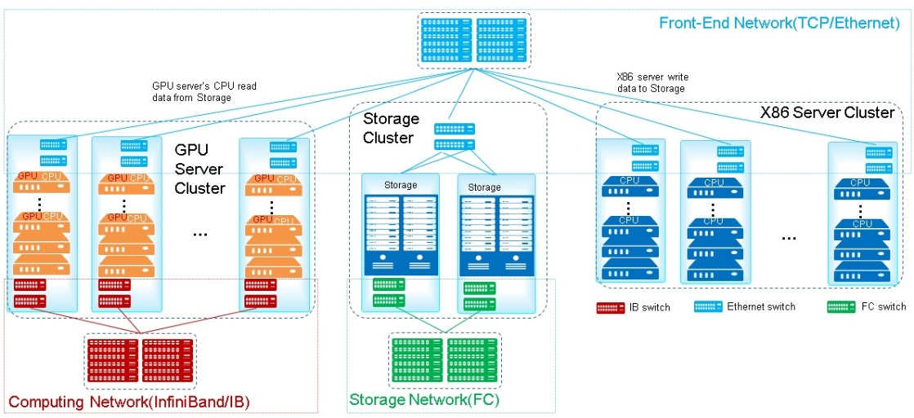

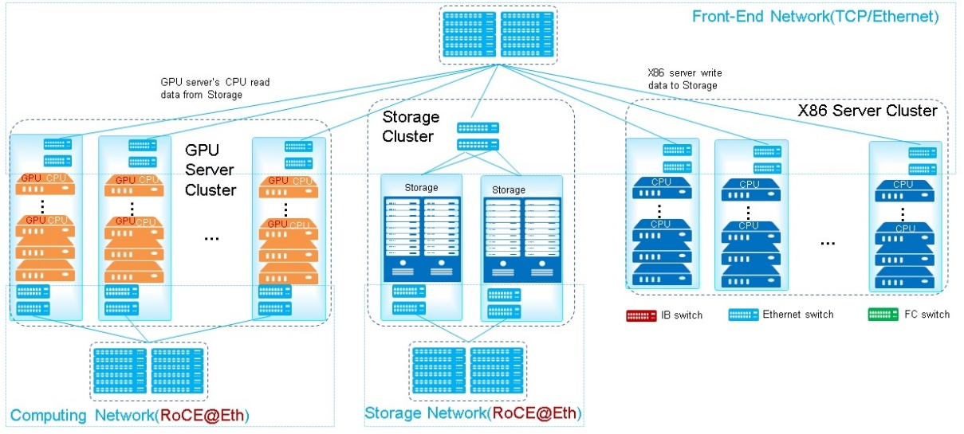
Technical requirements of Lossless network
Traditional DCN architecture: Separate InfiniBand (IB), Fiber Channel (FC), and Ethernet (Eth) networks
Large-scale RDMA DCN requirement:
Use Ethernet to unify all networks in DCN
Challenge:
For those RDMA applications, how can the Ethernet performance be as good as that of the IB?

Slide 4
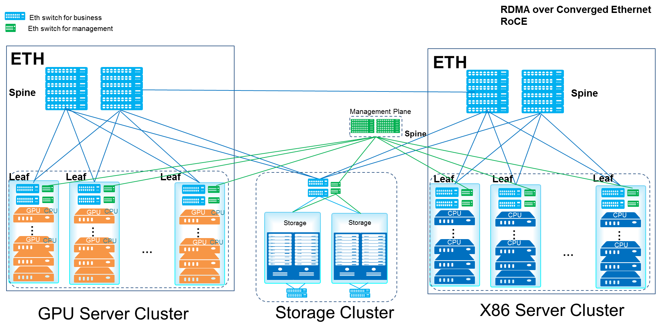
Technical requirements of Lossless network
Single DCN
Challenge:
How to implement large-scale use of Ethernet across pods?
Unified network O&M between pods.

Slide 5
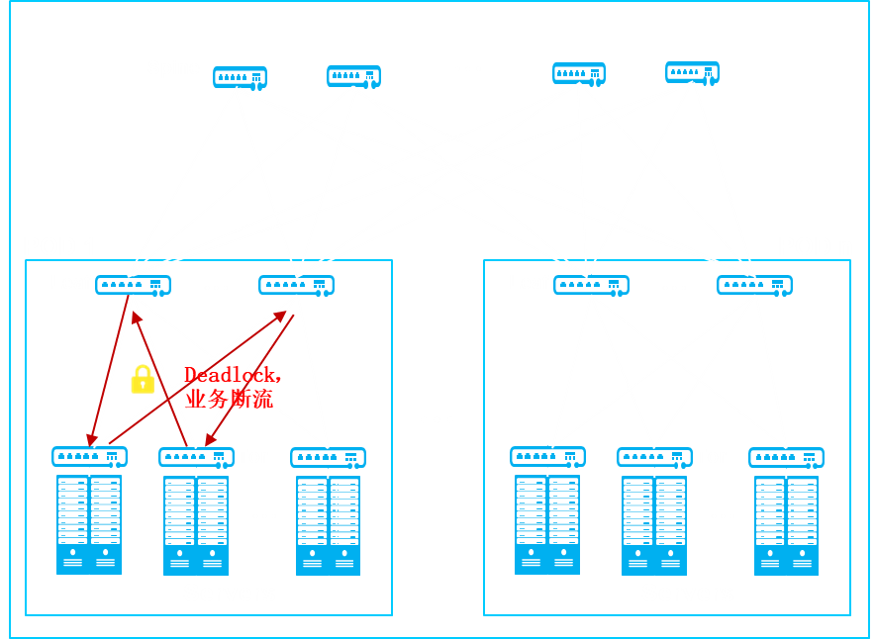
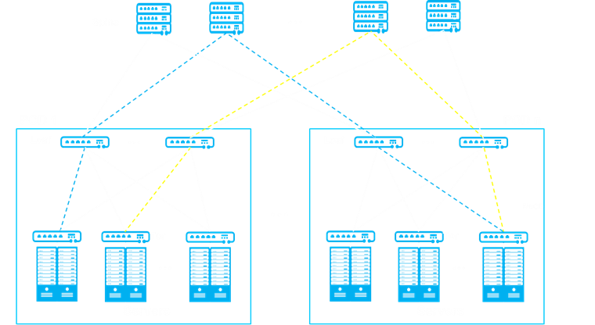

Problems we try to solve
Problem 1: PFC deadlock
Problem 2: TCP+RoCE flow mixed
Even 1‰ packet loss on the network leads to a sharp decrease in service performance.
In large-scale applications, TCP+RoCE traffic is mixed on the entire network.
RoCE
TCP
RDMA
applications
Traditional services
Traditional services
RDMA
applications
When the network scale increases, PFC deadlock may occur on the entire network.
In the flow mixed scenario, The ECN and CNP are invalid.

Slide 6

Large-scale DCN project-Test Specification of Lossless Network
Performance test
  RoCE V2 flow test
  TCP+RoCE V2 mixed flow test(8 to 1 and 4 to 1)
O&M function test
  PFC deadlock prevention
  RoCE Packet Loss Visualization
  RoCE performance visualization
Test Specification of Lossless Network
Distributed storage test
Large-scale RoCE network test
  4 to 1 flow mixed test across pods
  8 to 1 flow mixed test across pods
  PFC deadlock free test across pods
http://www.odcc.org.cn/download/22

Slide 7
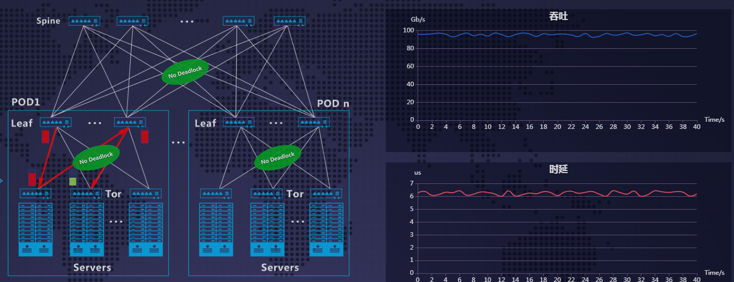
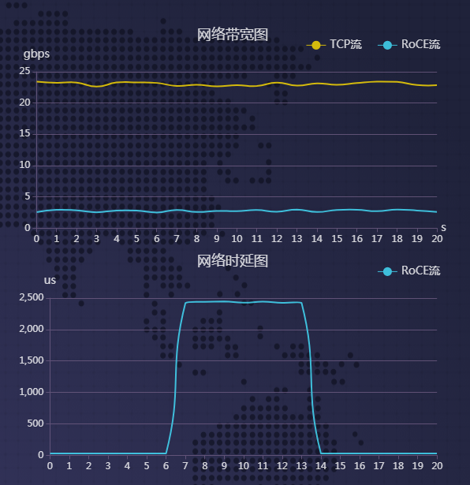
Test Results
Deadlock-free removes the CBD to ensure that no deadlock occurs on the entire network and the latency and throughput are better.
iQCN ensures that the QoS on the entire network is consistent.
Throughput
Throughput
In incast scenarios, the total throughput can reach more than 90% of the upper limit. Preventing and Treating Deadlocks in data center network
iQCN ensures that the throughput QoS is consistent
Latency
Latency
iQCN ensures latency optimization
The test results show that large-scale RDMA cross-POD applications are ready for implementation.
Notes:
CBD----

Slide 8
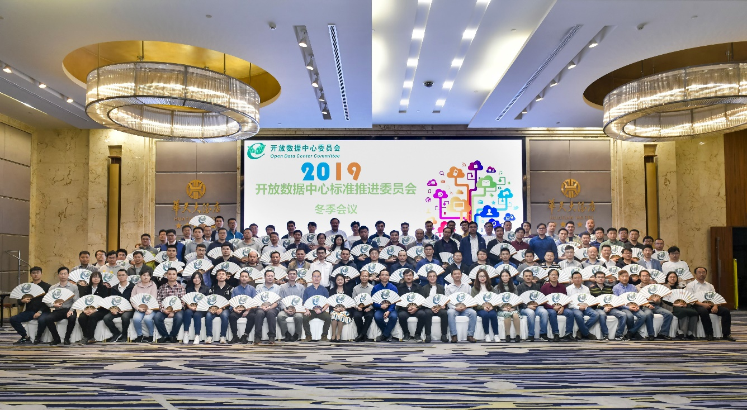
What’s NEXT:
Area of Intelligent lossless in Datacenter in ODCC
Area manager：
Liang Guo(CAICT）
Program manager：
Liyang Sun（Huawei）_ Research on the next generation RDMA switch
Ruixue Wang（CMCC）_ Lossless network application scenarios and technical requirements of operators
Qingchun Song（Mellanox）_ White paper of ROCE application in AI
Other Contributors：
Feng Gao(Baidu)
Zhongping Wang(Meituan)
Chuanshen Cheng(Tencent)
Xuequn Wei(Jingdong)
Yibing Jia(Kuaishou)
John Liu（Cisco）
Zongying He(Broadcom)
Jie Tang (Xilinx)
Kai Li (Keysight)
Other
ODCC
2 0 1 9
冬季全会

Slide 9
Area Prospects
1、Study the deployment technical requirements and schemes of Lossless network technology in cloud computing data center, business support system and other scenarios, and promote the implementation and pilot commercial use of Lossless network technology meeting business requirements.
2、Carry out the research on the relevant technologies of Lossless network technology, promote the maturity of commercial testing instruments and meters of Lossless network technology, and build a unified standard of Lossless network testing capability.
3、Welcome manufacturers, experts and friends to join us or give us valuable suggestions to jointly promote the development of the industry.
4、Strengthen interaction with international standards organizations, such as IEEE.

Slide 10
THANKS！

