Slide 1
LOSSLESS Network for RDMA in ODCC
Dr. JIE LI
VICE PRESIDENT OF ODCC

Slide 2
1
  Introduction of ODCC
  Progress of Lossless Network in ODCC
2

Slide 3



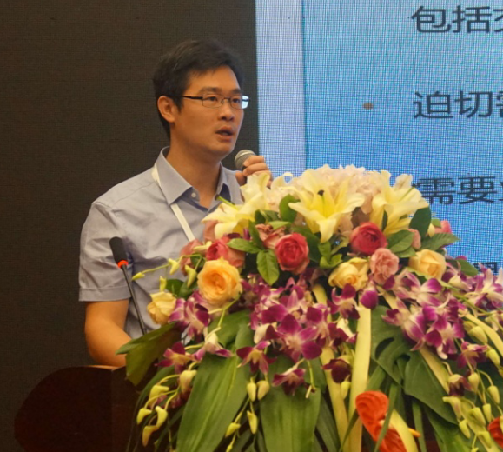








Management Organization
ODCC主要成员
主席
Chairman
Binghua Zhang
Baidu
张炳华
百度
系统部总监
Honorary chairman
Vice chairman
Baohong He CAICT | Hua Zhu Tencent | Shanyuan Gao Alibaba | Yongjun Huang China Telecom | Han Li China Mobile | Jie Li CAICT
committee member
Huabin Tang China Mobile | Liyin Liu Alibaba | Yongbing Fan China Telecom | Liang Guo CAICT | Feng Wang China Telecom | Gang Chen Baidu | Yongfeng Liu Alibaba
ODCC is a professional, national and non-profit social organization initiated by Baidu, Alibaba, Tencent, China Telecom, China Mobile, Intel and CAICT （China Academy of Information and Communication Technology）.

Slide 4







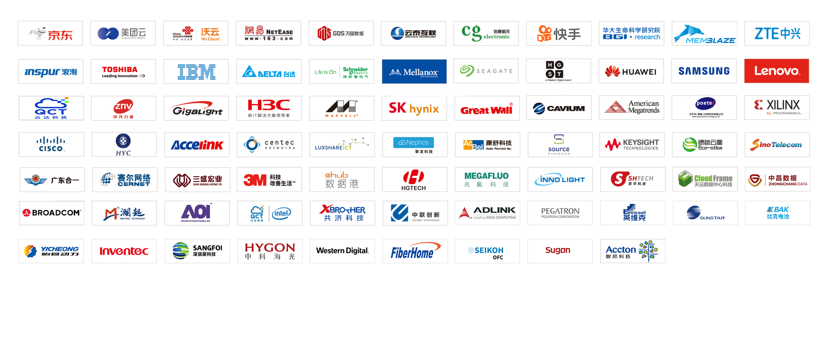
Members
core members（7）
members（75）

Slide 5
Achievements in Recent Years
ODCC近年发布成果
2016
2017
2018
14
Server
Data Center
Network
Test
Joint laboratory
3
3
3
4
1
20
Server
Data Center
Network
Test
Joint laboratory
4
3
6
6
1
22
Server
Data Center
Network
Test
Joint laboratory
4
6
3
5
4

Slide 6

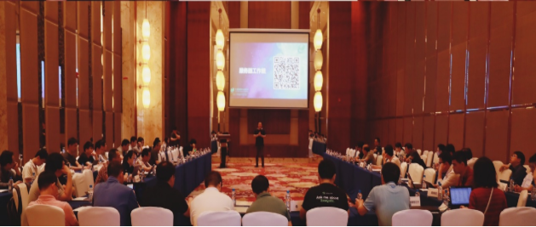
The purpose of ODCC
  The committee aims to create an open platform for data centers in China, promote the development of the Internet industry, promote the standardization and industrialization of infrastructure.
  Major Achievements：research on hotspot technologies、technical white paper、industry standards、test specification、test services

Slide 7

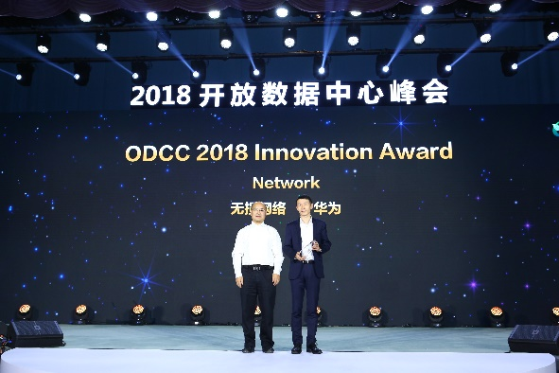
Star Programs
OTII Server for 5G and Edge computing
Open Telecom IT Infrastructure (OTII), a white-box server project of ODCC, is initiated by China Mobile, China Telecom, China Unicom, CAICT, and Intel in Nov 2017. The primary goal is to standardize a deep optimized server solution for 5G Network and edge computing.
Lossless network
Lossless network is a low-latency network, which has been improved and innovated in congestion control, traffic control, packet forwarding, routing and so on. China Mobile, China Telecom and other companies have begun to apply lossless networks.

Slide 8
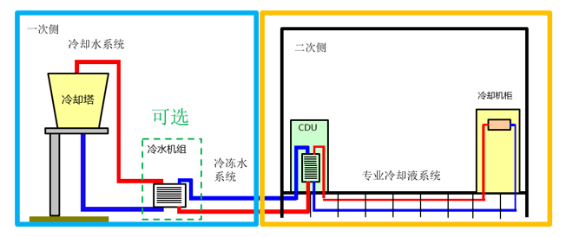
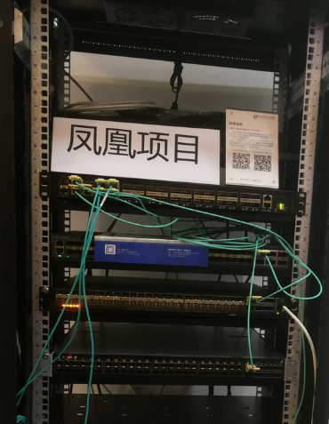
Star Programs
Liquid Cooling
The liquid cooling project focuses on the technical analysis, application research and verification test of the liquid cooling system. The design, architecture, testing, operation and maintenance of liquid cooling system are studied. The project has released a series of research results. And the results have been applied in data centers.
Phoenix Project
Phoenix project is an open source network OS project initiated by ODCC network working group. Relying on SONiC open source community, the project packages Base OS, SAI, platform driver and so on into a network OS image file that can be directly loaded and run on a white-box switch.

Slide 9
1
  Introduction of ODCC
  Progress of Lossless Network in ODCC
2

Slide 10
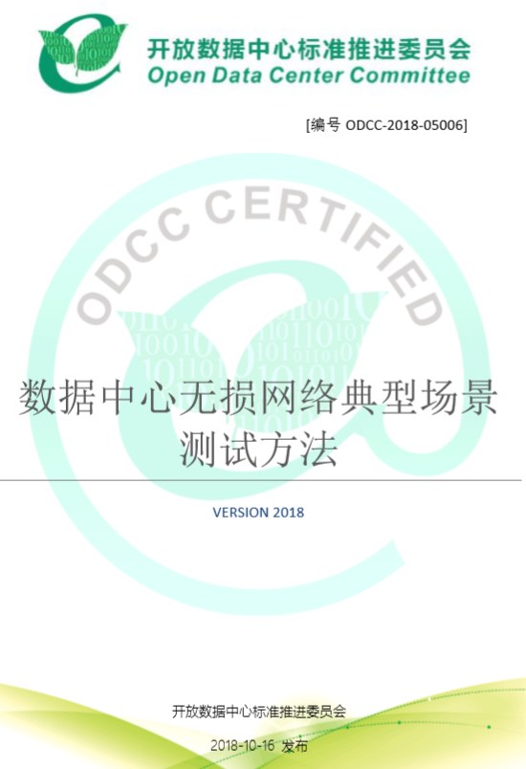
Test Specification & interoperation testing
To provide the interoperability and robustness of lossless network for RDMA fabrics in Data Center, a test specification of “Typical Scenario Testing Method for Lossless Network in Data Center“ was developed and released by NT WG.
This specification establishes the test method for typical application scenarios of data center lossless network, such as HPC, DPDK, virtualization, storage and so on.
Typical Scenario Testing Method for Lossless Network in Data Center

Slide 11
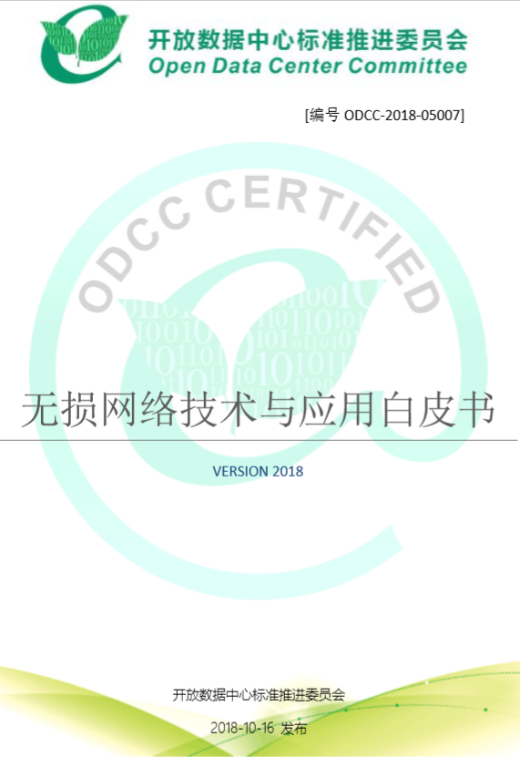
White Paper
A White Paper of “the Technology and Application of Lossless Network" is also released to guide the industry to adopt and deploy the lossless network for low latency applications, such as HPC.
The content of this white paper includes introduction of traditional network, application scenario of lossless network in data center, key technology of lossless network, test results, development trend and so on.
Technology and Application White Paper

Slide 12
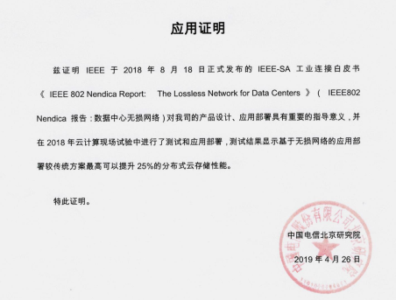
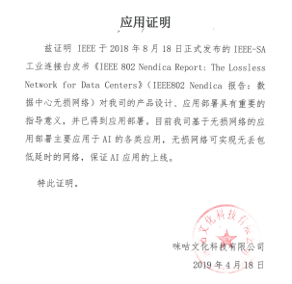
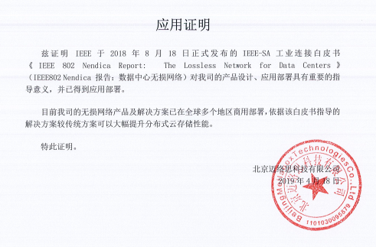
Deployments
Application Proof of China Telecom
Application Proof of China Mobile
Application Proof of Beijing Mellanox Technologies Co. Ltd.

Slide 13


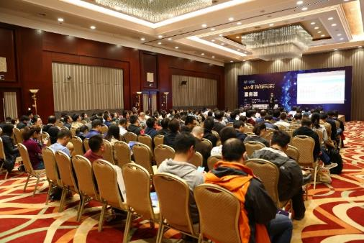
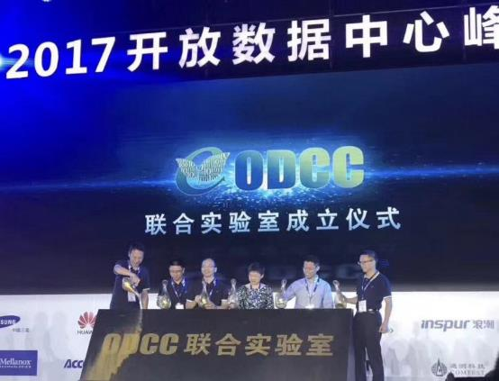

WELCOME TO ODCC SUMMIT 2019

Slide 14
THANKS！

