Slide 1
New Network Requirements for Service Provider Managed-LAN
Wei Qiu, Huawei
July 2019, Vienna, IEEE 802 Plenary

Slide 2
Presentation Objectives
To talk about the issues/requirements of service provider managed-LAN network.
To propose a new study item or work item to discuss and study those issues/requirements for potential standards at IEEE 802.

Slide 3
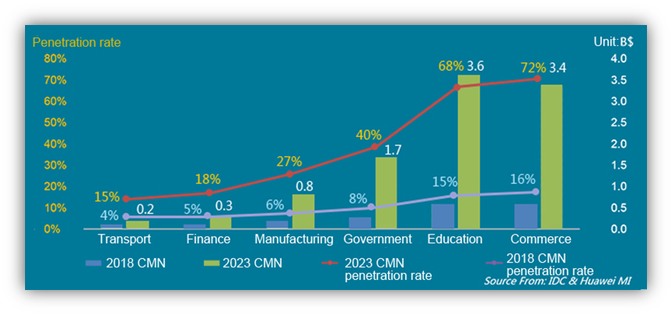
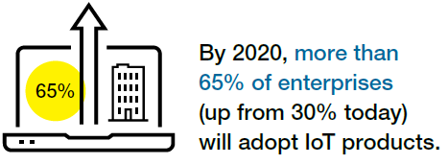
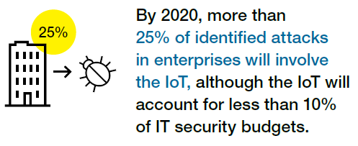
Enterprise LAN Trends: Cloud, Wireless, IoT, Outsourced
“By 2021, more than 70% of business users will be substantially provisioned with cloud office capabilities “
“By 2022, about 51% of traffic will be based on Wi-Fi access “
Source: Gartner
Source: Cisco VNI Mobile, 2019
Cloud requires more agile network for faster service provisioning, change and upgrade.
The traffic pattern will become more north-south. And LAN &WAN E2E policy integration is required.
Simplified WiFi deployment and maintenance are the keys for cost reduction of enterprise network.
WiFi network performance and user experience is more important than ever to increase staff productivity.
Source: https://www.gartner.com/imagesrv/books/iot/iotEbook_digital.pdf
Source: IDC & Huawei MI
Gartner, Inc. forecasts that connected devices worldwide will reach 20.8 billion by 2020@CAGR of 34%.
The IoT introduces a wide range of new security risks and management challenges for large-scale LAN network.
More and more enterprises prefer to outsource the network installation and maintenance given the increasing complex.
By 2023 cloud managed network market will be $10B worth.

Slide 4


Business Drivers for Service Provider Managed-LAN Service Adoption
Managed-LAN Service definition: The service provided by an operator for managing enterprise’s local area network (typically LAN and WLAN infrastructure and IT applications), including design, planning, implementation and network management and operations
Cost Reduction: According to IDC¹, adoption of managed IT can reduce in-house IT costs by 36%
IT Staff Efficiency: IT outsourcing enables internal IT staff to shift focus onto strategic projects
Security: Migration to managed services increases the reliability and security of enterprise networks
Enterprise Customer Drivers
Service Provider Managed Network
Enterprise Managed Network
Broadband Access Network
BNG
CPE
Core switch
Access switch
WAN
LAN
Moving up the value chain: adding additional revenue stream with managed LAN-related services
Easy Market Access: Easy market access to existing customer base ; one stop shop for connectivity, LAN & WAN value-added services
Service Agility: Simple implementation and upgrades that minimize staff effort; a more automated sales process with single pane of glass customer dashboards to manage their services and purchase additional services
Improved User Satisfaction: E2E service level assurance aligning with SD-WAN; single bill and single point contact for support
Service Provider Drivers
Service Provider Managed Network
Broadband Access Network
BNG
CPE
Core switch
Access switch
WAN
LAN
¹ Source: IDC predictive insight, automation and expertise drive added value for managed services white paper

Slide 5
Traditional Network Challenges and New Requirements for SP Managed-LAN Service
Lack of Flexibility and Agility
  Services planning across multiple devices with consideration of topology, user location, port attribute etc.
  Manual per-box configuration (i.e. plan and configure the ACL/VLAN for tens of hundred devices)
  High-level network service and policy coupled with low-level connectivity and configuration
Low Operational Efficiency
  Diverse configuration and disjoint policies are difficult to management and troubleshoot
  Prone to human error with large side effects (i.e. accident network operation cause L2 loop or policy compromise)
Lack of E2E SLA Assurance
  Difficult for LAN/WAN collaboration
  WiFi co-channel interference
Business Agility
  Easy network design & planning
  Fast and fully automatic network service and policy provisioning
Operational Cost Reduction
  Simplified network control and management
  Easy troubleshooting, fault location, isolation & repair
  Robust and reliable network, less prone to human error
E2E SLA Assurance
  LAN/WAN collaboration
  WiFi performance and roaming experience improvement

Slide 6

Use Case 1- Large-scale Layer 2 Network Plug & Play
Current challenge for large-scale LAN network auto-initiation
  Typical network initialization process:
    Device discovery by LLDP, propagate management VLAN.
    Get management IP address from DHCP server within management VLAN
    Get configuration/image from TFTP server
    Data path establish (active topology) based on Spanning Tree
  Complicated network planning for IP address, VLAN…
  Heavy broadcast traffic during DHCP process
  Prone to human error and cause network failure(i.e. L2 loop)
  Low efficient network utilization
Requirement
  Device auto-discovery supporting arbitrary topology
  Complete plug and play without network planning and risk of human error.
Possible way forward
  Enhanced L2 protocol for topology discovery and data path establishment without manual work?
DHCP server
TFTP server
Controller/NMS
DHCP relay
LLDP
LLDP
DHCP Discover(broadcast)
LLDP
LLDP

Slide 7
Use Case 2- Fast Service and Policy Provisioning
Current challenge for service and policy provisioning
  Policy for network becomes complicated and changes frequently
    Various of new services grow fast in enterprise along with digital transformation process, such as IoT
    BYOD, wireless devices used for work in enterprise is common, which request ‘use mobility’ support.
  A policy is achieved by a set of configurations (i.e. ACL, VLAN, QoS etc) rest on individual devices across whole network, which is very difficult to modify and validate.
  A small configuration change can result in undesired policy and is difficult to fix
Requirement
  Easy for policy change, few manual work
  Flexible to support different policies
  Policy is independent to user location
Possible way forward
  New mechanism for policy provisioning?

Slide 8



Use Case 3- LAN & WLAN & WAN Convergence
Challenge
  Separate management of WAN, WLAN and LAN, inconsistent policy
  Unguaranteed E2E SLA
    Need to reserve the bandwidth from WAN to LAN to WLAN for the live broadcast from high-level management team
    Unstable performance of WLAN, especially in high dense environment due to Overlapped Basic Service Sets (OBSS) interference
Requirement
  Single pane of glass for WAN, WLAN and LAN management
  Dynamic E2E bandwidth assurance
  Eliminate (OBSS) co-channel interference to improve WLAN performance
Possible way forward
  Define unified architecture/interfaces for WAN, LAN, WLAN management
  Wifi technology for network level performance enhancement instead of single AP performance, which is already under discussion in 802.11TGbe, such as multi AP coordination
Branch 1
WAN
  HQ
CPE
LAN
WAN

Slide 9
Potential activity in IEEE 802
Enhanced protocol for topology auto-discovery and data path establishment
New mechanism to support flexible and fast service/policy provisioning
Improvement in Wifi network to eliminate OBSS interference
Cooperation with other industry organization(e.g. BBF, MEF) on WAN/LAN/WLAN architecture/interface/protocol improvement to support E2E SLA

Slide 10
Summary
Managed-LAN could be the next profitable service for service provider. Traditional LAN network has many challenges for Managed-LAN service.
We analyzed several typical use cases with challenges and requirements. Those challenges need to be addressed by the 802 technologies. Some may need the collaboration among 802 Working Groups and other industry organizations.
We propose a new work item or study item and call for interest to join the discussion and study.

