Slide 1
IMPORTANT INFORMATION
IEEE 802 Wireless Interim Meeting
May 11 - 16, 2025
Warsaw, POLAND

Slide 2
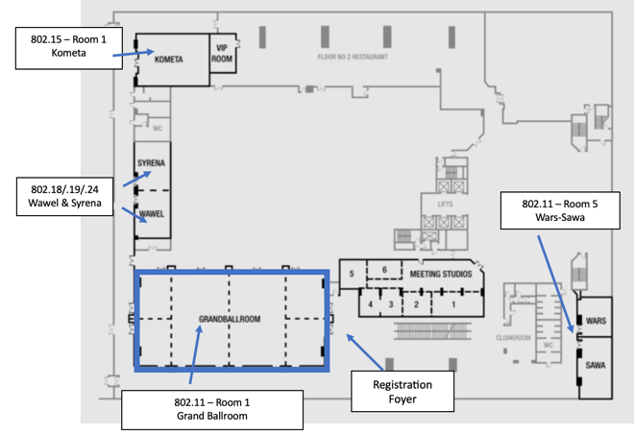
FLOOR PLAN: Level 2– Warsaw Presidential Hotel

Slide 3
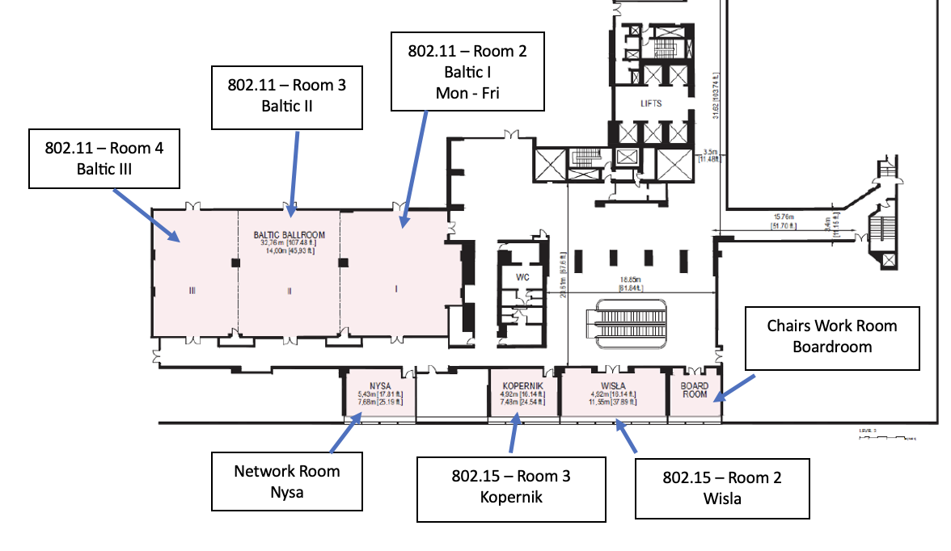
FLOOR PLAN: Level 3 - Warsaw Presidential Hotel

Slide 4
AUDIO VISUAL
AUDIO VISUAL:
The Audio Visual is being supplied by the Warsaw Presidential Hotel.
For any issues, please see a contact Sara or Daniel, MTG Events at the registration desk (sara@mtgevents.com.au, + 61418188488).
AUDIO IN MEETING ROOM
If you are a local participant, PLEASE, select “Don’t connect to audio” when joining the WebEx session. Connecting to the audio, may cause an audio feedback loop that prevents the meeting from proceeding.

Slide 5
IEEE 802 WIRELESS INTERIM –
NEWCOMER TRAINING
IN PERSON: 10:30am – 12:30am
Monday May 12 BALTIC III, 3rd Floor
REMOTE: IEEE 802 Calendar
https://ieee802.org/802tele_calendar.html
REGISTRATION FEE: Registration fee for the IEEE 802 Interim Session is required, whether attending in-person or remotely.

Slide 6
COMBINED SCHEDULE
IN PERSON Room Assignments: Schedule QR codes posted outside each meeting room and on the back of your name badge.
REMOTE Participation: https://ieee802.org/802tele_calendar.html
ATTENDANCE TOOL (IMAT) : https://imat.ieee.org/
REGISTRATION FEE REQUIREMENT REMINDER: Payment of the session registration fee is required for all who participate in any meetings associated with the 2025 May IEEE 802 Wireless Interim Session.

Slide 7
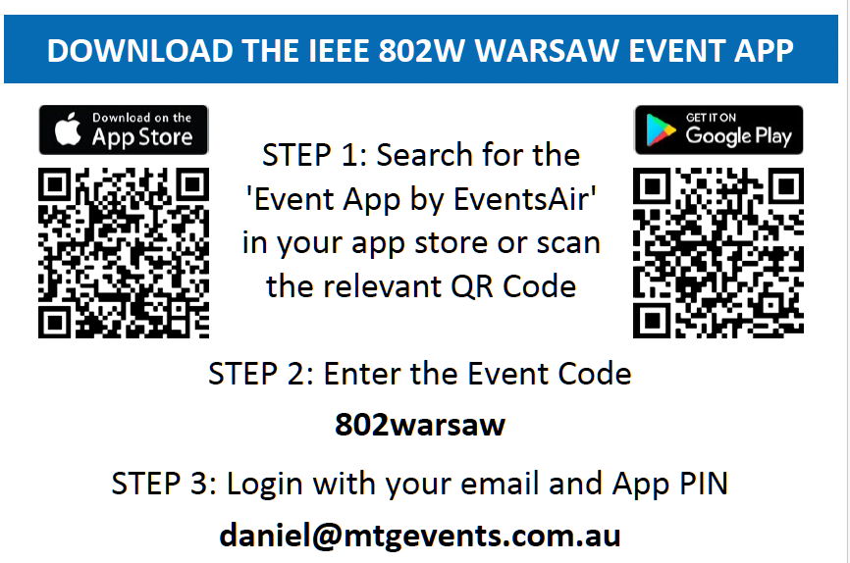
PROGRAM APP - Log in details for the IEEE 802 Wireless Interim Meeting App with combined schedule information is available on the back of your name badge. - Download the app by going to your Google Play or Apple App Store - Search for and install The Event App by EventsAIR - Load the app and enter The Event App Code: 802warsaw To get full functionality, please log in with your credentials

Slide 8
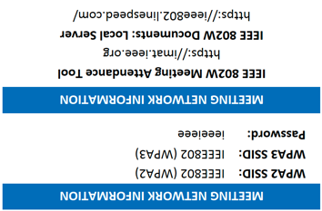
NETWORK ACCESS INFORMATION:
Local Document Server for IEEE 802W Documents:
http://ieee802.linespeed.com/
The network provider for the IEEE 802 Wireless Interim is Linespeed, who are located in in Nysa Room on Level 3 during the meeting.
Details on how to log into the network are printed on the back of your badge.

Slide 9
CATERING:
Breakfast: is included in your Hotel room rate if you booked at the Presidential using the meeting link.
Morning & Afternoon Tea: will be served from the foyer areas on levels 2 & 3.
Lunch: Monday - Thursday: will be served in the foyer areas on Levels 2 & 3
NB: Catering is for registered attendees

Slide 10
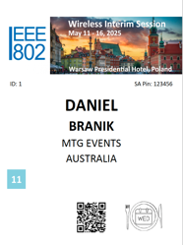
WEDNESDAY SOCIAL Wednesday May 14, 2025 Location: Concept 13 Restaurant, Concept 13 is on the roof of the Vitkac luxury department store (Level 5) and is a Michelin-recommended restaurant Transport: The Restaurant is 1 km away from the Hotel Coach: Meet at 6:30pm outside Warsaw Presidential Hotel for a coach Transfer Walk: walk the 1km/0.62 miles to the restaurant (approx. 10 min walk). Please arrive to the restaurant no later than 18:50 Return: return coaches will be provided to the Presidential Hotel from 21:00 Food: Alternate served sit down dinner Drinks included (No outside food or drinks permitted).
Please wear your name badge to the Social. Your ticket to the social is indicated on your name badge

Slide 11
The REGISTRATION DESK will be located on Level 2 Foyer, during the following times:
Sunday May 11 | 1330 - 1700
Monday May 12 | 0700 – 1700
Tuesday May 13 | 0730 – 1700
Wednesday May 14 | 0800 - 1700
Thursday May 15 | 0800 - 1700
Friday May 16, Level 3 Foyer | 0800 - 1200

Slide 12
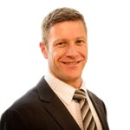
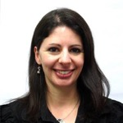
Any Questions Please see Daniel or Sara at the registration desk!
802wireless@mtgevents.com.au

