Slide 1
2025 March
IEEE 802 Plenary
Things to Know
Face to Face Events
IEEE 802 Plenary Meeting Planner
Email: 802info@facetoface-events.com

Slide 2
Meeting Planner Contact Information
Dawn Slykhouse, Face to Face Events
Mobile: +1 (408) 594-1342
Email: dawns@facetoface-events.com
Lisa Ronmark, Face to Face Events
Mobile: +1 (604) 316-4947
Email: lisa@facetoface-events.com
Stephanie Williams, Face to Face Events
Mobile: +1 (408) 497-9613
Email: stephanie@facetoface-events.com
Event Office
Room 201
2nd Floor
Office Hours
Sunday March 9th to Friday March 14th
General Email Inquiries
802info@facetoface-events.com

Slide 3
Network Vendor Contact Information
Onsite Network Support
Members of the Linespeed team can be dispatched by contacting the Meeting Planner directly or by placing a request at the event registration desk.
Linespeed Events Contact Information
Richard Alfvin
Mobile: +1 (585) 781-0952
Email: rick@linespeed.io
Network Vendor Office
Room 202
2nd Floor
Office Hours
Sunday March 9th to Friday March 14th
Local Document Server
http://ieee802.linespeed.com/

Slide 4
Audio Visual Equipment – Onsite Support
WHO TO CONTACT IF AUDIO VISUAL EQUIPMENT ISN’T WORKING IN YOUR ONSITE MEETING ROOM
Please contact the Meeting Planner directly if you have any issues with the audio visual equipment in your meeting room. The Meeting Planner will contact support and the appropriate technician will be sent to assist as soon as possible.
Meeting Planner can be reached at:
Registration and Information Desk: Pre Function Area, 2nd Floor
Registration Office: 201, 2nd Floor
Via Text or Call: Lisa Ronmark: +1 (604) 316-4947, Stephanie Williams +1 (408) 497-9613
WEBEX AUDIO IN THE ONSITE MEETING ROOM
If you are a local participant, PLEASE, select “Don’t connect to audio” when joining WebEx.
Connecting to the audio, may cause an audio interference or a feedback loop that will disrupt the meeting.

Slide 5
Name Badge Requirements & Pick Up
Name Badge Requirements
Photo ID Required for Pick Up
Session attendees must keep their attendance badges visible in the meeting and food and beverage break service spaces.
Hotel and security staff may request that an individual show a badge.
If an attendee does not have a badge, they can collect one at the event registration desk.
Name Badge Pick Up
Badges can be picked up at the Registration and Information desk located in the Pre Function area on the 2nd Floor of the Hilton Atlanta.
Sunday 5:00 PM – 7:30 PM
Monday – Wednesday 7:30 AM – 5:00 PM

Slide 6
IEEE 802 Mixed Mode Orientation
WHO: IEEE 802 WG Session Leaders (and all others interested)
WHAT: IEEE 802 Mixed Mode Meeting Orientation
How to run and participate in a mixed mode meeting.
WHEN: Sunday 09 March, 2:30 PM Eastern Time
ONSITE MEETING ROOM: 205/206, 2nd Floor
WEBEX: WebEx Link:
WebEX Meeting Number (access code):
Meeting password:
IEEE 802 CALENDAR https://ieee802.org/802tele_calendar.html
REGISTRATION FEE: Registration for the 802 Plenary Session (with fee) is required, whether attending in-person or remotely. Registration Link: https://cvent.me/q5le5L

Slide 7
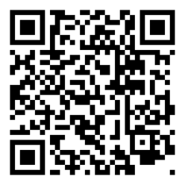
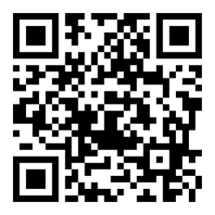
Schedule & Attendance
Schedule
Attendance
Onsite Meeting Rooms
Schedule QR codes posted outside each meeting room and on back of your badge.
http://schedule.802world.com/schedule/
Virtual Meeting Rooms
https://ieee802.org/802tele_calendar.html
IMAT Attendance Tool
Remember to log your attendance using the IMAT Attendance Tool.
https://imat.ieee.org/my-site/home
Registration Fee Reminder
Payment of the session registration fee is required for all individuals who participate in any meetings associated with the IEEE 802 Plenary Session.

Slide 8
Meeting Room Assignments
802.1
WG Room #1 302-303
WG Room #2 301
WG Room #3 308
WG Room #4* 204
*Shared Room
802.3
WG Room #1 Salon West
WG Room #2 212-213-214
WG Room #3 210-211
WG Room #4 209
802.11
WG Room #1 Salon East
WG Room #2 Grand Ballroom A
WG Room #3 Grand Ballroom B
WG Room #4 Grand Ballroom C
WG Room #5 205-206
802.15
WG Room #1 304-305
WG Room #2 306
WG Room #3 307
WG Room #4* 204
*Shared Room
802.15/18/19/24 - Shared Room
204
Subject to Change
While our goal is to keep the listed meeting room assignments throughout the session changes may occur based on WG requirements. Please check online for the most up to date schedule. http://schedule.802world.com/schedule/

Slide 9
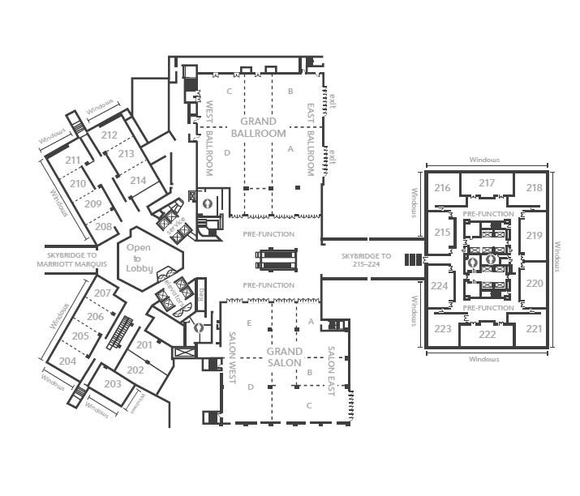
Meeting Room Map 2nd Floor

Slide 10
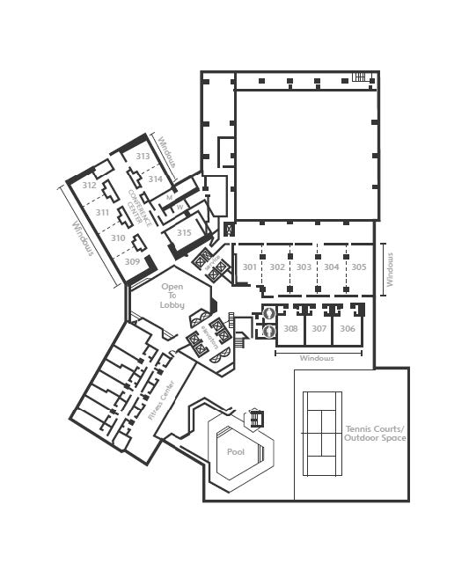
Meeting Room Map 3rd Floor

Slide 11
Attendee Food and Beverage
Breakfast
Monday – Thursday
7:15 – 8:30 AM, Crystal Ballroom
Friday
7:15 – 8:30 AM, PreFunction Area 2nd Floor
Lunch
Monday – Thursday
12:00 – 1:30 PM, Crystal Ballroom
AM Break
Monday – Thursday
9:50 – 10:35 AM, PreFunction Area
2nd Floor
PM Break
Monday – Thursday
3:15 – 4:00 PM, PreFunction Area
2nd Floor

Slide 12

Networking Social Event
Wednesday March 12, 2025
Georgia Aquarium
6:30 – 8:30 PM
Food, Beverage, Bus Transportation and Aquarium Admission Included
Tickets Required for All Attending
Available for $US24.99
Purchase at Plenary Session registration site.
  Modify Registration – Add Ticket
Food & Beverage Offerings
Buffet Dinner
Beverage Service
  Ticket provided w/ event badge.
NO OUTSIDE FOOD OR DRINK

Slide 13
Quick Start Guide to Atlanta, GA USA
Here is some information to help you enjoy your time in Atlanta, including:
Airport
Hartsfield Jackson International Airport (ATL) – https://www.atl.com/
  Security Wait Times
  Flight Information
  Getting To/From Airport: Transportation | ATL
General Guide to the Atlanta Region
Places to Eat: https://discoveratlanta.com/dining/main/
What kind of weather to expect in Atlanta, GA: Accu Weather Atlanta
For emergencies, call 911 immediately or visit an emergency care unit.
Currency: The US Dollar (USD) is used in Atlanta. Most places take Visa, Mastercard, and other major cards, or cash. Withdraw cash from the many ATMs around the city, or at a local currency exchange mart.
Time Zone
Time Zone: Eastern Time GMT -5 hours
Start of Daylight Savings Time Sunday, March 9, 2025,
  2:00:00 am clocks are turned forward 1 hour to Sunday, March 9, 2025, 3:00:00 am local daylight time instead.

Slide 14
2025 July 802 Plenary Session
Thanks for helping us make this session a success, we look forward to working with you again for the 2025 July Plenary!
Melia Castilla, Madrid Spain
Session Dates: Sunday July 27th through Friday August 1st, 2025
Participating Working Groups: 802.1, .3, .11, .15, 18, .19, .24
Hotel Reservations are available soon
Registration will be available in April 2025

