Slide 1
IEEE 802 February 2025 Public Visibility Standing Committee Report
February 2025

Slide 2
802 Public Visibility SC Scope, Duties, Membership
Scope and Duties
To raise public visibility and industry awareness in timely fashion of IEEE 802 WG / TAG activities
Develop social media content based on IEEE 802 WG / TAG activities
LinkedIn – https://www.linkedin.com/company/ieee802
IEEE-SA 802 - https://standards.ieee.org/featured/802/index.html
Content
Review Pre 802 Plenary meetings for social media messaging: PARs to be considered, Tutorials, [802.3] Call-for-Interests, New Task Force formations
Review Post 802 Plenary meetings for social media messaging: Study Group formations, IEEE 802 Position Approvals
Other 802 related material for social media messaging: Press Releases, White Paper publications, Other 802 approved news, 802 WG / TAG Activities with IEEE-SA
IEEE-SA Standards Board Related - PAR Approvals, Standards Approval, Standards Publication
Membership
Membership in the Standing Committee is open to anyone that wishes to participate (ideally at least one participant from each 802 WG and TAG)

Slide 3
Linkedin Report
https://www.linkedin.com/company/ieee802
4,967 total followers
Last 365 days
71717 Impressions
1508 Reactions
Latest Posts
January meeting reports
March Meeting
802.15 THz demo

Slide 4
IEEE Computer Society Standards Activities Board Seminar: Standards Development Opportunities & Leadership Experiences (Feb 20th, Tokyo and Online)
IEEE Computer Society’s Strategic Activities and Products including SWEBOK Guide
Hironori Washizaki (IEEE Computer Society President, Waseda University)
Introduction of IEEE Computer Society Standards Activities
Edward Au (IEEE Computer Society Vice President for Standards Activities)
Introduction of how to get involved in IEEE Standards Association and its standards development process Lei Wang (IEEE Standards Association Standards Board Chair)
Introduction of IEEE 802.11 (Wi-Fi) and how involvement in standards development shapes career
Dorothy Stanley (IEEE 802.11 Working Group Chair, IEEE Standards Association Board of Governors)
http://www.washi.cs.waseda.ac.jp/10133-2/

Slide 5
IEEE SA Standards Awards Nominations
Submit your nominations of deserving honorees today
https://standards.ieee.org/about/awards/nominate/
The nomination period is now open and will run until 31 July 2025.
IEEE SA CONFORMITY ASSESSMENT AWARD IEEE SA CORPORATE AWARD
IEEE SA STANDARDS BOARD DISTINGUISHED SERVICE AWARD
IEEE SA LIFETIME ACHIEVEMENT AWARD
IEEE SA INTERNATIONAL AWARD IEEE SA STANDARDS COMMITTEE AWARD FOR OUTSTANDING CONTRIBUTION TO ENTITY STANDARDS IEEE SA STANDARDS MEDALLION

Slide 6
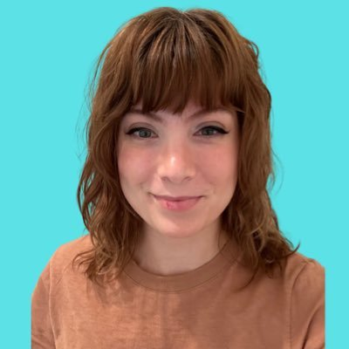
Reaching Young Engineer through Content Creators
Paul Nikolich introduced:
Lexie Cooper
TikTok https://www.tiktok.com/@tracketpacer
She works at Blue Origin as a Network Integration Engineer
Her Tik Tok channel has around 92K followers
Her content ranges from technical explanations to technical parody to cultural commentary with a technical lens.
Her primary area of expertise is in Ethernet, switching, and she has some familiarity with Wifi as well.

Slide 7
Possible 802 March Visit
She is interested to attend the March meeting Tuesday and Wednesday.
Paul and I are indicated that no recordings are allowed during sessions.
She would like to have some interviews with standards leaders and contributors.

Slide 8
Questions to IEEE 802 EC
What are your opinions of giving her an interview during the March meeting?
What are your opinions providing a fee waiver?

