Slide 1

IMPORTANT INFORMATION
IEEE 802 Wireless Interim Meeting
January 12 - 17, 2025
Kobe, JAPAN

Slide 2

HOLIDAYS / CEREMONIES to be aware of:
Monday 13 January 2025: National Holiday – Coming of Age Day (Seijin no Hi) in Japan is celebrated on the second Monday of January to mark the official coming of age for those who turn 20 during that calendar year. The holiday is celebrated at public facilities, traditional fashion across the country. Impact may only be increased people in streets as most have the day off school/work. (In Japan, you can vote, smoke and drink at 20.).
Thursday 16 / Friday 17 January 2025: 30th year anniversary of the Great Hanshin Earthquake – also known as the Hanshin Awaji Daishinsai (Great Earthquake) or Kobe earthquake. (date of earthquake: 17 January 1995. 5:46 JST. The earthquake strikes. It was 21:46 GMT on 16 January claiming 6,000 lives and over 40,000 injured and 300,000 people were left homeless.
  Time and Significance: At 5:46 AM on Friday 17th January, the exact moment when the earthquake struck in 1995, a minute of silence is observed in Kobe and surrounding areas to honor the lives lost and those affected by the disaster.
Notes:
While the overall mood is one of remembrance and solemn reflection, these activities also highlight the ongoing strength of the people in Kobe and the importance of disaster readiness, making the anniversary a mix of respectful commemoration and hopeful renewal.

Slide 3
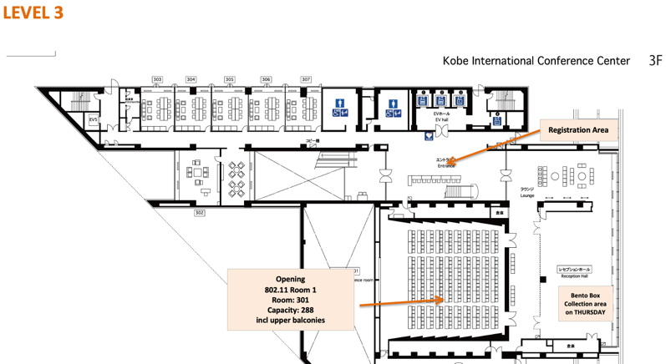
FLOOR PLAN: Level 3 Kobe Convention Centre

Slide 4
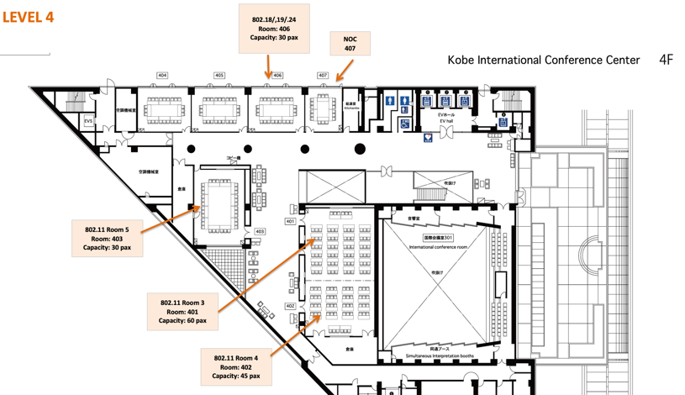
FLOOR PLAN: Level 4 Kobe Convention Centre

Slide 5
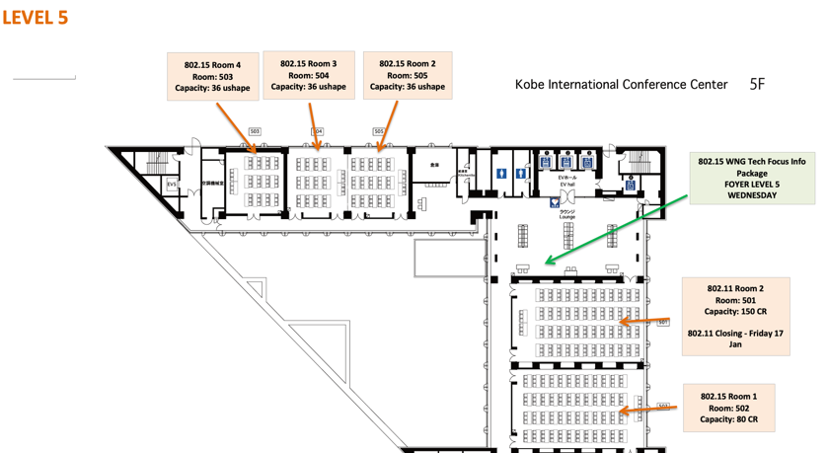
FLOOR PLAN: Level 5 Kobe Convention Centre

Slide 6
KOBE CONVENTION CENTRE
AUDIO VISUAL:
The Audio Visual is being supplied by the Kobe Convention Centre.
For any issues, please see a contact Sara or Daniel, MTG Events at the registration desk (sara@mtgevents.com.au, + 61418188488).
AUDIO IN MEETING ROOM
If you are a local participant, PLEASE, select “Don’t connect to audio” when joining the WebEx session. Connecting to the audio, may cause an audio feedback loop that prevents the meeting from proceeding.

Slide 7
KOBE CONVENTION CENTRE
CONVENTION CENTRE CLOSING TIME
The Kobe Convention Centre closes at 9pm each day.
Please ensure you have left the building by 9pm.
CLEANING
Please make sure you put your rubbish in the bin.
We do not have cleaners throughout the day.
Please clean up after yourself.
Notes:
Your mother is not here! Clean up after yourself

Slide 8
IEEE 802 WIRELESS INTERIM –
NEWCOMER TRAINING
IN PERSON: 1030am – 1230am
Monday January 13 ROOM 402, 4th Floor
REMOTE: IEEE 802 Calendar
https://ieee802.org/802tele_calendar.html
REGISTRATION FEE: Registration fee for the IEEE 802 Interim Session is required, whether attending in-person or remotely.

Slide 9
COMBINED SCHEDULE
IN PERSON Room Assignments: Schedule QR codes posted outside each meeting room and on the back of your name badge.
REMOTE Participation: https://ieee802.org/802tele_calendar.html
ATTENDANCE TOOL (IMAT) : https://imat.ieee.org/
REGISTRATION FEE REQUIREMENT REMINDER: Payment of the session registration fee is required for all who participate in any meetings associated with the 2025 January IEEE 802 Wireless Interim Session.

Slide 10
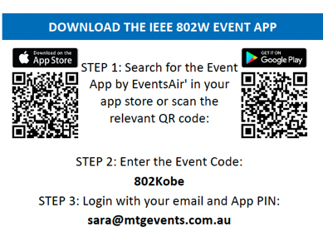
PROGRAM APP
- Log in details for the IEEE 802 Wireless Interim Meeting App with combined schedule information is available on the back of your name badge.
- Download the app by going to your Google Play or Apple App Store
- Search for and install The Event App by EventsAIR
- Load the app and enter The Event App Code: 802kobe
To get full functionality, please log in with your credentials

Slide 11
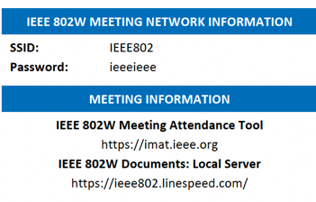
NETWORK ACCESS INFORMATION:
Local Document Server for IEEE 802W Documents:
http://ieee802.linespeed.com/
The network provider for the IEEE 802 Wireless Interim is Linespeed, who are located in in Room 407 on Level 4 during the meeting.
Details on how to log into the network are printed on the back of your badge.

Slide 12
CATERING:
  Breakfast: is included in your Hotel room rate if you booked at one of the 3 hotels offered.
  Morning & Afternoon Tea: will be served from the foyer areas on all 3 levels: Level 3, 4 and 5.
  Lunch: Monday - Wednesday: will be held in the Ohwada Ballroom of the Portopia Hotel – South Wing 1F (level 1)
  Lunch: Thursday: will be Bento Boxes, handed out on Level 3 of the Kobe Convention Centre
  NB: Catering is for registered attendees

Slide 13

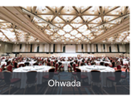
LUNCH - MONDAY, TUESDAY & WEDNESDAY
  Buffet lunch will be held in the Ohwada Ballroom of the Portopia Hotel, near the Portopia Hall
  TIME: 12:00 noon – 2:00pm
  Ohwada Ballroom is located on the 1st Floor of the South Wing of the Portopia Hotel
  Please allow 5-10min to walk to the Ohwada Ballroom
  Staff will be in place to direct along the pathway
  Access Portopia Hotel via the skybridge on Level 2 of the Kobe Convention Centre

Slide 14
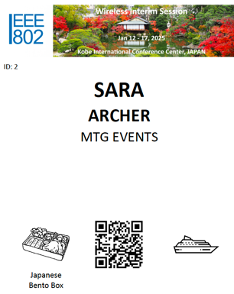
LUNCH - THURSDAY:
  Lunch: Thursday: will be Bento Boxes, handed out on Level 3 of the Kobe Convention Centre
  The type of Bento Box selected at registration is indicated at the bottom of your name.

Slide 15

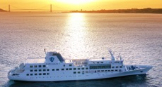
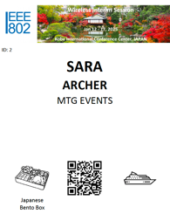
WEDNESDAY SOCIAL
Wednesday September 15, 2025
Time: 6:10pm - 6:30pm: Buses load from Portopia Hotel
6:40pm – 7:00pm: Ship Boarding
7:00pm – 9:00pm: Cruise
9:00pm: Buses return to Portopia Hotel
Entertainment: Awa Odori (Japanese traditional team dance), Traditional Lion Dance & Kampai Ceremony
Tickets: $24.99
Food: Buffet of Local Japanese Food & Drinks & Sake
4 Dining Rooms
(No outside food or drinks permitted).
Please wear your name badge to the Social. Your ticket is indicated on your badge

Slide 16

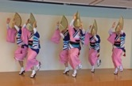
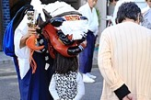
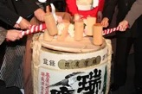
WEDNESDAY SOCIAL, cont..
Wednesday September 15, 2025
Program
19:00 Opening Ceremony
Welcome Kampai
on B-Deck
19:15 Dinner @ A-C Deck with
Shishimai dance
20:10 Awaodori Dance on B-Deck
& 20:35
21:00 Bus back to Portopia
Open deck
92
90
104
114

Slide 17



WEDNESDAY SOCIAL, cont..
Wednesday September 15, 2025
About Awaodori
Awaodori is a Bon dance with a history of over 400 years, originating in Awa Province, present-day Tokushima Prefecture.
There are various theories as to its origins, but it is believed that the Bon Odori dance was the basis for incorporating folk performing arts and becoming established as a traditional performing art of Tokushima.
The musical instruments used in Awa Odori are called “narimonos,” which basically consist of six instruments (flutes, shamisen, drums, etc.) and their players, and are an essential part of Awa Odori as a complement to the dance.
The dance group is called “ ren,” and there are many ren throughout Tokushima Prefecture and the rest of Japan, with the fast and slow tempos and other characteristics of each ren.
It is one of the three major festivals in Shikoku and is also known as one of the three major Bon dances in Japan.
About Shishimai
Shishimai is one of Japan's traditional performing arts, in which lions dance to the accompaniment of festival music.
There are various theories as to its origin, but it is believed to have come to Japan from China or India, where it took root.
In Japan, the dance was first performed at New Year's in the country of Ise in the early 16th century to ward off famine and epidemics.
It is said that being bitten on the head by a lion dance is an exorcism to ward off bad luck, and that the person will live a life free from illness and disease.

Slide 18



KOBE SIGHTSEEING

Slide 19
The REGISTRATION DESK will be located in the Foyer level 3, during the following times:
Sunday January 12 | 1330 - 1700
Monday January 13 | 0700 – 1700
Tuesday January 14 | 0730 – 1700
Wednesday January 15 | 0800 - 1700
Thursday January 16 | 0800 - 1700
Friday January 17, on Level 5 | 0800 - 1200

Slide 20

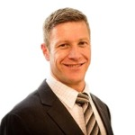
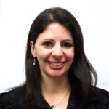

Any Questions
Please see Daniel or Sara on the registration desk!
ieee802@mtgevents.com.au

