Slide 1
IEEE LMSC 10/1/24
40th Anniversary of FCC Unlicensed ISM Band Decision
Michael J. Marcus, Sc.D., F-IEEE
Adjunct Professor/Lecturer, Department of Electrical and Computer Engineering
Principal Research Scientist, Institute for the Wireless Internet of Things
Northeastern University
m.marcus@northeastern.edu
www.northeastern.edu/wiot
N3JMM/7J1AKO

Slide 2
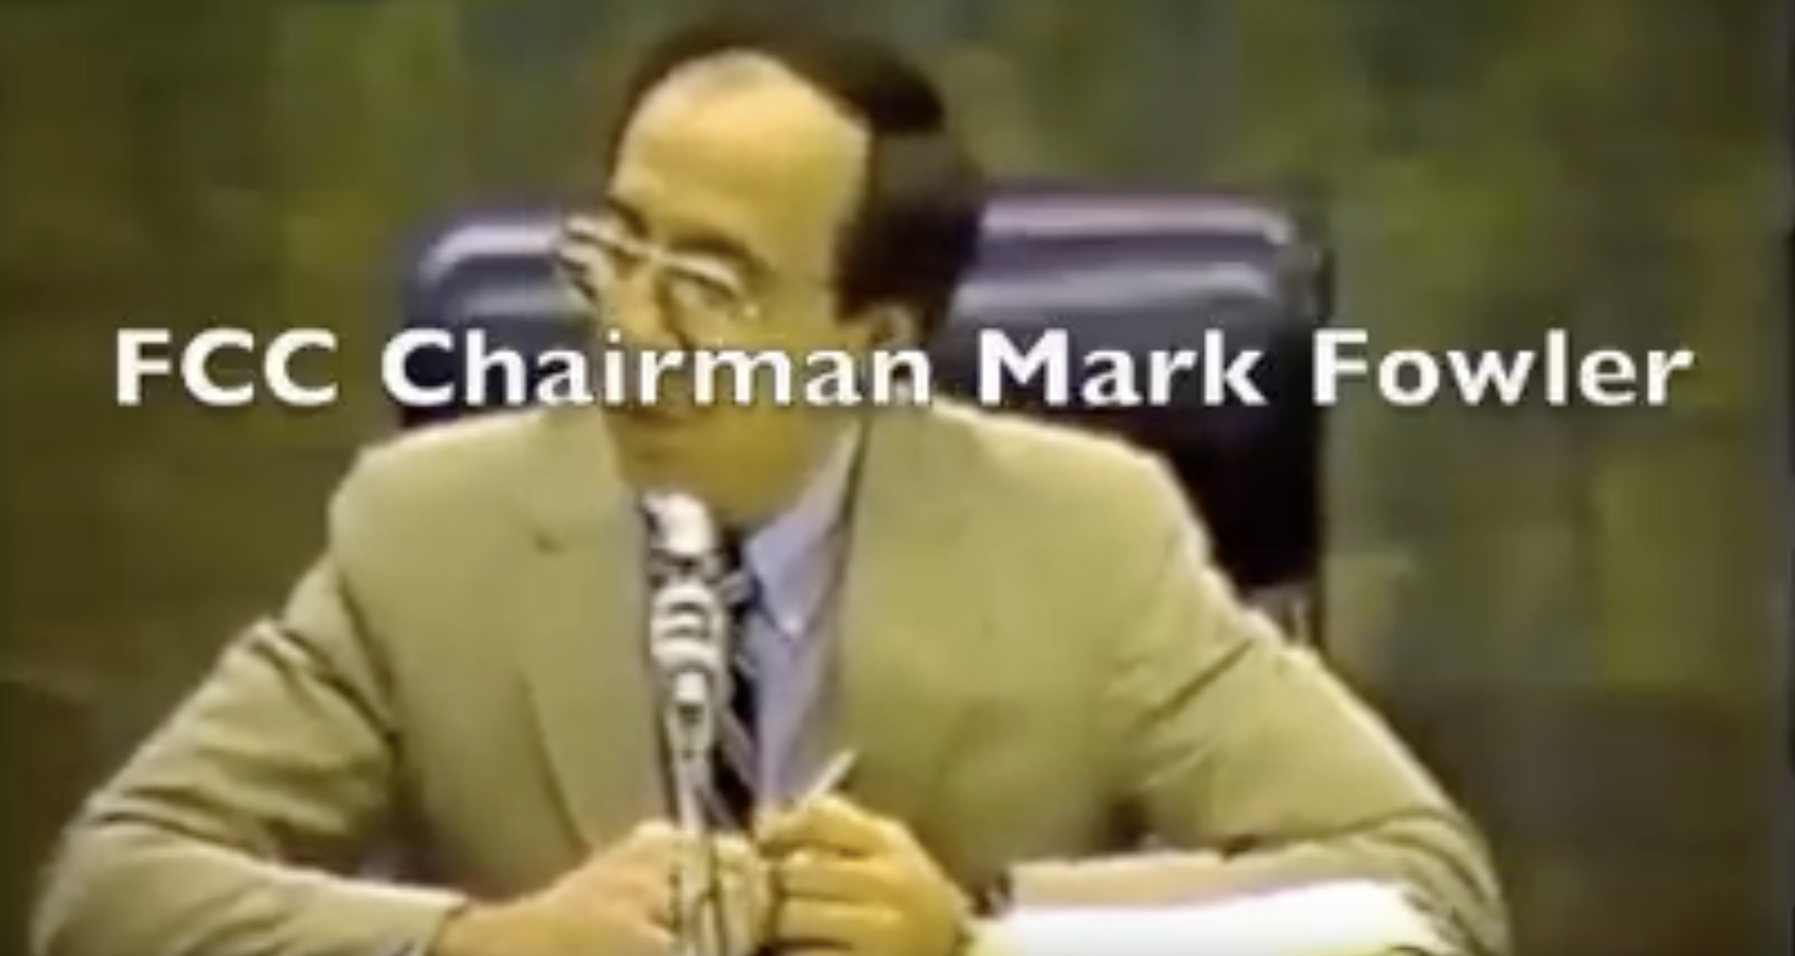
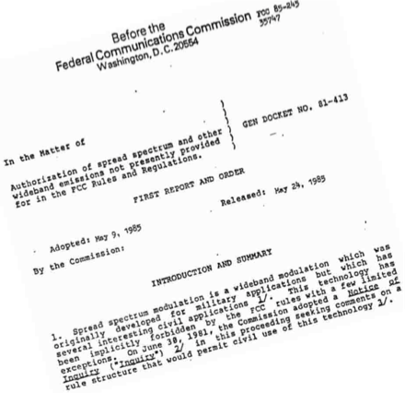
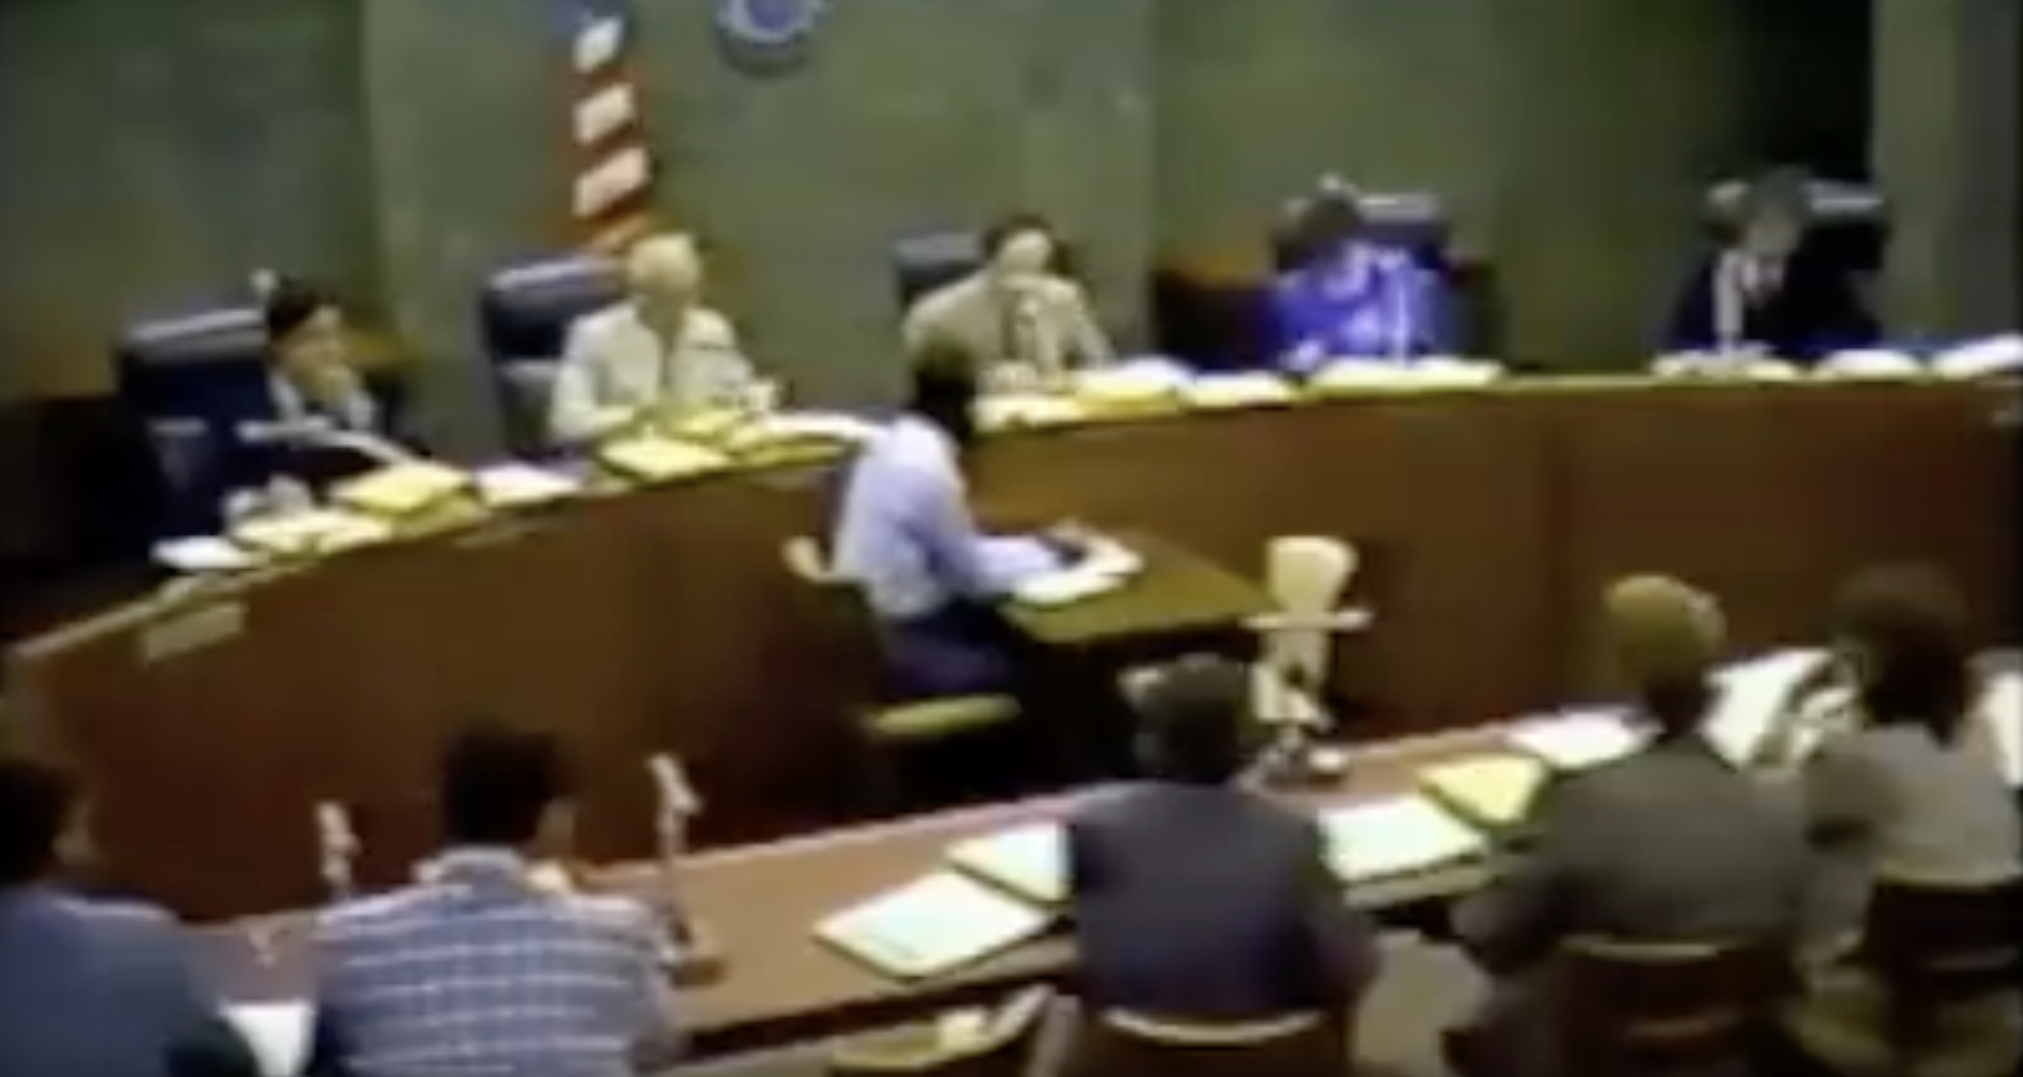
May 9, 1985 – FCC approves unlicensed ISM bands at 900 MHz, 2.4 GHz & 5.7 GHz
Your thoughts on comments?
Video:
https://youtu.be/Z0xhFrCl1HQ?si=2Lzsku85-ZL4cHeM
Text:
https://archives.federalregister.gov/issue_slice/1985/6/18/25229-25241.pdf#page=6

Slide 3
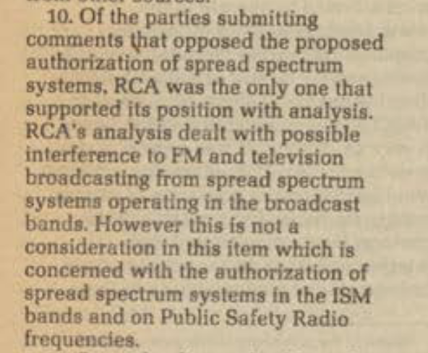
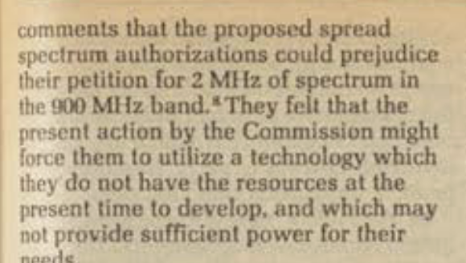
Opposed by virtually all spectrum incumbents
Many parties had various reasons to oppose – NIMBY
Only RCA tried to rationalize with analysis
Comments of CTA’s predecessor, EIA

Slide 4
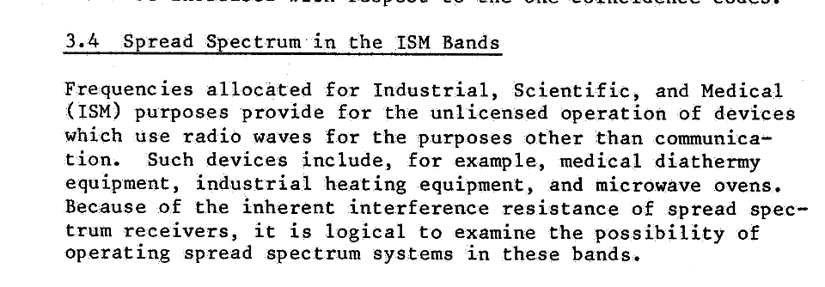
Fortunately, FCC had asked MITRE for a study
While FCC original interest had focused on use of spread spectrum – a technology implicitly prohibited by FCC’s FDMA-focused rules, MITRE mentioned parenthetically (p. 3-35 – 3-29)
Stated differently, “microwave ovens never call in interference complaints!”
https://apps.dtic.mil/sti/pdfs/AD1107109.pdf

Slide 5
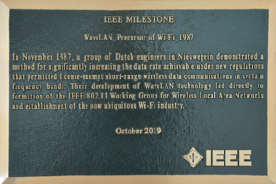
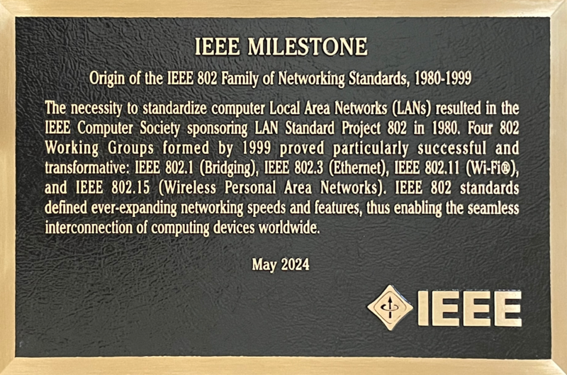
IEEE Milestone Program
“The IEEE Milestones program honors significant technical achievements in all areas associated with IEEE. It is a program of the IEEE History Committee, administered through the IEEE History Center. Milestones recognize the technological innovation and excellence for the benefit of humanity found in unique products, services, seminal papers and patents.”
https://ethw.org/Milestones:IEEE_Milestones_Program

Slide 6
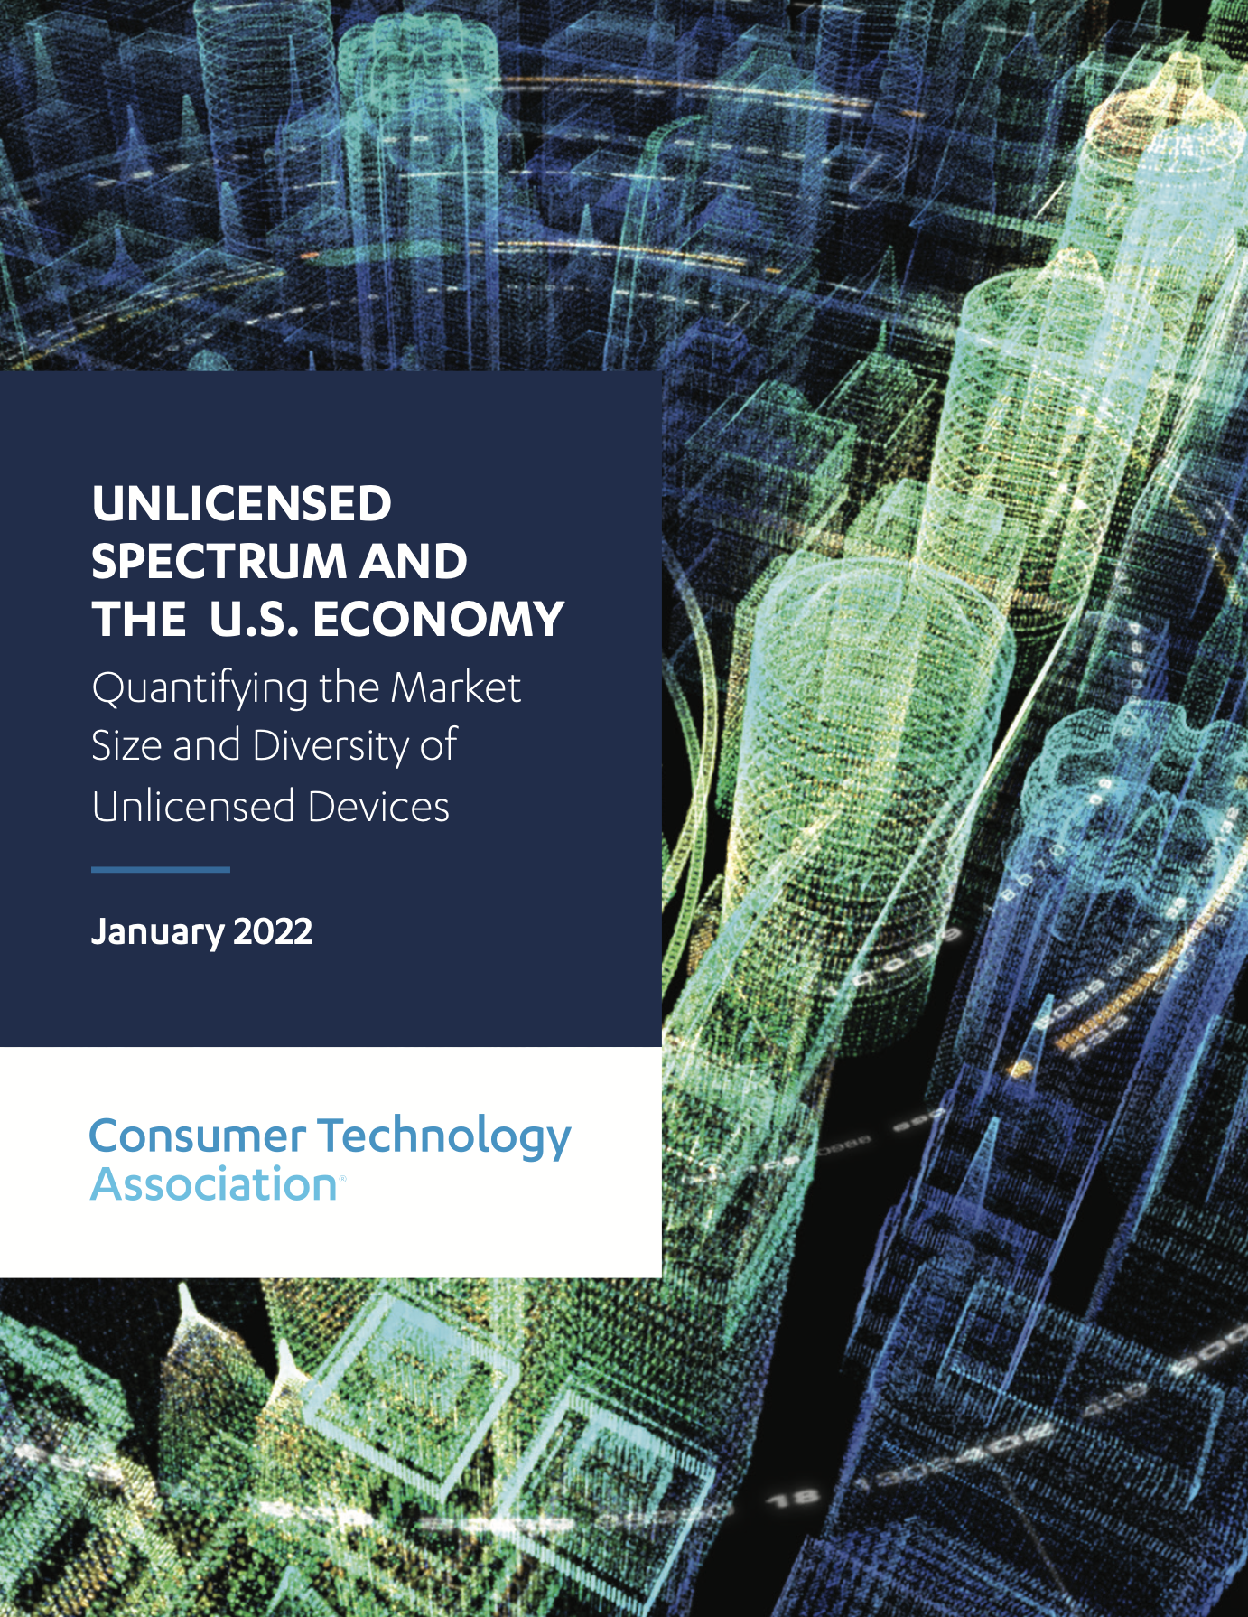
Impact of FCC Unlicensed ISM Band Decision
CTA Report
https://shop.cta.tech/products/unlicensed-spectrum-and-the-us-economy-quantifying-the-market-size-and-diversity-of-unlicensed-devices
“Unlicensed spectrum — more broadly, “permissionless” spectrum as discussed in Section 2.1 — has become a critical element of infrastructure in the United States. As a natural consequence of this importance, products using this spectrum also contribute significantly to the U.S. economy’s bottom line.”
“CTA estimates that permissionless spectrum generates $95.8 billion per year in incremental sales value (ISV) at retail”

Slide 7
Impact of FCC Unlicensed ISM Band Decision
CTA Report
Wi-Fi and Bluetooth® are a sizable portion of the overall market, but the unlicensed story continues through medical devices, automatic vehicle identification systems, wireless microphones, near field communications (NFC)-enabled contactless payment, consumer radar devices and many more. The products in this vast landscape of permissionless-enabled applications have an important role to play, in practice and in the economy.

Slide 8
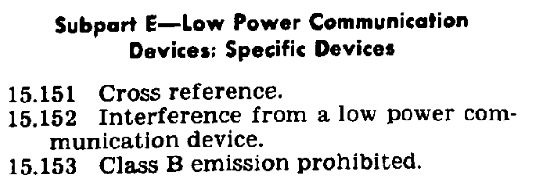
Part 15 in 1982
https://tile.loc.gov/storage-services/service/ll/cfr/cf/r1/98/21/64/-T/47/CI/P1/5/cfr1982164-T47CIP15/cfr1982164-T47CIP15.pdf
• Each item was very narrow
and had little transmitter power
• New items required a petition
disclosing market plans and
several years of public deliberations
• Unresponsive to new needs and
niche applications
•RLANs were viewed initially as a
niche application until Ethernet
suddenly proliferated!
• Prevented market surprises
to major market players

Slide 9
Possible Commemoration of 5/85 Events
IEEE Milestone Plaque at FCC
Nice companion for Emmy received for “Incentive Auction”
https://docs.fcc.gov/public/attachments/DOC-400749A1.pdf
Possible citation:
Designation of Unlicensed ISM Bands for Permissionless Innovation
On May 9, 1985, FCC made a major policy change for unlicensed radio spectrum recognizing that new spread spectrum technology did not need case by case approval for new uses in bands used for ISM e.g. microwave ovens. Within a few years this allowed rapid innovation including Wi-Fi and Bluetooth and became a common policy around the world

Slide 10
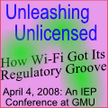
Possible Commemoration of 5/85 Events
Symposium on 1985 decision and its impact today
Update of 2008 “Unleashing Unlicensed”
https://www.clemson.edu/centers-institutes/iep/conferences-events/genesis-unlicensed-wireless-policy.html
Possible cosponsors;
Wi-Fi Alliance
NCTA
MITRE
CTA

