Slide 1
Kobe Interim Summary
Date: 2024-01-11
Authors:

Slide 2
Abstract
This file contains the summary accommodation information for 2025 Jan Kobe Interim meeting.

Slide 3
Portpia
Ms. Masako Kido, m_kido@portopia.co.jp
1. Room Type and Rate
  (Room Type)
Twin or Double room for Single Use (Run of House)
  (Rate)
    21,450JPY per person, including Breakfast, Tax, and Service Charge
2. Cancel policy
  20 days before 10%
  9 days before 20%
  1 day before 80%
  On the day of arrival 100%
  No Show 100%
  Cancellation fees are calculated as a percentage of the daily room charge.
  The same applies to early check-outs during consecutive nights.
3. Additional changes（Single-use → 2 Person）
For guests who wish to stay in a twin or double room with your companion, by double use,
  the rates are as follows ;
<Twin or Double Room>Includes Breakfast, Tax and Service Charges
21,450JPY Twin or Double room (Weekday days - Single occupancy)
28,050JPY Twin or Double room (Weekend days - Single occupancy)
26,400JPY Twin or Double room (Weekday days - Two occupants)
39,600JPY Twin or Double room (Weekend days - Two occupants)
* An additional rate of 4,950JPY from the single-use rate will be required

Slide 4
Ariston
Mr. Atsushi Takanashi ryoin.m.kobe@aristonhotels.co.jp
1. Room Type and Rate
  (Room Type)
    Twin room for single-use
  (Rate)
    11,850 JPY per person, including Breakfast, Tax, and Service Charge
2. Cancel policy
  30 days before 20%
  6 days before 50%
  1 day before 100%
  On the day of arrival 100%
  No Show 100%
  Cancellation fees are calculated as a percentage of the daily room charge.
  The same applies to early check-outs during consecutive nights.
3. Additional changes（Single-use → 2 Person）
For guests who wish to stay in a twin or double room with their companion by double use,
  the rates are as follows ;
<Twin Room>
  17,400 JPY/per room, including Breakfast, Tax and Service Charge
  * An additional rate of 5,550JPY from the single-use rate will be required for a companion in the room

Slide 5
Pearl City
Mr.Kensaku Ochi, ochi.k@hmihotelgroup.com
1. Room Type and Rate
  (Room Type)
    Twin room for single-use
  (Rate)
    16,500 JPY per person, including Breakfast, Tax, and Service Charge, Jan 11th –Jan 12th
    14,300 JPY per person, including Breakfast, Tax, and Service Charge, Jan 13th –Jan 17th
2. Cancel policy
  1 day before 20%
  On the day of arrival 80%
  No Show 100%
  Cancellation fees are calculated as a percentage of the daily room charge.
  The same applies to early check-outs during consecutive nights.
3. Additional changes（Single-use → 2 Person）
For guests who wish to stay in a twin or double room with your companion, by double use,
  the rates are as follows ;
<Twin Room>
  17,600 JPY per room, including Breakfast, Tax, and Service Charge, Jan 11th –Jan 12th
  * An additional rate of 1,100 JPY from the single-use rate will be required
  15,400 JPY per room, including Breakfast, Tax, and Service Charge, Jan 13th –Jan 17th
  An additional rate of 1,100 JPY from the single-use rate will be required¥

Slide 6
Reservation Page
All three hotels will provide a reservation page by Mid of Oct linked from meeting registration page, and it will be closed by 2024/12/11.
Adjustments will be made if the fulfillment of reservations is not satisfactory.

Slide 7
The contract with KCVC(Kobe Convention Center).
Current Status
Japanese Volunteer Committee (same as myself) had signed the application form for KCVC.
This sign-up means the Japanese Volunteer Committee accepts the condition of the KCVC use term.
Attached is the English translation of the term, which includes the canceling policy and all other relevant conditions.
However, there is some confusion regarding the payment condition, which needs to be addressed.
In the case of a Japanese applicant, we do not need a pay deposit, and payment will be made after the event. This is cleared by e-mail between KVCC and me.
No additional terms or a formal letter from KCVC is required.

Slide 8
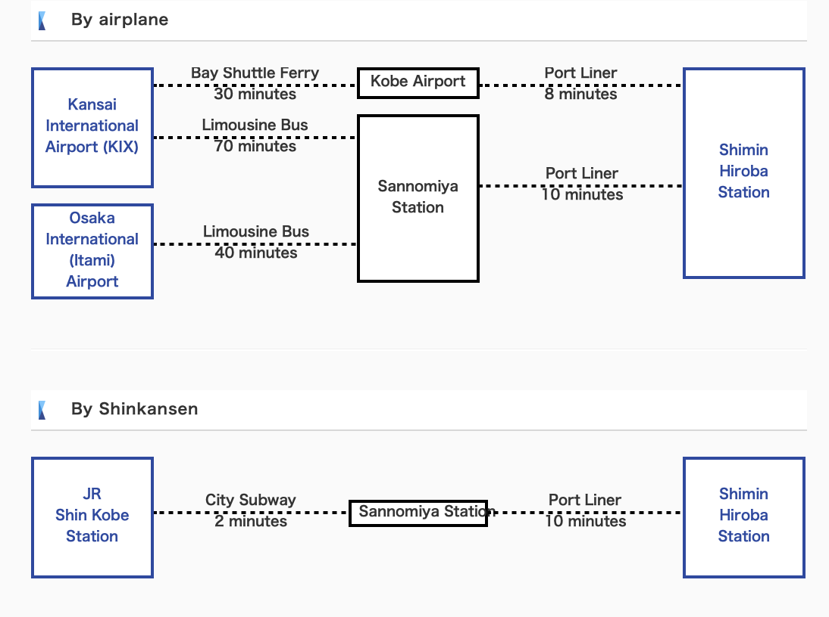


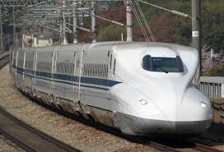
How to get to Kobe https://kobe-cc.jp/en/visitors/access/
70min
Skymark or ANA
70min
JAL/ANA/etc,.
HND
Haneda
30min
NRT
Narita
JR
Tokyo
60min
3h

Slide 9
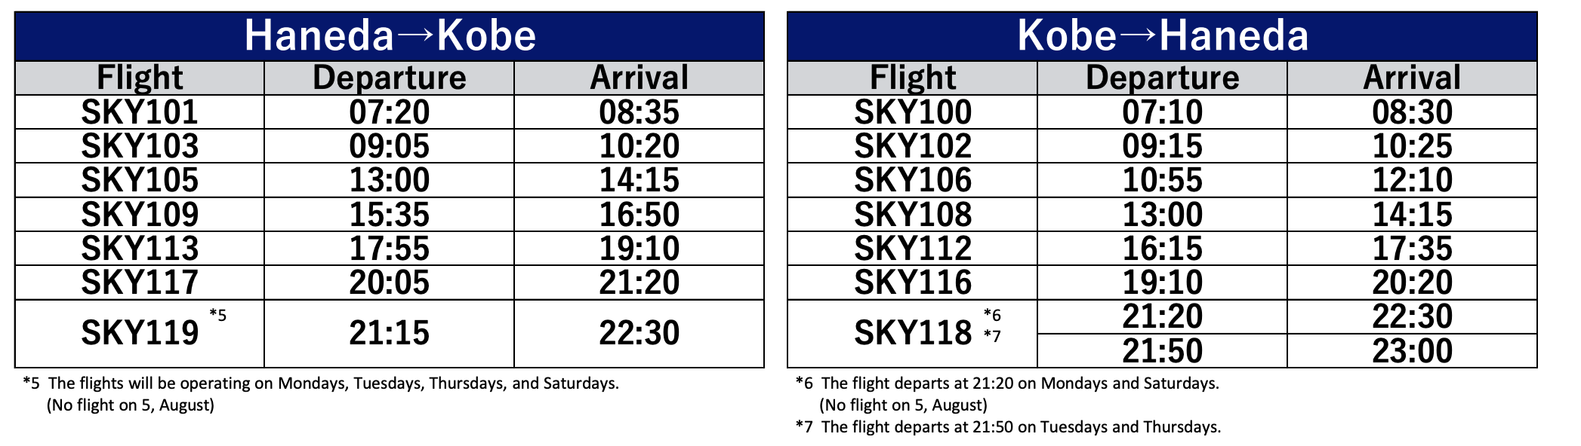
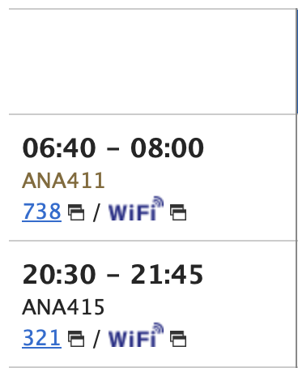
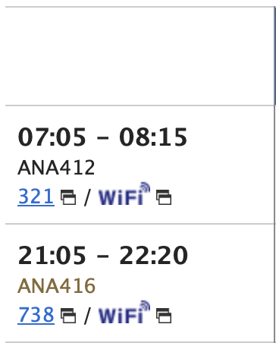
Flight to Kobe from Tokyo HND
https://www.skymark.co.jp/en/
http://ana.co.jp
HND-Kobe
Kobe-HND

Slide 10

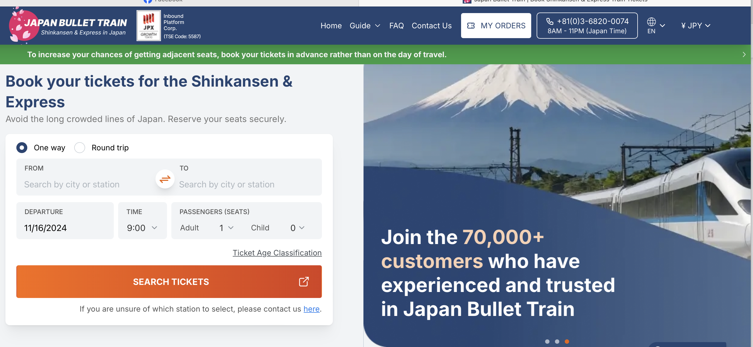
Shinkansen Bullettrain
Rail Pass
https://www.jrailpass.com/
Single ticket
https://www.japan-bullettrain.com/

Slide 11
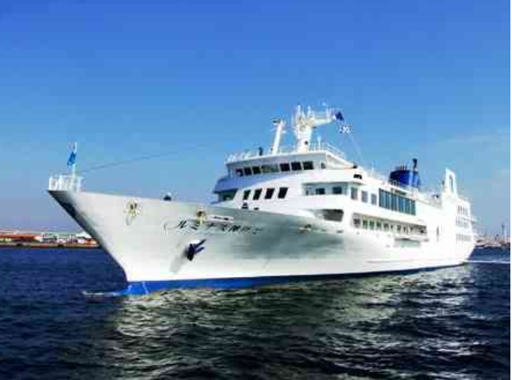
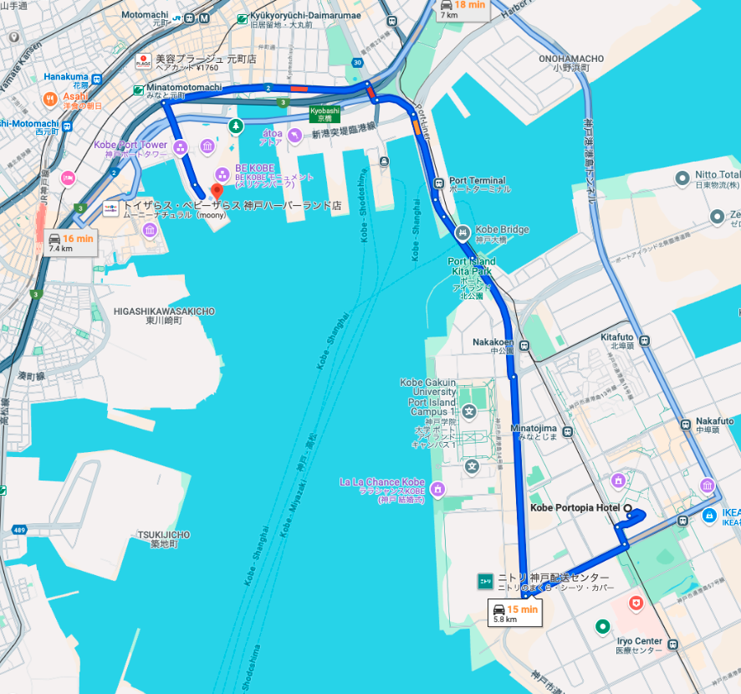
Social at Kobe cruiser
https://thekobecruise.com/concerto/luminous-photo
Luminous2 wholly charter
One of the Largest Restaurant Cruises in Japan
Six rooms of various sizes on board the 106-meter-long, 4,778-ton ship
Awa Odori (Japanese traditional team dance)
Schedule: 18:00-18:30 transportation by BUS from Portpia Hotel
18:30-19:00 Boarding boat
19:00-21:00 Cruising
21:00- returning to Portpia Hotel by BUS

Slide 12
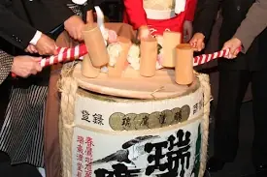
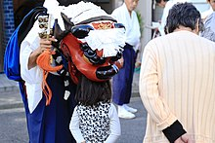
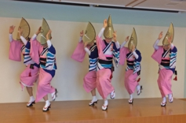
92
Program
19:00 Opening Ceremony
Welcome Kampai
Carib@B-Deck
19:15 Breakout
Dinner @ A-C Deck
with Shishimai dance
20:20
Awaodori dance
Carib@B-Deck
21:00 Back to Kobe port
1, 84
2, 24 officer waiting room
3, standing for ceremony
4, 88
5, 124
6, 72+ Counter
Total table
368
Open deck
90
104
114

Slide 13
Lunch Mon-Wed @ Portpia Hotel

Slide 14
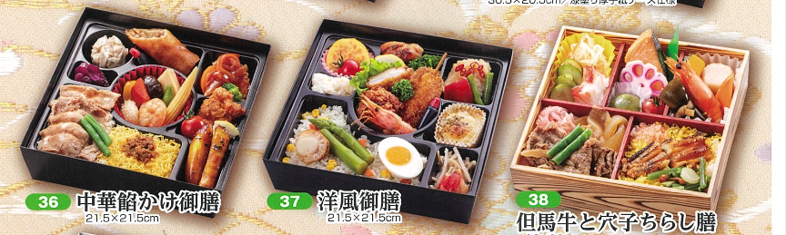
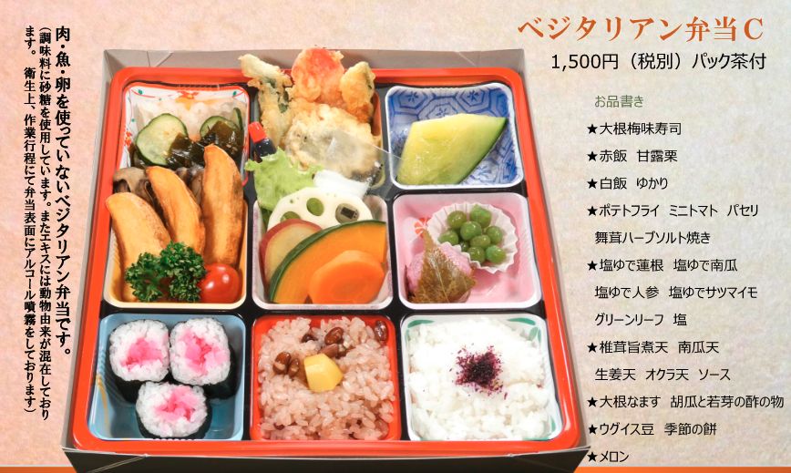
Bento Box on Thursday
We will provide Japanese Bento Box lunch on Thursday at the convention center.

Slide 15
Payment Scheme
IEEE 802 Wireless Interim Sponsor Committee
Treasure
(Japan volunteer group)
¥・・・・
KVCC
Convention facilities
Lunch Box on Thursday
IEEE 802 Wireless
Treasure
¥・・・・
Social party cruise
USD$ TBD
Kobe cruiser
¥・・・・
Teisan BUS
Bus transportation for Social
City of Kobe
MISE
¥2,621,990
¥・・・・
Portpia Hotel
Lunch Mon,Tue,Wed
USD$・・・・
MTG Event
The Nakauchi Foundation
¥2,500,000
¥・・・・
miscellaneous expense
Entertainment on Social, etc,.
¥・・・・
Auditor
Audit for funding support
Hiroshi Mano (Koden TI)

Slide 16
Estimation cost (only for inside Japan)
Hiroshi Mano (Koden TI)

Slide 17
Outreach workshop
Registration page
https://events.vtools.ieee.org/m/423118
Organizer: Japanese Volunteer Committee
Date: 2025/01/11 Sat (day before the interim)
Attendance: 100 max
Program:
13:00-13:20 Opening remarks
13:20-14:00 Introducing LMSC / Dorothy Stanley
14:00-14:20 Introducing 802.11 / Stephen McCann
14:20-14:40 Introducing 802.15 / Phil Beecher
14:40-15:00 Introducing 802.18 / Dorothy Stanley
15:00-15:20 Introducing 802.19 Tuncer Baykas
15:20-15:30 Coffee Break
15:30-16:00 Tutorial to Join Standard Activity / Hiroshi Mano
16:00-17:00 Panel Discussion / Moderated Hiroshi Mano / Panelist : all of speakers
17:00-17:15 Closing
17:30- Social party
Treasurer
  Japanese Volunteer Committee provides all of the expenses for this workshop.
Notes:
From 802 WCSC Ops Man 2.5: All decisions related to or affecting the Joint Treasury shall be delegated to the Executive Committee of the Joint Treasury. Examples of such decisions include approval to spend funds and venue selection.

Slide 18
Quantity
 | Booked | Additional | Total
Western Style | 40 | 10 | 50
Vegetarian Style | 38 | 10 | 48
Japanese Style | 270 | 20 | 290
Chinese Style | 52 | 10 | 62
TOTAL | 400 | 50 | 450
IN-person 413+ 7 staff
Social ticket 360

