Slide 1
Kobe Interim Summary
Date: 2024-09-08
Authors:

Slide 2
Abstract
This file contains the summary accommodation information for 2025 Jan Kobe Interim meeting.

Slide 3
Portpia Ms. Masako Kido, m_kido@portopia.co.jp
1. Room Type and Rate
(Room Type)
Twin or Double room for Single Use (Run of House)
(Rate)
21,450JPY per person, including Breakfast, Tax, and Service Charge
2. Cancel policy
20 days before 10%
9 days before 20%
1 day before 80%
On the day of arrival 100%
No Show 100%
Cancellation fees are calculated as a percentage of the daily room charge.
The same applies to early check-outs during consecutive nights.
3. Additional changes（Single-use → 2 Person）
For guests who wish to stay in a twin or double room with your companion, by double use,
the rates are as follows ;
<Twin or Double Room>
26,400JPY/per room, including Breakfast, Tax, and Service Charge
* An additional rate of 4,950JPY from the single-use rate will be required

Slide 4
Ariston Mr. Atsushi Takanashi ryoin.m.kobe@aristonhotels.co.jp
1. Room Type and Rate
(Room Type)
Twin room for single-use
(Rate)
11,850 JPY per person, including Breakfast, Tax, and Service Charge
2. Cancel policy
30 days before 20%
6 days before 50%
1 day before 100%
On the day of arrival 100%
No Show 100%
Cancellation fees are calculated as a percentage of the daily room charge.
The same applies to early check-outs during consecutive nights.
3. Additional changes（Single-use → 2 Person）
For guests who wish to stay in a twin or double room with their companion by double use,
the rates are as follows ;
<Twin Room>
17,400 JPY/per room, including Breakfast, Tax and Service Charge
* An additional rate of 5,550JPY from the single-use rate will be required for a companion in the room

Slide 5
Pearl City Mr.Kensaku Ochi, ochi.k@hmihotelgroup.com
1. Room Type and Rate
(Room Type)
Twin room for single-use
(Rate)
16,500 JPY per person, including Breakfast, Tax, and Service Charge, Jan 11th –Jan 12th
14,300 JPY per person, including Breakfast, Tax, and Service Charge, Jan 13th –Jan 17th
2. Cancel policy
1 day before 20%
On the day of arrival 80%
No Show 100%
Cancellation fees are calculated as a percentage of the daily room charge.
The same applies to early check-outs during consecutive nights.
3. Additional changes（Single-use → 2 Person）
For guests who wish to stay in a twin or double room with your companion, by double use,
the rates are as follows ;
<Twin Room>
17,600 JPY per room, including Breakfast, Tax, and Service Charge, Jan 11th –Jan 12th
* An additional rate of 1,100 JPY from the single-use rate will be required
15,400 JPY per room, including Breakfast, Tax, and Service Charge, Jan 13th –Jan 17th
An additional rate of 1,100 JPY from the single-use rate will be required¥

Slide 6
Reservation Page
All three hotels will provide a reservation page by Mid of Sep linked from meeting registration page, and it will be closed by 2024/12/11.
Adjustments will be made if the fulfillment of reservations is not satisfactory.

Slide 7
The contract with KCVC(Kobe Convention Center).
Current Status Japanese Volunteer Committee (same as myself) had signed the application form for KCVC. This sign-up means the Japanese Volunteer Committee accepts the condition of the KCVC use term. Attached is the English translation of the term, which includes the canceling policy and all other relevant conditions. However, there is some confusion regarding the payment condition, which needs to be addressed. In the case of a Japanese applicant, we do not need a pay deposit, and payment will be made after the event. This is cleared by e-mail between KVCC and me.
No additional terms or a formal letter from KCVC is required.

Slide 8
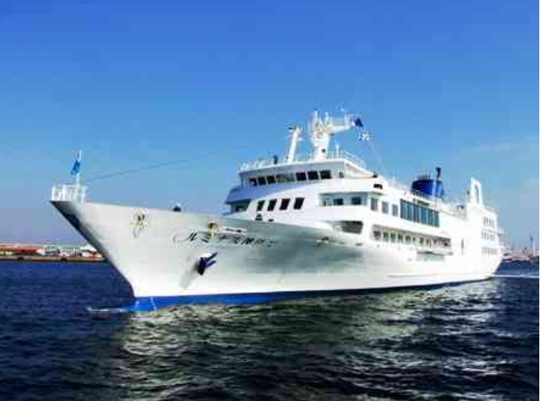
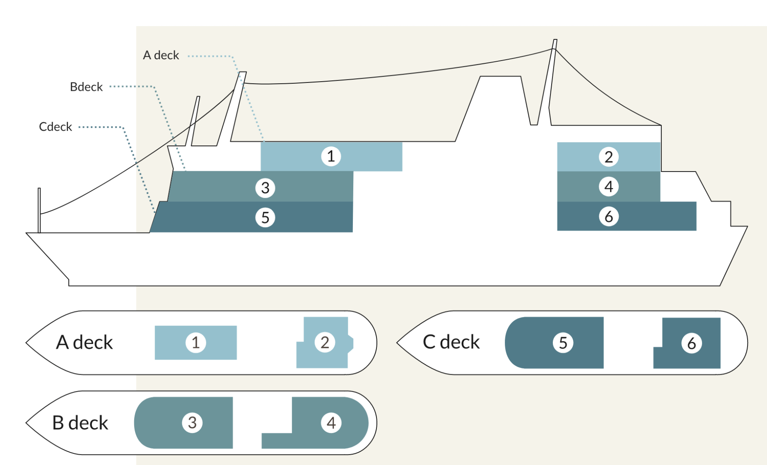
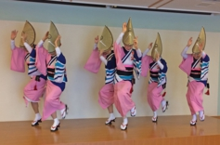
Social at Kobe cruiser
https://thekobecruise.com/concerto/luminous-photo
Luminous 2 wholly charter
One of the Largest Restaurant Cruises in Japan
Six rooms of various sizes on board the 106-meter-long, 4,778-ton ship
Awa Odori (Japanese traditional team dance)

Slide 9
Bento Box on Thursday
We will provide Japanese Bento Box lunch on Thursday at the convention center.

Slide 10
Payment Scheme
IEEE 802 Wireless Interim Sponsor Committee
Treasure
(Japan volunteer group)
¥・・・・
KVCC
Convention facilities Lunch Box on Thursday
IEEE 802 Wireless Treasure
¥・・・・
Social party cruise
USD$ TBD
Kobe cruiser
¥・・・・
Teisan BUS
Bus transportation for Social
City of Kobe MISE
¥2,621,990
¥・・・・
Portpia Hotel
Lunch Mon,Tue,Wed
USD$・・・・
MTG Event
The Nakauchi Foundation
¥2,500,000
¥・・・・
miscellaneous expense
Entertainment on Social, etc,.
¥・・・・
Auditor
Audit for funding support
Hiroshi Mano (Koden TI)

Slide 11
Estimation cost (only for inside Japan)
Hiroshi Mano (Koden TI)

Slide 12
Outreach workshop
Move to approve to hold the outreach workshop on Jan 11 Sat, at Kobe as the following conditions.
Organizer: Japanese Volunteer Committee
Date: 2025/01/11 Sat (day before the interim)
Attendance: 100 max
Program:
Opening remarks
Introduction of WG
Tutorial to join 802
Networking dinner
Request to wireless chair meeting
Speaker appointment
Treasurer
Japanese Volunteer Committee provides all of the expenses for this workshop.
Moved: Rosdahl
Second: Stacey
Results: Unanimous approval – Motion passes.
Notes:
From 802 WCSC Ops Man 2.5: All decisions related to or affecting the Joint Treasury shall be delegated to the Executive Committee of the Joint Treasury. Examples of such decisions include approval to spend funds and venue selection.

Slide 13
Call for speaker
Call for a speaker who introduces WG activity in the workshop.
Those who can provide the presentation, please provide the following speaker’s information to mano@koden-ti.com
Name
Affiliation
WG
Notes:
Stephen McCann has volunteered on Thu, Aug 29, 8:49 AM

