Slide 1
Executive Secretary Report for July Plenary - Montreal
Jon Rosdahl
IEEE Executive Secretary
jrosdahl@ieee.org

Slide 2
Event Conduct and Safety Statement
IEEE believes that science, technology, and engineering are fundamental human activities, for which openness, international collaboration, and the free flow of talent and ideas are essential. Its meetings, conferences, and other events seek to enable engaging, thought-provoking conversations that support IEEE’s core mission of advancing technology for humanity. Accordingly, IEEE is committed to providing a safe, productive, and welcoming environment to all participants, including staff and vendors, at IEEE-related events.

Slide 3
Event Conduct and Safety Statement
IEEE has no tolerance for discrimination, harassment, or bullying in any form at IEEE-related events. All participants have the right to pursue shared interests without harassment or discrimination in an environment that supports diversity and inclusion. Participants are expected to adhere to these principles and respect the rights of others.
IEEE seeks to provide a secure environment at its events. Participants should report any behavior inconsistent with the principles outlined here, to onsite staff, security or venue personnel, or toeventconduct@ieee.org.

Slide 4
Title and text slide
6.02 Montreal - 2024 July 802 Plenary - Things to Know
  Event Summary and Important Information
6.03 "Future Venues“
    Registration Reminder
    Straw Poll for WGs
    Future Venue Contract Status

Slide 5
6.02 Montreal - 2024 July 802 Plenary - Things to Know
Slide deck is on Mentor: 802 EC-24/0123r0:
https://mentor.ieee.org/802-ec/dcn/24/ec-24-0123-00-00EC-montreal-2024-july-802-plenary-things-to-know.pptx

Slide 6
July 2024 IEEE 802 Plenary Session
Event Summary and Important Information
Prepared By: Face to Face Events, June 27, 2024

Slide 7
Meeting Planner Contact Information
Dawn Slykhouse, Face to Face Events
Mobile: +1 (408) 594-1342
Email: dawns@facetoface-events.com
Lisa Ronmark, Face to Face Events
Mobile: +1 (604) 316-4947
Email: lisa@facetoface-events.com
Stephanie Williams, Face to Face Events
Mobile: +1 (408) 497-9613
Email: stephanie@facetoface-events.com
Meeting Planner Office: Salon 6
Registration: Ballroom Foyer, Level 4

Slide 8
Network Access and Support Information
Plenary Session Network
SSID: IEEE802
Password: ieeeieee
This SSID will support all IEEE 802.11 compliant devices using any of the 2.4GHz, 5GHz or 6GHz radio bands.
IEEE 802 Documents: Local Document Server
http://ieee802.linespeed.com/
Onsite Network Support
Members of the Linespeed team can be dispatched by contacting the Meeting Planner directly or by placing a request at the event registration desk.
Linespeed Events Contact Information
  Richard Alfvin
  Mobile: +1 (585) 781-0952
  Email: rick@linespeed.com
Network Office: Salon 6

Slide 9
Audio Visual Support – Onsite support
WHO TO CONTACT IF AUDIO VISUAL EQUIPMENT ISN’T WORKING IN YOUR ONSITE MEETING ROOM
Please contact the Meeting Planner directly if you have any issues with the audio visual equipment in your meeting room. The Meeting Planner will contact support and the appropriate technician will be sent to assist as soon as possible.
Meeting Planner can be reached at:
Registration and Information Desk: Ballroom Foyer, Level 4 Le Centre Sheraton Montreal
Event Office: Salon 6
Via Text or Call: Lisa Ronmark: +1 (604) 316-4947, Stephanie Williams +1 (408) 497-9613
WEBEX AUDIO IN THE ONSITE MEETING ROOM
If you are a local participant, PLEASE, select “Don’t connect to audio” when joining WebEx.
Connecting to the audio, may cause an audio interference or a feedback loop that will disrupt the meeting.

Slide 10
Badge Pick Up and In Person Registration Times and Location
Sunday
  Registration Counter, Ballroom Foyer Level 4 Le Centre Sheraton Montreal
  5:00 PM - 7:30 PM
Monday - Wednesday
  Registration Counter, Ballroom Foyer Level 4 Le Centre Sheraton Montreal
  7:30 AM - 5:00 PM
Thursday
  Event Office, Salon 6, Level 3 Le Centre Sheraton Montreal
  8:00 AM - 5:00 PM

Slide 11
IEEE 802 Newcomer Orientation
Monday July 8th
11:00 AM or 10:00 PM ET
WHO: IEEE 802 Newcomers (and all others!)
WHAT: IEEE 802 Orientation Program
WHEN: Monday 8 July, 11 AM ET and or Monday 8 July, 10 PM ET
WHERE: WebEx Link: https://ieeesa.webex.com/ieeesa/j.php?MTID=md68b84ad111f7d97b2213bd1867d8b22
Meeting number (access code): 2344 643 3773 Meeting password: 802sec
or IEEE 802 Calendar https://ieee802.org/802tele_calendar.html
HOW TO PREPARE:
Please review the presentation: https://mentor.ieee.org/802-ec/documents?is_dcn=0023&is_year=2020
REGISTRATION FEE:
Registration for the IEEE 802 Plenary Session (with fee) is required, whether attending in-person or remotely.

Slide 12
Schedule of Meetings and Attendance
In Person Room Assignments: Schedule QR codes posted outside each meeting room and on back of your badge. http://schedule.802world.com/schedule/schedule/show
Virtual Participation details: https://ieee802.org/802tele_calendar.html
ATTENDANCE TOOL (IMAT)
  https://imat.ieee.org/my-site/home
REGISTRATION FEE REQUIREMENT REMINDER
  Payment of the session registration fee is required for all individuals who participate in any meetings associated with the July 2024 IEEE 802 Plenary Session.
Registration Link: https://cvent.me/LV94ez

Slide 13
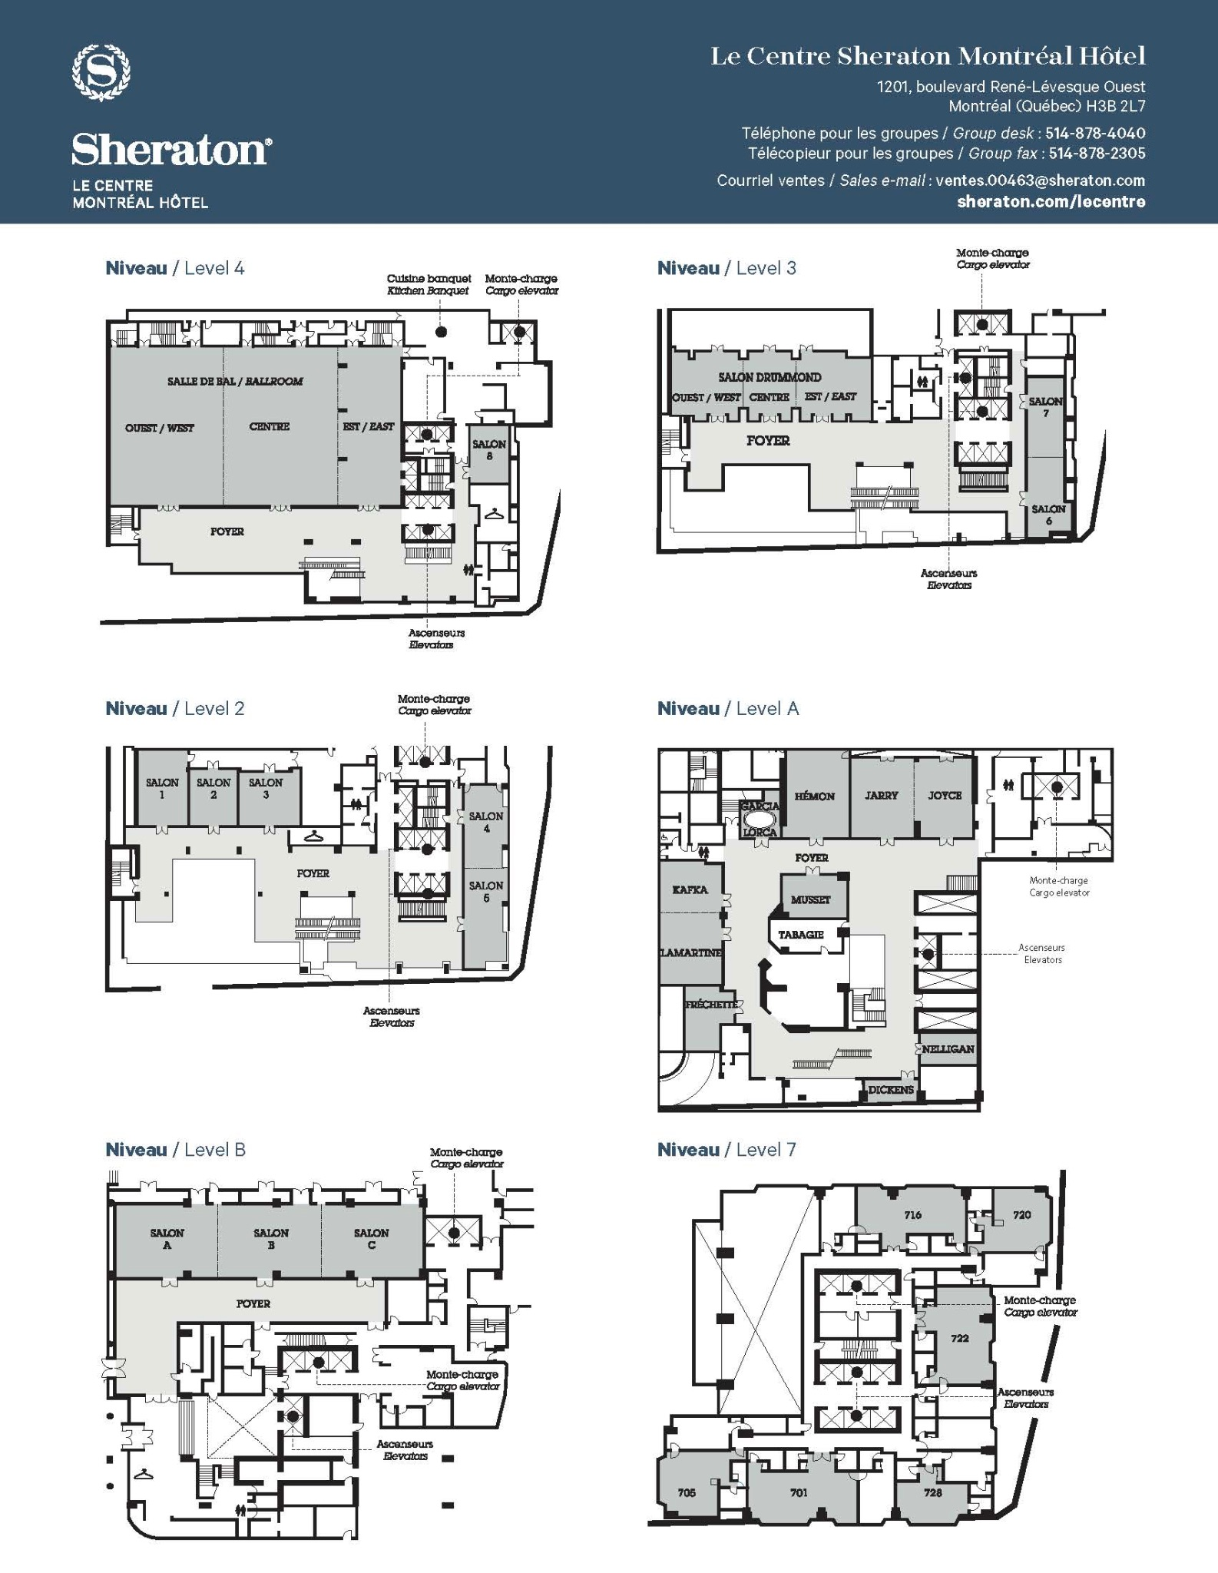
Le Centre Sheraton Montreal All Floors Meeting Space Map
Level 4
Ballroom Est (East) - EC Opening/Closing
Ballroom Centre - Lunch
Ballroom Ouest (West) - 802.11 Plenaries and Large Sessions
Ballroom Foyer - Breakfast, AM, PM Breaks
Salon 8 - 802.11 Room #5
Level 3
Drummond Est (East) - 802.11 Room #3
Drummond Ouest Centre (West Centre) - 802.11 Room #2
Salon 7 - 802.11 Room #4
Level 2
Salon 1 - 802. Shared Room (.18/.19/.24)
Salon 2 - 802.15
Salon 3 - 802.1
Salon 4 5 - 802.1, 802.15/.15 Joint, 802 Yangsters
Level A
Garcia Lorca - 802 EC/WG Chair Work Room
Hemon - 802.15
Jarry Joyce - 802.15
Kafka - 802 EC Board Room
Lamartine - 802.15
Musset - 802.3, 802 ITU SC
Level B
Salon AB - 802.3
Salon C - 802. 3
Room Assignments are subject to change

Slide 14
Food and Beverage Breaks
FOR REGISTERED ATTENDEES ONLY
Light Breakfast
Ballroom Foyer, Level 4
Monday - Friday
7:15 AM - 8:30 AM
Morning Coffee & Tea Break
Ballroom Foyer, Level 4
Monday - Thursday
9:50 AM - 10:35 AM
Lunch
Ballroom Centre, Level 4
Monday - Thursday
12:00 PM - 1:30 PM
Afternoon Break
Ballroom Foyer, Level 4
Monday - Thursday
3:15 PM - 4:00 PM

Slide 15

IEEE 802 Social
Wednesday July 17th at 6:30 PM
WHO: Registered Attendee & Guests who purchased tickets.*
*Tickets were sold online until sold out (400 capacity) for $24.99 each.
WHAT: Networking Reception, Food Court, Bar Service, Games
WHERE: TimeOut Market Montreal - 705 rue Sainte-Catherine Ouest
DIRECTIONS: The market is a modest distance (approximately 800 m) from the hotel and can be accessed by walking, public transport or private car service such as Uber or Lyft.
Google directions may inform your travel choice. https://maps.app.goo.gl/WRGUaEzgaL7wxRZCA
SOCIAL EVENT NAME BADGE
All individuals attending the event (attendees and their guests) must wear a Social Event Name Badge. Badges must be picked up before 12:00 PM Wednesday July 17th.
Late requests may not be accommodated.

Slide 16
Quick Start Guide to Local information in Montreal
Weather Forecast
Montreal, Quebec Weather Forecast | AccuWeather
Time Zone - Eastern Time
Time Zone Tool (What time is at home or where virtual attendees are logging in?) https://www.timeanddate.com/worldclock/meeting.html
Montreal Airport - Guide and Flight Status
Airport Guide
Arrival and Departure Flight Status
Getting the Bus Back to the Airport
https://www.admtl.com/en/access/transports/buses-747
Places to Eat
Time Out Montreal - Eatery Guide
Things to Do In Montreal, When You’re Not in a Meeting
Some of the Best Things to Do In Montreal

Slide 17
Nearby Emergency & Health Services
Emergency Services
Montréal Police Department: 911
Fire: 911
Ambulance: 911
Walk In Clinics
Clinique Médicale Crescent
1198 Crescent St
Phone # +1 (514) 933-8383
Clinique Medicale en Route
895 Rue De la Gauchetière O Suite 335
Phone # +1 (514) 954-1444
RocklandMD - Downtown Montreal
1538 Sherbrooke St W #500
Phone # +1 (514) 667-3383
Pharmacies
Shoppers Drug Mart
1120 Saint-Catherine St W ·
Phone # +1 (514) 398-9759
PJC Jean Coutu
980 Saint-Catherine St W
Phone # +1 (514) 866-7791
Pharmaprix
1500 Saint-Catherine St W
Phone # +1 (514) 933-4744
Hospitals
CHUM - Centre hospitalier de l'Université de Montréal
1051 Rue Sanguinet, Montréal, QC H2X 3E4
+1 (514) 890-8000
Montreal General Hospital
1650 Cedar Ave, Montreal, Quebec H3G 1A4
+1 (514) 934-1934

Slide 18
General Shops & Services
Market & Groceries
Provigo
1275 Av. des Canadiens-de-Montréal #200, Montreal, Quebec
Sunday 08:00 - 21:00
Monday 07:00 - 21:00
Tuesday 07:00 - 21:00
Wednesday 07:00 - 21:00
Thursday 07:00 - 21:00
Friday 07:00 - 21:00
Saturday 08:00 - 21:00
Website: PLM Lefebvre Montreal Canadien - Montréal, Québec | Provigo
Convenience Store
Presse Gateway
Located Inside Le Centre Sheraton Montreal
Dépanneur 4 Saisons
1439 Stanley St
Shopping District
Nearby Shopping Street: Rue Sainte Catherine West
Transportation
Bus Station
Gare d'autocars de Montreal
Subway Stations
Peel Station - Green Line
Bonaventure - Orange Line
Metro Map
Centre Ville Underground Map
Train Station
Gare Centreal - Central Station
Lucien-L'allier

Slide 19
Thanks for helping us make this session a success, we look forward to working with you again!
The next IEEE 802 Plenary Session will be November 10-15, 2024. In-Person participation at the
Hyatt Regency Vancouver in Vancouver British Columbia, Canada with remote participation available.
We are preparing to make Hotel Reservations and Registration available in August 2024
If you have any questions please email: 802info@facetoface-events.com

Slide 20
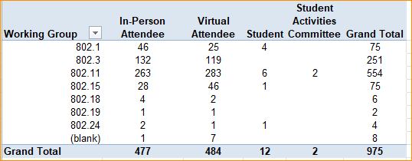
2024 July IEEE 802 Plenary Registration report as of 03/09/2024

Slide 21
Basic Room Resource Allocation
Big meetings
(≥ 100, e.g., WG plenaries)
Medium meetings
(35-100, e.g., Task Forces)
Smaller meetings
(30 or less)
Head table (5)
1 projector/screen
2 tables mics
1 or 2 floor mics
Sound system
(speakers, sound board, etc.)
Ethernet/HDMI/USB
Scarlett Audio Interface
Head table (3)
1 projector/screen
1 table mic
1 floor mic
Sound system
(speakers, sound board, etc.)
Ethernet/HDMI/USB
Scarlett Audio Interface
U-shaped or board meeting setup
1 room microphone
  Portable or speakerphone-type
Sound system
(speakers, sound board, etc.)
Ethernet/HDMI/USB
Scarlett Audio Interface

Slide 22
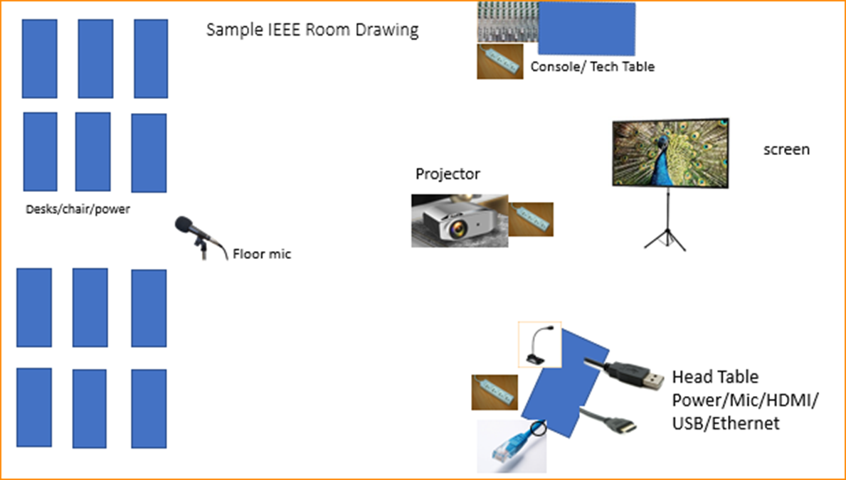

Scarlett
Notes:
This Photo by Unknown Author is licensed under CC BY-NC
This Photo by Unknown Author is licensed under CC BY-SA-NC
This Photo by Unknown Author is licensed under CC BY-SA

Slide 23
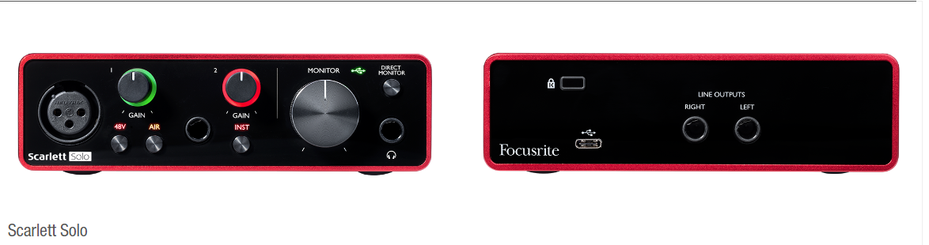
Scarlett Solo – Audio Interface by Focusrite
the USB connector not only supplies 5 VDC @ 900mA but also serves as the digital communication interface between WebEx and the Focusrite audio mixer.
Known Issue of connection dropping on newer models of Notebooks and Laptops.
Our Scarlett Boxes are 3rd Generation – Driver update can be found here:
https://downloads.focusrite.com/focusrite/scarlett-3rd-gen/scarlett-solo-3rd-gen

Slide 24
Suggested best practices
One central laptop/computer per meeting connects at head table.
Local speakers' queue/speak only at a microphone when called on.
Remote speakers request to speak via chat window and only speak when called on.
Presenters have chair (central laptop) share the presentation
Local attendees when logged into WebEx SHALL NOT connect Audio.
When Starting a meeting the host should do the following:
  Select “Meeting” -> “Meeting Options” -> [Disable] “Allow Participant to turn on Video”
  Select “Participant” -> [Enable] “Mute on Entry”.
For the Host and Remote Attendees connecting to Webex, Configure Webex Audio to use “Music Mode”.
If newer laptop, load updated Focusrite Scarlett Gen-3 drivers.
  Driver updates can be found here:
  https://downloads.focusrite.com/focusrite/scarlett-3rd-gen/scarlett-solo-3rd-gen

Slide 25
Mixed-mode Meeting Protocol
Sample Intro Meeting Slide
In-room Attendees:
  In Webex choose connect without audio before you join
  Use the Webex queue to indicate you want to speak
  Wait to be called on while standing/holding a microphone to make a comment
  Repeat any questions that are inadvertently asked away from the microphone
Remote Attendees:
  Join Webex and set Webex audio as ‘music’
  Use the Webex chat window to indicate you want to speak (“q”)
  Wait to be called on to speak

Slide 26
6.03 "Future Venues“
Registration Reminder
Straw Poll for WGs
Future Venue Contract Status
Future Venue AdHoc Thursday 7:30-8:00
Review Resources for November
Future Venue AdHoc Thursday 8:00-9:00
Review contract status – May not be very long

Slide 27
Registration for the July IEEE 802 plenary session
This meeting is part of the July IEEE 802 plenary session
You must pay the registration fee whether attending in-person or remotely
If you have not already done so, you can register here: https://cvent.me/dkO9BB
If you do not intend to register for this session you must leave this meeting and, if you have logged attendance on IMAT, email the 802 chair or vice chairs to have your attendance cancelled

Slide 28
Straw Poll needed today!
Straw poll from each WG required by 1pm today!
1. Are you planning on eating on Friday?
  Breakfast
  Lunch
  Break
This is most important for those that are attending 802.1/802.11/802 LMSC Closing meetings.
We can adjust our Friday F&B today.

Slide 29
Request for 802 WG Item for Closing Plenaries:
Request to WG Chairs,
Please Conduct the following Straw Poll in your Closing Plenaries:
  1. How many people would like to come back to this venue?
  Yes –
  No –
  2. Did you go to the social?
  Yes –
  No –
  3. If you attended the Social, did you like the social?
  Yes –
  No –

Slide 30
Status of IEEE 802 Plenary Contracts
2024 July 14-19 – Sheraton Le Centre Montreal
– Concern with Room Block and Attrition – not at 80% level
– May need to consider 2028 July return to avoid attrition charges and loss of concessions.
2025 July - Site Visit completed at Melia Castilla Madrid – May 21-25
– Draft Contract from hotel July 5 -
– Finalize the exhibits and then submit to IEEE CEE.
2025/2026 November – Marriott Marquis Queen’s Park
– Terms and Conditions agreed to, need contract from Face to face Events.
– Target to complete by end of June 2024
2027 March – Hilton Atlanta
– need to get contract formalized – Face to Face Events to finalize
– Targeting end of July 2024
2027 July – Gothia Towers
– Site Visit Scheduled – 21-22 Aug 2024
– Contract pending site visit

Slide 31

Future 802 Plenary Venue Contract Status
2024 July 14-19 – Sheraton Le Centre Montreal, Montreal, Quebec, Canada (July 2020)
2024 November 10-15 –Hyatt Regency Vancouver, Vancouver, Canada (Nov 2021)
2025 March 9-14 –Hilton Atlanta, Atlanta, GA, United States (2 of 2 – March 2020).
2025 July 27-August 1 –Melia Castilla Madrid, Madrid, Spain (NOTE: Week of July 27)
2025 November 9-14 – Marriott Marquis Queen’s Park, Bangkok, Thailand
2026 March 8-13 - Hyatt Regency Vancouver, Vancouver, Canada (Change from Chicago)
2026 July 12-17 – Le Centre Sheraton Montreal, Montreal (July 2022 attrition offset)
2026 November 8-13 - Marriott Marquis Queen’s Park, Bangkok, Thailand
2027 March 14-19 – Hilton Atlanta, Atlanta, GA, United States (offset potential shortfall 2023/2025)
2027 July 11-16 - Gothia Towers, Gothenburg, Sweden
2027 November 14-19 – Hawaiian Village, Oahu, Hawaii, United States
2028 July 9-14 – Sheraton Le Centre Montral, Montreal, Quebec, Canada (July 2024 attrition offset)
802 EC Approved – Contract is being Negotiated.
Contracts Executed
As of July 13, 2024
Notes:
2025 July - Site Visit planned for Melia Castilla Madrid (May 21-25) – Draft Contract back from Hotel July 5th.
2025/2026 November – Terms and Conditions agreed to, need contract from Hotel (expect complete by end of June)
2026 March – Hyatt Regency Vancouver Contract - 802Fin-24/0005r0 – April 5, 2024
2027 March – Hilton Atlanta – need to get contract formalized – Targeted by end of July
2027 July – Gothia Towers – Site Visit Scheduled Aug 17-23

Slide 32
Future Venue AdHocs --

Slide 33
Next Venue Meeting planning – Thurs 7:30 am
Proposed Agenda:
  Start time 7:30 am
  Review meeting space plan for 2024 November Plenary
    Hyatt Regency Vancouver, Vancouver, Canada
  Adjourn 8:00am

Slide 34
Future Venues AdHoc – Thurs 8 am
Proposed Future Venues AdHoc Agenda:
  Start time – 8:00 am
    Review Contract Status
  End time – 9:00am

Slide 35
Executive Secretary Agenda Items
Closing Plenary:
  4.02: Future Meetings
    1. Straw poll on This Venue
    2. 802 Contract Status
  8.033 Executive Secretary Report
  8.04 Announcement of 802 EC Interim Telecons
  8.05 Call for Tutorials for Nov 2024 Plenary

Slide 36
Straw Poll: Return to This Venue:
(Hyatt Regency Denver)
1. How many people would like to come back to this venue?
Yes No Abstain
  .1
  .3
  .11
  .15

Slide 37
Venue Polls (continued)
(Hyatt Regency Denver)
2. Did you go to the social?
    Yes No
  .1
  .3
  .11
  .15
3. If you attended the Social, did you like the social?
        Yes No
  .1
  .3
  .11
  .15

Slide 38
8.04 Monthly IEEE 802 LMSC Telecons
Announcement of 802 LMSC Interim Telecons
Tuesday 6 August 2024, 19:00-21:00 UTC
Tuesday 3 September 2024, 19:00-21:00 UTC
Tuesday 1 October 2024,19:00-21:00 UTC
Call Time: Tuesday, 3:00 PM - 5:00 PM (UTC-05:00) Eastern Time (ET)
Recurrence: Occurs Generally the first Tuesday of every month.
From 7:00 PM to 9:00 PM, (UTC+00:00) Monrovia, Reykjavik time zone.
Calls after November Plenary to be Scheduled during 2024 November IEEE 802 LMSC Closing Plenary meeting.
Notes:
802 Interim Telecons – 1st Tuesday of the following Months: January/February/April/May/June/August/September/October
Delayed January 9th Telecon determined during

Slide 39
8.05 Call for Tutorials for November 2024
Tutorials may be held electronic: TBA
In person/Mixed-mode Tutorials: November (Mon/Tues)
Tutorial Request form:
  https://mentor.ieee.org/802-ec/dcn/23/ec-23-0128-00-00EC-802-tutorial-request-form-2023.docx
As a reminder, please refer to Chair's Guidelines section 2.5 Tutorials for the logistics for participating in sponsoring/presenting a Tutorial.
Note that Tutorial times are limited to 80 minutes with 10 minutes to allow for presenters to setup and depart. (Starting at 18:15).
All requests for Tutorials must be made by 27 September 2024
Notes:
All official tutorial request forms must be submitted no later than 45 days in advance of the Plenary Session.
Approved Tutorial Requests will be assigned a time slot based on the order in which they were received.
The Final Tutorial Schedule will be posted at http://802world.org/plenary and http://ieee802.org no less than 30 days in advance of the Plenary Session.
Mentor Link to 2023 Tutorial Request form: https://mentor.ieee.org/802-ec/dcn/23/ec-23-0128-00-00EC-802-tutorial-request-form-2023.docx

