Slide 1
July 2024 IEEE 802 Plenary Session
Event Summary and Important Information
Prepared By: Face to Face Events, June 27, 2024

Slide 2
Meeting Planner Contact Information
Dawn Slykhouse, Face to Face Events
Mobile: +1 (408) 594-1342
Email: dawns@facetoface-events.com
Lisa Ronmark, Face to Face Events
Mobile: +1 (604) 316-4947
Email: lisa@facetoface-events.com
Stephanie Williams, Face to Face Events
Mobile: +1 (408) 497-9613
Email: stephanie@facetoface-events.com
Meeting Planner Office: Salon 6
Registration: Ballroom Foyer, Level 4

Slide 3
Network Access and Support Information
Plenary Session Network
SSID: IEEE802
Password: ieeeieee
This SSID will support all IEEE 802.11 compliant devices using any of the 2.4GHz, 5GHz or 6GHz radio bands.
IEEE 802 Documents: Local Document Server
http://ieee802.linespeed.com/
Onsite Network Support
Members of the Linespeed team can be dispatched by contacting the Meeting Planner directly or by placing a request at the event registration desk.
Linespeed Events Contact Information
Richard Alfvin
Mobile: +1 (585) 781-0952
Email: rick@linespeed.com
Network Office: Salon 6

Slide 4
Audio Visual Support – Onsite support
WHO TO CONTACT IF AUDIO VISUAL EQUIPMENT ISN’T WORKING IN YOUR ONSITE MEETING ROOM
Please contact the Meeting Planner directly if you have any issues with the audio visual equipment in your meeting room. The Meeting Planner will contact support and the appropriate technician will be sent to assist as soon as possible.
Meeting Planner can be reached at:
Registration and Information Desk: Ballroom Foyer, Level 4 Le Centre Sheraton Montreal
Event Office: Salon 6
Via Text or Call: Lisa Ronmark: +1 (604) 316-4947, Stephanie Williams +1 (408) 497-9613
WEBEX AUDIO IN THE ONSITE MEETING ROOM
If you are a local participant, PLEASE, select “Don’t connect to audio” when joining WebEx.
Connecting to the audio, may cause an audio interference or a feedback loop that will disrupt the meeting.

Slide 5
Badge Pick Up and In Person Registration Times and Location
Sunday
Registration Counter, Ballroom Foyer Level 4 Le Centre Sheraton Montreal
5:00 PM - 7:30 PM
Monday - Wednesday
Registration Counter, Ballroom Foyer Level 4 Le Centre Sheraton Montreal
7:30 AM - 5:00 PM
Thursday
Event Office, Salon 6, Level 3 Le Centre Sheraton Montreal
8:00 AM - 5:00 PM

Slide 6
IEEE 802 Newcomer Orientation
Monday July 8th
11:00 AM or 10:00 PM ET
WHO: IEEE 802 Newcomers (and all others!)
WHAT: IEEE 802 Orientation Program
WHEN: Monday 8 July, 11 AM ET and or Monday 8 July, 10 PM ET
WHERE: WebEx Link: https://ieeesa.webex.com/ieeesa/j.php?MTID=md68b84ad111f7d97b2213bd1867d8b22
Meeting number (access code): 2344 643 3773 Meeting password: 802sec
or IEEE 802 Calendar https://ieee802.org/802tele_calendar.html
HOW TO PREPARE:
Please review the presentation: https://mentor.ieee.org/802-ec/documents?is_dcn=0023&is_year=2020
REGISTRATION FEE:
Registration for the IEEE 802 Plenary Session (with fee) is required, whether attending in-person or remotely.

Slide 7
Schedule of Meetings and Attendance
In Person Room Assignments: Schedule QR codes posted outside each meeting room and on back of your badge. http://schedule.802world.com/schedule/schedule/show
Virtual Participation details: https://ieee802.org/802tele_calendar.html
ATTENDANCE TOOL (IMAT)
https://imat.ieee.org/my-site/home
REGISTRATION FEE REQUIREMENT REMINDER
Payment of the session registration fee is required for all individuals who participate in any meetings associated with the July 2024 IEEE 802 Plenary Session.
Registration Link: https://cvent.me/LV94ez

Slide 8
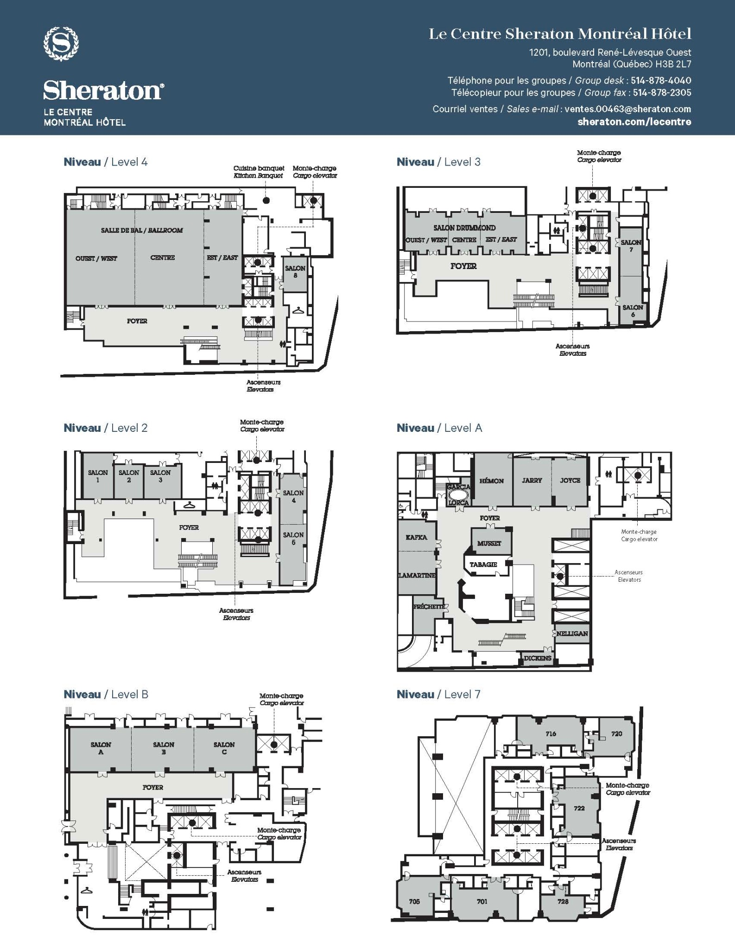
Le Centre Sheraton Montreal All Floors Meeting Space Map
Level 4
Ballroom Est (East) - EC Opening/Closing
Ballroom Centre - Lunch
Ballroom Ouest (West) - 802.11 Plenaries and Large Sessions
Ballroom Foyer - Breakfast, AM, PM Breaks
Salon 8 - 802.11 Room #5
Level 3
Drummond Est (East) - 802.11 Room #3
Drummond Ouest Centre (West Centre) - 802.11 Room #2
Salon 7 - 802.11 Room #4
Level 2
Salon 1 - 802. Shared Room (.18/.19/.24)
Salon 2 - 802.15
Salon 3 - 802.1
Salon 4 5 - 802.1, 802.15/.15 Joint, 802 Yangsters
Level A
Garcia Lorca - 802 EC/WG Chair Work Room
Hemon - 802.15
Jarry Joyce - 802.15
Kafka - 802 EC Board Room
Lamartine - 802.15
Musset - 802.3, 802 ITU SC
Level B
Salon AB - 802.3
Salon C - 802. 3
Room Assignments are subject to change

Slide 9
Food and Beverage Breaks
FOR REGISTERED ATTENDEES ONLY
Light Breakfast
Ballroom Foyer, Level 4
Monday - Friday
7:15 AM - 8:30 AM
Morning Coffee & Tea Break
Ballroom Foyer, Level 4
Monday - Thursday
9:50 AM - 10:35 AM
Lunch
Ballroom Centre, Level 4
Monday - Thursday
12:00 PM - 1:30 PM
Afternoon Break
Ballroom Foyer, Level 4
Monday - Thursday
3:15 PM - 4:00 PM

Slide 10
IEEE 802 Social
Wednesday July 17th at 6:30 PM
WHO: Registered Attendee & Guests who purchased tickets.*
*Tickets were sold online until sold out (400 capacity) for $24.99 each.
WHAT: Networking Reception, Food Court, Bar Service, Games
WHERE: TimeOut Market Montreal - 705 rue Sainte-Catherine Ouest
DIRECTIONS: The market is a modest distance (approximately 800 m) from the hotel and can be accessed by walking, public transport or private car service such as Uber or Lyft.
Google directions may inform your travel choice. https://maps.app.goo.gl/WRGUaEzgaL7wxRZCA
SOCIAL EVENT NAME BADGE
All individuals attending the event (attendees and their guests) must wear a Social Event Name Badge. Badges must be picked up before 12:00 PM Wednesday July 17th.
Late requests may not be accommodated.

Slide 11
Quick Start Guide to Local information in Montreal
Weather Forecast
Montreal, Quebec Weather Forecast | AccuWeather
Time Zone - Eastern Time
Time Zone Tool (What time is at home or where virtual attendees are logging in?) https://www.timeanddate.com/worldclock/meeting.html
Montreal Airport - Guide and Flight Status
Airport Guide
Arrival and Departure Flight Status
Getting the Bus Back to the Airport
https://www.admtl.com/en/access/transports/buses-747
Places to Eat
Time Out Montreal - Eatery Guide
Things to Do In Montreal, When You’re Not in a Meeting
Some of the Best Things to Do In Montreal

Slide 12
Nearby Emergency & Health Services
Emergency Services
Montréal Police Department: 911
Fire: 911
Ambulance: 911
Walk In Clinics
Clinique Médicale Crescent
1198 Crescent St
Phone # +1 (514) 933-8383
Clinique Medicale en Route
895 Rue De la Gauchetière O Suite 335
Phone # +1 (514) 954-1444
RocklandMD - Downtown Montreal
1538 Sherbrooke St W #500
Phone # +1 (514) 667-3383
Pharmacies
Shoppers Drug Mart
1120 Saint-Catherine St W ·
Phone # +1 (514) 398-9759
PJC Jean Coutu
980 Saint-Catherine St W
Phone # +1 (514) 866-7791
Pharmaprix
1500 Saint-Catherine St W
Phone # +1 (514) 933-4744
Hospitals
CHUM - Centre hospitalier de l'Université de Montréal
1051 Rue Sanguinet, Montréal, QC H2X 3E4
+1 (514) 890-8000
Montreal General Hospital
1650 Cedar Ave, Montreal, Quebec H3G 1A4
+1 (514) 934-1934

Slide 13
General Shops & Services
Market & Groceries
Provigo
1275 Av. des Canadiens-de-Montréal #200, Montreal, Quebec
Sunday 08:00 - 21:00
Monday 07:00 - 21:00
Tuesday 07:00 - 21:00
Wednesday 07:00 - 21:00
Thursday 07:00 - 21:00
Friday 07:00 - 21:00
Saturday 08:00 - 21:00
Website: PLM Lefebvre Montreal Canadien - Montréal, Québec | Provigo
Convenience Store
Presse Gateway
Located Inside Le Centre Sheraton Montreal
Dépanneur 4 Saisons
1439 Stanley St
Shopping District
Nearby Shopping Street: Rue Sainte Catherine West
Transportation
Bus Station
Gare d'autocars de Montreal
Subway Stations
Peel Station - Green Line
Bonaventure - Orange Line
Metro Map
Centre Ville Underground Map
Train Station
Gare Centreal - Central Station
Lucien-L'allier

Slide 14
Thanks for helping us make this session a success, we look forward to working with you again!
The next IEEE 802 Plenary Session will be November 10-15, 2024. In-Person participation at the
Hyatt Regency Vancouver in Vancouver British Columbia, Canada with remote participation available.
We are preparing to make Hotel Reservations and Registration available in August 2024
If you have any questions please email: 802info@facetoface-events.com

