Slide 1

IMPORTANT INFORMATION
IEEE 802 Wireless Interim Meeting
May 12 – 17, 2024
Warsaw Marriott. Hotel, POLAND

Slide 2
AUDIO VISUAL:
The Audio Visual is being supplied by the Hotel – Marriott Hotel.
There will be floating AV technicians between the rooms during the meetings.
For any issues, please see a contact Sara at the Registration Desk (sara@mtgevents.com.au)
AUDIO IN MEETING ROOM
If you are a local participant, PLEASE, select “Don’t connect to audio” when joining the WebEx session. Connecting to the audio, may cause an audio feedback loop that prevents the meeting from proceeding

Slide 3
COMBINED SCHEDULE
IN PERSON Room Assignments: Schedule QR codes posted outside each meeting room and on the back of your name badge.
REMOTE Participation: https://ieee802.org/802tele_calendar.html
ATTENDANCE TOOL (IMAT) : https://imat.ieee.org/

Slide 4
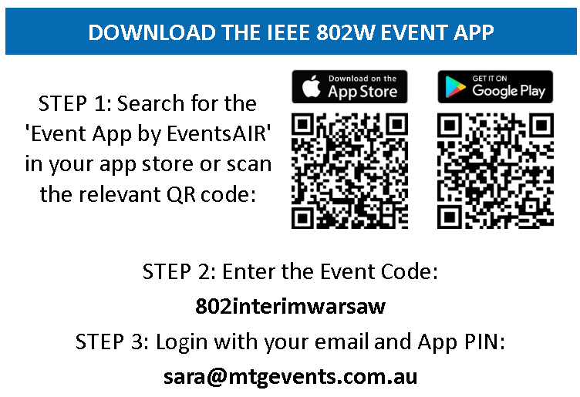
PROGRAM APP
- The IEEE 802 Wireless Interim Meeting App information is available on the back of your name badge

Slide 5
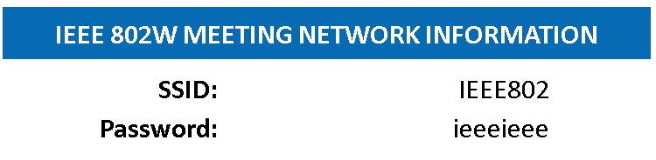
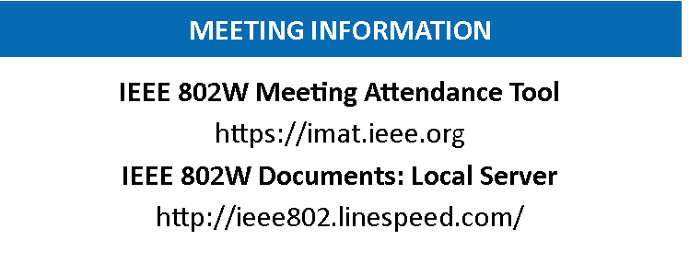
NETWORK ACCESS INFORMATION:
Local Document Server for IEEE 802W Documents:
http://ieee802.linespeed.com/
The network provider for the IEEE 802 Wireless Interim is Linespeed Events. Linespeed are located in the Nysa Room (level 3) during the meeting.
Details on how to log into the network are printed on the back of your badge.

Slide 6
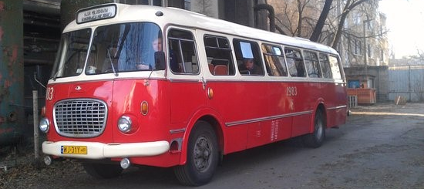
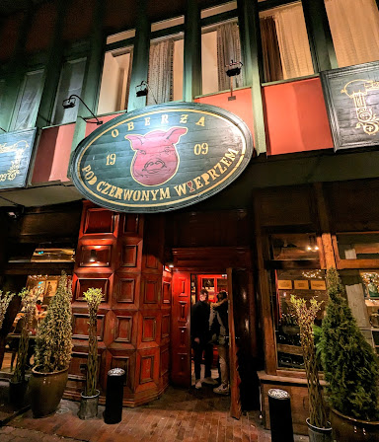
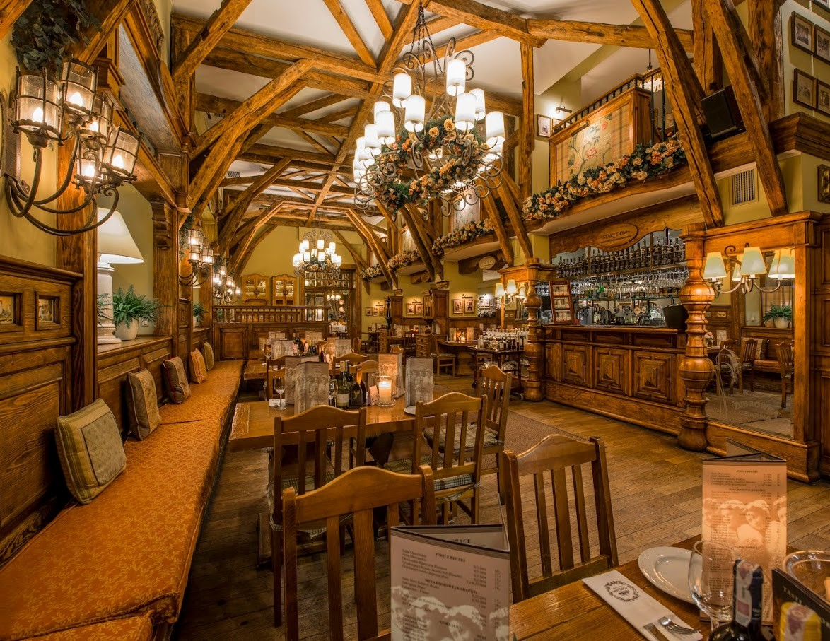
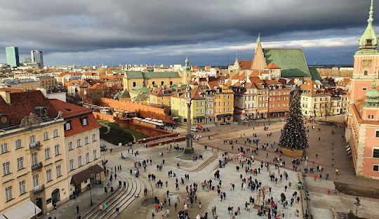
WEDNESDAY SOCIAL
TOUR OF OLD TOWN + POLISH DINNER
Wednesday May 15, 2024
Time:
6.00-6:30pm: 8 Buses will depart from Marriott Hotel
Please meet from 6:00-6:30pm on the street level (Ground) of the Marriott Hotel to join one of the Cucumber Buses.
Tour of Warsaw:
Enjoy a short tour of Old Town in a historic communist era Cucumber Bus.
Dinner:
Due to increased numbers, we have 2 restaurants booked, both will serve Family Style Polish Food. Make sure you are on the same bus as those you would like to dine with.
Return Coaches:
Coaches will return from the restaurants to the Marriott from 9pm
Please let the Registration Desk know if you CAN’T make the dinner to assist with restaurant numbers.

Slide 7
CATERING:
  Breakfast: is included in your room rate if you booked at the Marriott.
  Morning & Afternoon teas will be served from the foyer areas on both floors, Level 2 and 3
  Lunch: will be held in the Terrace on Level 2

Slide 8
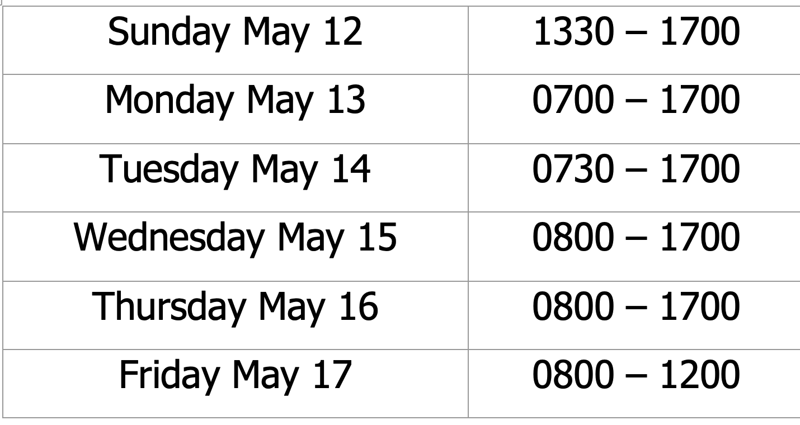
The REGISTRATION DESK will be located in the Hotel Foyer, on level 2, during the following times:

Slide 9
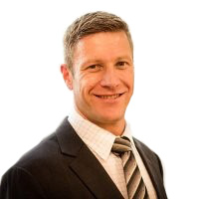
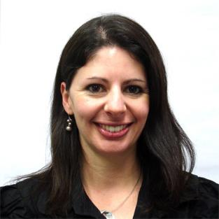

Any Questions
Please see Daniel or Sara on the registration desk!
802wireless@mtgevents.com.au

