Slide 1
802.1 consent agenda items for LMSC Closing Plenary
March 2024
(V2 – 802.1 version #)

Slide 2
Agenda
PARs to NesCom
  5.021 – P802.1ASeb
Drafts to SA Ballot
  5.022 – IEC/IEEE 60802
  5.023 – P802-REVc
  5.024 – P802.1Qdy
Drafts to RevCom
  5.025 – P802.1DC
  5.026 – P802.1Qdj
  5.027 – P802.1ASdm
  5.028 – P802.1ASdn
  5.029 – P802.1Qdx

Slide 3
Agenda
Liaisons and external communications (ME)
  7.0?? – Approve liaison of drafts for adoption to ISO/IEC JTC1/SC6 under the PSDO agreement
  7.031 – Approve responses to ballot comments received from SC6 on FDIS and CIB ballots
  7.032 – Approve 802.1 communication to ITU-T SG15
  7.033 – Approve 802.1 communication to ITU-T JCA IMT-2020
Liaisons and external communications (II)
  7.034 – Approve 802.1 communication to Broadband Forum
  7.035 – Approve 802.1 communication to IEEE 1588

Slide 4
802.1 Motions
2024-03
Consent Agenda
PARs to NesCom

Slide 5
5.021 - Motion
Approve forwarding P802.1ASeb PAR documentation in https://www.ieee802.org/1/files/public/docs2024/eb-PAR-0324-v01.pdf to NesCom
Approve CSD documentation in https://www.ieee802.org/1/files/public/docs2024/eb-CSD-0324-v01.pdf
In the WG, Proposed: Don Pannell, Second: Max Turner
  PAR (y/n/a): <y>,<n>,<a>
  CSD (y/n/a): <y>,<n>,<a>
In EC, mover: Glenn Parsons, Second: Roger Marks
  (y/n/a): <y>,<n>,<a>

Slide 6
802.1 Motions
2024-03
Consent Agenda
Drafts to SA Ballot

Slide 7
5.022 - Motion
Conditionally approve sending IEC/IEEE 60802 D3.0 to Standards Association ballot
Confirm the CSD for IEC/IEEE 60802 in https://mentor.ieee.org/802-ec/dcn/18/ec-18-0088-01-ACSD-p60802.pdf
IEC/IEEE 60802 D2.2 had 98% approval at the end of the last WG ballot
In the WG, Proposed: Ludwig Winkel, Second: János Farkas
  Sending draft (y/n/a): <y>,<n>,<a>
  CSD (y/n/a): <y>,<n>,<a>
In EC, mover: Glenn Parsons, Second: Roger Marks
  (y/n/a): <y>,<n>,<a>

Slide 8
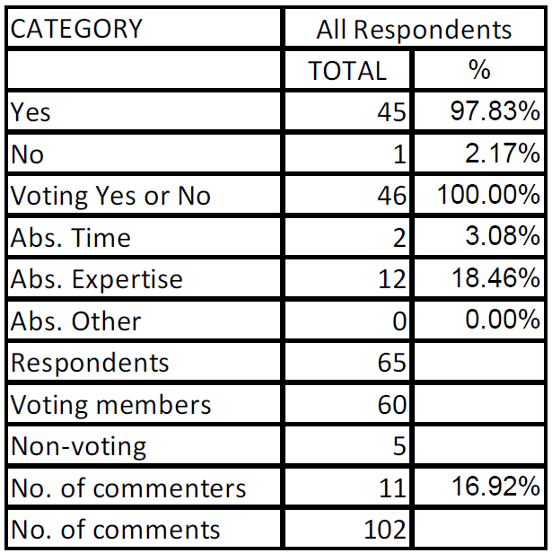
Supporting Information IEC/IEEE 60802
WG ballot closed: 9 March 2024
All WG ballot requirements are met
The ballot resulted in
  0 new Disapprove votes
  9 Must Be Satisfied (MBS) comments
  1 Disapprove vote maintained from initial WG ballot
Comment resolution available here: https://www.ieee802.org/1/files/private/60802-drafts/d2/60802-d2-2-pdis-v03.pdf Recirculation ballot will be conducted during April/May with comment resolution in the regularly scheduled IEC/IEEE 60802 meetings. A possible final recirculation in May/June if required with comment resolution in the regularly scheduled IEC/IEEE 60802 meetings.
Ballot results:

Slide 9
Supporting Information IEC/IEEE 60802
Voters maintaining Disapprove vote from initial WG ballot on D2.1
  Karl Weber
MBS comments associated with the maintained Disapprove vote are on the following slides

Slide 10
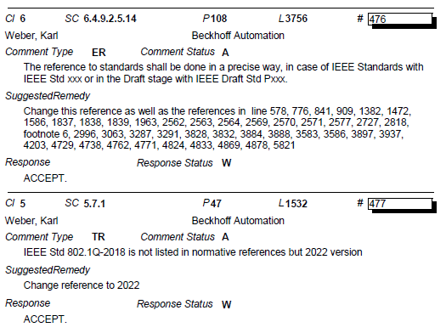
Supporting Information IEC/IEEE 60802

Slide 11
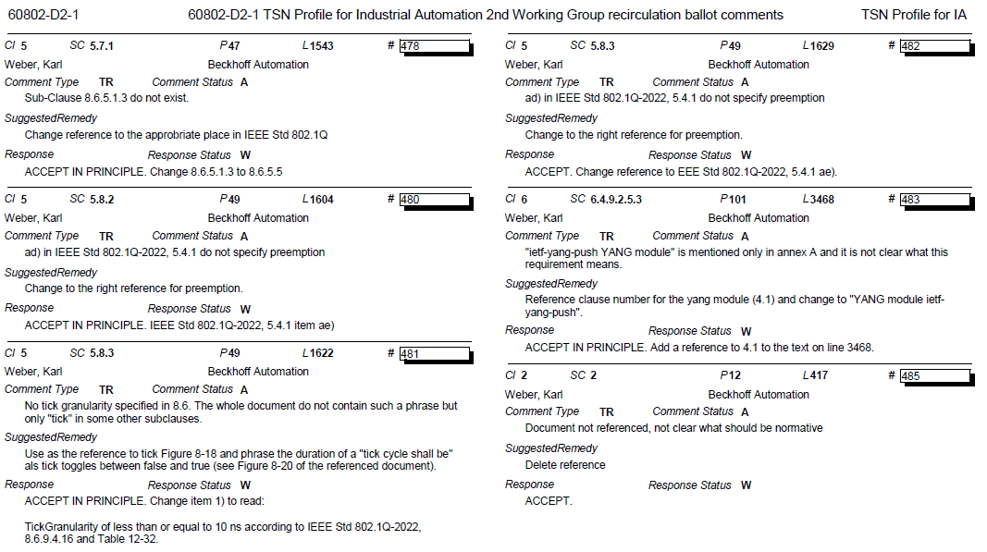
Supporting Information IEC/IEEE 60802

Slide 12
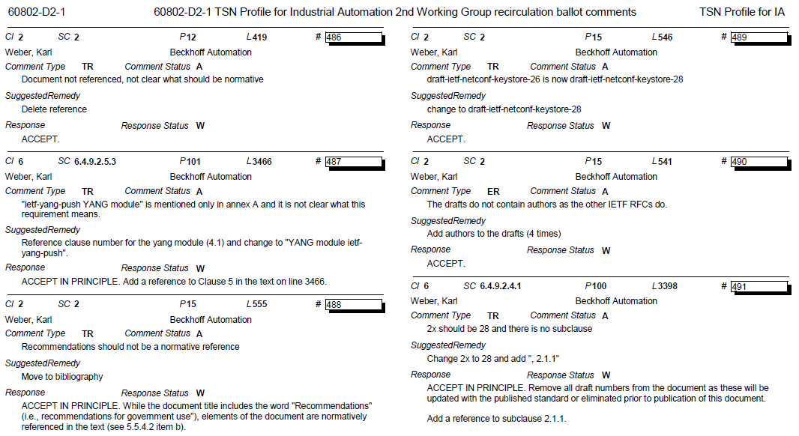
Supporting Information IEC/IEEE 60802

Slide 13
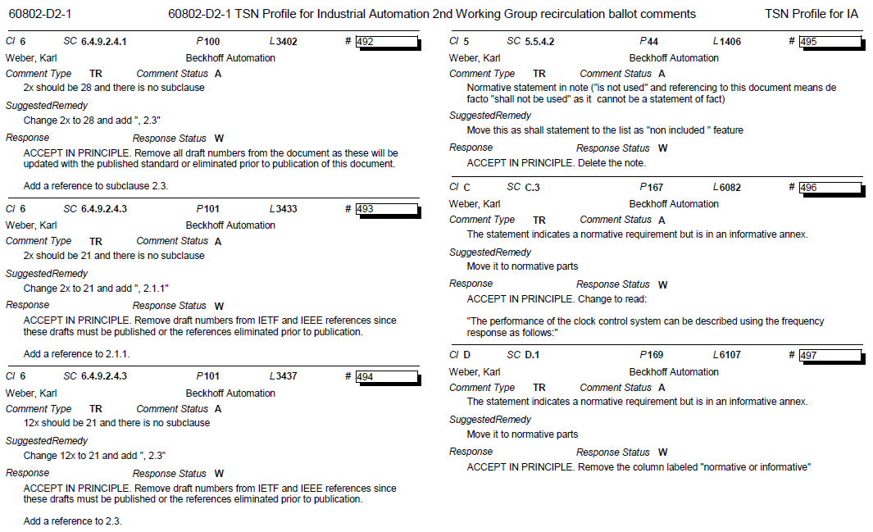
Supporting Information IEC/IEEE 60802

Slide 14
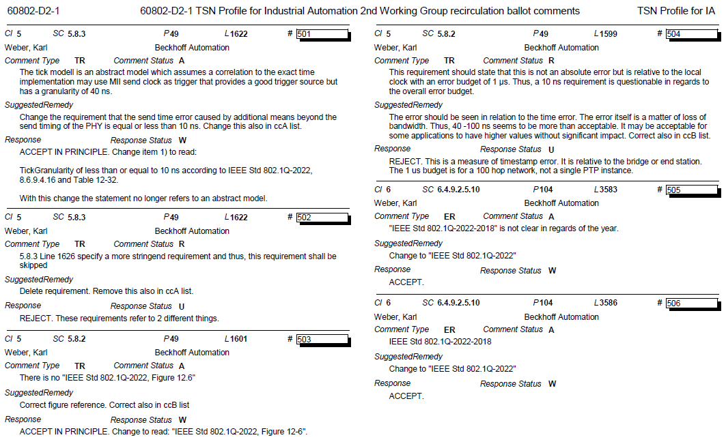
Supporting Information IEC/IEEE 60802

Slide 15
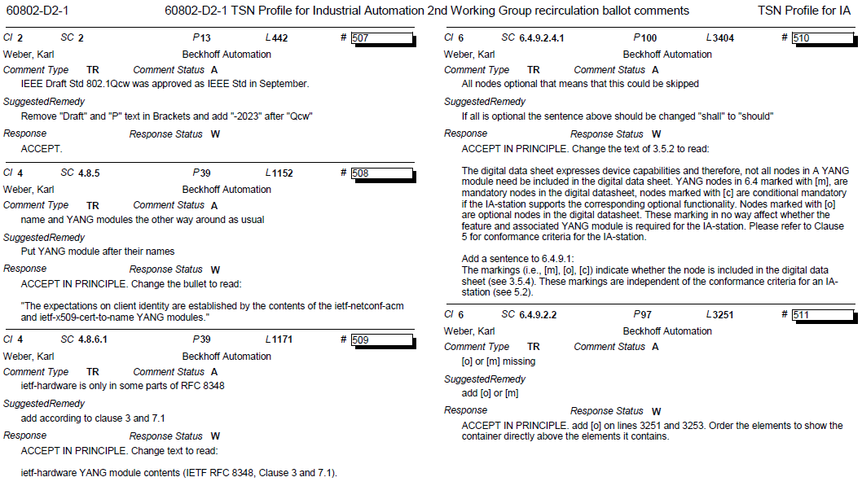
Supporting Information IEC/IEEE 60802

Slide 16
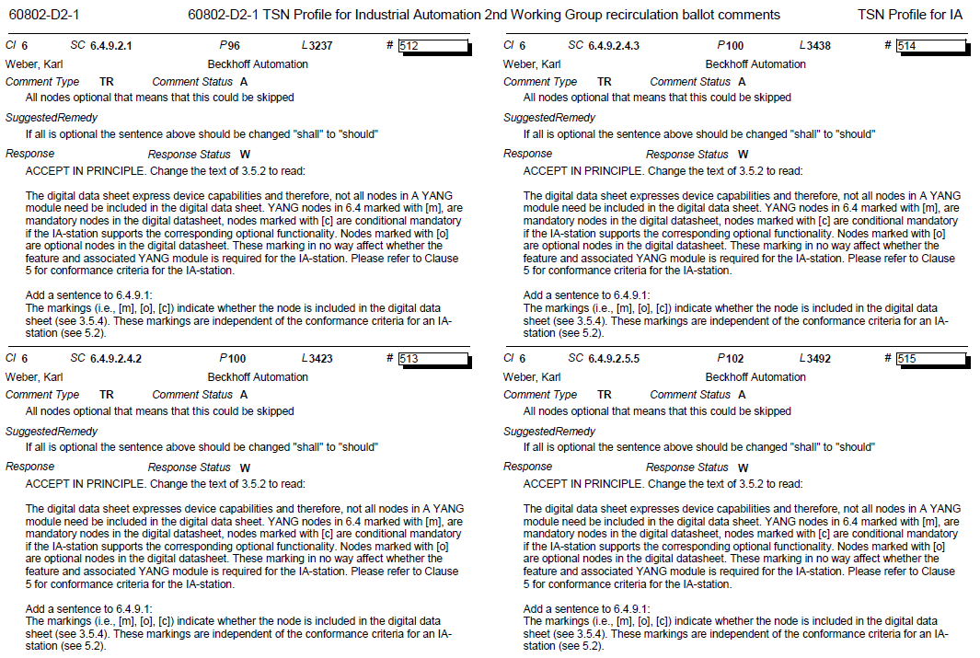
Supporting Information IEC/IEEE 60802

Slide 17
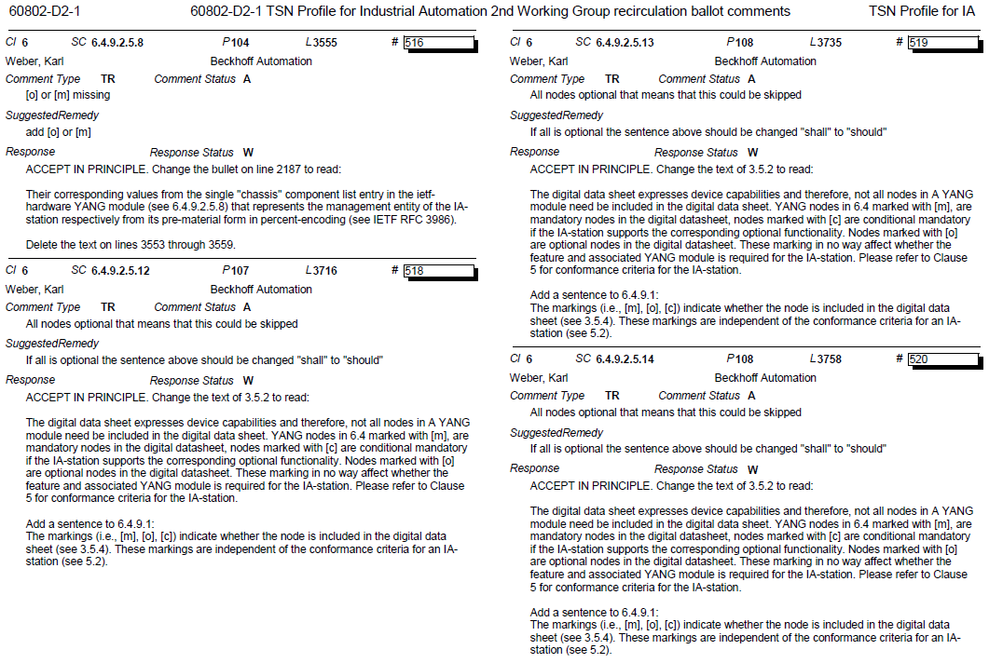
Supporting Information IEC/IEEE 60802

Slide 18
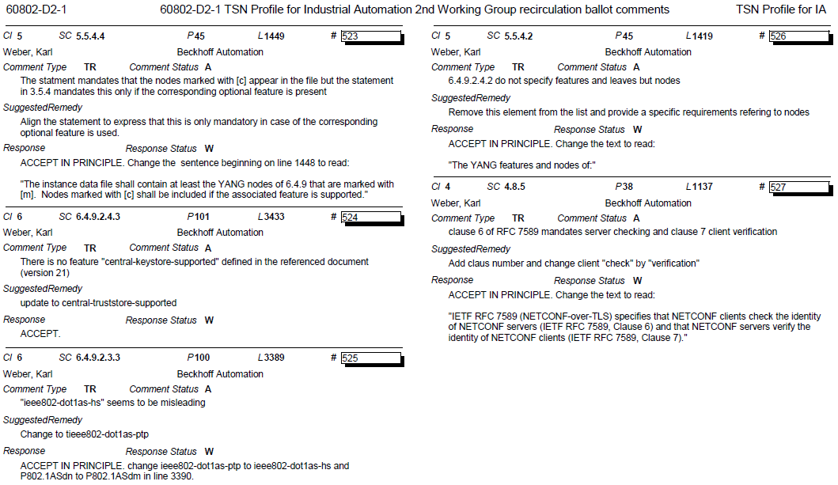
Supporting Information IEC/IEEE 60802

Slide 19
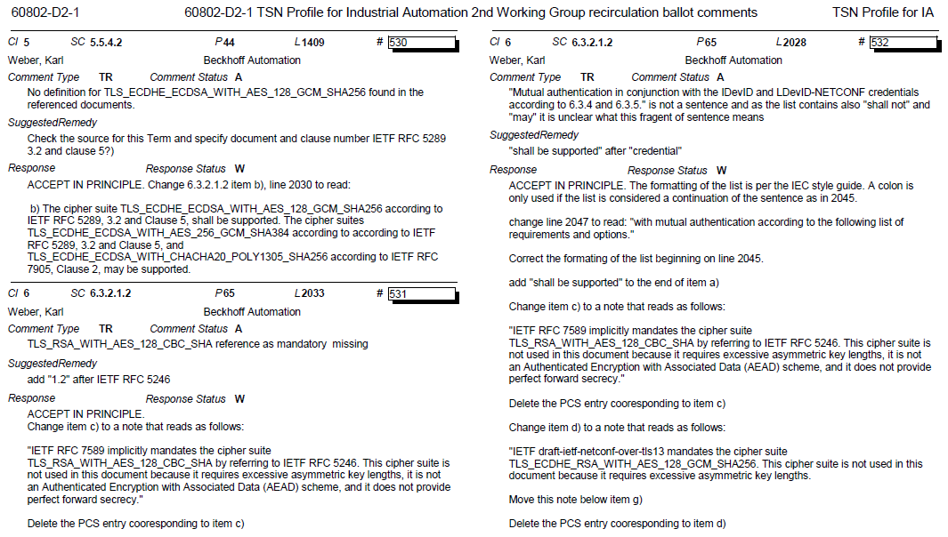
Supporting Information IEC/IEEE 60802

Slide 20
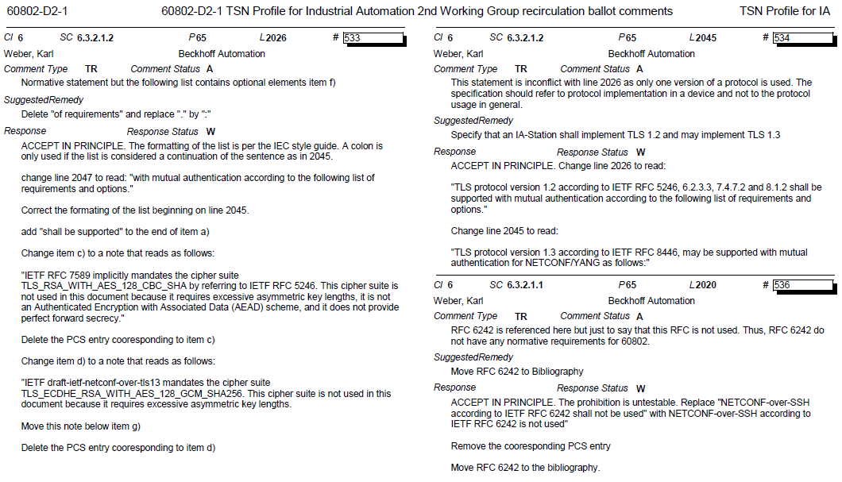
Supporting Information IEC/IEEE 60802

Slide 21
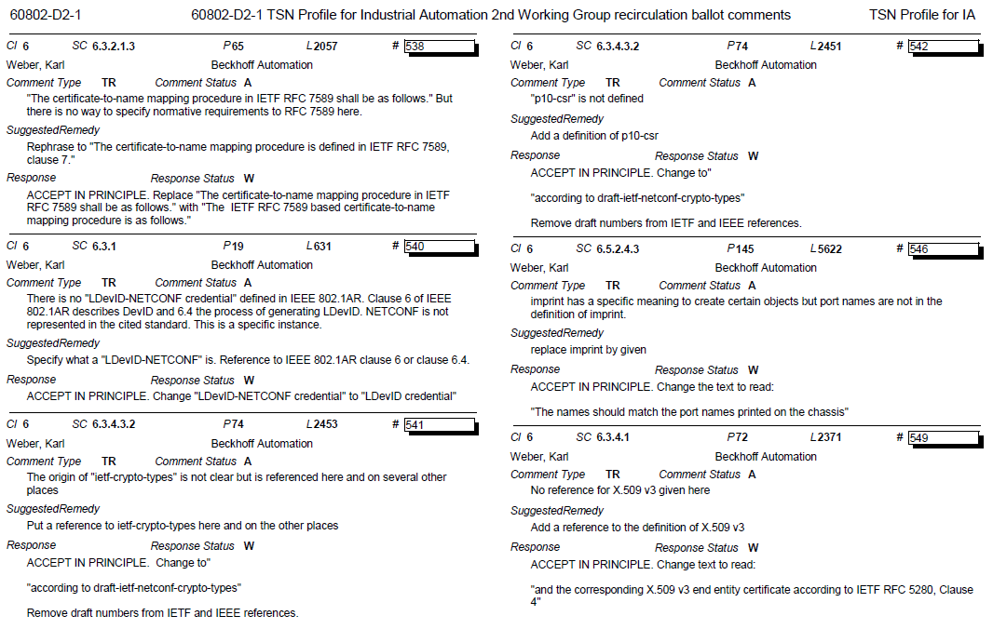
Supporting Information IEC/IEEE 60802

Slide 22
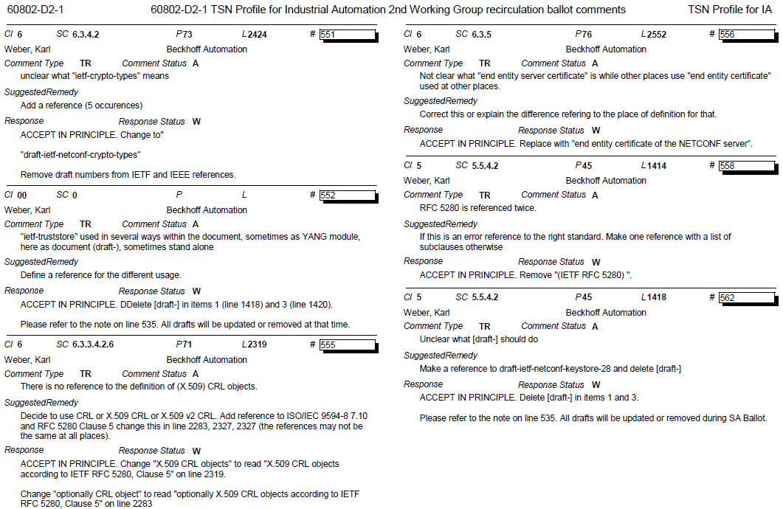
Supporting Information IEC/IEEE 60802

Slide 23
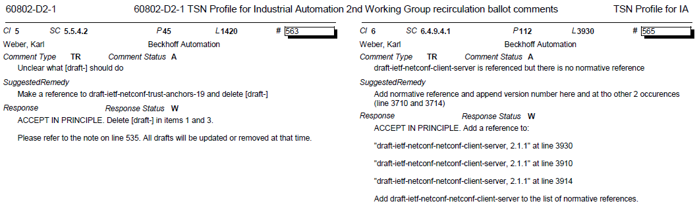
Supporting Information IEC/IEEE 60802

Slide 24
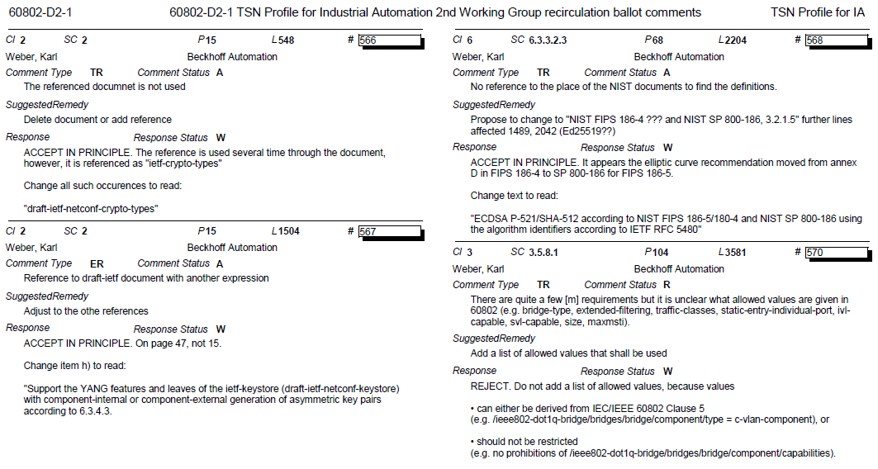
Supporting Information IEC/IEEE 60802

Slide 25
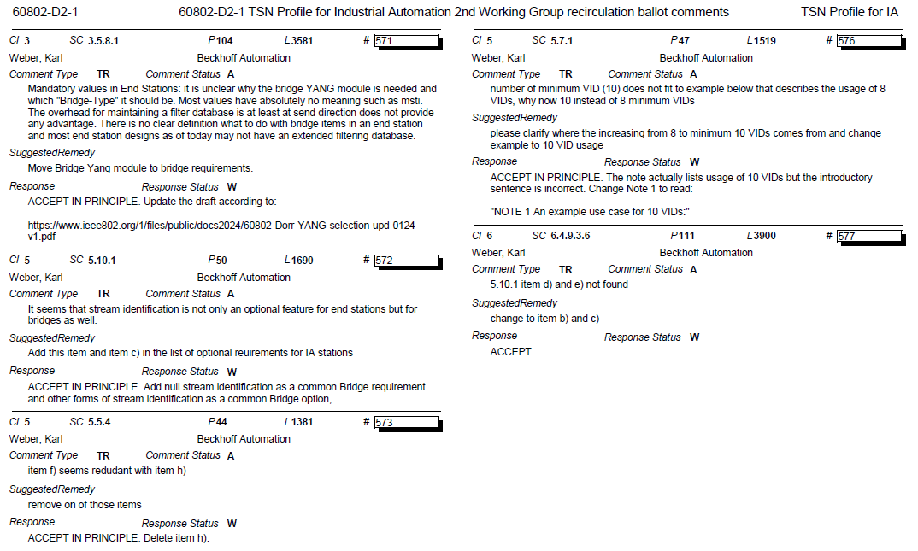
Supporting Information IEC/IEEE 60802

Slide 26
5.023 - Motion
Conditionally approve sending P802-REVc D2.0 to Standards Association Ballot
  Note: there is no CSD statement since this maintenance project is not intended to provide any new functionality
P802-REVc D1.2 had 88% approval at the end of the last WG ballot
In the WG, Proposed: Mark Hantel, Second: Karen Randall
  Sending draft (y/n/a): <y>,<n>,<a>
In EC, mover: Glenn Parsons, Second: Roger Marks
  (y/n/a): <y>,<n>,<a>

Slide 27
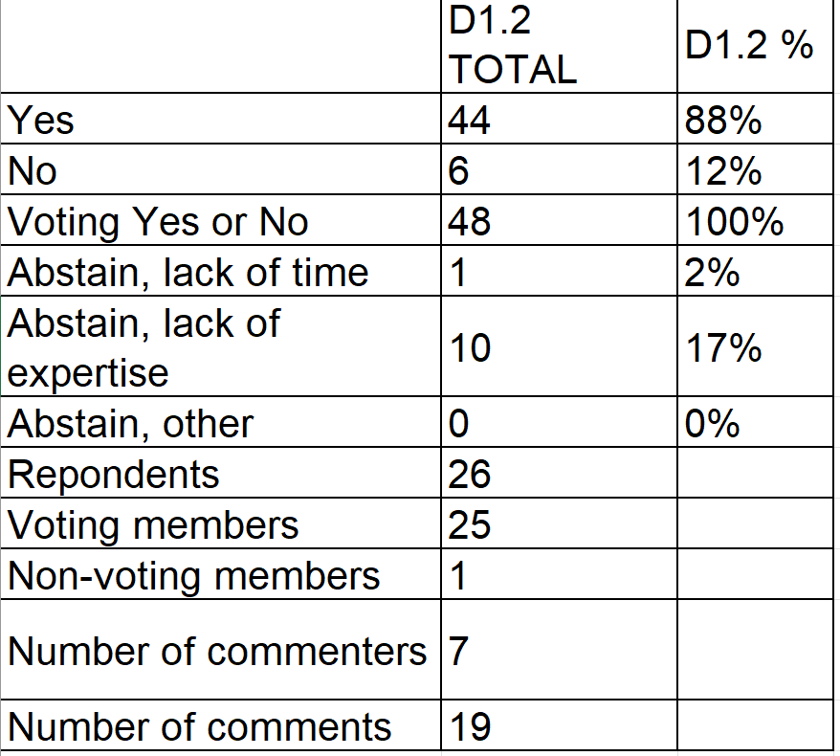
Supporting Information P802-REVc
D1.2 WG recirculation ballot closed: 11 January 2024
All WG ballot requirements are met
The ballot resulted in
  9 outstanding no voters over 3 WG ballots
  9 Must Be Satisfied (MBS) comments on D1.2
  56 MBS comments on D1.1
  99 MBS comments on D1.0
Current Comment resolution available here: https://www.ieee802.org/1/files/private/802-REVc-drafts/d1/802-REVc-d1-2-comments-dis.pdf
Recirculation ballot will be conducted late March/early April with comment resolution in mid-April. A possible final recirculation in late April/early May if required with comment resolution at the May 802.1 interim meeting.
Ballot results:

Slide 28
Supporting Information P802-REVc
Voters maintaining Disapprove vote from initial WG ballot on D1.0, as well as recirc on D1.1 and recirc on D1.2
  Joe Levy
  Mark Hamilton
  Roger Marks
  Johannes Specht
  Jessy Rouyer
  Geoff Thompson
  Dorothy Stanley
  Craig Gunther
  Weiyi Li
MBS comments associated with the maintained Disapprove vote are on the following slides

Slide 29
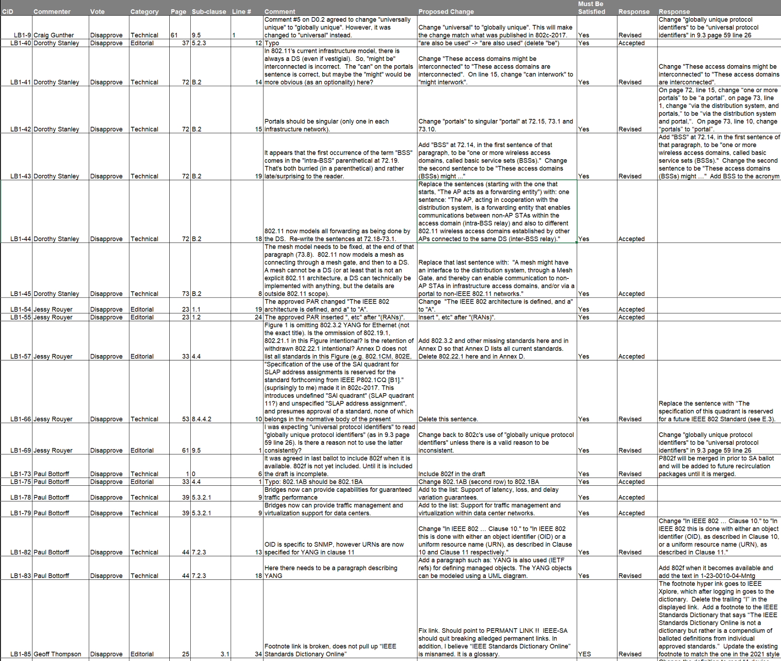
Supporting Information P802-REVc
Outstanding MBS Comments
https://mentor.ieee.org/802.1/dcn/24/1-24-0016-01-Mntg-p802-revc-unsatisfied-comments.ods

Slide 30
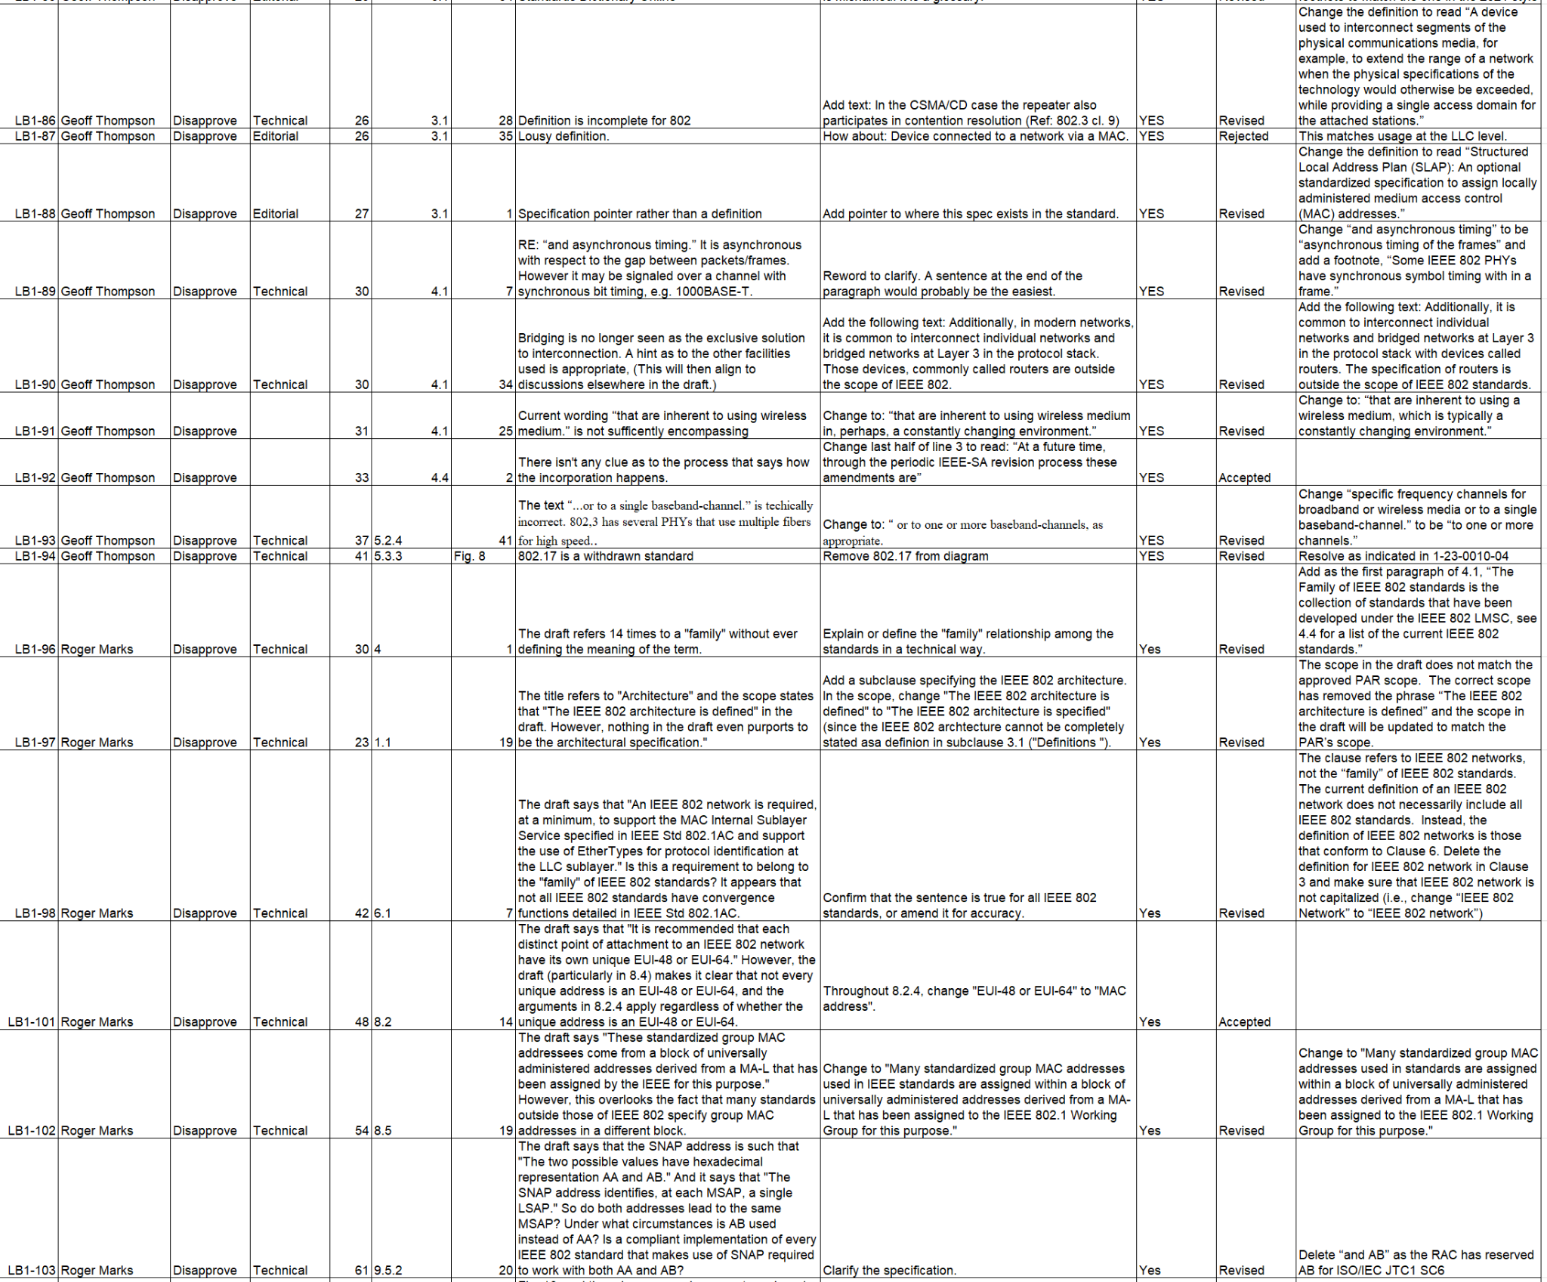
Supporting Information P802-REVc
Outstanding MBS Comments

Slide 31
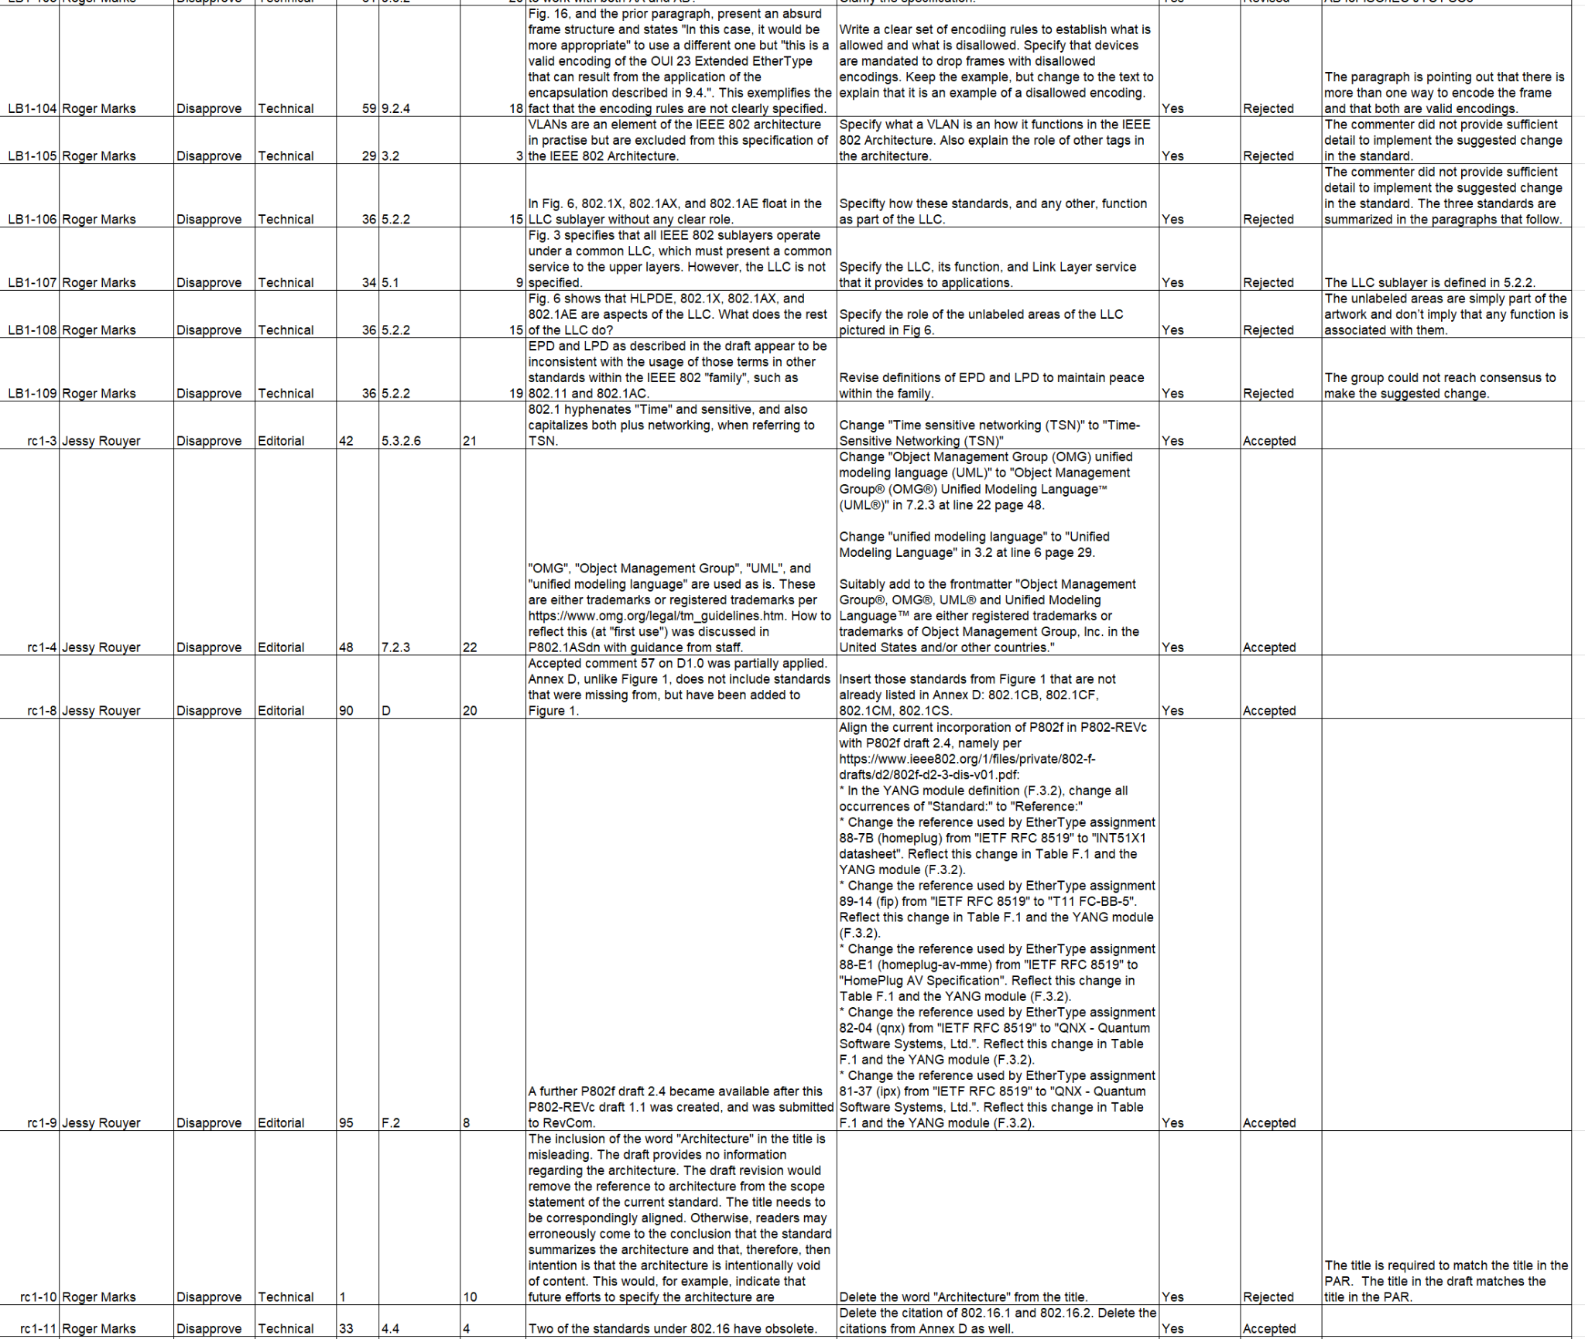
Supporting Information P802-REVc
Outstanding MBS Comments

Slide 32
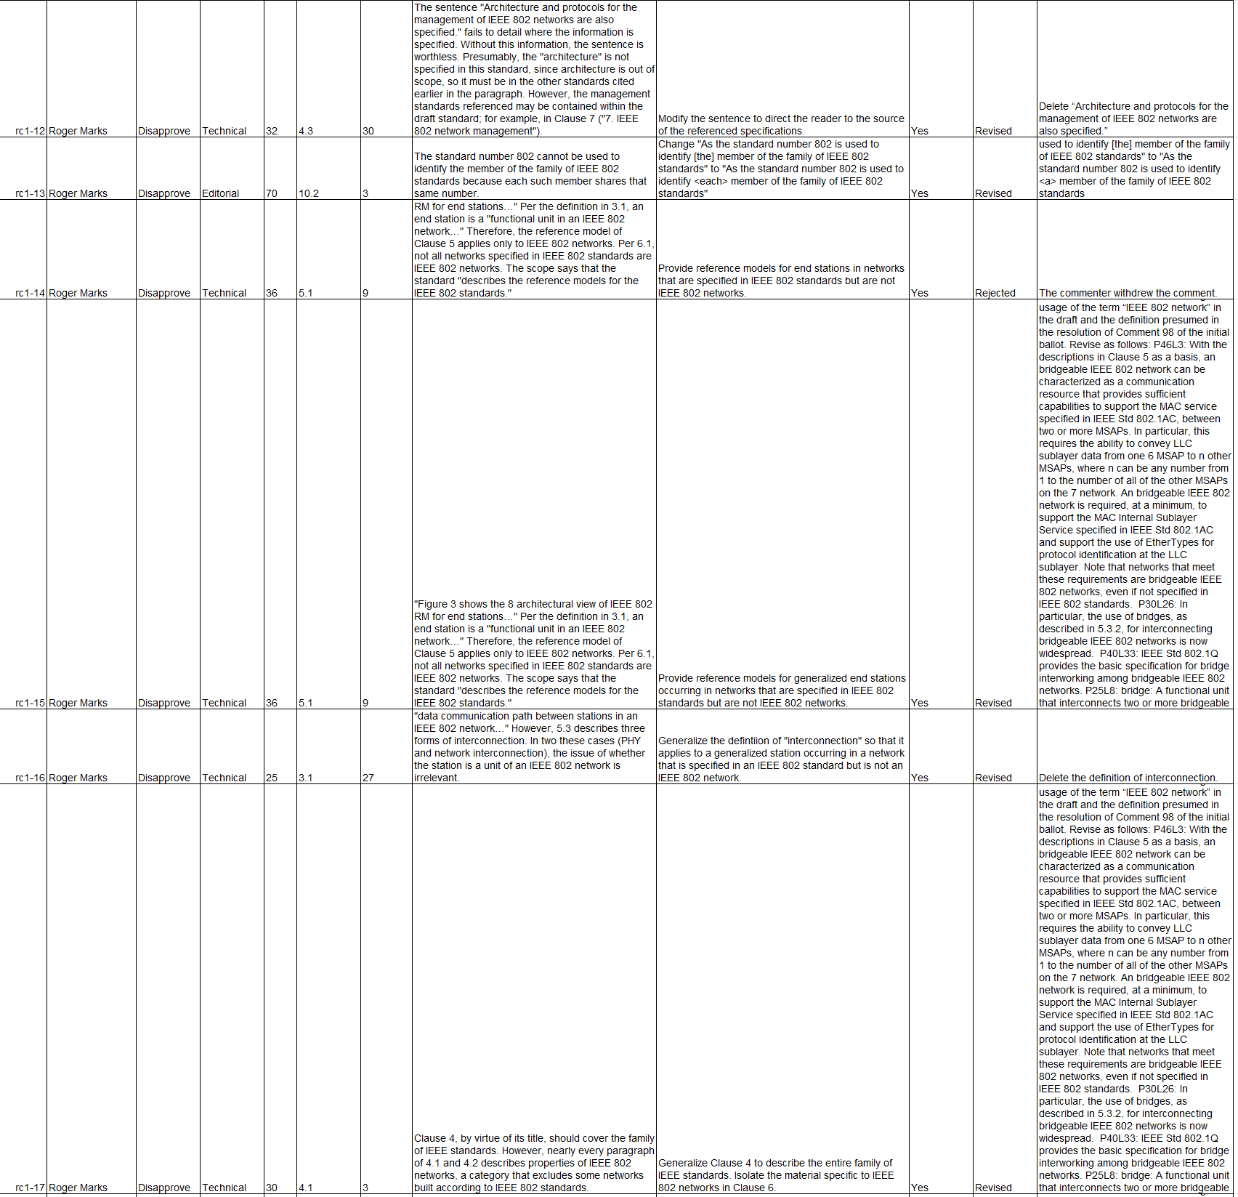
Supporting Information P802-REVc
Outstanding MBS Comments

Slide 33
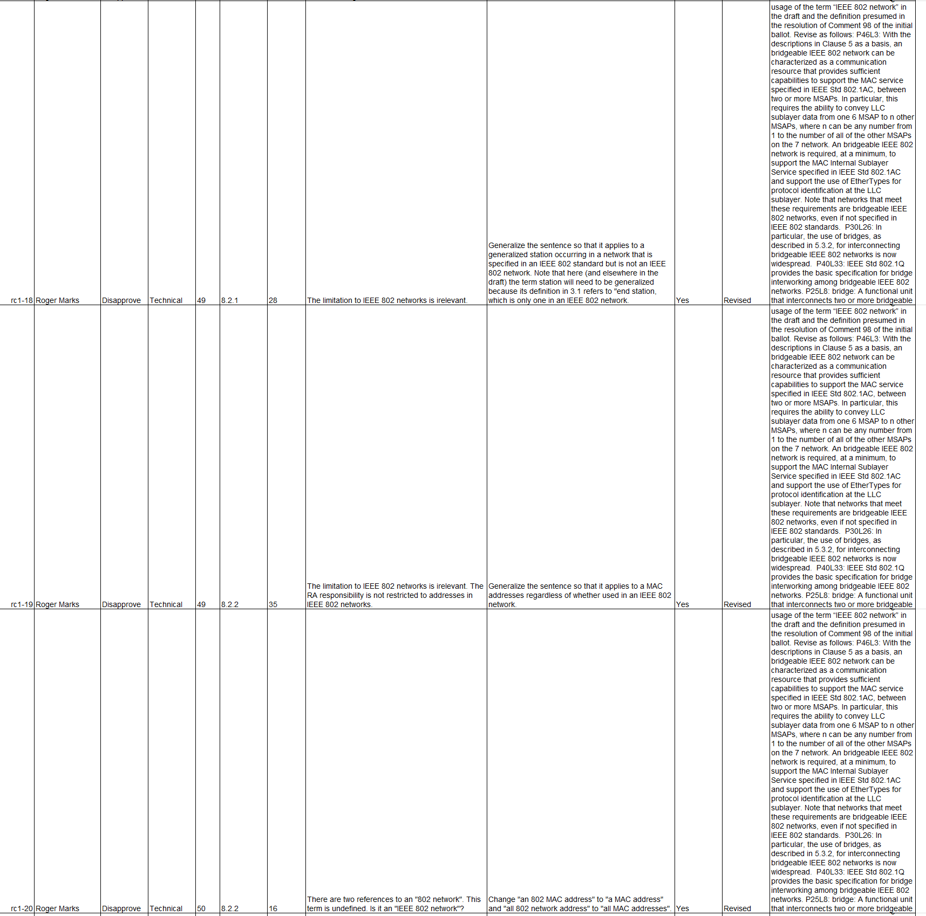
Supporting Information P802-REVc
Outstanding MBS Comments

Slide 34
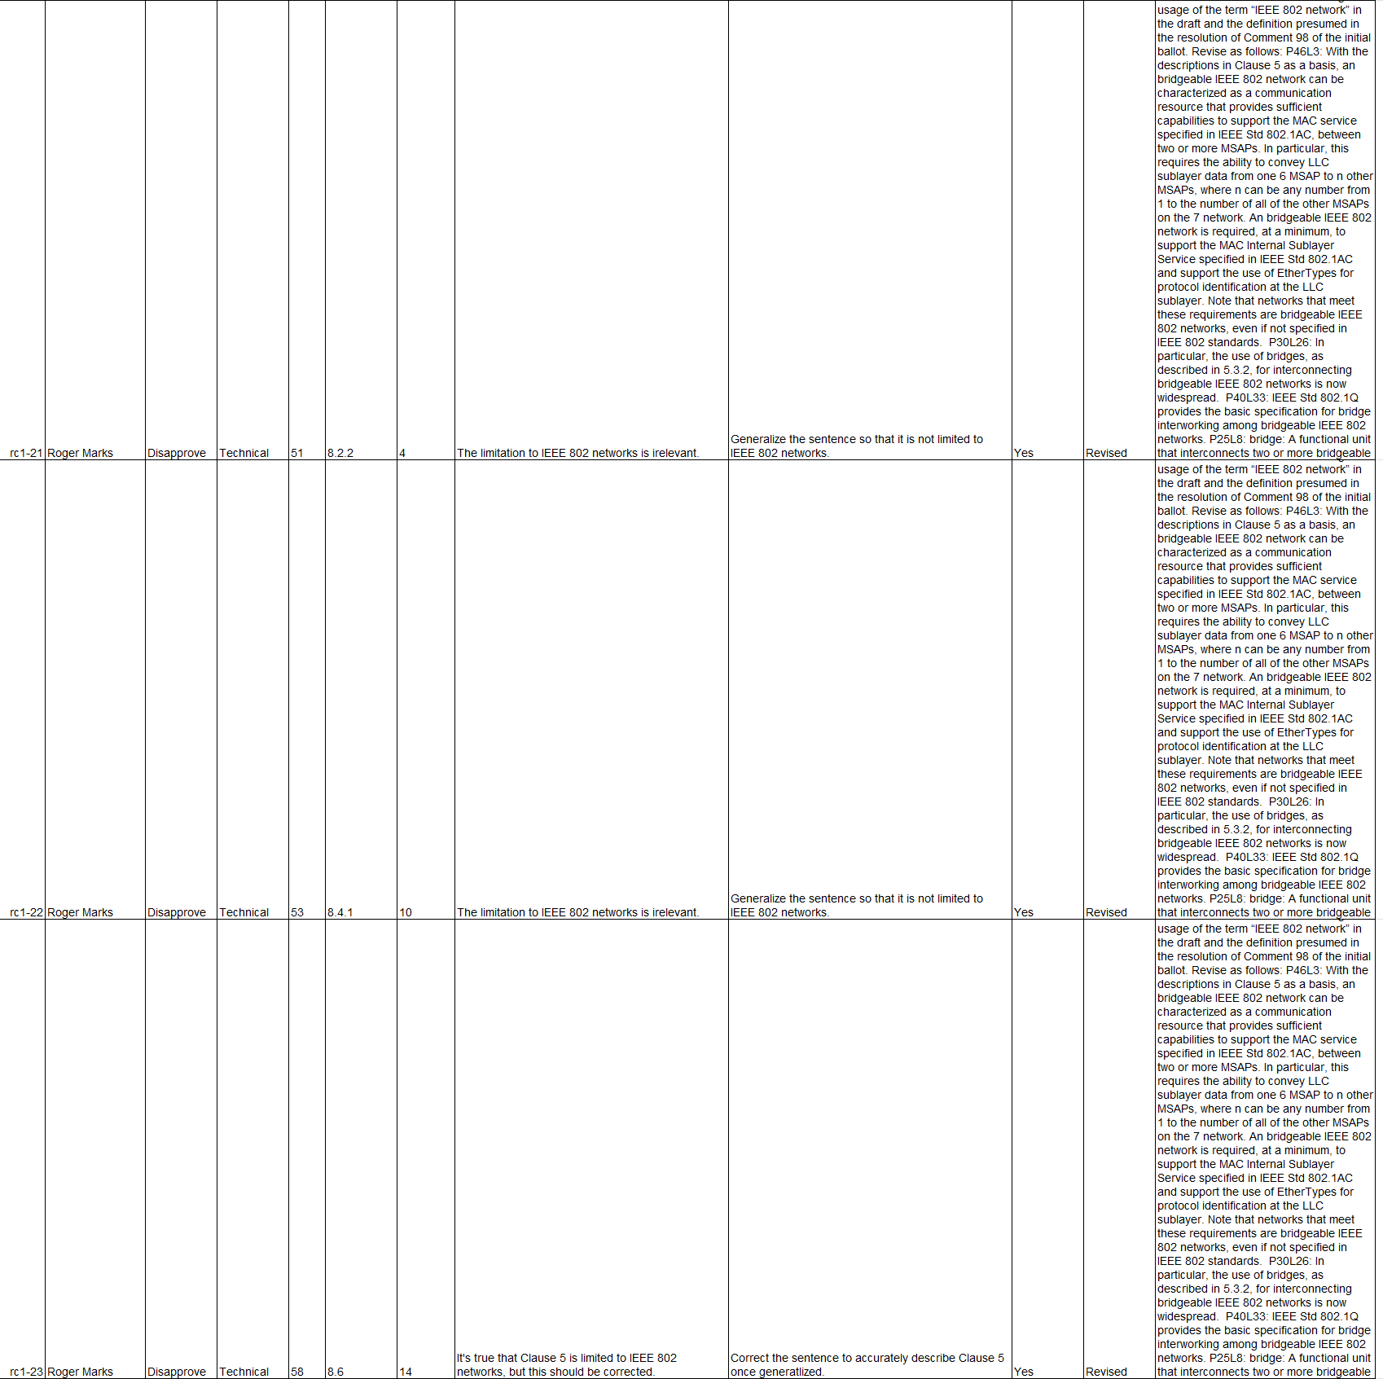
Supporting Information P802-REVc
Outstanding MBS Comments

Slide 35
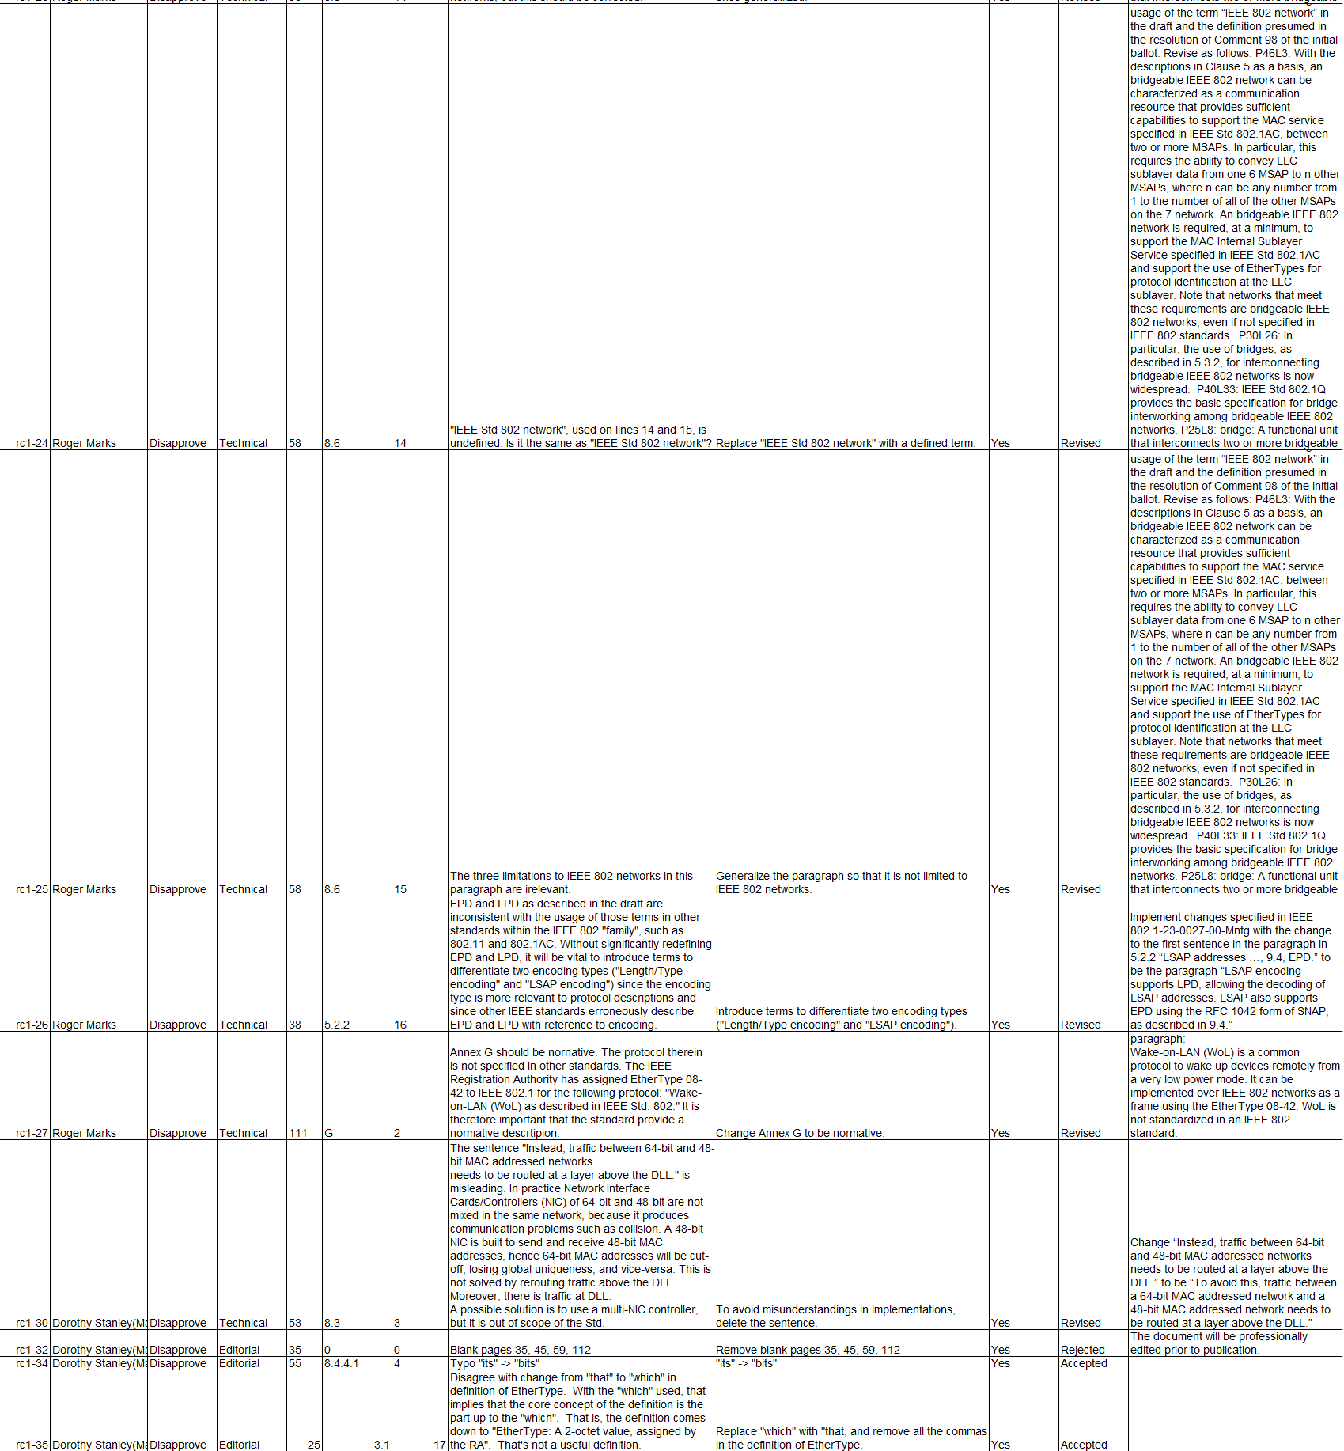
Supporting Information P802-REVc
Outstanding MBS Comments

Slide 36
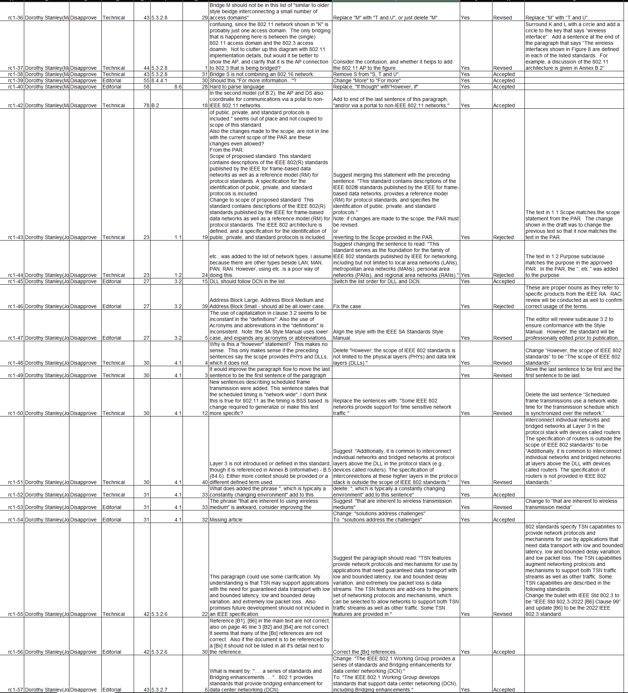
Supporting Information P802-REVc
Outstanding MBS Comments

Slide 37
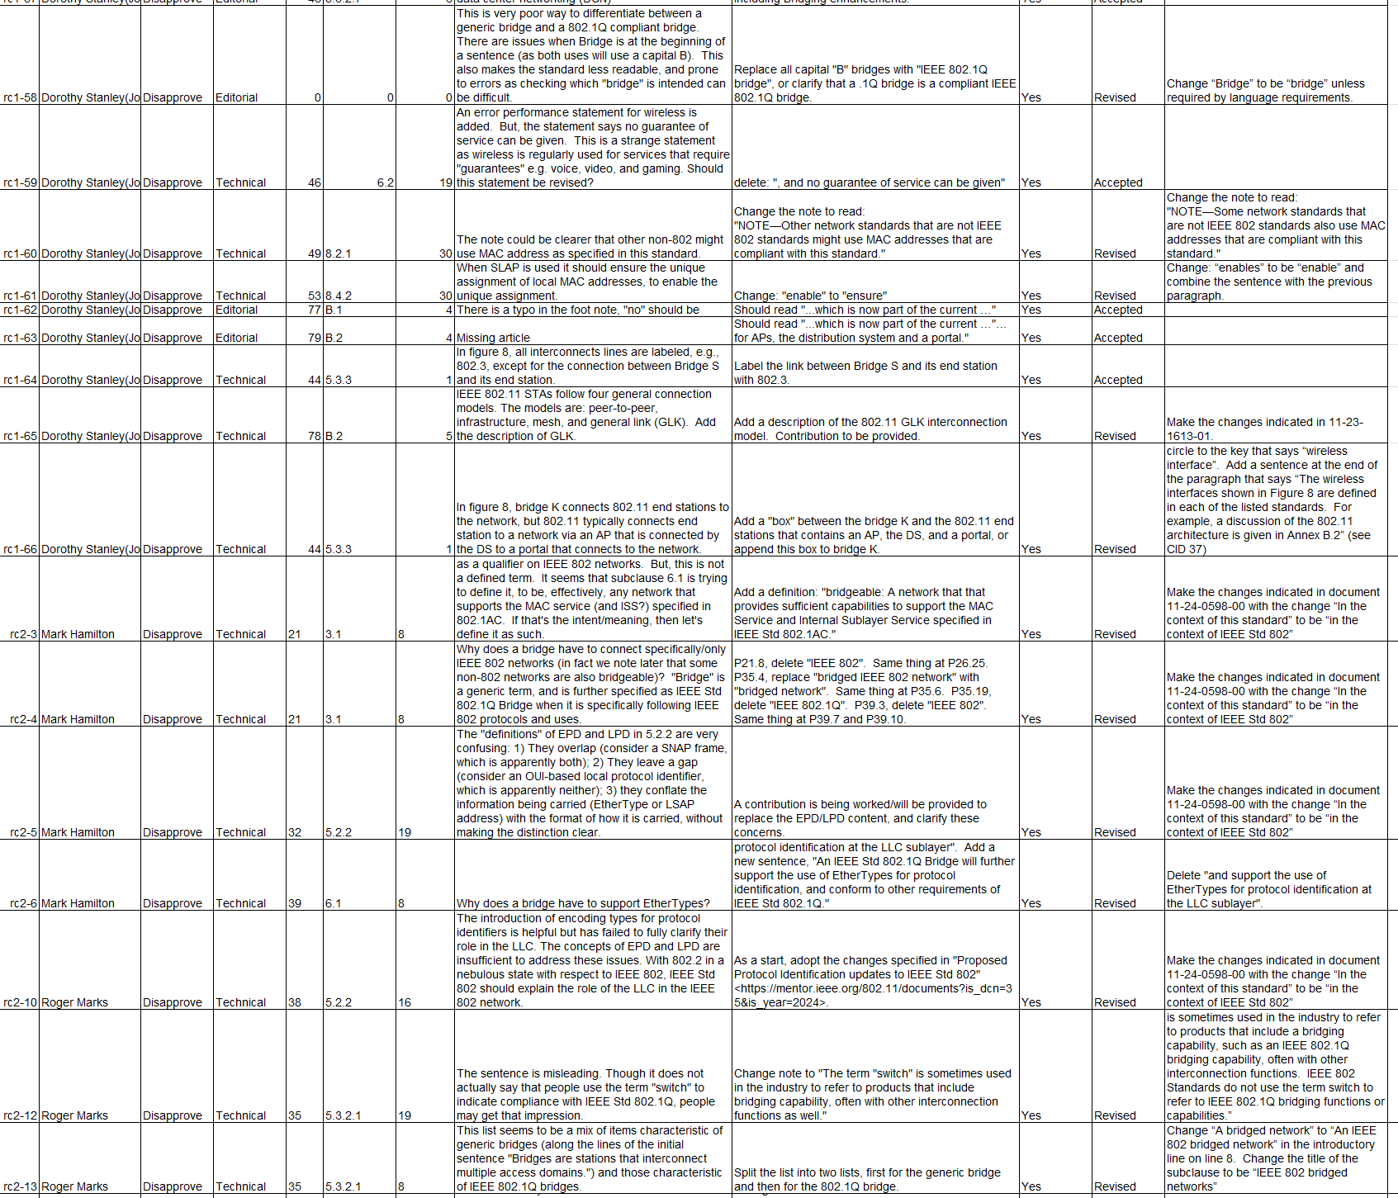
Supporting Information P802-REVc
Outstanding MBS Comments

Slide 38
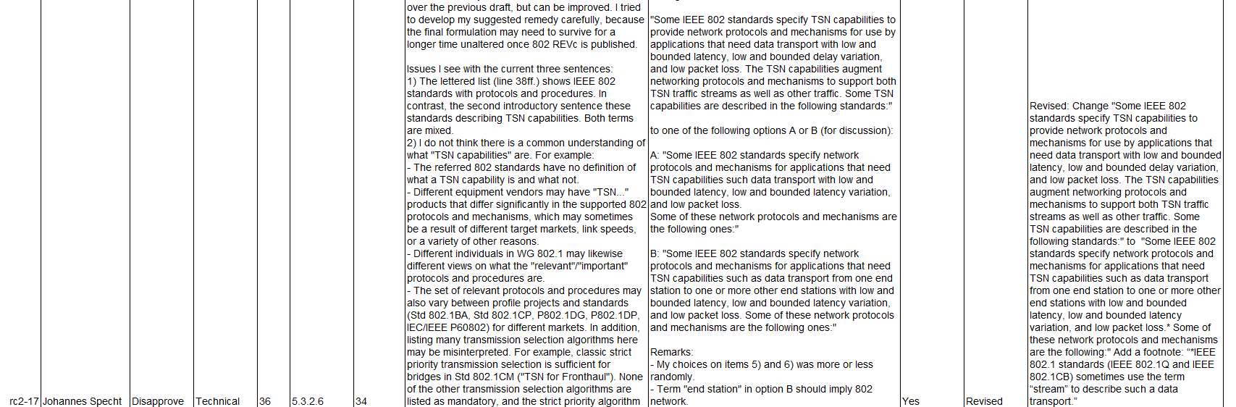
Supporting Information P802-REVc
Outstanding MBS Comments

Slide 39
802.1 Motions
2024-03
Consent Agenda
Drafts to RevCom

Slide 40
5.026 - Motion
Approve sending P802.1Qdj to RevCom
Approve CSD documentation in https://mentor.ieee.org/802-ec/dcn/19/ec-19-0139-00-ACSD-p802-1qdj.pdf
P802.Qdj D2.2 had 100% approval at the end of the last SA ballot
In the WG, Proposed: Stephan Kehrer, Second: János Farkas
  Sending draft (y/n/a): <y>,<n>,<a>
  CSD (y/n/a): <y>,<n>,<a>
In EC, mover: Glenn Parsons, Second: Roger Marks
  (y/n/a): <y>,<n>,<a>

Slide 41
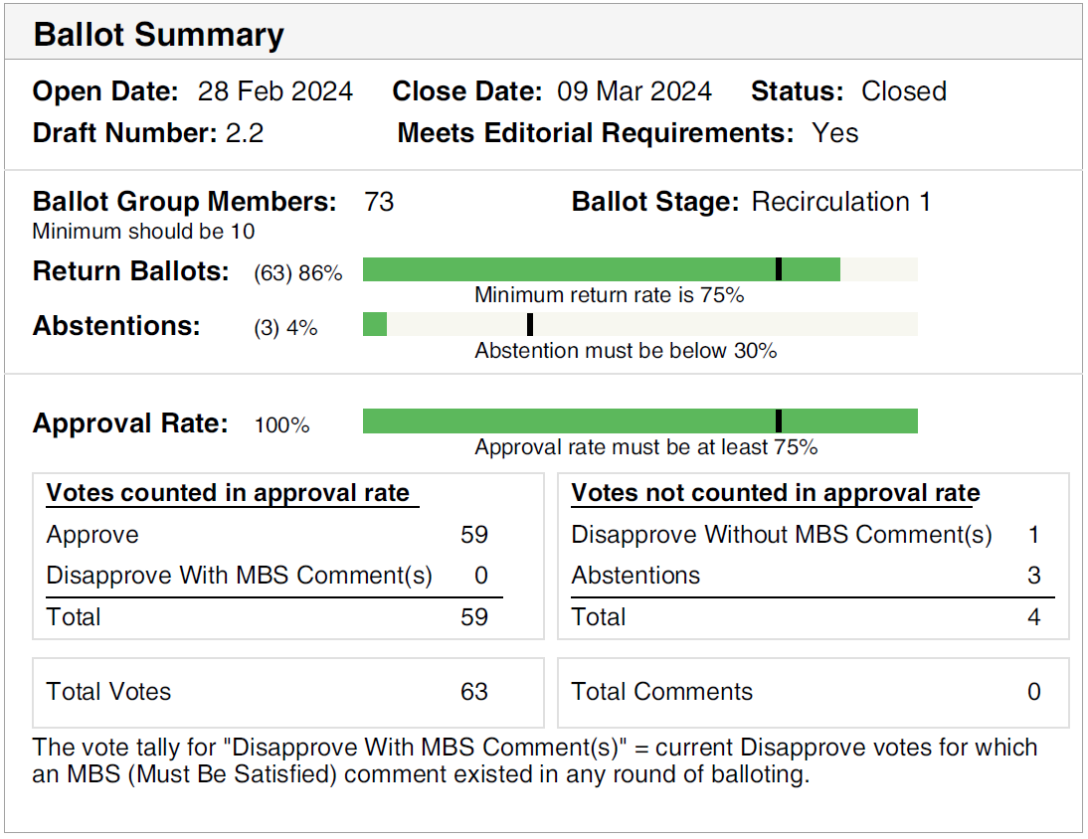
Supporting Information P802.1Qdj
SA ballot closed:
  9 March 2024
All SA ballot requirements
are met
The ballot resulted in
  100% approval
  1 Disapprove vote
  without any comments,
  maintained from initial
  SA ballot
  0 comments
Disposition: https://www.ieee802.org/1/files/private/dj-drafts/d2/802-1Qdj-d2-2-dis-v01.pdf

Slide 42
5.029 - Motion
Conditionally approve sending P802.1Qdx to RevCom
Approve CSD documentation in https://mentor.ieee.org/802-ec/dcn/23/ec-23-0075-00-ACSD-p802-1qdx.pdf
P802.Qdx D2.0 had 98% approval at the end of the last SA ballot
In the WG, Proposed: János Farkas, Second: Mick Seaman
  Sending draft (y/n/a): <y>,<n>,<a>
  CSD (y/n/a): <y>,<n>,<a>
In EC, mover: Glenn Parsons, Second: Roger Marks
  (y/n/a): <y>,<n>,<a>

Slide 43
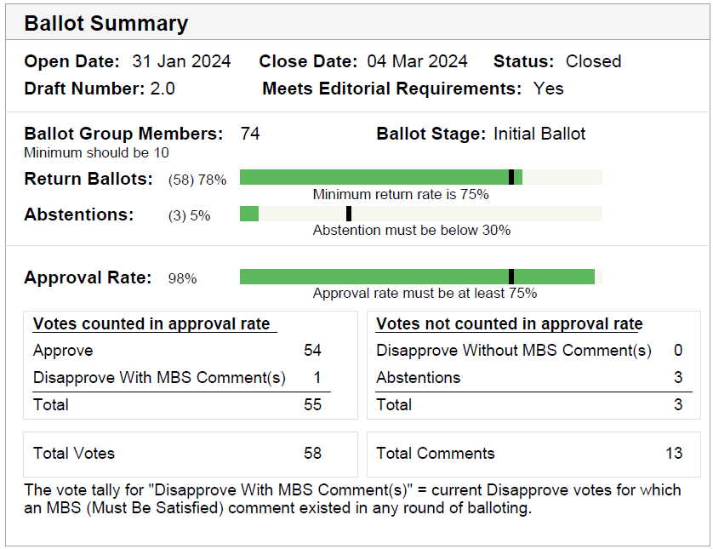
Supporting Information P802.1Qdx
SA ballot closed: 4 March 2024
All SA ballot requirements are met
The ballot resulted in
  1 Disapprove votes with
  2 Must Be Satisfied (MBS) comments
Comment resolution available here: https://ieee802.org/1/files/private/dx-drafts/d2/802-1Qdx-d2-0-dis-v01.pdf
Recirculation ballot will be conducted during April/May with comment resolution in the regularly scheduled TSN TG meetings. A possible final recirculation in May/June if required with comment resolution in the regularly scheduled TSN TG meetings.

Slide 44
Supporting Information P802.1Qdx
Voters with Disapprove vote
  Rodney Cummings
MBS comments associated with the Disapprove vote are on the following slide

Slide 45
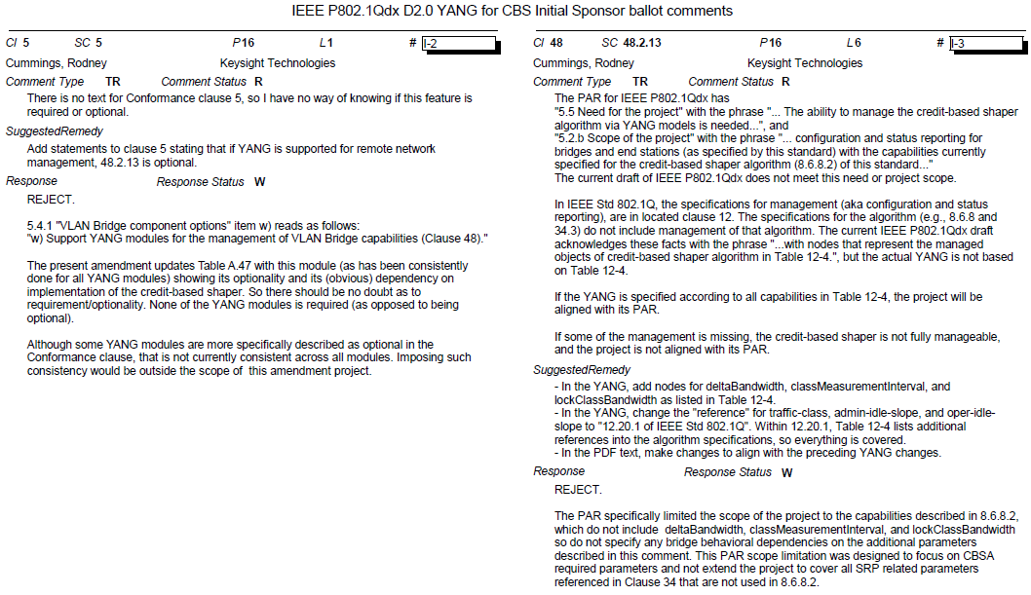
Supporting Information P802.1Qdx

Slide 46
802.1 Motions
2024-03
Consent Agenda
Liaisons and external communications (ME)

Slide 47
Motion
Approve submission of the following drafts when published to ISO/IEC JTC1/SC6 for adoption under the PSDO agreement:
    IEEE 802.1Qdj, IEEE 802.1Qdx
  In the WG, Proposed: Mark Hantel Second: Karen Randall
  Sending draft (y/n/a): <y>,<n>,<a>
In EC, mover: Glenn Parsons Second: Roger Marks
  (y/n/a): <y>,<n>,<a>

Slide 48
Motion
Approve submission of the following comment responses to ISO/IEC JTC1/SC6 for adoption under the PSDO agreement:
  IEEE 802.1Qcw-2023
    https://www.ieee802.org/1/files/public/docs2024/liaison-randall-SC6CommentResponseQcw-0324.pdf
  IEEE 802.1Qcj-2023
    https://www.ieee802.org/1/files/public/docs2024/liaison-randall-SC6CommentResponseQcj-0324.pdf
In the WG, Proposed: Mark Hantel Second: Karen Randall
  Sending draft (y/n/a): <y>,<n>,<a>
In EC, mover: Glenn Parsons Second: Roger Marks
  (y/n/a): <y>,<n>,<a>

Slide 49
7.032 - Motion
Approve https://www.ieee802.org/1/files/public/docs2024/liaison-itu-t-sg15-LS89-OTNTSWP33-ieee8021status-0324.pdf as communication to ITU-T SG15 on LS89: LS on OTNT Standardization Work Plan Issue 33, granting the IEEE 802.1 WG chair (or his delegate) editorial license.
  This approval is under LMSC OM “Procedure for public statements to government bodies”
In the WG, Proposed: Mark Hantel Second: Karen Randall
  Sending draft (y/n/a): <y>,<n>,<a>
In EC, mover: Glenn Parsons Second: Roger Marks
  (y/n/a): <y>,<n>,<a>

Slide 50
7.033 - Motion
Approve https://www.ieee802.org/1/files/public/docs2024/liaison-response-itu-t-JCA-RoadmapIMT2020-0324.pdf as communication to ITU-T JCA on LS14: LS on Invitation to update the information in the IMT2020 roadmap, granting the IEEE 802.1 WG chair (or his delegate) editorial license.
  This approval is under LMSC OM “Procedure for public statements to government bodies”
In the WG, Proposed: Mark Hantel Second: Karen Randall
  Sending draft (y/n/a): <y>,<n>,<a>
In EC, mover: Glenn Parsons Second: Roger Marks
  (y/n/a): <y>,<n>,<a>

Slide 51
802.1 Motions
2024-03
Consent Agenda
Liaisons and external communications (II)

Slide 52
7.034 - Motion
Approve https://www.ieee802.org/1/files/public/docs2024/liaison-response-BroadbandForum-YANG-0324-v01.pdf as communication to Broadband Forum, granting the IEEE 802.1 WG chair (or his delegate) editorial license.
Proposed: Stephan Kehrer
Second: Jessy Rouyer
In the WG (y/n/a): <y>, <n>, <a>
In the EC, for information (or motion to block)

Slide 53
7.035 - Motion
Approve https://www.ieee802.org/1/files/public/docs2024/liaison-response-ieee1588-P8021ASebPARcomments-0324-v01.pdf as communication to IEEE 1588 WG, granting the IEEE 802.1 WG chair (or his delegate) editorial license.
Proposed: Don Pannell
Second: Jessy Rouyer
In the WG (y/n/a): <y>, <n>, <a>
In the EC, for information (or motion to block)

