Slide 1
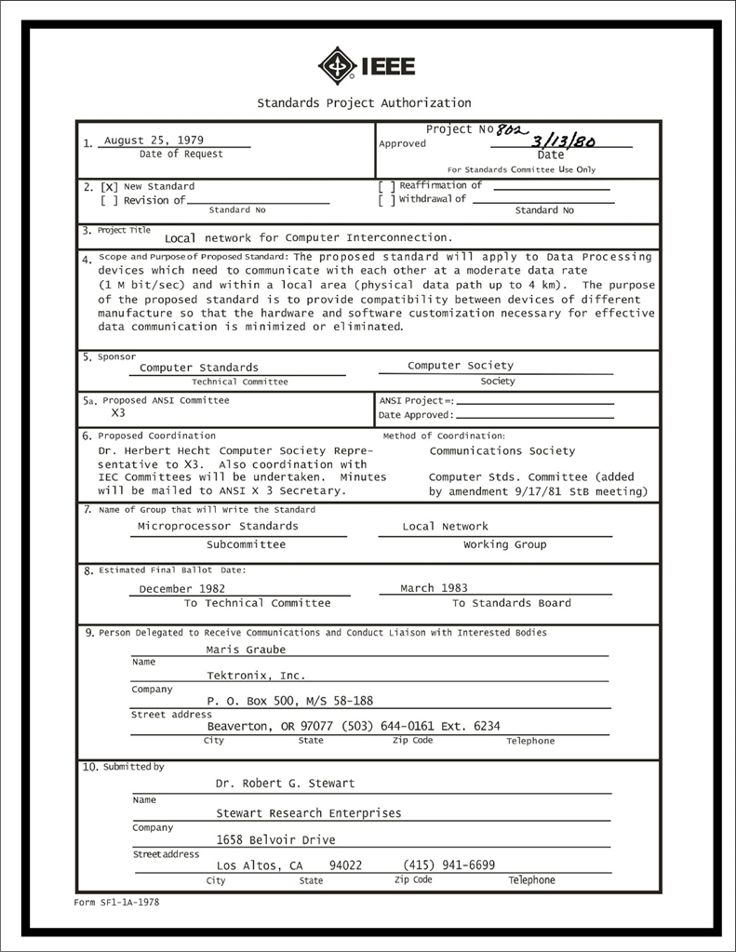
IEEE 802 LMSC Executive Committee 06 February 2024 Electronic Meeting 19:00-21:00 UTC 14:00-16:00 ET
DCN ec-24-0035-00-00EC

Slide 2
1.00 Meeting called to order/roll call
2.00 Review/modify/approve agenda
2.01 Participation Slide Set URLs:
https://ieee802.org/sapolicies.shtml
https://standards.ieee.org/content/dam/ieee-standards/standards/web/documents/other/Participant-Behavior-Individual-Method.pdf
Participant behavior is guided by IEEE Code of Ethics & Conduct
Participants shall act independently of others, including employers
Standards activities shall allow the fair & equitable consideration of all viewpoints
2.02 Approval of 09JAN2024 minutes (consent agenda)

Slide 3
3.00 Chair’s Announcements
Proforma:
Use IMAT to log your attendance
Please enable mute when you are not speaking
Please use the chat function to request being put in the queue
Other
tbd

Slide 4
3.001 IEEE 802 Milestone Update
IEEE 802 Milestone Plaque ‘early viewing’ at March 802 Plenary Social
Short (15 minute) ceremony planned
Objective is to give visibility and credit to the hard-working dedicated IEEE 802 volunteers that made the Milestone possible
Invites issued to IEEE leadership, waiting for responses
Formal dedication ceremony to be held 19 May 2024 at Stanford University Memorial Auditorium
Public event, all are welcome to attend

Slide 5
3.002 802 Election/Appointment Process
Prior to start of March 2024 plenary session (8amMT Monday 11 March 2024)
Potential LMSC Chair candidates shall declare candidacy
Candidate(s) shall identify individuals to serve in LMSC appointed officer positions
James Gilb is the only candidate at this time.
At the closing plenary meeting
1. LMSC Chair-Elect to be elected by current Working Group and Technical Advisory Group Chairs.
2. Nikolich appoints individuals as identified by the eventual LMSC Chair-Elect.
3. Confirmation of Nikolich’s appointments by current EC voting members will be considered.
4. Confirmation of LMSC WG/TAG Chair and Vice-Chair elections will be considered by current EC voting members.
5. Confirmation of elected WG/TAG chairs and vice chairs will be considered by current EC voting members.
6. Confirmation of appointed Hibernating WG Chairs will be considered by current EC voting members. will be considered by current EC voting members.
7. Confirmation of appointed Standing Committee chairs will be considered by current EC voting members. will be considered by current EC voting members.
Details at https://mentor.ieee.org/802-ec/dcn/23/ec-23-0168-00-00EC-march-2024-802-ec-election-process.pdf

Slide 6
6.00 Any Other Business
Any Other Business?
TBD

Slide 7
9.0 EC Action Item Status Review
Review Action Items from this meeting
tbd

Slide 8
Adjourn EC Meeting

