Slide 1
2023 Social Media Report
Scope
  To raise industry awareness in timely fashion of IEEE 802 WG / TAG activities
  Develop social media content based on IEEE 802 WG / TAG activities
    LinkedIn – https://www.linkedin.com/company/ieee802
    IEEE-SA 802 - https://standards.ieee.org/featured/802/index.html

Slide 2
2023 Public Visibility SC Activities Linkedin Report
  4,348 total followers. 3856 are added in 2023.
  Between 1/6/2023 and 1/7/2024 we got
  15,829 Reactions,
  234 Comments,
  851 Reposts and
  625,861 Impressions.

Slide 3
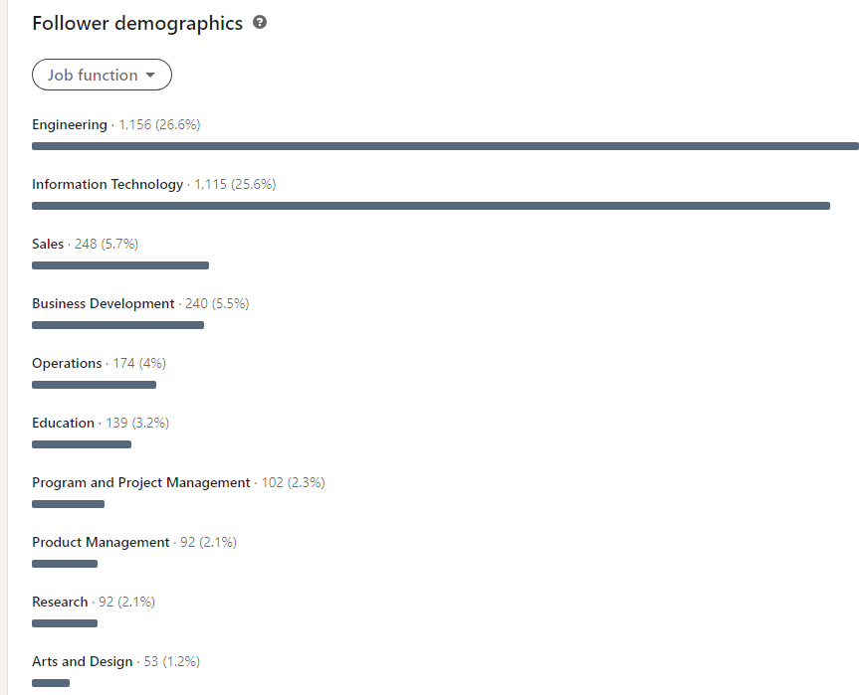

Slide 4
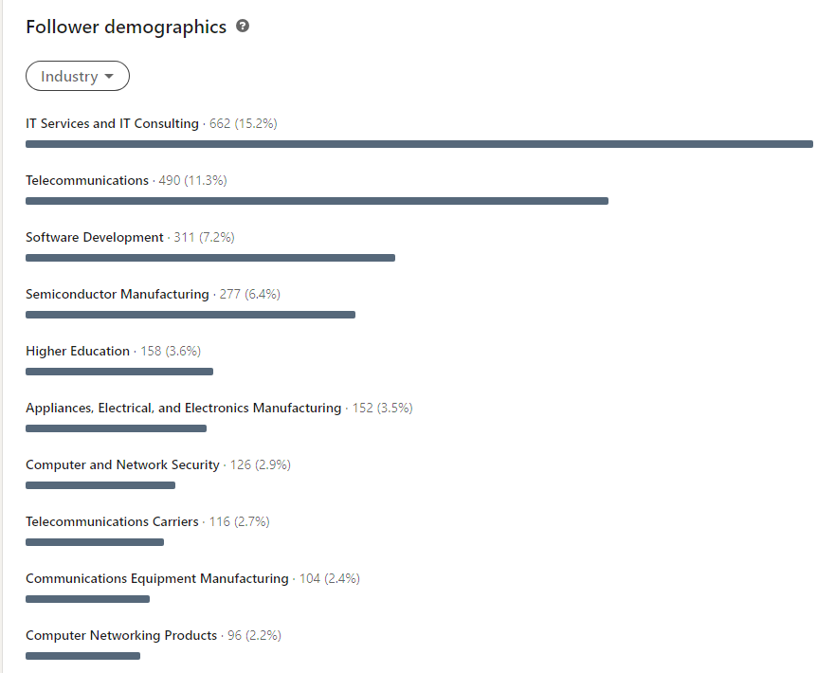

Slide 5
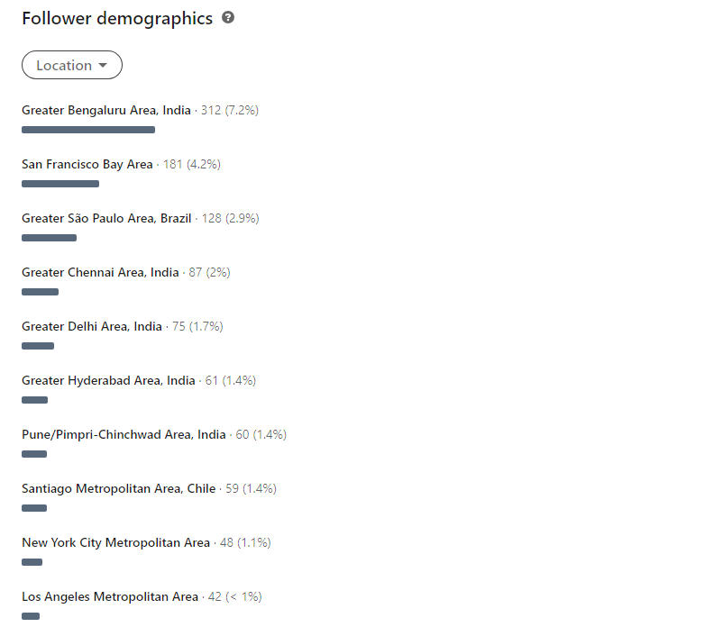

Slide 6
New events
Why Li-Fi Might Be Better Than Wi-Fi An expert on IEEE’s new standard weighs in
IEEE Spectrum Dec 2023
Interview with Volker Jungnickel (802.15.3c chair, 802.11bb editor)
IEEE GEPS Webinar on 802.11: (2024-01-24)
Speaker D. Stanley, H. Yaghoobi, R. DeVegt, E. Au
WI-FI SENSING: USE CASES, STANDARD TECHNOLOGIES, AND ECOSYSTEM ENABLEMENT (IEEE 2024 9–13 June // Denver)
Speakers: Cheng Chen and Carlos Cordeiro (Intel Corporation, USA)

Slide 7

Possible Panel
90 Minutes Deadline March 3rd 2024
Options:
Future of IEEE 802
Next Generation IEEE 802 Wireless Standards

