Slide 1
March 2024 IEEE 802 Plenary Session
Event Summary and Important Information
Prepared By: Face to Face Events, February 28, 2024

Slide 2
Meeting Planner Contact Information
Dawn Slykhouse, Face to Face Events
Mobile: +1 (408) 594-1342
Email: dawns@facetoface-events.com
Lisa Ronmark, Face to Face Events
Mobile: +1 (604) 316-4947
Email: lisa@facetoface-events.com
Stephanie Williams, Face to Face Events
Mobile: +1 (408) 497-9613
Email: stephanie@facetoface-events.com
Meeting Planner Office: Agate A
Registration: Centennial Foyer

Slide 3
Network Access and Support Information
SSID: IEEE802
Password: ieeeieee
Encryption Type: WPA2/WPA3
Supports 2.4 GHz & 5 GHz Wi-Fi
SSID: IEEE802-6G
Password: ieeeieee
Encryption Type: WPA3
Supports 2.4 GHz, 5 GHz & 6Ghz Wi-Fi
IEEE 802 Documents: Local Document Server
http://ieee802.linespeed.com/
Onsite Network Support: Linespeed Events
Members of the Linespeed team can be dispatched by contacting the Meeting Planner directly or by placing a request at the event registration desk.
Linespeed Events
  Richard Alfvin
  Mobile: +1 (585) 781-0952
  Email: rick@linespeed.com
Network Office: Agate B
If the Network Office is closed, please check in with Meeting Planner at the Registration Desk (Centennial Foyer) or Meeting Planner Office (Agate A).

Slide 4
In Person Registration Times and Location
Sunday
  Registration Counter, Centennial Foyer 3rd Floor Hyatt Regency Denver
  5:00 PM - 7:30 PM
Monday - Wednesday
  Registration Counter, Centennial Foyer 3rd Floor Hyatt Regency Denver
  7:30 AM - 5:00 PM
Thursday
  Event Office, Agate A, 3rd Floor Hyatt Regency Denver
  8:00 AM - 5:00 PM

Slide 5
IEEE 802 Newcomer Orientation
Monday March 11th at 9:00 AM
WHO: IEEE 802 Newcomers (and all others!)
WHAT: IEEE 802 Orientation Program, Details at <https://tinyurl.com/yurnwntr>
WHEN: Monday 11 March, 9-10 MT
WHERE: Granite BC II or online at IEEE 802 Calendar https://ieee802.org/802tele_calendar.html
HOW TO PREPARE: Please take an hour and get to up speed with a high-level view of IEEE 802 and how it works before you plunge into the session. IEEE 802.15 First Vice Chair Phil Beecher will lead the program. Your questions will be answered.
REGISTRATION FEE: Registration for the IEEE 802 Plenary Session (with fee) is required, whether attending in-person or remotely.

Slide 6
Schedule of Meetings and Attendance
In Person Room Assignments: Schedule QR codes posted outside each meeting room and on back of your badge. http://schedule.802world.com/schedule/schedule/show
Virtual Participation details: https://ieee802.org/802tele_calendar.html
ATTENDANCE TOOL (IMAT)
  https://imat.ieee.org/my-site/home
REGISTRATION FEE REQUIREMENT REMINDER
  Payment of the session registration fee is required for all individuals who participate in any meetings associated with the March 2024 IEEE 802 Plenary Session.
Registration Link: https://cvent.me/vKY5P4

Slide 7
Audio Visual Support – Onsite support
WHO TO CONTACT IF AUDIO VISUAL EQUIPMENT ISN’T WORKING IN YOUR ONSITE MEETING ROOM
Please contact the Meeting Planner directly if you have any issues with the audio visual equipment in your meeting room. The Meeting Planner will contact support and the appropriate technician will be sent to assist as soon as possible.
Meeting Planner can be reached at:
Registration and Information Desk: Centennial Foyer, 3rd Floor Hyatt Regency Denver
Event Office: Tiare
Via Text or Call: Lisa Ronmark: +1 (604) 316-4947, Stephanie Williams +1 (408) 497-9613
WEBEX AUDIO IN THE ONSITE MEETING ROOM
If you are a local participant, PLEASE, select “Don’t connect to audio” when joining WebEx.
Connecting to the audio, may cause an audio interference or a feedback loop that will disrupt the meeting.

Slide 8
Food and Beverage Breaks
FOR REGISTERED ATTENDEES ONLY
Light Breakfast
Centennial Foyer, 3rd Floor
Monday - Friday
7:15 AM - 8:30 AM
Morning Coffee & Tea Break
Centennial Foyer, 3rd Floor
Monday - Thursday
9:50 AM - 10:35 AM
Lunch
Centennial D, 3rd Floor
Monday - Thursday
12:00 PM - 1:15 PM
Afternoon Break
Centennial Foyer, 3rd Floor
Monday - Thursday
3:15 PM - 4:00 PM

Slide 9

IEEE 802 Milestone Preview & Social
Wednesday March 13th at 6:30 PM
WHO: Registered Attendee & Guests who purchased tickets.*
*Tickets were sold online until Friday March 8, 2024 for $24.99 each.
WHAT: Networking Reception and Celebration to acknowledge the IEEE 802 Milestone.
A buffet dinner will be followed by special guest speeches and a preview of the IEEE 802 Milestone plaque.
WHERE: Centennial D Ballroom, 3rd Floor Hyatt Regency Denver
PARTICIPATION NAME BADGE
All individuals attending the event must wear a Social Event name badge.
Social Event Badges will be distributed at the Plenary Session registration desk.
You must purchase a Social Event Badge for you and your guests attending.
All Social Event Badges must be picked up before 12:00 PM Wednesday March 13th.
Late requests may not be accommodated.
Please contact the Meeting Planner if have any questions.

Slide 10
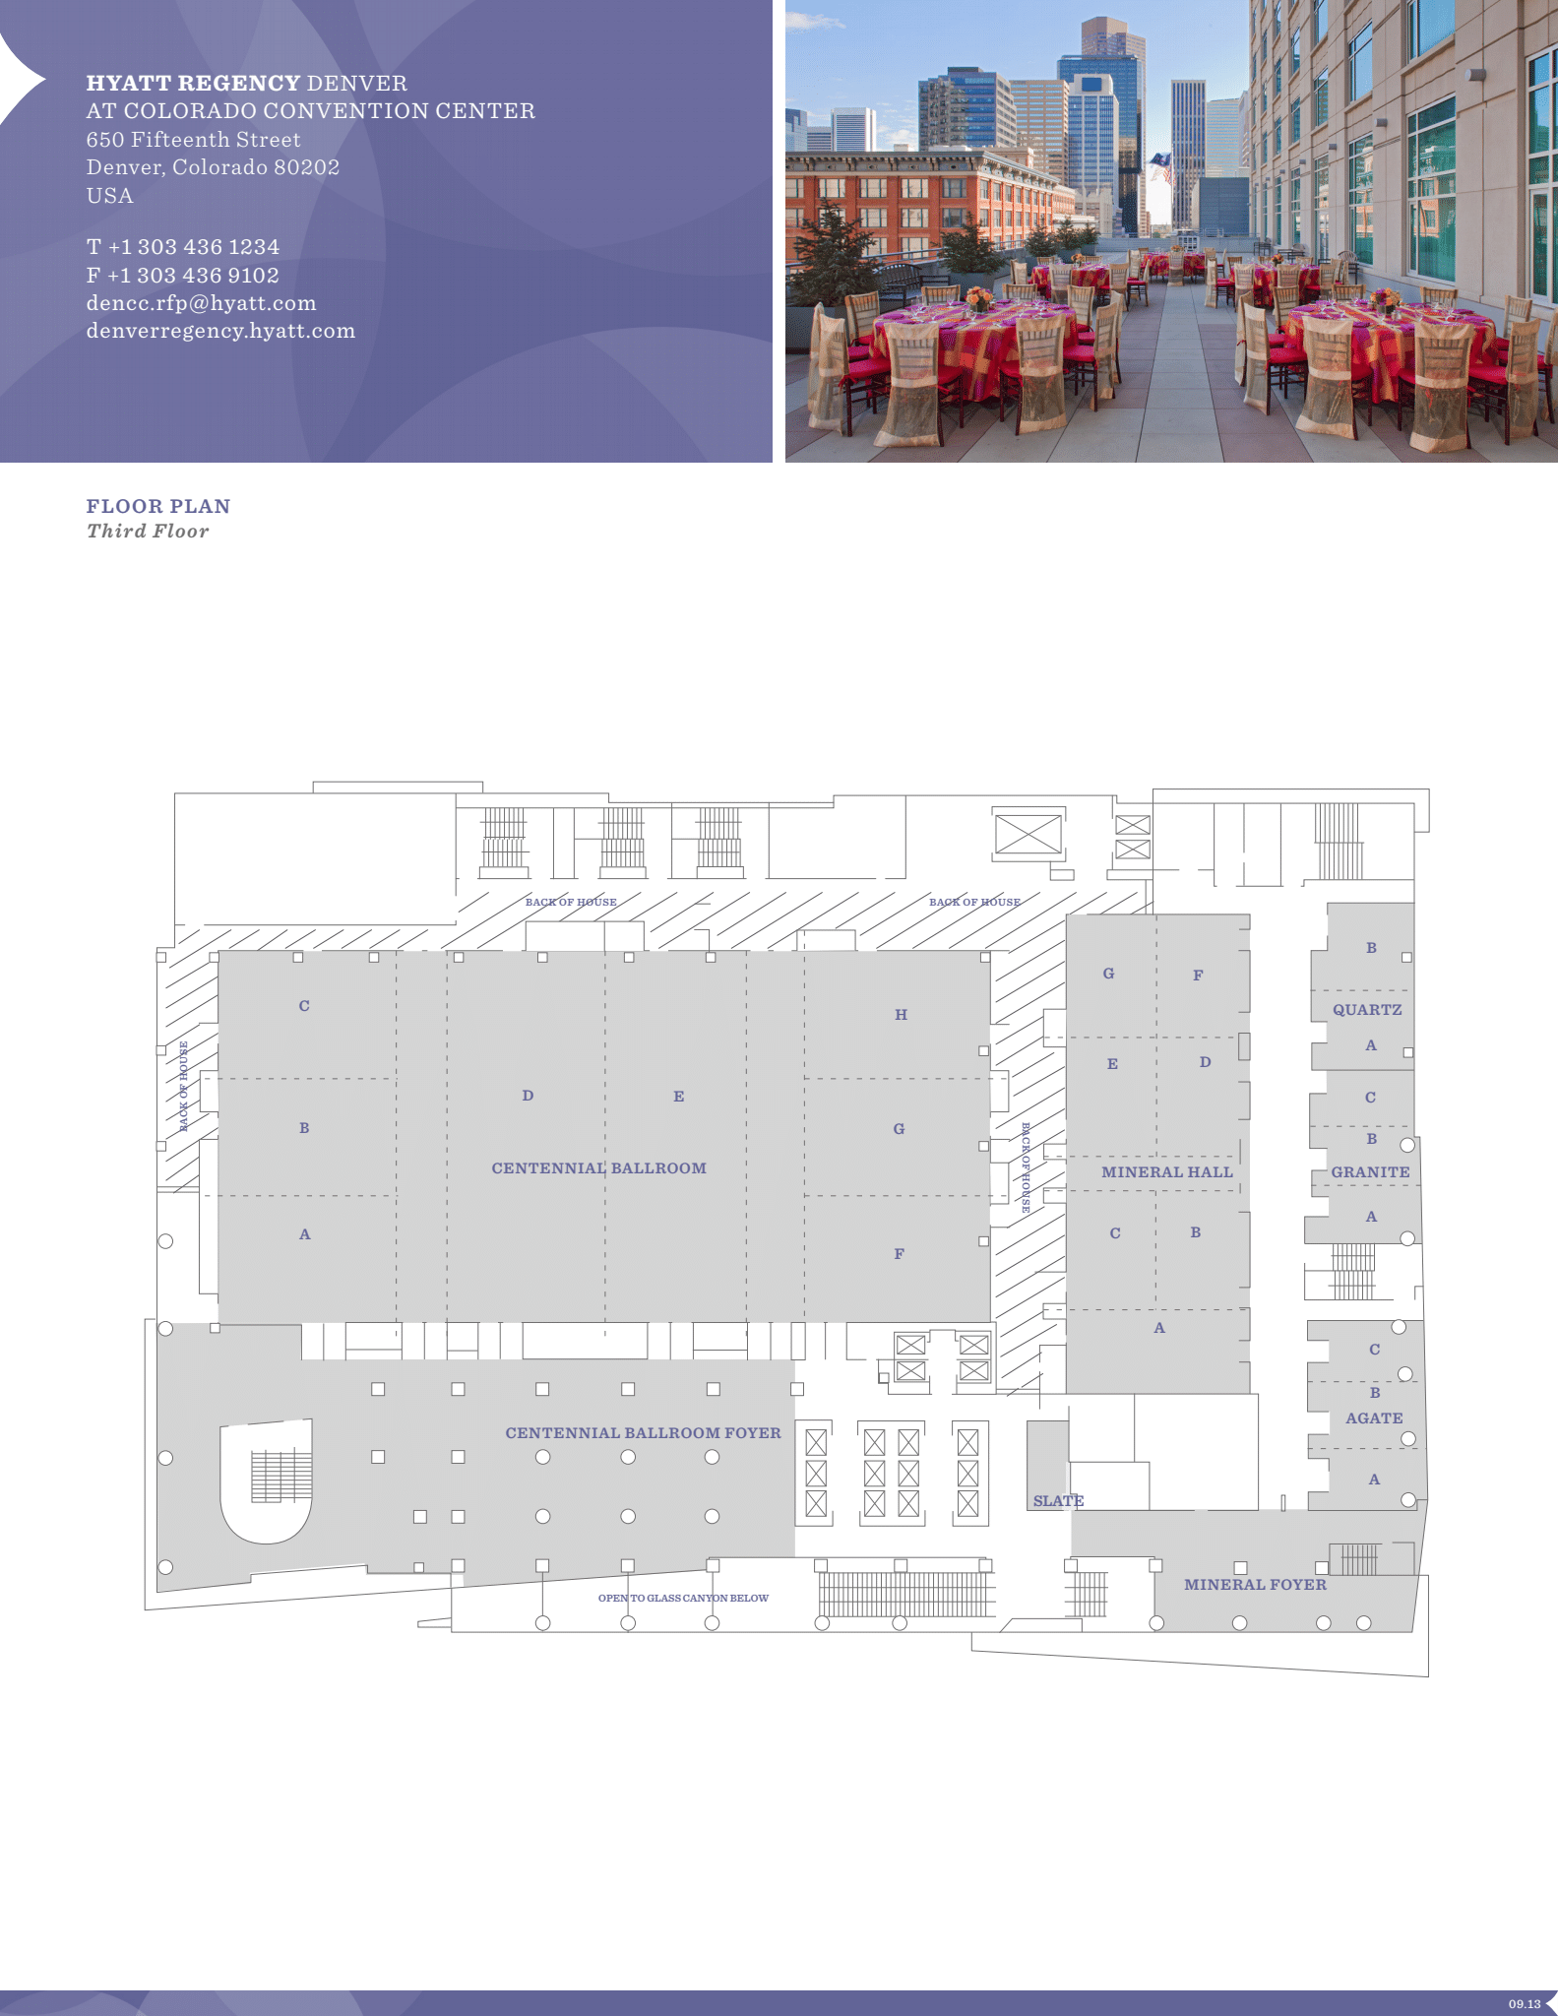
Hyatt Regency Denver 3rd Floor Meeting Space Map
Centennial Foyer
Registration
Light Breakfast
AM and PM Breaks
Centennial BCD
Lunch
Centennial AB
Executive Committee Opening/Closing Session
Centennial E, F, G, H
802.11 Sessions
Mineral Hall A,BC,D,E
802.15 Sessions
Mineral FG
802.11 Sessions
Quartz AB
Executive Committee Boardroom
Granite BC
802.18/.19./24 Sessions

Slide 11
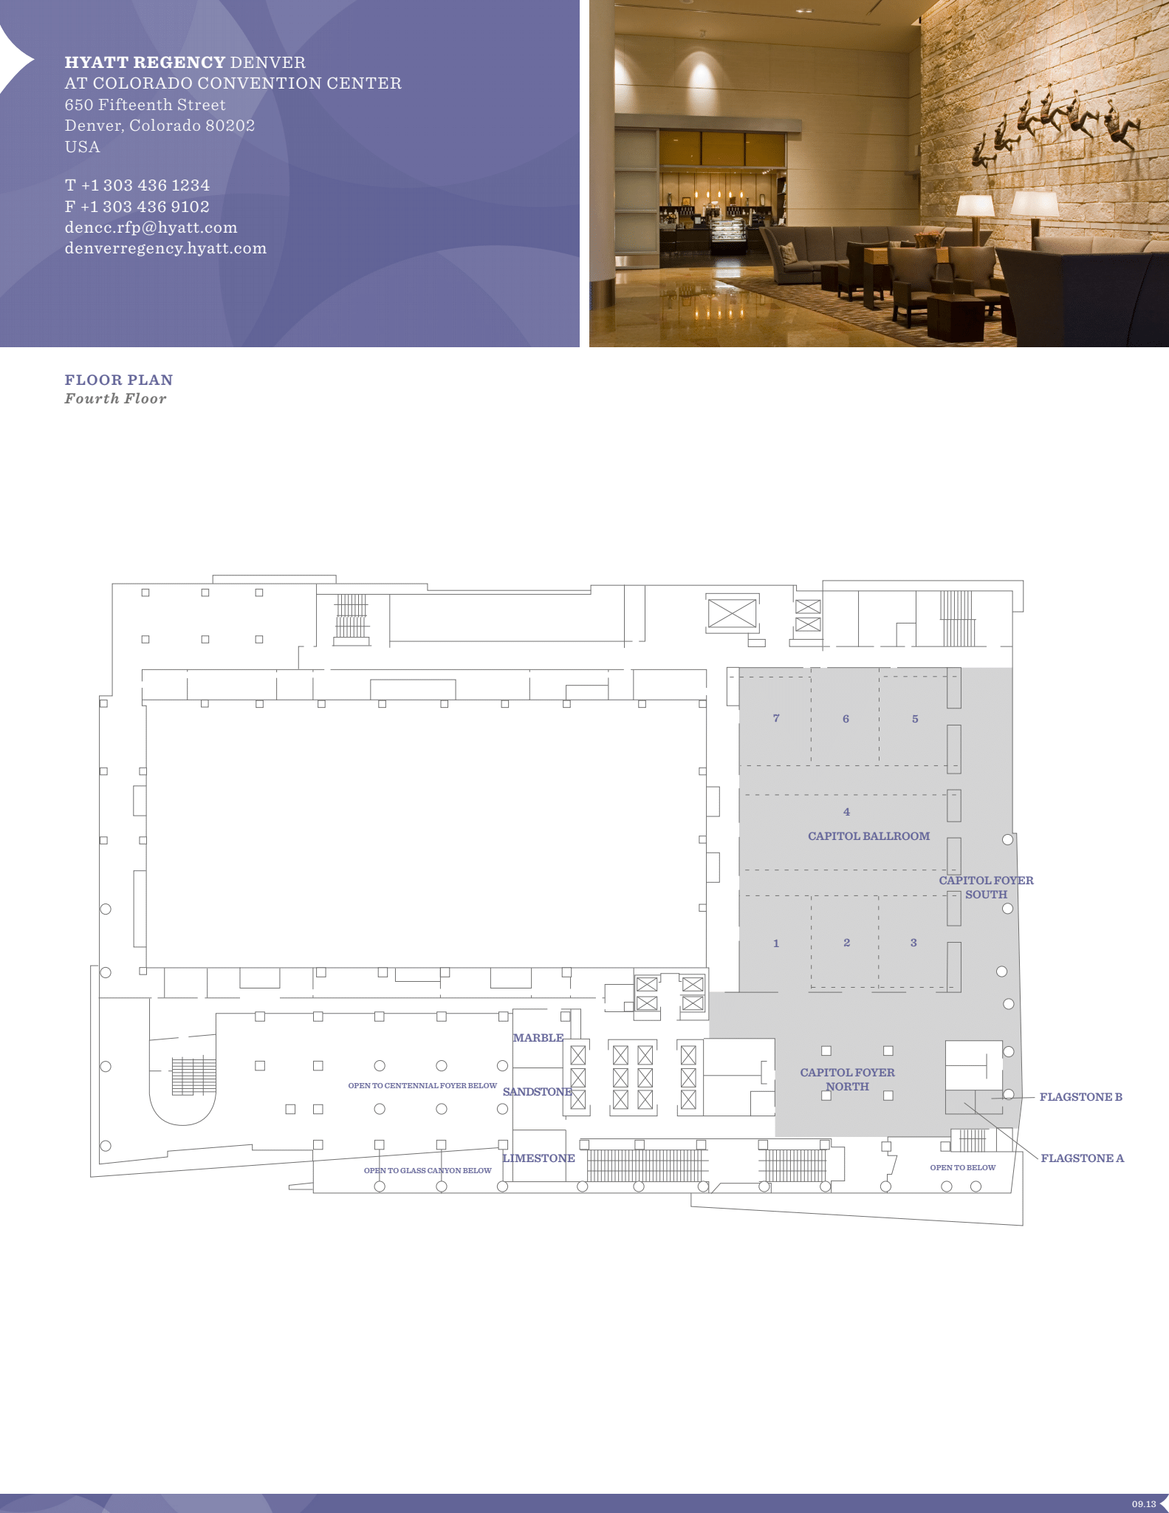
Hyatt Regency Denver 4th Floor Meeting Space Map
Capitol 1,2,3,4
802.3 Sessions
Capitol 5,6,7
802.1 Sessions

Slide 12
Quick Start Guide to Local information in Denver
Weather Forecast
Denver, CO Weather Forecast | AccuWeather
Time Zone - Time Change
Sunday, March 10, 2024 — Daylight Saving Time Starts. Clocks move forward 1 hour.
Time Zone Tool (What time is at home or where virtual attendees are logging in?) https://www.timeanddate.com/worldclock/meeting.html
Denver Airport - Flight Status
https://www.flydenver.com/departures/
Getting the Train Back to the Airport
https://youtu.be/Hj6PYgvu7zg?feature=shared
Places to Eat
Visit Denver
Free Things to Do In Denver, When You’re Not in a Meeting
https://www.denver.org/things-to-do/tours/free-tours/

Slide 13
Health and Safety Options Close to Hyatt Regency
Nearby Hospitals:
Denver Health, 777 Bannock St, 303.436.6000
Saint Joseph Hospital, 1375 E 19th Ave, 303-812-2000
Kindred Hospital Denver, 1920 N High St, 303-320-5871
Rose Medical, 4567 E 9th Ave, 303-320-2121
Walk-in/Non-Emergency Medical Facility:
Denver Health Downtown Urgent Care, 1545 California St, 303-602-6500
Pharmacies:
Walgreens, 801 16th St, Denver, CO 80202. 303.571.5314 (8:00 AM – 11:00 PM)
CVS Pharmacy, 750 16th St, Denver, CO 80202. 303-534-1182
CVS Pharmacy @ Target, 1600 California St, Ste 14, Denver, CO 80202

Slide 14
Thanks for helping us make this session a success, we look forward to working with you again!
The next IEEE 802 Plenary Session will be July 14-19, 2024. In-Person participation at the Le Centre Sheraton Montreal in Montreal Quebec, Canada with remote participation available.
If you have any questions please email: 802info@facetoface-events.com
We are preparing to make Hotel Reservations and Registration available on Monday April 8, 2024
  Early Registration Deadline
    Friday May 17, 2024
  Group Hotel Reservations: Le Centre Sheraton Montreal
    Available Soon
  Hotel Reservation Booking Cut Off Date:
    Friday June 14, 2024 5:00 PM Eastern Time
Note Joint IEEE 802 – ITU SG15 Workshop – July 13, 2024

