Slide 1
Executive Secretary Agenda Items 2024 March IEEE 802 Plenary
Jon Rosdahl IEEE 802 Executive Secretary jrosdahl@ieee.org

Slide 2
Event Conduct and Safety Statement
IEEE believes that science, technology, and engineering are fundamental human activities, for which openness, international collaboration, and the free flow of talent and ideas are essential. Its meetings, conferences, and other events seek to enable engaging, thought-provoking conversations that support IEEE’s core mission of advancing technology for humanity. Accordingly, IEEE is committed to providing a safe, productive, and welcoming environment to all participants, including staff and vendors, at IEEE-related events.

Slide 3
Event Conduct and Safety Statement
IEEE has no tolerance for discrimination, harassment, or bullying in any form at IEEE-related events. All participants have the right to pursue shared interests without harassment or discrimination in an environment that supports diversity and inclusion. Participants are expected to adhere to these principles and respect the rights of others.
IEEE seeks to provide a secure environment at its events. Participants should report any behavior inconsistent with the principles outlined here, to onsite staff, security or venue personnel, or toeventconduct@ieee.org.

Slide 4
IEEE 802 Opening EC Mtg – March 11, 2024
Agenda Items
3.03 --July 2024 Joint IEEE 802 / ITU-T SG15 Workshop
6.02 – II Current / Future venues 20 Mins
Event Summary and Important Information
Registration Reminder
Straw Poll for WGs
Future Venue Contract Status
Other Future Sessions
Review RFP Status

Slide 5
March 2024 IEEE 802 Plenary Session
Event Summary and Important Information
Prepared By: Face to Face Events, February 28, 2024
Posted to Mentor doc: 802 EC-24/0032r2:
Notes:
Posted in Mentor 802 EC-24/0032r2: https://mentor.ieee.org/802-ec/dcn/24/ec-24-0032-02-00EC-802-0324-thingstoknow-hyatt-regency-denver.pptx

Slide 6
Meeting Planner Contact Information
Dawn Slykhouse, Face to Face Events
Mobile: +1 (408) 594-1342
Email: dawns@facetoface-events.com
Lisa Ronmark, Face to Face Events
Mobile: +1 (604) 316-4947
Email: lisa@facetoface-events.com
Stephanie Williams, Face to Face Events
Mobile: +1 (408) 497-9613
Email: stephanie@facetoface-events.com
Meeting Planner Office: Agate A
Registration: Centennial Foyer

Slide 7
Network Access and Support Information
SSID: IEEE802
Password: ieeeieee
Encryption Type: WPA2/WPA3
Supports 2.4 GHz & 5 GHz Wi-Fi
SSID: IEEE802-WPA3
Password: ieeeieee
Encryption Type: WPA3
Supports 2.4 GHz, 5 GHz & 6Ghz Wi-Fi
IEEE 802 Documents: Local Document Server
http://ieee802.linespeed.com/
Onsite Network Support: Linespeed Events
Members of the Linespeed team can be dispatched by contacting the Meeting Planner directly or by placing a request at the event registration desk.
Linespeed Events
Richard Alfvin
Mobile: +1 (585) 781-0952
Email: rick@linespeed.com
Network Office: Agate B
If the Network Office is closed, please check in with Meeting Planner at the Registration Desk (Centennial Foyer) or Meeting Planner Office (Agate A).

Slide 8
In Person Registration Times and Location
Sunday
Registration Counter, Centennial Foyer 3rd Floor Hyatt Regency Denver
5:00 PM - 7:30 PM
Monday - Wednesday
Registration Counter, Centennial Foyer 3rd Floor Hyatt Regency Denver
7:30 AM - 5:00 PM
Thursday
Event Office, Agate A, 3rd Floor Hyatt Regency Denver
8:00 AM - 5:00 PM

Slide 9
IEEE 802 Newcomer Orientation
Monday March 11th at 9:00 AM
WHO: IEEE 802 Newcomers (and all others!)
WHAT: IEEE 802 Orientation Program, Details at <https://tinyurl.com/yurnwntr>
WHEN: Monday 11 March, 9-10 MT
WHERE: Granite BC II or online at IEEE 802 Calendar https://ieee802.org/802tele_calendar.html
HOW TO PREPARE: Please take an hour and get to up speed with a high-level view of IEEE 802 and how it works before you plunge into the session. IEEE 802.15 First Vice Chair Phil Beecher will lead the program. Your questions will be answered.
REGISTRATION FEE: Registration for the IEEE 802 Plenary Session (with fee) is required, whether attending in-person or remotely.

Slide 10
Schedule of Meetings and Attendance
In Person Room Assignments: Schedule QR codes posted outside each meeting room and on back of your badge. http://schedule.802world.com/schedule/schedule/show
Virtual Participation details: https://ieee802.org/802tele_calendar.html
ATTENDANCE TOOL (IMAT)
https://imat.ieee.org/my-site/home
REGISTRATION FEE REQUIREMENT REMINDER
Payment of the session registration fee is required for all individuals who participate in any meetings associated with the March 2024 IEEE 802 Plenary Session.
Registration Link: https://cvent.me/vKY5P4

Slide 11
Audio Visual Support – Onsite support
WHO TO CONTACT IF AUDIO VISUAL EQUIPMENT ISN’T WORKING IN YOUR ONSITE MEETING ROOM
Please contact the Meeting Planner directly if you have any issues with the audio visual equipment in your meeting room. The Meeting Planner will contact support and the appropriate technician will be sent to assist as soon as possible.
Meeting Planner can be reached at:
Registration and Information Desk: Centennial Foyer, 3rd Floor Hyatt Regency Denver
Event Office: Agate A
Via Text or Call: Lisa Ronmark: +1 (604) 316-4947, Stephanie Williams +1 (408) 497-9613
WEBEX AUDIO IN THE ONSITE MEETING ROOM
If you are a local participant, PLEASE, select “Don’t connect to audio” when joining WebEx.
Connecting to the audio, may cause an audio interference or a feedback loop that will disrupt the meeting.

Slide 12
Food and Beverage Breaks
FOR REGISTERED ATTENDEES ONLY
Light Breakfast
Centennial Foyer, 3rd Floor
Monday - Friday
7:15 AM - 8:30 AM
Morning Coffee & Tea Break
Centennial Foyer, 3rd Floor
Monday - Thursday
9:50 AM - 10:35 AM
Lunch
Centennial D, 3rd Floor
Monday - Thursday
12:00 PM - 1:15 PM
Afternoon Break
Centennial Foyer, 3rd Floor
Monday - Thursday
3:15 PM - 4:00 PM

Slide 13
IEEE 802 Milestone Preview & Social
Wednesday March 13th at 6:30 PM
WHO: Registered Attendee & Guests who purchased tickets.*
*Tickets were sold online until Friday March 8, 2024 for $24.99 each.
WHAT: Networking Reception and Celebration to acknowledge the IEEE 802 Milestone.
A buffet dinner will be followed by special guest speeches and a preview of the IEEE 802 Milestone plaque.
WHERE: Centennial D Ballroom, 3rd Floor Hyatt Regency Denver
SOCIAL EVENT NAME BADGE
All individuals attending the event must wear a Social Event Name Badge.
Social Event Name Badges will be distributed at the Plenary Session registration desk.
You must purchase a Social Event Badge for you and your guests attending.
All Social Event Name Badges must be picked up before 12:00 PM Wednesday March 13th.
Late requests may not be accommodated.
Please contact the Meeting Planner if have any questions.

Slide 14
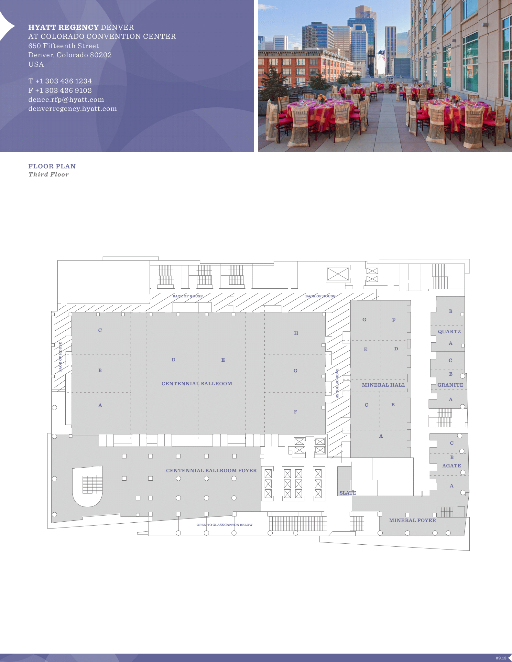
Hyatt Regency Denver 3rd Floor Meeting Space Map
Centennial Foyer
Registration
Light Breakfast
AM and PM Breaks
Centennial BCD
Lunch
Centennial AB
Executive Committee Opening/Closing Session
Centennial E, F, G, H
802.11 Sessions
Mineral Hall A,BC,D,E
802.15 Sessions
Mineral FG
802.11 Sessions
Quartz AB
Executive Committee Boardroom
Granite BC
802.18/.19./24 Sessions

Slide 15
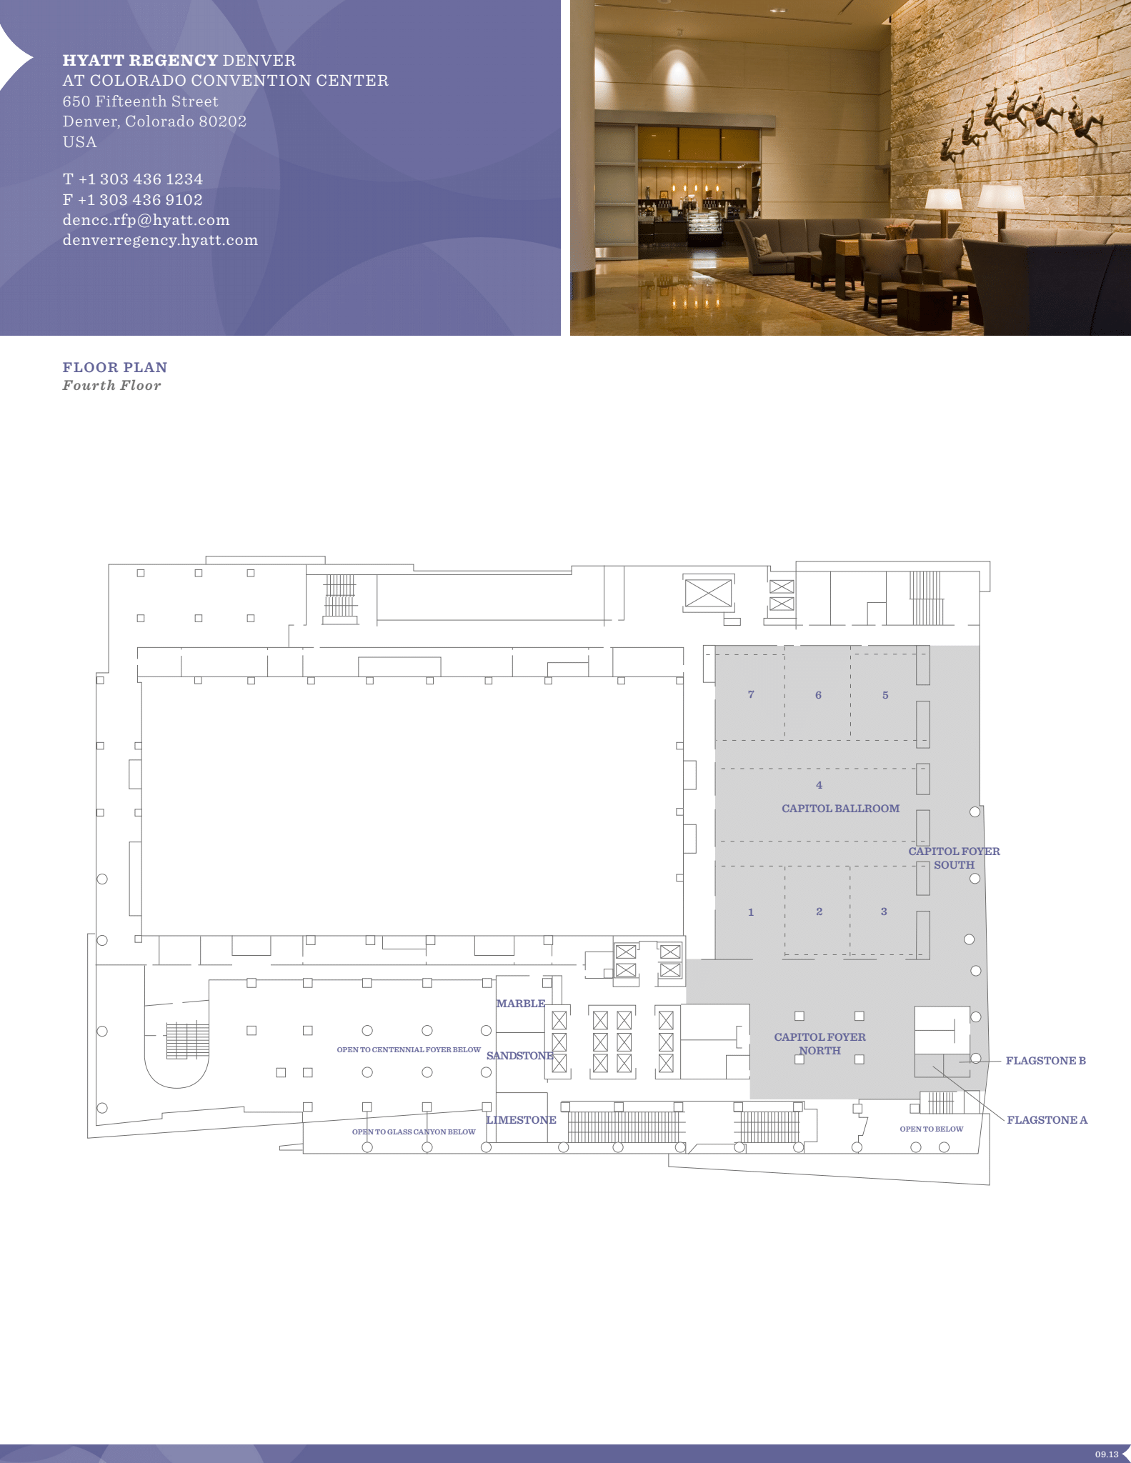
Hyatt Regency Denver 4th Floor Meeting Space Map
Capitol 1,2,3,4
802.3 Sessions
Capitol 5,6,7
802.1 Sessions

Slide 16
Quick Start Guide to Local information in Denver
Weather Forecast
Denver, CO Weather Forecast | AccuWeather
Time Zone - Time Change
Sunday, March 10, 2024 — Daylight Saving Time Starts. Clocks move forward 1 hour.
Time Zone Tool (What time is at home or where virtual attendees are logging in?) https://www.timeanddate.com/worldclock/meeting.html
Denver Airport - Flight Status
https://www.flydenver.com/departures/
Getting the Train Back to the Airport
https://youtu.be/Hj6PYgvu7zg?feature=shared
Places to Eat
Visit Denver
Free Things to Do In Denver, When You’re Not in a Meeting
https://www.denver.org/things-to-do/tours/free-tours/

Slide 17
Health and Safety Options Close to Hyatt Regency
Nearby Hospitals:
Denver Health, 777 Bannock St, 303.436.6000
Saint Joseph Hospital, 1375 E 19th Ave, 303-812-2000
Kindred Hospital Denver, 1920 N High St, 303-320-5871
Rose Medical, 4567 E 9th Ave, 303-320-2121
Walk-in/Non-Emergency Medical Facility:
Denver Health Downtown Urgent Care, 1545 California St, 303-602-6500
Pharmacies:
Walgreens, 801 16th St, Denver, CO 80202. 303.571.5314 (8:00 AM – 11:00 PM)
CVS Pharmacy, 750 16th St, Denver, CO 80202. 303-534-1182
CVS Pharmacy @ Target, 1600 California St, Ste 14, Denver, CO 80202

Slide 18
Thanks for helping us make this session a success, we look forward to working with you again!
The next IEEE 802 Plenary Session will be July 14-19, 2024. In-Person participation at the Le Centre Sheraton Montreal in Montreal Quebec, Canada with remote participation available.
If you have any questions please email: 802info@facetoface-events.com
We are preparing to make Hotel Reservations and Registration available on Monday April 8, 2024
Early Registration Deadline
Friday May 17, 2024
Group Hotel Reservations: Le Centre Sheraton Montreal
Available Soon
Hotel Reservation Booking Cut Off Date:
Friday June 14, 2024 5:00 PM Eastern Time
Note Joint IEEE 802 – ITU SG15 Workshop – July 13, 2024

Slide 19
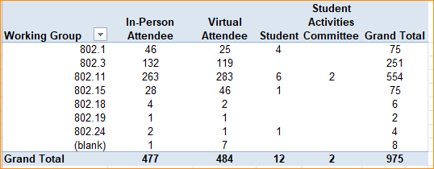
2024 March IEEE 802 Plenary Registration report as of 03/09/2024

Slide 20
Basic Room Resource Allocation
Big meetings
(≥ 100, e.g., WG plenaries)
Medium meetings
(35-100, e.g., Task Forces)
Smaller meetings
(30 or less)
Head table (5)
1 projector/screen
2 tables mics
1 or 2 floor mics
Sound system
(speakers, sound board, etc.)
Ethernet/HDMI/USB
Scarlett Audio Interface
Head table (3)
1 projector/screen
1 table mic
1 floor mic
Sound system
(speakers, sound board, etc.)
Ethernet/HDMI/USB
Scarlett Audio Interface
U-shaped or board meeting setup
1 room microphone
Portable or speakerphone-type
Sound system
(speakers, sound board, etc.)
Ethernet/HDMI/USB
Scarlett Audio Interface

Slide 21
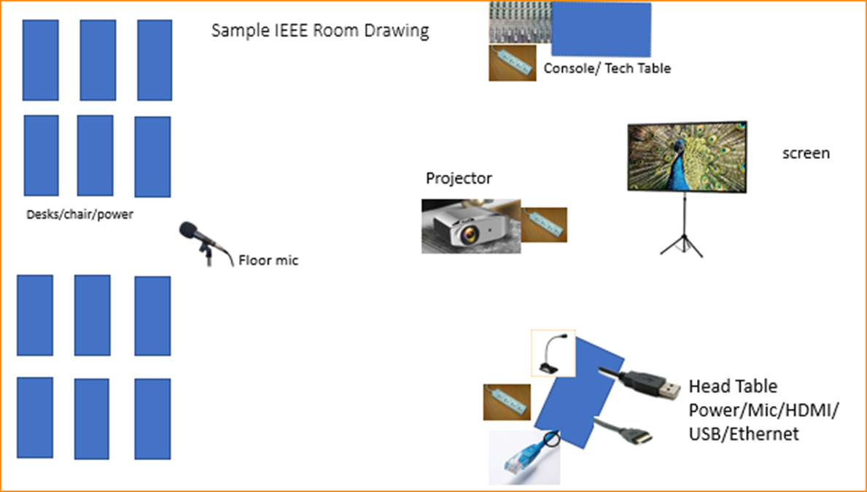
Scarlett
Notes:
This Photo by Unknown Author is licensed under CC BY-NC
This Photo by Unknown Author is licensed under CC BY-SA-NC
This Photo by Unknown Author is licensed under CC BY-SA

Slide 22
Scarlett Solo – Audio Interface by Focusrite
the USB connector not only supplies 5 VDC @ 900mA but also serves as the digital communication interface between WebEx and the Focusrite audio mixer.
Known Issue of connection dropping on newer models of Notebooks and Laptops.
Our Scarlett Boxes are 3rd Generation – Driver update can be found here: https://downloads.focusrite.com/focusrite/scarlett-3rd-gen/scarlett-solo-3rd-gen

Slide 23
Suggested best practices
One central laptop/computer per meeting connects at head table.
Local speakers' queue/speak only at a microphone when called on.
Remote speakers request to speak via chat window and only speak when called on.
Presenters have chair (central laptop) share the presentation
Local attendees when logged into WebEx SHALL NOT connect Audio.
When Starting a meeting the host should do the following:
Select “Meeting” -> “Meeting Options” -> [Disable] “Allow Participant to turn on Video”
Select “Participant” -> [Enable] “Mute on Entry”.
For the Host and Remote Attendees connecting to Webex, Configure Webex Audio to use “Music Mode”.
If newer laptop, load updated Focusrite Scarlett Gen-3 drivers.
Driver updates can be found here: https://downloads.focusrite.com/focusrite/scarlett-3rd-gen/scarlett-solo-3rd-gen

Slide 24
Mixed-mode Meeting Protocol
Sample Intro Meeting Slide
In-room Attendees:
In Webex choose connect without audio before you join
Use the Webex queue to indicate you want to speak
Wait to be called on while standing/holding a microphone to make a comment
Repeat any questions that are inadvertently asked away from the microphone
Remote Attendees:
Join Webex and set Webex audio as ‘music’
Use the Webex chat window to indicate you want to speak (“q”)
Wait to be called on to speak

Slide 25
Status of IEEE 802 Plenary Contracts
2025 July - Site Visit planned for Melia Castilla Madrid – May 21-25 –
Contract pending visit.
2025/2026 November – Terms and Conditions agreed to, need contract from Hotel
2026 March – Hyatt Regency Vancouver Contract has been submitted to IEEE Legal.
2027 March – Hilton Atlanta – need to get contract formalized
2027 July – Gothia Towers – Site Visit to be Scheduled – Contract pending site visit

Slide 26
Future 802 Plenary Venue Contract Status
2024 March 10-15 – Hyatt Regency Denver at Colorado Convention Center, Denver, CO, (March 2021)
2024 July 14-19 – Sheraton Le Centre Montreal, Montreal, Quebec, Canada (July 2020)
2024 November 10-15 –Hyatt Regency Vancouver, Vancouver, Canada (Nov 2021)
2025 March 9-14 –Hilton Atlanta, Atlanta, GA, United States (2 of 2 – March 2020).
2025 July 27-August 1 –Melia Castilla Madrid, Madrid, Spain (Changing Week to July 27)
2025 November 9-14 – Marriott Marquis Queen’s Park, Bangkok, Thailand
2026 March 8-13 - Hyatt Regency Vancouver, Vancouver, Canada (Change from Chicago)
2026 July 12-17 – Le Centre Sheraton Montreal, Montreal (July 2022 attrition offset)
2026 November 8-13 - Marriott Marquis Queen’s Park, Bangkok, Thailand
2027 March 14-19 – Hilton Atlanta, Atlanta, GA, United States ( offset potential shortfall 2023/2025)
2027 July 11-16 - Gothia Towers, Gothenburg, Sweden
2027 November 14-19 – Hawaiian Village, Oahu, Hawaii, United States
802 EC Approved – Contract is being Negotiated.
Contracts Executed
As of March 9, 2023
Notes:
2025 July - Site Visit planned for Melia Castilla Madrid – May 21-25 – Contract pending visit.
2025/2026 November – Terms and Conditions agreed to, need contract from Hotel
2026 March – Hyatt Regency Vancouver Contract has been submitted to IEEE Legal.
2027 March – Hilton Atlanta – need to get contract formalized
2027 July – Gothia Towers – Site Visit to be Scheduled

Slide 27
Request for 802 WG Item for Closing Plenary:
Request to WG Chairs,
Please Conduct the following Straw Poll in your Closing Plenaries:
1. How many people would like to come back to this venue?
Yes –
No –
2. Did you go to the social?
Yes –
No –
3. If you attended the Social, did you like the social?
Yes –
No –

Slide 28
Future Venue AdHocs --

Slide 29
Next Venue Meeting planning – Thurs 7:30 am
Proposed Agenda:
Start time 7:30 am
Review meeting space plan for 2024 July Plenary
Le Centre Sheraton Montreal in Montreal Quebec, Canada,
Adjourn 8:00am

Slide 30
Future Venues AdHoc – Thurs 8 am
Proposed Future Venues AdHoc Agenda:
Start time – 8:00 am
Review Contract Status
End time – 9:00am

Slide 31
Executive Secretary Agenda Items
Closing Plenary:
4.02: Future Meetings
1. Straw poll on This Venue
2. 802 Contract Status
3. 2024 July Budget Review and Registration Fee Motion.
4. 2024 November Budget Review and Registration Fee Motion.
45 Student Outreach/University Outreach AdHoc request
6. Motion to increase budget for IEEE 802 to sponsor a joint workshop with ITU-T on July 13th 2024.

Slide 32
Straw Poll: Return to This Venue: (Hyatt Regency Denver)
1. How many people would like to come back to this venue?
.1 25 12 13
.3 42 10
.11 52 2
.15 20

Slide 33
Venue Polls (continued) (Hyatt Regency Denver)
2. Did you go to the social?
.1 26 16
.3 59 8
.11 58 10
.15 19
3. If you attended the Social, did you like the social?
.1 18 8
.3 40 3
.11 38 11
.15 16

Slide 34
Future 802 Plenary Venue Contract Status
2024 March 10-15 – Hyatt Regency Denver at Colorado Convention Center, Denver, CO, (March 2021)
2024 July 14-19 – Sheraton Le Centre Montreal, Montreal, Quebec, Canada (July 2020)
2024 November 10-15 –Hyatt Regency Vancouver, Vancouver, Canada (Nov 2021)
2025 March 9-14 –Hilton Atlanta, Atlanta, GA, United States (2 of 2 – March 2020).
2025 July 27-August 1 –Melia Castilla Madrid, Madrid, Spain (Changing Week to July 27)
2025 November 9-14 – Marriott Marquis Queen’s Park, Bangkok, Thailand
2026 March 8-13 - Hyatt Regency Vancouver, Vancouver, Canada (Change from Chicago)
2026 July 12-17 – Le Centre Sheraton Montreal, Montreal (July 2022 attrition offset)
2026 November 8-13 - Marriott Marquis Queen’s Park, Bangkok, Thailand
2027 March 14-19 – Hilton Atlanta, Atlanta, GA, United States ( offset potential shortfall 2023/2025)
2027 July 11-16 - Gothia Towers, Gothenburg, Sweden
2027 November 14-19 – Hawaiian Village, Oahu, Hawaii, United States
802 EC Approved – Contract is being Negotiated.
Contracts Executed
As of March 9, 2023
Notes:
2025 July - Site Visit planned for Melia Castilla Madrid – May 21-25 – Contract pending visit.
2025/2026 November – Terms and Conditions agreed to, need contract from Hotel
2026 March – Hyatt Regency Vancouver Contract has been submitted to IEEE Legal.
2027 March – Hilton Atlanta – need to get contract formalized
2027 July – Gothia Towers – Site Visit to be Scheduled

Slide 35
Proposed Budget for 2024 July IEEE 802 Plenary
Total Session Income/Credits = $ 604,984.83
Total Session Expenses: = ($602,885.09)
Net Session Surplus/(Loss): = $ 2,099.74
This includes IEEE 802-ITU SG15 Workshop = $25,107.76

Slide 36
Motion to set Meeting Fees for 2024 July
Move to set the meeting fees for the 2024 July IEEE 802 Plenary to be held July 14-19 , 2024 at the Sheraton Le Centre Montreal, Montreal, Quebec, Canada as follows:
Early-bird $600 until May 17, 2024
Standard $850 until June 28, 2024
Late/On-site $1100 after June 28, 2024
An in-Hotel Discount of $300 for a 3-night stay
Cancellation Fees:
Full Refund - No Fee until May 17, 2024
Cancellation fee $150 May 18 until June 28, 2024;
Cancelation - No refund after June 29, 2024
Moved: Rosdahl
2nd: Zimmerman
Results:

Slide 37
Proposed Budget for 2024 Nov IEEE 802 Plenary
Total Session Income/Credits = $549,774.63
Total Session Expenses: = ($553,596.16)
Net Session Surplus/(Loss): = ($3,821.53)
Includes IEEE 802 LMSC Workshop November 16, 2024

Slide 38
Motion to set Meeting Fees for 2024 November
Move to set the meeting fees for the 2024 November IEEE 802 Plenary to be held November 10-15, 2024, at Hyatt Regency Vancouver, Vancouver, Canada, as follows.
Early-bird $600 until Sept 20, 2024
Standard $850 until Nov 1, 2024
Late/On-site $1100 after Nov 1, 2024
An in-Hotel Discount of $300 for a 3-night stay
Cancellation Fees:
Full Refund - No Fee until Sept 20, 2024
Cancellation fee $150 Sept 21 until Nov 1, 2024;
Cancelation - No refund after Nov 1, 2024
Moved: Rosdahl
2nd: Zimmerman
Results:

Slide 39
IEEE 802 University Outreach Program for Montreal – July 2024
University Outreach Program for Montreal - July 2024
The purpose of our Student Outreach program is to give students a chance to see firsthand how the Standards process works. We realize it is like getting a drink from a fire-hose, but it does give a good first look into the process.
It is a one-day event Tuesday of the Plenary Week:
7:30-9:00 – sign in and get badge
9:00am Start with an introduction meeting with a couple of the 802 Leadership members to orient the students to what activities may be of most interest to them that day
10:30am (AM2) the students attend actual working meetings and can meet and participate in the discussions.

Slide 40
IEEE 802 University Outreach Program for Montreal – July 2024
17:00 (5pm) Debrief: A short debrief meeting at the end of the day is provided to answer questions and help provide closure to the experience.
The Outreach Student fee is USD$25 per student
The program is limited to 42 Students.
Note that membership attendance credit is not granted for student activities.
The Students are invited to join for Lunch and breaks as our guests.
Previous material prepared for 2015 and 2017 programs:
https://www.ieee802.org/Univ_Outreach.shtml
A motion to approve program for July 2024 will be made during the 802 Closing Plenary March 15.

Slide 41
Motion to approve the University Outreach 2024 July
Move to approve the University Outreach program for July 2024:
The Outreach Student fee is USD$25 per student
The program is limited to 42 Students.
Move: Rosdahl
Second: Law
Results:

Slide 42
IEEE 802 / ITU-T SG15 joint workshop
Glenn Parsons
Coordinators: Jessy Rouyer and Tom Huber
ec-24-0060-00-INTL

Slide 43
IEEE 802 / ITU-T SG15 workshop
9th joint workshop since 2007
13 July 2024, Le Centre Sheraton Montreal, Canada
In-person with provisions (TBC) to support mixed mode
Following 1-12 July 2024 ITU-T Study Group 15 plenary
Preceding 14-19 July 2024 IEEE 802 plenary session
Workshop registration required - no fee
Open to ITU members, IEEE 802 participants and other interested individuals
Further logistical details and detailed program forthcoming

Slide 44
July 2024
Canadian government (with industry sponsorship) has expressed interest in hosting ITU-T SG15 in Montreal
July 1 – 12, 2024
Sheraton Montreal has space available
Given good relationship with ITU-T SG15, the ITU hosting of IEEE 802 sessions, and the alignment of sessions in 2024, IEEE 802 should consider hosting a workshop with ITU-T SG15 in conjunction with our July 2024 session
Sheraton Montreal space could be included in 802 contract amendment
Network & meeting planning provided by IEEE 802 service providers
AM/PM breaks (and possibly lunch)
Additional cost will be less than US$10,000 US30,000

Slide 45
High level agenda
8:30 opening remarks
TSB Director, SA President, 802 Chair, SG15 Chair
Topics arranged in four sessions:
Evolving to Beyond 1T Transmission
Organizers: P802.3dj TF Chair John D’Ambrosia, ITU-T Q11/15 Rapporteur Steve Gorshe
Access and In-Premises Networks
Organizers: P802.3dg TF Chair George Zimmerman, ITU-T Q2/15 Frank Effenberger
Synchronization and TSN
Organizers: 802.1 TSN TG Chair János Farkas, ITU-T Q13/15 Rapporteur Stefano Ruffini
YANG and Data Modelling
Organizer: 802 YANGsters Chair and ITU-T Q14/15 Rapporteur Scott Mansfield
17:30 – 18:00 wrap-up, takeaways, closing

Slide 46
Needed additional funding
Joint IEEE 802-ITU SG15 Workshop 200 people
AV-Power-Staging $15,371.76
Dinner for 40 CAD$3200 $2,368.00
Coffee for 200 CAD$3200 $2,368.00
Face to Face $5,000.00
Contingency – Misc $4803.24
Total $30,000
Notes:
Joint IEEE 802-ITU SG15 Workshop 200 people
AV-Power-Staging $15,371.76
Dinner for 40 CAD$3200 $2,368.00
Coffee for 200 CAD$3200 $2,368.00
Face to Face $5,000.00
Total: $25,107.76

Slide 47
Motion – Increase Budget for Joint Workshop
Move to increase funding for approved hosting of joint workshop with ITU-T SG15 adjacent to 2024 July IEEE 802 plenary session, with additional costs not to exceed US$30,000.
Moved: Jon Rosdahl
2nd: Glenn Parsons
Results:

Slide 48
3.05 Recognitions

Slide 49
8.033 Executive secretary report

Slide 50
8.04 Monthly IEEE 802 EC Telecons
Announcement of 802 EC Interim Telecons
Tuesday 2 April 2024, 19:00-21:00 UTC
Tuesday 7 May 2024, 19:00-21:00 UTC
Tuesday 4 June 2024,19:00-21:00 UTC
Call Time: Tuesday, 3:00 PM - 5:00 PM (UTC-05:00) Eastern Time (ET)
Recurrence: Occurs Generally the first Tuesday of every month.
From 7:00 PM to 9:00 PM, (UTC+00:00) Monrovia, Reykjavik time zone.
Calls after July Plenary to be Scheduled during 2024 July IEEE 802 EC Closing Plenary meeting.
Notes:
802 Interim Telecons – 1st Tuesday of the following Months: January/February/April/May/June/August/September/October
Delayed January 9th Telecon determined during

Slide 51
8.05 Call for Tutorials for July 2024
Tutorials may be held electronic: TBA
In person/Mixed-mode Tutorials: July (Mon/Tues)
Tutorial Request form:
https://mentor.ieee.org/802-ec/dcn/23/ec-23-0128-00-00EC-802-tutorial-request-form-2023.docx
As a reminder, please refer to Chair's Guidelines section 2.5 Tutorials for the logistics for participating in sponsoring/presenting a Tutorial.
Note that Tutorial times are limited to 80 minutes with 10 minutes to allow for presenters to setup and depart. (Starting at 18:15).
All requests for Tutorials must be made by 31 May 2024
Notes:
All official tutorial request forms must be submitted no later than 45 days in advance of the Plenary Session.
Approved Tutorial Requests will be assigned a time slot based on the order in which they were received.
The Final Tutorial Schedule will be posted at http://802world.org/plenary and http://ieee802.org no less than 30 days in advance of the Plenary Session.
Mentor Link to 2023 Tutorial Request form: https://mentor.ieee.org/802-ec/dcn/23/ec-23-0128-00-00EC-802-tutorial-request-form-2023.docx

