Slide 1

IEEE 802 LMSC
134th Plenary Session
(5th mixed mode Plenary Session)
13-17 November 2023
DCN ec-23-0226-00-00EC

Slide 2
3.00 Chair’s Announcements

Slide 3
3.00 Chair’s Announcements
  Reminder #1: Please use IMAT to log your attendance
  Reminder #2:
  November 2024 was Paul Nikolich’s PENultimate IEEE 802 LMSC Plenary Session as 802 Chairman.
  Candidates for 802 Chair and the 802 EC Appointed positions are sought as soon as possible. Candidates should contact the holder of the position they seek to enable them to fully understand the responsibilities of the positions (802 Chair, Vice Chairs, Treasure, Recording Secretary, Executive Secretary and Chair).
  James Gilb has announced his intention to be considered for the 802 Chair position.
  Please see https://mentor.ieee.org/802-ec/dcn/23/ec-23-0168-00-00EC-march-2024-802-ec-election-process.pdf for process details

Slide 4
4.04 IEEE 802 LMSC Milestone
Project Status Update
Geoff Thompson

Slide 5
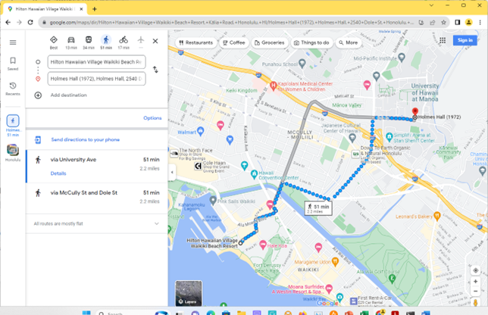
4.04 Milestone Supplemental Information
  If you have time, consider checking out the IEEE Milestone for ALOHA Packet Radio Data Network, 1971
  Citation: In June 1971, the ALOHA packet radio data network began providing inter-island access to computing facilities at the University of Hawaii. ALOHAnet was the first to demonstrate that communication channels could be effectively and efficiently shared on a large scale using simple random access protocols. It led directly to the development of Ethernet and personal wireless communication technologies.
  (https://ieeemilestones.ethw.org/Milestones:ALOHANET_(aka_ALOHA_System))
  The Milestone Plaque is located about 2.2 miles from the Hilton
  at the University of Hawai’i College of Engineering.
  (https://www.eng.hawaii.edu/about/history/alohanet/)
  2540 Dole Street, Holmes Hall, Honolulu, Hawaii (50 minute walk)

Slide 6
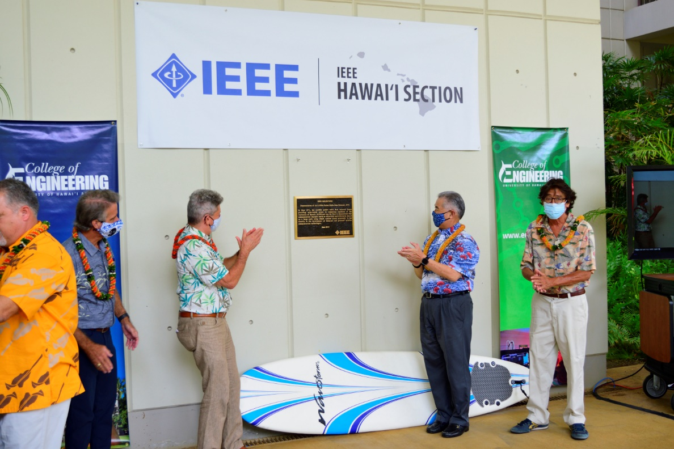
4.04 Milestone Supplemental Information
  ALOHAnet
  IEEE Milestone
  dedication
  13OCT2020

Slide 7
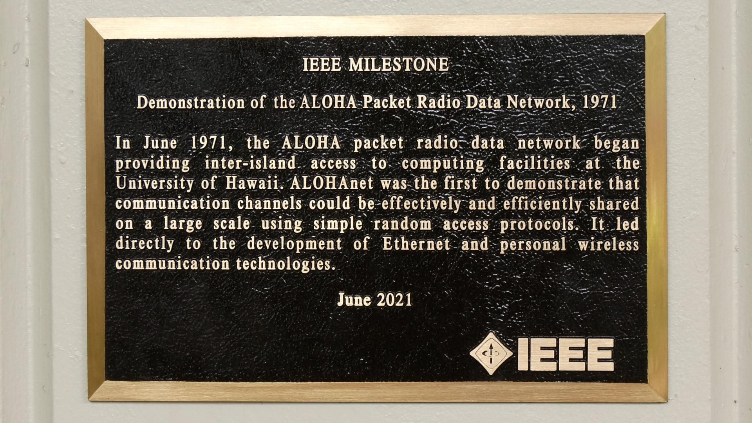
4.04 Milestone Supplemental Information
  ALOHAnet
  IEEE Milestone Plaque
  dedication
  13OCT2020

Slide 8
End of Closing EC Meeting

Slide 9
Parking Lot Items

Slide 10
Future 802 meeting ad hoc updates
Future 802 meeting ad hoc update; tbd.
We are also considering alternative mechanisms to make progress on this topic.

