Slide 1
Executive Secretary Agenda Items
2023 November IEEE 802 Plenary
Jon Rosdahl
IEEE 802 Executive Secretary
jrosdahl@ieee.org

Slide 2
Event Conduct and Safety Statement
IEEE believes that science, technology, and engineering are fundamental human activities, for which openness, international collaboration, and the free flow of talent and ideas are essential. Its meetings, conferences, and other events seek to enable engaging, thought-provoking conversations that support IEEE’s core mission of advancing technology for humanity. Accordingly, IEEE is committed to providing a safe, productive, and welcoming environment to all participants, including staff and vendors, at IEEE-related events.

Slide 3
Event Conduct and Safety Statement
IEEE has no tolerance for discrimination, harassment, or bullying in any form at IEEE-related events. All participants have the right to pursue shared interests without harassment or discrimination in an environment that supports diversity and inclusion. Participants are expected to adhere to these principles and respect the rights of others.
IEEE seeks to provide a secure environment at its events. Participants should report any behavior inconsistent with the principles outlined here, to onsite staff, security or venue personnel, or toeventconduct@ieee.org.

Slide 4
IEEE 802 Opening EC Mtg – November 12, 2023
Agenda Items
  6.02 – II Current / Future venues 30 Mins
    Event Summary and Important Information
    Registration Reminder
    Straw Poll for WGs
    Future Venue Contract Status
    Other Future Sessions
    Review RFP Status
    Discussion on July 2025/Nov 2025
  6.04 – DT Student Outreach AdHoc 5 Mins
    Review AdHoc Call

Slide 5
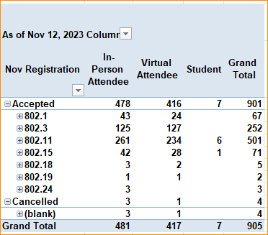
2023 Nov 802 Plenary Registration report as of 11/12/23 – 4:00pm HT

Slide 6
November 2023
IEEE 802 Plenary Session
Event Summary and Important Information
Prepared By: Face to Face Events and Jon Rosdahl, November 12, 2023

Slide 7
IEEE 802 Newcomer Orientation
Monday November 13th at 9:00 AM
WHO: IEEE 802 Newcomers (and all others!)
WHAT: IEEE 802 Orientation Program, Details at <https://t.ly/pdtku>
WHEN: Monday 13 November, 9-10 HST
WHERE: IEEE 802 Calendar https://ieee802.org/802tele_calendar.html
HOW TO PREPARE: Please take an hour and get to up speed with a high-level view of IEEE 802 and how it works before you plunge into the session. IEEE 802.15 First Vice Chair Phil Beecher will lead the program. Your questions will be answered.
REGISTRATION FEE: Registration for the IEEE 802 Plenary Session (with fee) is required, whether attending in-person or remotely.

Slide 8
In Person Registration Times and Location
Sunday
  Registration Counter, Coral Lounge in Mid Pacific Conference Center
  5:00 PM - 7:30 PM
Monday - Wednesday
  Registration Counter, Coral Lounge in Mid Pacific Conference Center
  7:30 AM - 5:00 PM
Thursday
  Event Office, Tiare at Kalia Executive Conference Center
  8:00 AM - 5:00 PM

Slide 9
Meeting Planner Contact Information
Dawn Slykhouse, Face to Face Events
Mobile: +1 (408) 594-1342
Email: dawns@facetoface-events.com
Lisa Ronmark, Face to Face Events
Mobile: +1 (604) 316-4947
Email: lisa@facetoface-events.com
Stephanie Williams, Face to Face Events
Mobile: +1 (408) 497-9613
Email: stephanie@facetoface-events.com
Meeting Planner Office: Kalia Executive Conference Center, Tiare
Registration: Mid Pacific Conference Center, Coral Lounge

Slide 10
Network Access Information
SSID: IEEE802
Password: ieeeieee
Encryption Type: WPA2/WPA3
SSID: IEEE802-6G
Password: ieeeieee
Encryption Type: WPA3
Support for 6GHz WiFi
Local Document Server for IEEE 802 Documents: http://ieee802.linespeed.com/
Network Provider and Onsite Network Support
The November 2023 IEEE 802 Plenary Session Network Provider is Linespeed Events.
Richard Alfvin
Mobile: +1 (585) 781-0952
Email: rick@linespeed.com
Members of the Linespeed team can be dispatched by contacting the Meeting Planner directly or by placing a request at the event registration desk.

Slide 11
Schedule of Sessions and Attendance
SCHEDULE OF SESSIONS
In Person Room Assignments: Schedule QR codes posted outside each meeting room and on your badge hand out. http://schedule.802world.com/schedule/schedule/show
Virtual Participation: https://ieee802.org/802tele_calendar.html
ATTENDANCE TOOL (IMAT) : https://imat.ieee.org/
REGISTRATION FEE REQUIREMENT REMINDER
Payment of the session registration fee is required for all individuals who participate in any session associated with the November 2023 IEEE 802 Plenary Session. Registration: https://cvent.me/nwK28E

Slide 12
Audio Visual Support - In Person Sessions
WHO TO CONTACT IF AUDIO VISUAL EQUIPMENT ISN’T WORKING IN YOUR ONSITE MEETING ROOM
Please contact the Meeting Planner directly if you have any issues with the audio visual equipment in your meeting room. The Meeting Planner will contact support and the appropriate technician will be sent to assist as soon as possible.
Meeting Planner can be reached at:
Registration and Information Desk: Coral Lounge
Event Office: Tiare
Via Text or Call: Lisa Ronmark: +1 (604) 316-4947, Stephanie Williams +1 (408) 497-9613
WEBEX AUDIO IN THE ONSITE MEETING ROOM
If you are a local participant, PLEASE, select “Don’t connect to audio” when joining the WebEx session. Connecting to the audio, November cause an audio feedback loop that prevents the meeting from proceeding

Slide 13
Food and Beverage Breaks
FOR REGISTERED ATTENDEES ONLY
Light Breakfast
Coral Lounge, 2nd Floor
Monday - Friday
7:15 AM - 8:15 AM
Morning Coffee & Tea Break
Coral Lounge, 2nd Floor
Monday - Thursday
9:50 AM - 10:35 AM
Lunch
Coral III, 2nd Floor
Monday - Thursday
12:00 PM - 1:30 PM
Afternoon Break
Coral Lounge, 2nd Floor
Monday - Thursday
3:00 PM - 4:00 PM

Slide 14
Request for information on F&B Friday needs
During WG Opening Meetings
1. If you will attend one of the three meetings on Friday, November 17, 2023 ( 802 EC Closing Plenary, the 802.11 Closing Plenary or the 802.1 " IEC/IEEE 60802" meeting ) will you participate (eat/drink) :
    With breakfast? -
    with the AM Break? -
    With lunch? -
    With PM Break
Due end by end of Monday (Today)

Slide 15
IEEE 802 Networking Social
Wednesday November 15th at 6:30 PM
WHO: All registered attendees and their guests.
WHAT: Casual Networking Reception with refreshments, bar service and musical entertainment.
WHERE: Great Lawn
PARTICIPATION WRISTBANDS
All individuals (including children over the age 8) attending the Social event must wear a wrist band. Wrist Bands and drink ticket shall be distributed with Name Badges at the Plenary Session registration desk. If you plan to have guests attend please pick up their wrist bands by this time. Late requests may not be accommodated.
Please contact the Meeting Planner if have any questions.

Slide 16
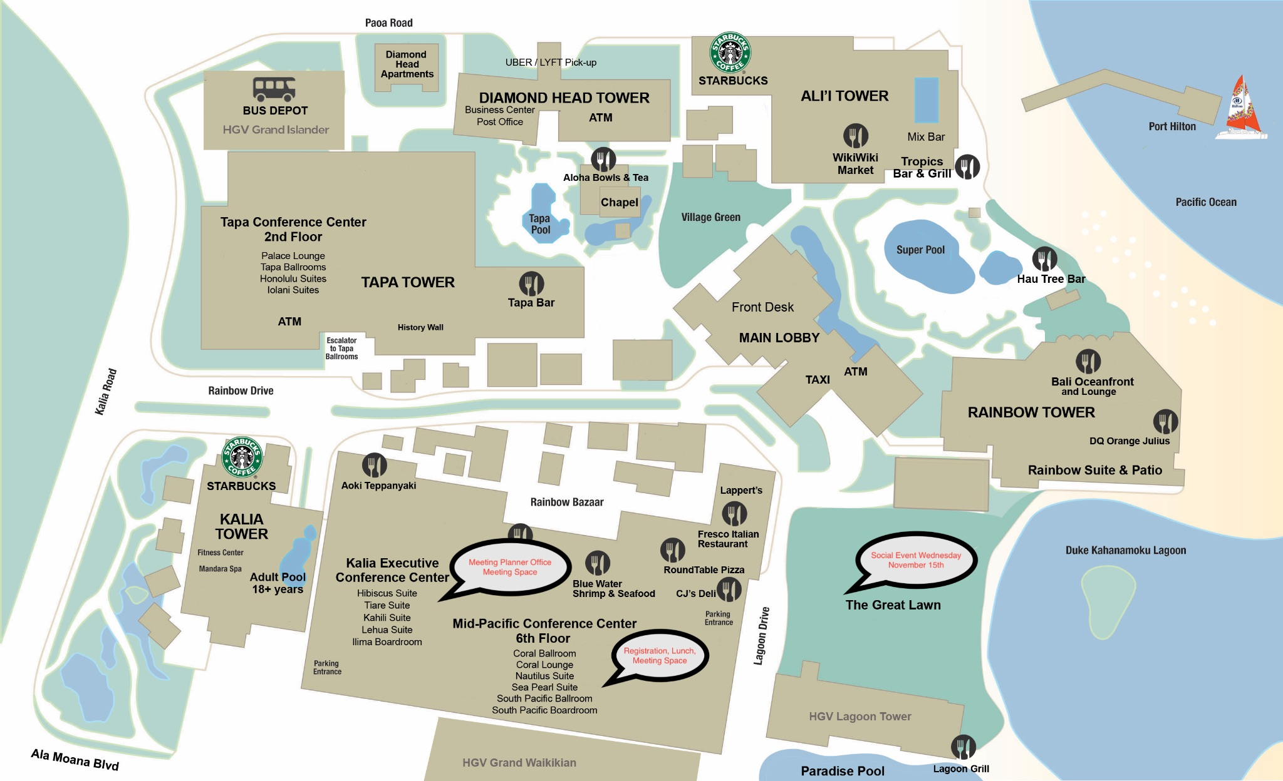
Resort Map - Meeting Space, Lunches, Social Locations Highlighted

Slide 17
Next IEEE 802 Plenary Session – March 2024
The next IEEE 802 Plenary Session will be March 10-15, 2024. The session will be a Mixed Mode with In-Person participation at the Hyatt Regency Denver. If you have any questions please email: 802info@facetoface-events.com
Information and Registration
  IEEE 802 Session Registration opens Dec 1, 2023
    Early Registration Deadline : Friday January 12, 2024
  Group Hotel Reservations: Hyatt Regency Denver at Colorado Convention Center
    Available Soon
  Hotel Reservation Booking Cut Off Date: February 16, 2024
Future Plenary Sessions (802world.org)

Slide 18
Basic Room Resource Allocation
Big meetings
(≥ 100, e.g., WG plenaries)
Medium meetings
(35-100, e.g., Task Forces)
Smaller meetings
(30 or less)
Head table (5)
1 projector/screen
2 tables mics
1 or 2 floor mics
Sound system
(speakers, sound board, etc.)
Ethernet/HDMI/USB
Scarlett Audio Interface
Head table (3)
1 projector/screen
1 table mic
1 floor mic
Sound system
(speakers, sound board, etc.)
Ethernet/HDMI/USB
Scarlett Audio Interface
U-shaped or board meeting setup
1 room microphone
  Portable or speakerphone-type
Sound system
(speakers, sound board, etc.)
Ethernet/HDMI/USB
Scarlett Audio Interface

Slide 19
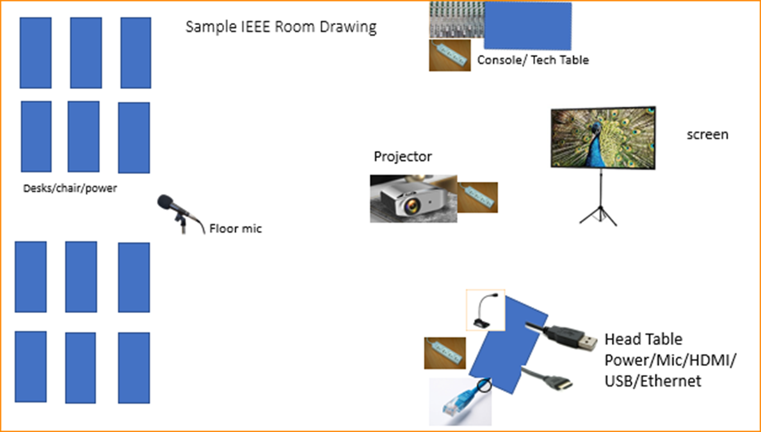

Scarlett
Notes:
This Photo by Unknown Author is licensed under CC BY-NC
This Photo by Unknown Author is licensed under CC BY-SA-NC
This Photo by Unknown Author is licensed under CC BY-SA

Slide 20
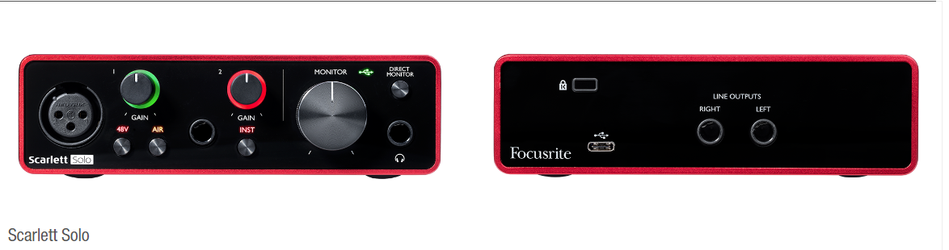
Scarlett Solo – Audio Interface by Focusrite
the USB connector not only supplies 5 VDC @ 900mA but also serves as the digital communication interface between WebEx and the Focusrite audio mixer.
Known Issue of connection dropping on newer models of Notebooks and Laptops.
Our Scarlett Boxes are 3rd Generation – Driver update can be found here:
https://downloads.focusrite.com/focusrite/scarlett-3rd-gen/scarlett-solo-3rd-gen

Slide 21
Suggested best practices
One central laptop/computer per meeting connects at head table.
Local speakers' queue/speak only at a microphone when called on.
Remote speakers request to speak via chat window and only speak when called on.
Presenters have chair (central laptop) share the presentation
Local attendees when logged into WebEx SHALL NOT connect Audio.
When Starting a meeting the host should do the following:
  Select “Meeting” -> “Meeting Options” -> [Disable] “Allow Participant to turn on Video”
  Select “Participant” -> [Enable] “Mute on Entry”.
For the Host and Remote Attendees connecting to Webex, Configure Webex Audio to use “Music Mode”.
If newer laptop, load updated Focusrite Scarlett Gen-3 drivers.
  Driver updates can be found here:
  https://downloads.focusrite.com/focusrite/scarlett-3rd-gen/scarlett-solo-3rd-gen

Slide 22
Mixed-mode Meeting Protocol
Sample Intro Meeting Slide
In-room Attendees:
  In Webex choose connect without audio before you join
  Use the Webex queue to indicate you want to speak
  Wait to be called on while standing/holding a microphone to make a comment
  Repeat any questions that are inadvertently asked away from the microphone
Remote Attendees:
  Join Webex and set Webex audio as ‘music’
  Use the Webex chat window to indicate you want to speak (“q”)
  Wait to be called on to speak

Slide 23
Future Venue Contract Status
2024 March 10-15 – Hyatt Regency Denver at Colorado Convention Center, Denver, CO, (March 2021)
2024 July 14-19 – Sheraton Le Centre Montreal, Montreal, Quebec, Canada (July 2020)
2024 Nov 10-15 –Hyatt Regency Vancouver, Vancouver, Canada (Nov 2021)
2025 March 9-14 –Hilton Atlanta, Atlanta, GA, United States (2 of 2 – March 2020).
2025 July 13-18 –Melia Castilla, Madrid Spain
  Was Marriott Madrid Auditorium (July 2021) – Changed to co-locate with IETF the week after.
2025 Nov 9-14 – Open –RFP NA
2026 March 8-13 -, Hyatt Regency Vancuver
  Was Hyatt Regency Chicago (March 2024) changed due to cancel of Hyatt Regency Chicago
2026 July 13-18 – Le Centre Sheraton Montreal, Montreal (July 2022 attrition offset)
2026 Nov 8-13 - Open – RFP Asia
2027 March –Hilton Atlanta, Atlanta, GA, United States ( offset potential shortfall 2023/2025)
2027 July 11-16 - Open –RFP Europe
2027 Nov 14-19 – Hawaiian Village, Oahu, Hawaii, United States
802 EC Approved – Contract is being Negotiated.
Notes:
Yellow Highlight – Was replaced – then circumstances cause another change.
Blue Highlight – replacement dates for venues deferred.
Light Green highlight – potential targets for possible deferrals or offset penalties.
Dark Green Highlight – rebooked due to COVID
Red – Cancelled – Electronic Plenary
No highlight – pre Covid assigned dates/venues.
Note: 2026 March - RFP -2019 - Hyatt Regency Chicago selected for March 2023, Contract not signed due to PSAV - Moved to 2024 March - then moved to 2026 due to agreement with rebooking Denver 2024.
Executed Contract
items are Venues approved by IEEE 802 EC, but Contract not complete.
These are open Calendar items I am working with potential venues.
Calendar open
https://mentor.ieee.org/802-ec/dcn/20/ec-20-0001-05-00EC-802-plenary-future-venue-contract-status.xlsx

Slide 24
Plenary RFP Targets
IEEE 802 Plenary Sessions are held Mar/July/Nov each year.
  - one in Asia in Even years and one in Europe in Odd years.
The room block is about 2400 – Estimate 450-500 in person.
Specific Requirements for Meeting Space/Network/AV etc. is located in Doc 802 EC-23/0145r0:
      https://mentor.ieee.org/802-ec/dcn/23/ec-23-0145-00-00EC-ieee-802-rfp-2023.xlsx
Potential Dates:
2025 July 13-18 Melia Castilla in Madrid (currently EC approval for Marriott Auditorium Madrid)
IETF meets in Madrid July 19-26, 2025
– Motion to approve on November 17
  2025 Nov 9-24– RFP
  2026 Mar 8-13 – Was Chicago – Proposed change to Hyatt Regency Vancouver
  -- Motion to approve on November 17
  2026 Nov 8-13 - RFP (Targeting Asia)
  2027 July 11-16 – RFP (Targeting Europe)

Slide 25
Canada Visa Status Report
The report, An Immigration System for Canada’s Future – A plan to get us there, includes the following action item addressing a key business events industry issue:
Expedite visitor visas, with benefits for tourism, major conferences and events.
"As of June 6, 2023, 13 more countries have been added to a partial visa exempt countries list. Now, travellers from 67 countries can apply for an electronic travel authorization (eTA) instead of a visa with most eTA applications approved within minutes.

Slide 26
Items for Closing Plenary:
4.02: MI Future Venues/Sessions - 60 minutes
  RFP report on 802 and 802W status
  Motions to approve proposed IEEE 802 Venues (2025, 2026, 2027)
  Motion to approve the Melia Castilla in Madrid for July 2025
  Motion for IEEE 802 to sponsor a joint workshop with ITU-T on July 13th 2024.
  Motion for approval Site Visit for Vancouver (2024 November)
  Motion to approve Sessions to be Mixed Mode in 2024
  Motion to approve Setting Meeting Fees for 2024 sessions.
4.05: MI Student Outreach/University Outreach AdHoc report 15 minutes
  a) Motion to approve University Outreach for 2024 March - Denver

Slide 27
Future Venue AdHocs --

Slide 28
Next Venue Meeting planning – Thurs 7:30 am
Proposed Agenda:
  Start time 7:30 am
  Review meeting space plan for 2024 March Plenary
    Hyatt Regency Denver at Colorado Convention Center, Denver, CO,
  Adjourn 8:00am

Slide 29
Future Venues AdHoc – Thurs 8 am
Proposed Agenda:
  Start time – 8:00 am
    Review Contract Status
    Review requirements for future sessions.
    Review RFP responses
    Select 2025 Nov, 2026 Nov, 2027 July
    .
  End time – 9:00am

Slide 30
IEEE 802 RFP Requirements
I expect that we will get the following items for comparison of the bids:
  1. Dates of Availability
  2. Network Requirements met
  3. Room Rate (Hope for US$200 or less).
  4. Meeting Room Fit - in a hotel rather than convention center
  5. AV company - In House or 3rd party
  6. Airport - International Cities Served
  7. Distance from Airport
  8. Visa – Issues – Number of Countries not requiring VISA
  9. Costs of Meeting Space.

Slide 31
Executive Secretary Agenda Items
Closing Plenary:
4.02: Future Meetings - I will need 60 minutes
1. RFP report -- 802 and 802W status
2. Motions to approve proposed 802 Venues (2025, 2026, 2027)
3. Motion for approval Site Visit for Vancouver (2024 November)
4.. Motion to approve Sessions to be Mixed Mode in 2024
5. Motion to approve Setting Meeting Fees for 2024 March session.
6. - Student Outreach/University Outreach AdHoc report 15 minutes
7. Motion for IEEE 802 to sponsor a joint workshop with ITU-T on July 13th 2024.

Slide 32
Future Interim Venue Status
As of Nov 13, 2023
2024-01 (14-19) Panama (Rebooked from Jan 2022)
2024-05 (12-17) Warsaw, Poland – (Rebook from May 2022)
2024-09 (8-13) Waikoloa, HI
2025-01 (12-17) Kobe, Japan – TBC (Moved from May 2023)
2025-05 (11-16) – RFP - Europe
2025-09 (14-19) Waikoloa, HI
2026-01 (11-16) - RFP
2026-05 (10-15) – RFP - Europe
2026-09 (13-18) Waikoloa, HI
2027-01 (10-15) - RFP
2027-05 (9-14) – RFP Asia (could rotate J-M-S)
2027-09 (12-17) - RFP
Meeting Planner:
Starred Venues :MTG Events
Dotted Venues: Face to Face Events
Notes:
Future Wireless Interim Meetings: review and status Sept 1, 2023
In General, Each year one Session must be Non-NA/US – Odd years Asia – Even Years Europe
2024 January 14-19 – Hilton Panama, Panama – Contract executed (802WFIN-21/31r0)
2024 May 12-17 - Warsaw Marriott, Warsaw, Poland– Contract signed by hotel in IEEE legal processing
2024 Sept 8-13 - Hilton Waikoloa Village – Contract executed (802WFIN-20/12r0)
2025 Jan 12-17 – Kobe, Japan – in negotiations
2025 May 11-16 – Open – Target Europe - RFP
2025 Sept 9-14 - Hilton Waikoloa Village, Waikoloa, HI – Contract executed (802WFIN-22-0007r0)
2026 Jan 11-16 – RFP – Open (NA/Asia)
2026 May 10-15– RFP – Open (Asia/NA)
2026 Sept 13-18 Hilton Waikoloa Village, Waikoloa, HI – Contract executed (802WFIN-22-0008r0)
2027 Jan 10-15 – RFP – Open (NA/Asia)
2027 May 9-14 – RFP – Open (Asia/NA)
2027 Sept 12-17 – RFP – Open (NA/Asia)

Slide 33
Future Venue Contract Status
2024 March 10-15 – Hyatt Regency Denver at Colorado Convention Center, Denver, CO, (March 2021)
2024 July 14-19 – Sheraton Le Centre Montreal, Montreal, Quebec, Canada (July 2020)
2024 Nov 10-15 –Hyatt Regency Vancouver, Vancouver, Canada (Nov 2021)
2025 March 9-14 –Hilton Atlanta, Atlanta, GA, United States (2 of 2 – March 2020).
2025 July 13-18 –Melia Castilla, Madrid Spain
  Was Marriott Madrid Auditorium (July 2021) – Changed to co-locate with IETF the week after.
2025 Nov 9-14 – Open –RFP NA
2026 March 8-13 -, Hyatt Regency Vancuver
  Was Hyatt Regency Chicago (March 2024) changed due to cancel of Hyatt Regency Chicago
2026 July 13-18 – Le Centre Sheraton Montreal, Montreal (July 2022 attrition offset)
2026 Nov 8-13 - Open – RFP Asia
2027 March –Hilton Atlanta, Atlanta, GA, United States ( offset potential shortfall 2023/2025)
2027 July 11-16 - Open –RFP Europe
2027 Nov 14-19 – Hawaiian Village, Oahu, Hawaii, United States
802 EC Approved – Contract is being Negotiated.
Nov 13, 2023
Notes:
As of 11-13-2023
Yellow Highlight – Was replaced – circumstances cause another change.
Blue Highlight – replacement dates for venues deferred.
Light Green highlight – potential targets for possible deferrals or offset penalties.
Dark Green Highlight – rebooked due to COVID
Red – Cancelled – Electronic Plenary
No highlight – pre Covid assigned dates/venues.
Note: 2026 March - RFP -2019 - Hyatt Regency Chicago selected for March 2023, Contract not signed due to PSAV - Moved to 2024 March - then moved to 2026 due to agreement with rebooking Denver 2024.
Executed Contract
items are Venues approved by IEEE 802 EC, but Contract not complete.
These are open Calendar items I am working with potential venues.
Calendar open
https://mentor.ieee.org/802-ec/dcn/20/ec-20-0001-05-00EC-802-plenary-future-venue-contract-status.xlsx

Slide 34
IEEE 802 PLENARY
RFP SUMMARY
Presented November 2023
November 2024

Slide 35
IEEE 802 PLENARY
July 2025
Presented November 2023
Replacement Choice - Melia Castilla Madrid

Slide 36
Presented November 2023
Melia Castilla Madrid
Madrid, Spain
Internet speed/cost: (<$7k): TBD
Hotel Room Rate 180 EURO ( USD$195)
Conference Center attached to hotel
Name AV company : Internal
Adolfo Suárez Madrid–Barajas Airport 7.5 miles from hotel
Visa Required for specific countries
Costs of the Meeting Space: TBD
July 12-18, 2025
F&B Minimum :$202,032
Note: We will Have IETF/IEEE 802 Joint Meeting on July 19
Please plan for Friday dinner and Saturday Workshop
Motion Nov 17th
Notes:
DDR - Minimum - 4 days at 135 per person 335 guarantee

Slide 37
Motion to Approve Venue 2025 July – Melia Castilla Madrid
Whereas Marriott Auditorium, Madrid, Spain was not available as originally planned,
Move to approve the Melia Castilla Madrid, Madrid, Spain as the location for the 2025 July IEEE 802 Plenary.
Moved: Rosdahl
Second:
Results: Unanimous Consent – Motion Passes

Slide 38
Presented November 2023
IEEE 802 Plenary
November 2025
Marriott Marquis Queen’s Park
Exception for 2025 to have one Asia/NA/Europe Venue for 2025 to make up for 3 NA for 2024.

Slide 39
Presented November 2023
Marriott Marquis Queen’s Park
November 8-14, 2025
Bangkok, Thailand
Internet speed/cost: (<$7k): TBD
Hotel Room Rate: $183.00 USD
Hotel Only No Conference Center
Name AV company : B Concept
Suvarnabhumi International Airport 15.8 Miles from hotel
Visa Required for specific countries
Costs of the Meeting Space: Meeting room rental complimentary with satisfied F&B Minimum
F&B Minimum- $124,930 USD
AdHoc one objection to selection.

Slide 40
Motion to Approve Venue 2025 November –
Marriott Marquis Queen’s Park
Whereas all 3 of the IEEE 802 Plenary Sessions were in North America in 2024, as an exception to the normal location rotation for 2025,
Move to approve the Marriott Marquis Queen’s Park, Bangkok, Thailand as the location for the 2025 November IEEE 802 Plenary.
Moved: Rosdahl
Second:
Results: Unanimous – Motion Passes

Slide 41
Presented November 2023
IEEE 802 Plenary
March 2026
Replacement of Hyatt Regency Chicago with Hyatt Regency Vancouver:

Slide 42
Presented November 2023
Hyatt Regency Vancouver
March 7-13, 2026
Vancouver, Canada
Internet speed/cost: (<$7k): TBD
Room Rate: $215 USD
Hotel Only No Conference Center
Name AV company - Encore
Vancouver International Airport: 8.7 miles from hotel
Visa Required for specific countries
Costs of the Meeting Space: Meeting room rental complimentary with satisfied F&B Minimum
F&B Minimum: $102,239.00 USD
A Concession for COVID rebooking
Replacement for Hyatt Regency Chicago

Slide 43
Motion to Approve Venue 2026 March –
Hyatt Regency Vancouver
Whereas the Hyatt Regency Chicago has informed us that they cannot meet our requirements for 2026 March,
Move to approve the Hyatt Regency Vancouver, Vancouver, BC, Canada as the location for the 2026 March IEEE 802 Plenary.
Moved: Rosdahl
Second:
Results: Unanimous – Motion Passes

Slide 44
Presented November 2023
IEEE 802 Plenary
November 2026
Top Choice:
Bangkok
However, we have made a choice for November 2025 for Bangkok, I suggest that we will go back and look for different venue choices.

Slide 45
Presented November 2023
Marriott Marquis Queen’s Park
November 8-13, 2026
Bangkok, Thailand
Internet speed/cost: (<$7k): TBD
Hotel Room Rate: $197.00 USD
Hotel Only No Conference Center
Name AV company - B Concept
Suvarnabhumi International Airport 15.8 Miles from hotel
Visa Required for specific countries
Costs of the Meeting Space: Meeting room rental complimentary with satisfied F&B Minimum
F&B Minimum- $130,135 USD
Repeat location - Worked with us during pandemic

Slide 46
Motion to Approve Venue 2026 November –
Marriott Marquis Queen’s Park
Move to approve the Marriott Marquis Queen’s Park, Bangkok, Thailand as the location for the 2026 November IEEE 802 Plenary.
Moved: Rosdahl
Second: Clint Powell
Results: Unanimous – Motion Passes

Slide 47
Presented November 2023
Hyatt Regency Sydney
November 8-13, 2026
Sydney, Australia
Internet speed/cost: (<$7k): TBD
Room Rate : $272.00
Hotel Only No Conference Center
Name AV company - Encore
Sydney International Airport 5.2 miles from the airport
Visa Required for specific countries
Costs of the Meeting Space: $202,000 USD
F&B Minimum: $200,000 USD

Slide 48
Presented November 2023
Brisbane Convention & Exhibition Centre
November 8-13, 2026
Brisbane, Australia
Internet speed/cost: (<$7k): TBD
Room Rate: $273 USD
Only Conference Centre
Name AV company - AVPS
Brisbane International Airport 11 miles from the airport
Visa Required for specific countries
Costs of the Meeting Space: $311,602.50 AUD ($201,648 USD)
F&B Minimum: $112,950 AUD (73,106 USD)

Slide 49
Presented November 2023
IEEE 802 Plenary
July 2027
Top Choices:
Gothenburg

Slide 50
Presented November 2023
Gothia Towers
July 10-16, 2027
Gothenburg, Sweden
Internet speed/cost: (<$7k): TBD
Hotel Room Rate: $181 USD
Conference Center Connected
Name AV company - Gothia Towers
Gothenburg-Landvetter Airport- 30 mins from the hotel
Visa Required for specific countries
Costs of the Meeting Space: $193,202 USD
F&B Minimum: $135,000 USD

Slide 51
Motion to Approve Venue 2027 Jully –
Gothia Towers, Gothenburg, Sweden
Move to approve the Gothia Towers, Gothenburg, Sweden as the location for the 2027 July IEEE 802 Plenary.
Moved: Rosdahl
Second: Powell
Results: Unanimous – Motion Passes.

Slide 52
Presented November 2023
Other Locations Considered
Asia: Singapore, Hong Kong, Macao, Sanya
Europe: Copenhagen, Oslo, Amsterdam, Antwerp, Paris, Athens, Dublin, Cannes, London, Maastricht, Istanbul, Vienna
North America: Seattle, Palm Springs, Atlanta, Ohio, Chicago, Denver
Africa: Cape Town

Slide 53
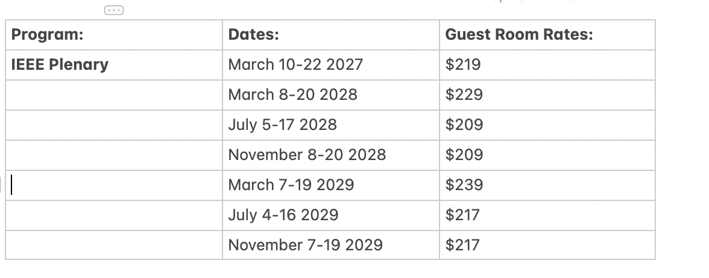
Presented November 2023
2028-2029 Hilton Columbus Downtown

Slide 54
Motion to Approve Site Exec Sec Visit (1)
Move to approve a site visit for the Executive Secretary to visit the Hyatt Regency Vancouver with the Meeting planner (Face to Face Events) and the Network Vendor (Linespeed Events) for the purposes of preparing the mixed mode capabilities. Executive Secretary expenses not to exceed $2500.
Moved:
2nd:
Results: Unanimous – Motion passes

Slide 55
Motion to Approve Site Exec Sec Visit (2)
Move to approve a site visit for the Executive Secretary to visit the Melia Castilla Madrid, Madrid, Spain with the Meeting planner (Face to Face Events) and the Network Vendor (Linespeed Events) for the purposes of preparing the mixed mode capabilities. Executive Secretary expenses not to exceed $5000.
Moved:
2nd:
Results: Unanimous – Motion Passes

Slide 56
Motion to Approve Site Exec Sec Visit (3)
Move to approve a site visit for the Executive Secretary to visit the Gothia Hotel in Gothenburg, Sweden with the Meeting planner (Face to Face Events) and the Network Vendor (Linespeed Events) for the purposes of preparing the mixed mode capabilities. Executive Secretary expenses not to exceed $5000.
Moved:
2nd:
Results: Unanimous – Motion Passes

Slide 57
Motion to approve 3 Plenaries in 2024 as Mixed Mode
Move to designate the three 2024 Plenaries as Mixed Mode
Moved: Rosdahl
2nd: Powell
Results: Unanimous – Motion Passes

Slide 58
Value of Lunches
802 Wireless Interim has lunches.
802.3 straw poll
  “ Would you approve a $100 extra registration fee to provide onsite lunch? Y-106 N-13
802.1 straw poll:
  Would you prefer lunch to be provided at plenaries (which may increase the meeting fee)? Yes –29 No -13 Did not respond - 7
802.15 straw poll in the room (this does not include remote participants):
  Do you prefer having a lunch as part of the plenary? Y 28 : N 0
Providing Lunches ensures a potential location for cross discussions and collaboration.
Not providing lunches – may take longer to find restaurant and returning in a timely manner.

Slide 59
Proposed Registration fees for Denver
2024 March Denver with lunches: 800/1150/1500
  Total Session Income/Credits $695,127.43
  Total Session Expenses: $704,021.73
  Net Session Surplus/(Loss): ($8,894.30)
  Per Person F&B = $671 (lunch is about $50 per day per person)
2024 March Denver with out lunches: 700/1050/1400
  Total Session Income/Credits $605,127.43
  Total Session Expenses: $559,321.73
  Net Session Surplus/(Loss): $45,805.70
  Per Person F&B = $375

Slide 60
Motion to set Meeting Fees for 2024 March - Denver
Move to set the meeting fees for the 2024 March IEEE 802 Plenary to be held at the Hyatt Regency Denver as the following:
  Early-bird $800 until January 12, 2024
  Standard $1150 until March 1, 2024
  Late/On-site $1500 after March 1, 2024
  A in Hotel Discount of $300 for a 3-night stay
  Cancellation Fees:
    Full Refund - No Fee until January 12, 2024
    Cancellation fee $150 January 13 until March 1;
    Cancelation - No refund after March 1
Moved: Rosdahl
2nd: Powell
Results: Unanimous consent – Motion Passes

Slide 61
IEEE 802 University Outreach Program for Denver March 2024
  University Outreach Program for Denver July 2024
The purpose of our Student Outreach program is to give students a chance to see firsthand how the Standards process works. We realize it is like getting a drink from a fire-hose, but it does give a good first look into the process.
It is a one-day event Tuesday of the Plenary Week:
  7:30-9:00 – sign in and get badge
  9:00am Start with an introduction meeting with a couple of the 802 Leadership members to orient the students to what activities may be of most interest to them that day
  10:30am (AM2) the students attend actual working meetings and can meet and participate in the discussions.

Slide 62
IEEE 802 University Outreach Program for Denver March 2024
17:00 (5pm) Debrief: A short debrief meeting at the end of the day is provided to answer questions and help provide closure to the experience.
The Outreach Student fee is USD$25 per student
The program is limited to 42 Students.
Note that membership attendance credit is not granted for student activities.
The Students are invited to join for Lunch and breaks as our guests.
Previous material prepared for 2015 and 2017 programs:
  https://www.ieee802.org/Univ_Outreach.shtml
A motion to approve program for March 2024 will be made during the 802 Closing Plenary Nov 17.

Slide 63
Motion to approve the University Outreach for 2024 March
Move to approve the University Outreach program for March 2024:
The Outreach Student fee is USD$25 per student
The program is limited to 42 Students.
Move: Rosdahl
Second: Gilb
Results: Unanimous Consent – Motion Passes

Slide 64
ITU-T SG15 & IEEE 802
There has been a cordial liaison relationship and mutual participation for decades
IEEE 802 plenary was hosted in Geneva by ITU in July 2013
  There was no registration fee and no network fee
  Facility was ITU HQ building and adjacent CICG convention centre
  The session was followed by an ITU-T SG15 plenary
802.1 & 802.3 interims have been hosted as well
  May 2007, May 2010, January 2018 and January 2020
A joint workshop between SG15 and 802 was held on the weekend
  This event that has been repeated many times, most recently in January 2020

Slide 65
July 2024
Canadian government (with industry sponsorship) has expressed interest in hosting ITU-T SG15 in Montreal
  July 1 – 12, 2024
  Sheraton Montreal has space available
Given good relationship with ITU-T SG15, the ITU hosting of IEEE 802 sessions, and the alignment of sessions in 2024, IEEE 802 should consider hosting a workshop with ITU-T SG15 in conjunction with our July 2024 session
  Sheraton Montreal space could be included in 802 contract amendment
  Network & meeting planning provided by IEEE 802 service providers
  AM/PM breaks (and possibly lunch)
  Additional cost will be less than US$10,000

Slide 66
Motion
Approve hosting of joint workshop with ITU-T SG15 adjacent to July 2024 IEEE 802 plenary session, with additional cost not to exceed US$10,000 .
Moved: Jon Rosdahl
2nd: Glenn Parsons
Results: Unanimous Consent – Motion Passes

Slide 67
8.04 Monthly IEEE 802 EC Telecons
Announcement of 802 EC Interim Telecons
Tuesday 9 January 2024, 19:00-21:00 UTC
Tuesday 6 February 2024, 19:00-21:00 UTC
Skip December 2023 and March 2024
Call Time: Tuesday, 2:00 PM - 4:00 PM (UTC-05:00) Eastern Time (ET)
Recurrence: Occurs Generally the first Tuesday of every month.
From 7:00 PM to 9:00 PM, (UTC+00:00) Monrovia, Reykjavik time zone.
Calls after March Plenary to be Scheduled during 2024 March IEEE 802 EC Closing Plenary meeting.
Notes:
802 Interim Telecons – 1st Tuesday of the following Months: January/February/April/May/June/August/September/October
Delayed January 9th Telecon determined during

Slide 68
8.05 Call for Tutorials for March 2024
Tutorials may be held electronic: TBA
In person/Mixed-mode Tutorials: March (Mon/Tues)
Tutorial Request form:
  https://mentor.ieee.org/802-ec/dcn/23/ec-23-0128-00-00EC-802-tutorial-request-form-2023.docx
As a reminder, please refer to Chair's Guidelines section 2.5 Tutorials for the logistics for participating in sponsoring/presenting a Tutorial.
Note that Tutorial times are limited to 80 minutes with 10 minutes to allow for presenters to setup and depart. (Starting at 18:15).
All requests for Tutorials must be made by 26 January 2024
Notes:
All official tutorial request forms must be submitted no later than 45 days in advance of the Plenary Session.
Approved Tutorial Requests will be assigned a time slot based on the order in which they were received.
The Final Tutorial Schedule will be posted at http://802world.org/plenary and http://ieee802.org no less than 30 days in advance of the Plenary Session.
Mentor Link to 2023 Tutorial Request form: https://mentor.ieee.org/802-ec/dcn/23/ec-23-0128-00-00EC-802-tutorial-request-form-2023.docx

