Slide 1
Executive Secretary Agenda Items
2023 October Interim Telecon
Jon Rosdahl
IEEE 802 Executive Secretary
jrosdahl@ieee.org

Slide 2
IEEE 802 Opening EC Mtg – October 3
Agenda Items
  3.01 – MI Current / Future venues 30 Mins
      Nov Registration Status
      Future Venue Contract Status
      Review RFP Status
      Discussion on July 2025/Nov 2025
  6.04 – DT Student Outreach AdHoc 5 Mins
    Review AdHoc Call

Slide 3
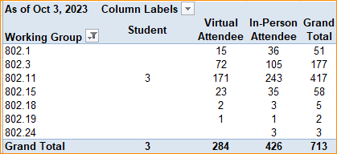
2023 Nov 802 Plenary Registration report as of 10/03/23 – 11:25 ET

Slide 4
Basic Room Resource Allocation
Big meetings
(≥ 100, e.g., WG plenaries)
Medium meetings
(35-100, e.g., Task Forces)
Smaller meetings
(30 or less)
Head table (5)
1 projector/screen
2 tables mics
1 or 2 floor mics
Sound system
(speakers, sound board, etc.)
Ethernet/HDMI/USB
Scarlett Audio Interface
Head table (3)
1 projector/screen
1 table mic
1 floor mic
Sound system
(speakers, sound board, etc.)
Ethernet/HDMI/USB
Scarlett Audio Interface
U-shaped or board meeting setup
1 room microphone
  Portable or speakerphone-type
Sound system
(speakers, sound board, etc.)
Ethernet/HDMI/USB
Scarlett Audio Interface

Slide 5
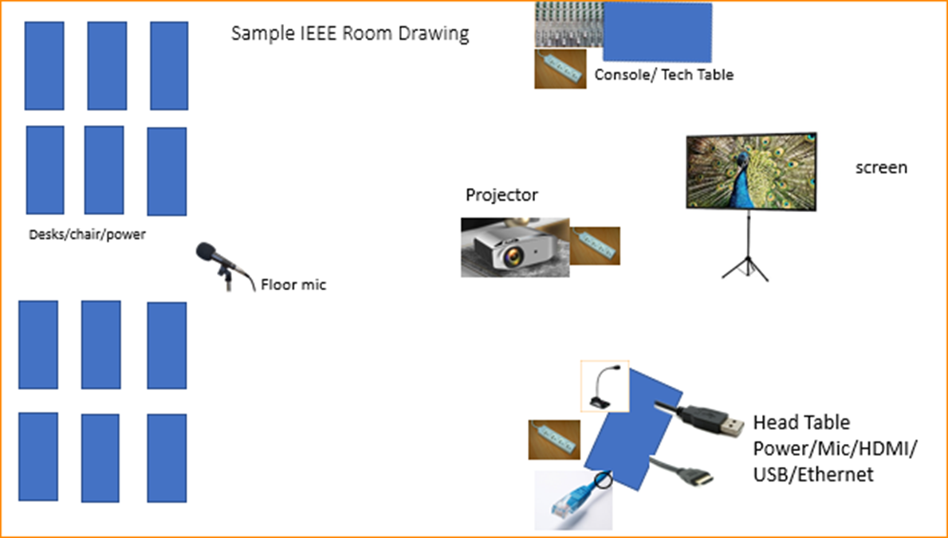

Scarlett
Notes:
This Photo by Unknown Author is licensed under CC BY-NC
This Photo by Unknown Author is licensed under CC BY-SA-NC
This Photo by Unknown Author is licensed under CC BY-SA

Slide 6
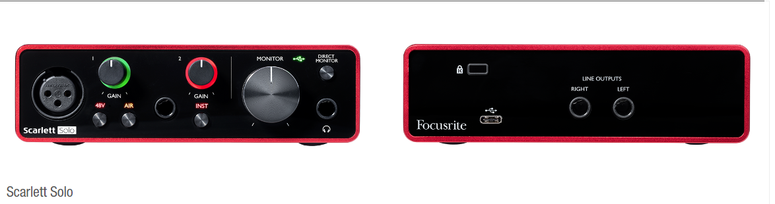
Scarlett Solo – Audio Interface by Focusrite
the USB connector not only supplies 5 VDC @ 900mA but also serves as the digital communication interface between WebEx and the Focusrite audio mixer.
Known Issue of connection dropping on newer models of Notebooks and Laptops.
Our Scarlett Boxes are 3rd Generation – Driver update can be found here:
https://downloads.focusrite.com/focusrite/scarlett-3rd-gen/scarlett-solo-3rd-gen

Slide 7
Suggested best practices
One central laptop/computer per meeting connects at head table.
Local speakers' queue/speak only at a microphone when called on.
Remote speakers request to speak via chat window and only speak when called on.
Presenters have chair (central laptop) share the presentation
Local attendees when logged into WebEx SHALL NOT connect Audio.
When Starting a meeting the host should do the following:
  Select “Meeting” -> “Meeting Options” -> [Disable] “Allow Participant to turn on Video”
  Select “Participant” -> [Enable] “Mute on Entry”.
For the Host and Remote Attendees connecting to Webex, Configure Webex Audio to use “Music Mode”.
If newer laptop, load updated Focusrite Scarlett Gen-3 drivers.
  Driver updates can be found here:
  https://downloads.focusrite.com/focusrite/scarlett-3rd-gen/scarlett-solo-3rd-gen

Slide 8
Mixed-mode Meeting Protocol
Sample Intro Meeting Slide
In-room Attendees:
  In Webex choose connect without audio before you join
  Use the Webex queue to indicate you want to speak
  Wait to be called on while standing/holding a microphone to make a comment
  Repeat any questions that are inadvertently asked away from the microphone
Remote Attendees:
  Join Webex and set Webex audio as ‘music’
  Use the Webex chat window to indicate you want to speak (“q”)
  Wait to be called on to speak

Slide 9
Future Venue Contract Status
2023 Nov 12-17 – Hawaiian Village, Oahu, Hawaii, United States
2024 March 10-15 – Hyatt Regency Denver at Colorado Convention Center, Denver, CO, (March 2021)
2024 July 14-19 – Sheraton Le Centre Montreal, Montreal, Quebec, Canada (July 2020)
2024 Nov 10-15 –Hyatt Regency Vancouver, Vancouver, Canada (Nov 2021)
2025 March 9-14 –Hilton Atlanta, Atlanta, GA, United States (2 of 2 – March 2020).
2025 July 13-18 –Marriott Madrid Auditorium, Madrid, Spain (July 2021) / NEW RFP ?
2025 Nov 9-24 – Open – Request for Hong Kong, Macao, or Sanya
2026 March 8-13 - Hyatt Regency Chicago, Chicago, IL, United States (March 2024)
2026 July 13-18 – Le Centre Sheraton Montreal, Montreal (July 2022 attrition offset)
2026 Nov 8-13 - Open – RFP Asia
2027 March –Hilton Atlanta, Atlanta, GA, United States ( offset potential shortfall 2023/2025)
2027 July 11-16 - Open –RFP Europe
2027 Nov 14-19 – Hawaiian Village, Oahu, Hawaii, United States
802 EC Approved – Contract is being Negotiated.
Notes:
Yellow Highlight – Potential deferral identified.
Blue Highlight – replacement dates for venues deferred.
Light Green highlight – potential targets for possible deferrals or offset penalties.
Dark Green Highlight – rebooked due to COVID
Red – Cancelled – Electronic Plenary
No highlight – pre Covid assigned dates/venues.
Note: 2026 March - RFP -2019 - Hyatt Regency Chicago selected for March 2023, Contract not signed due to PSAV - Moved to 2024 March - then moved to 2026 due to agreement with rebooking Denver 2024.
Executed Contract
items are Venues approved by IEEE 802 EC, but Contract not complete.
These are open Calendar items I am working with potential venues.
Calendar open
https://mentor.ieee.org/802-ec/dcn/20/ec-20-0001-05-00EC-802-plenary-future-venue-contract-status.xlsx

Slide 10
Plenary RFP Targets
IEEE 802 Plenary Sessions are held Mar/July/Nov each year.
  - one in Asia in Even years and one in Europe in Odd years.
The room block is about 2400 – Estimate 450-500 in person.
Specific Requirements for Meeting Space/Network/AV etc. is located in Doc 802 EC-23/0145r0:
      https://mentor.ieee.org/802-ec/dcn/23/ec-23-0145-00-00EC-ieee-802-rfp-2023.xlsx
Potential Dates:
2025 July 13-18 (Targeting Europe) (currently EC approval for Marriott Auditorium Madrid)
IETF meets in Madrid July 19-26, 2025
Melia Castilla in Madrid –
  2025 Nov 9-24 Huawei 0ffer – Hong Kong, Macao, Sanya –
  Sands Macao has called and shown interest
  Results: 4 - 7- 2 (Recuse 1)
  2026 Nov 8-13 (Targeting Asia)
  2027 July 11-16 (Targeting Europe)
  2028/2029 allowed for bid as well.

Slide 11
Straw Poll #1 – 2025 July
1.Would you support moving the 2025 July 13-18 (currently EC approval for Marriott Auditorim Madrid) to co-locate with the IETF which meets in Madrid July 19-26, 2025 at the Melia Castilla in Madrid
  A.yes 14 (93%)
  B.No 1 ( 7%)
  C.Abstain 0 ( 0%)

Slide 12
Straw Poll #2 – November 2025
1.Do you support 2025 Nov 9-24 being held in possibly Hong Kong, Macao, or Sanya ?
  A.yes 4 (31%)
  B.No 7 (54%)
  C.Abstain 2 (15%)

Slide 13
IEEE RFP Requirements
I expect that we will get the following items for comparison of the bids:
  1. Network Requirements met
  2. Room Rate (Hope for US$200 or less).
  3. Meeting Room Fit - in a hotel rather than convention center
  4. AV company - In House or 3rd party
  5. Airport - International Cities Served
  6. Visa - Issues
  7. Costs of Meeting Space.

Slide 14
IEEE MCE Convene - Follow-up
Email Follow-up was sent to the following:
  Rocco LaForgia - Director of Sales Worldwide Accounts, Hilton International
  Cindy Ramesh - Complex Director of Sales and Marketing - Hilton San Francisco Union Square, San Francisco, CA.
  Fraser Abbott - Director of Business Dev, Calgary Champions Program - Calgary Alberta, Canada
  Matthew Hourihan - National Sales Manager - Pasadena Convention and Visitors Bureau
  Carl Lauto, Senior Account Executive - New Orleans and Company
  Coleen Buchanan, Senior Sales Manager - Visit San Antonio
  Joy Kang, Assistant Director of Sales - Marina Bay Sands, Singapore
  Thembi Kuchena - Manager Sales (Conferences) - ADNEC - Abu Dhabi National Exhibition Centre - Abu Dhabi, UAE
  Zenab Gharib Ahmed Mohamed, Conventions Senior Executive, Abu Dhabi Convention and Exhibition Bureau
  Neasa Ni Dhomhnaill, Business Dev Officer, Dublin Convention Bureau - Dublin, Ireland
  Trese Moser, Sales Manager - Evans Hotels - 802W program only - San Diego, CA
  Pam Lee, Global Account Executive, Global Sales, U.S. & Canada, Marriott International

Slide 15
IEEE EC Action item – Where would you like to go?
- Anywhere in AUS
- Anywhere in NZ
- Manila
- Any reasonable spot in South Korea - Probably not Jeuju
- Any reasonable spot in Japan
- Singapore
- Taiwan

Slide 16
6.04 Student Outreach/Student University Outreach
Form AdHoc:
  Chair Jon
    Members:
      Paul Nikolich, Edward Au, Geoff Thompson, Clint Powell, David Law, Tuncer Baykays, George Zimmerman, Subir Das, Guido Hiertz
Deliverables:
  Jon and Paul to prepare Scope by August 15th
  AdHoc initial proposal by Oct Interim Telecon.
Next Call Oct 26th 3pm ET for one hour

Slide 17
Things to improve
2 student programs
  (Student Outreach and University Outreach was confusing).
  Consider format to allow more flexibility
  Consider orientation prior to arrival (like new members).
Change Student Outreach fee's structure.
  Change from $150 to some other value but continue to allow repeat usage.

Slide 18
Student Outreach Ad Hoc Purpose and Scope
Purpose:
  Encourage university students and professors to participate in IEEE 802 LMSC standards activities, by reducing or eliminating barriers to their participation.
Scope:
  Prepare P&P changes that will enable a wide range of university students and professors across a several university disciplines, e.g., engineering, economics, law, policy, and business, to fully participate in IEEE 802 LMSC standards activities on a long-term basis.
  Some changes to be considered may be:
    reduction or elimination of registration fees with constraints on voting membership rights, enable remote participation, and consider reducing in-person participation costs by providing reduced cost hotel rooms.
Rationale:
  Current IEEE 802 LMSC P&P provide little to no incentive to university students and professors engage in sustained IEEE 802 standards activities. This represents a missed opportunity, as this cohort is the next generation of professional 802 members that will support the continued growth and health of the organization. Reducing or eliminating this cohort’s participation barriers should be viewed as a long-term investment in IEEE 802.

Slide 19
Student Outreach Telcon
Attendance – Sept 28: 2
  Items discussed to improve program:
    Advertise to Student IEEE and Computer Society student branches.
    Logistics – Key to successful program
    Costs – What is the 802 EC willing to fund?
      Currently: Subsidized Registration: Badging, F&B, Lunch if served.
      Registration ? -- Hotel ? -- other Travel expenses?
    Registration Fees now:
      $150 full week -- $25 one day – Tuesday.
  Alternatives:
    Current Program: 2 802 EC officers for orientation and debrief.
    Make one-day Student a day pass – would require Professor participation to shepherd.

Slide 20
8.04 Monthly IEEE 802 EC Telecons
Announcement of 802 EC Interim Telecons
Tuesday 1 August 2023 – HOLIDAY
Tuesday 5 September 2023, 19:00-21:00 UTC
Tuesday 3 October 2023, 19:00-21:00 UTC
Call Time: 3:00 PM - 5:00 PM Tuesday, (UTC-04:00) Eastern Time (US & Canada)
Recurrence: Occurs Generally the first Tuesday of every month.
From 7:00 PM to 9:00 PM, (UTC+00:00) Monrovia, Reykjavik time zone.
Calls after Nov to be Scheduled during 2023 Nov IEEE 802 EC Closing Plenary meeting.
Notes:
802 Interim Telecons – 1st Tuesday of the following Months: January/February/April/May/June/August/September/October

Slide 21
8.05 Call for Tutorials for November 2023
Tutorials may be held electronic: TBA
In person/Mixed-mode Tutorials: November (Mon/Tues)
Tutorial Request form:
  Generic: http://www.ieee802.org/802_tutorials/802_Tutorial_Request_Form.doc
As a reminder, please refer to Chair's Guidelines section 2.5 Tutorials for the logistics for participating in sponsoring/presenting a Tutorial.
Note that Tutorial times are limited to 80 minutes with 10 minutes to allow for presenters to setup and depart. (Starting at 18:15).
All requests for Tutorials must be made by 29 September 2023
Notes:
All official tutorial request forms must be submitted no later than 45 days in advance of the Plenary Session.
Approved Tutorial Requests will be assigned a time slot based on the order in which they were received.
The Final Tutorial Schedule will be posted at http://802world.org/plenary and http://ieee802.org no less than 30 days in advance of the Plenary Session.
Mentor Link to 2023 Tutorial Request form: https://mentor.ieee.org/802-ec/dcn/23/ec-23-0128-00-00EC-802-tutorial-request-form-2023.docx

