Slide 1
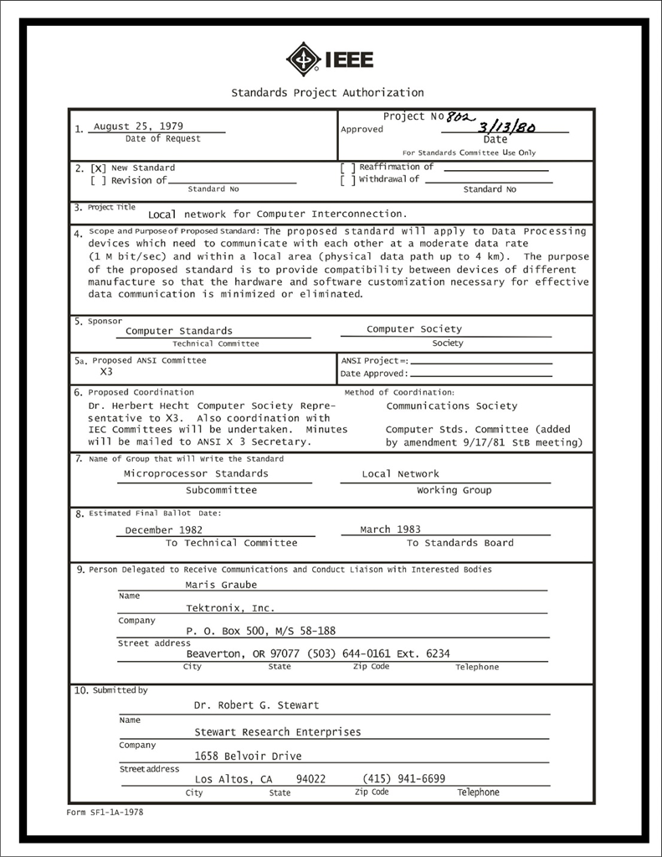
IEEE 802 LMSC
Executive Committee
03 October 2023
Electronic Meeting
19:00-21:00 UTC
15:00-17:00 ET
DCN ec-23-0174-00-00EC

Slide 2
1.00 Meeting called to order/roll call
2.00 Review/modify/approve agenda
2.01 Participation Slide Set URLs:
https://ieee802.org/sapolicies.shtml
https://standards.ieee.org/content/dam/ieee-standards/standards/web/documents/other/Participant-Behavior-Individual-Method.pdf
Participant behavior is guided by IEEE Code of Ethics & Conduct
Participants shall act independently of others, including employers
Standards activities shall allow the fair & equitable consideration of all viewpoints

Slide 3
3.00 Chair’s Announcements
  Proforma:
    Use IMAT to log your attendance
    Please enable mute when you are not speaking
    Please use the chat function to request being put in the queue
  Reminder to vote in IEEE 2023 General Election and 2024 SA President Elect Forum
    IEEE Annual Election began closed 02 October 2023.
    Unofficial election results will be announced on 6 October 2023.
  The SA Managing Director, Konstantinos Karachalios, resignation effective 31 December 2023.
  Alpesh Shah, Senior Director, Global Business Strategy & Intelligence at IEEE Standards Association has been appointed to be the SA Managing Director effective 01 January 2024.

Slide 4
6.06 EC Any Other Business?
Any other business?
TBD

Slide 5
9.0 EC Action Item Status Review
Review Action Items from this meeting
tbd

Slide 6
Adjourn EC Meeting

