Slide 1
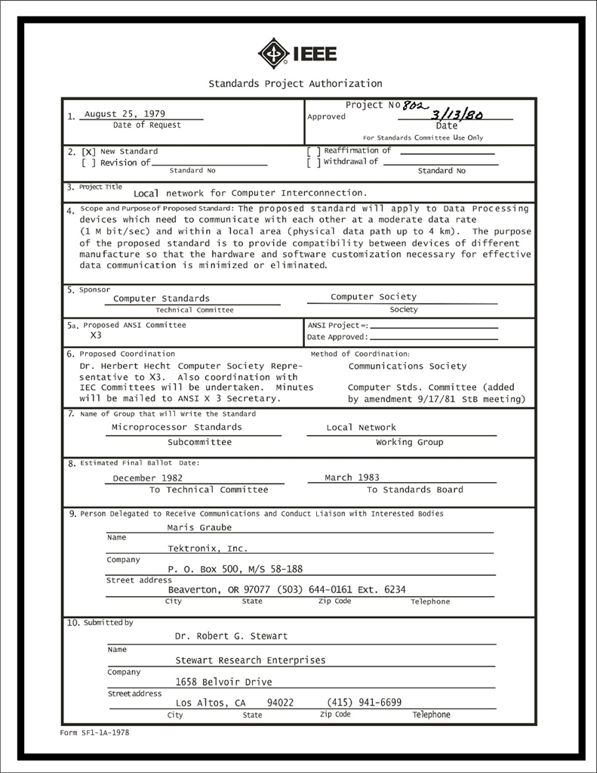
IEEE 802 LMSC Executive Committee 06 September 2023 Electronic Meeting 19:00-21:00 UTC 15:00-17:00 ET
DCN ec-23-162-00-00EC

Slide 2
1.00 Meeting called to order/roll call
2.00 Review/modify/approve agenda
2.01 Participation Slide Set URLs:
https://ieee802.org/sapolicies.shtml
https://standards.ieee.org/content/dam/ieee-standards/standards/web/documents/other/Participant-Behavior-Individual-Method.pdf
Participant behavior is guided by IEEE Code of Ethics & Conduct
Participants shall act independently of others, including employers
Standards activities shall allow the fair & equitable consideration of all viewpoints

Slide 3
3.00 Chair’s Announcements
Proforma:
Use IMAT to log your attendance
Please enable mute when you are not speaking
Please use the chat function to request being put in the queue
Reminder to vote in IEEE 2023 General Election and 2024 SA President Elect Forum
IEEE Annual Election began 15 August 2023 and closes 02 October 2023. See https://www.ieee.org/about/corporate/election/index.html
2024 SA President Elect Forum recording is available at https://ieeetv.ieee.org/video/ieee-sa-2024-president-elect-candidates-forum

Slide 4
6.0 EC Any Other Business?
Any other business?
6.01, II, Transitioning from using SA PIN to Customer ID numbers as the personal identifier, Haasz, 10 minutes
6.02, II, A general status update on IMAT (Requested by 802 at the next scheduled task force meeting), Haasz, 10 minutes
6.03, II, Public Visibility Standing Committee - Permissions Process, Haasz, 10 minutes

Slide 5
9.0 EC Action Item Status Review
Review Action Items from this meeting
tbd

Slide 6
Adjourn EC Meeting

