Slide 1
802.1 consent agenda items for LMSC Closing Plenary
July 2023
(V5 – 802.1 version #)

Slide 2
Agenda
Industry Connections
  5.xxx – Nendica ICAID extension
Drafts to SA Ballot
  5.xxx – P802.1ASdr
  5.xxx – P802.1CS/cor1
  5.xxx – P802.1ASdn
  5.xxx – P802.1DC
Drafts to RevCom
  5.xxx – P802.1Qcj
  5.xxx – P802.1Qcw
  5.xxx – P802f
PARs to NesCom
  5.xxx – P802.1DG
  5.xxx – P802.1Qdj
  5.xxx – P60802
  5.xxx – P802.1Qdy

Slide 3
Agenda
Liaisons and external communications (ME)
  7.xxx – Approve liaison of drafts for information to ISO/IEC JTC1/SC6 under the PSDO agreement
  7.xxx – Approve liaison of drafts for adoption to ISO/IEC JTC1/SC6 under the PSDO agreement
  7.xxx – Approve responses to ballot comments received from SC6 on FDIS and CIB ballots
Liaisons and external communications (II)
  7.xxx – Approve 802.1 communication to ITU-T JCA IMT 2020
  7.xxx – Approve 802.1 communication to ITU-T SG15
  7.xxx – Approve 802.1 communication to ITU-T SG13
  7.xxx – Approve 802.1 communication with BBF
  7.xxx – Approve 802.1 communication with 1588 WG
  7.xxx – Approve 802.1 communication with 3400 WG
  7.xxx – Approve 802.1 communication with LNI 4.0

Slide 4
802.1 Motions
2023-07
Consent Agenda
ICAID to ICCom

Slide 5
Motion – 5.0xx
Forward Nendica ICAID Renewal https://mentor.ieee.org/802.1/dcn/23/1-23-0004-06-ICne-draft-nendica-icaid-renewal-to-september-2025.docx, including Nendica ICCom Report https://mentor.ieee.org/802.1/documents?is_group=ICne&is_year=2023&is_dcn=0007 for information, to ICCom
In the WG, Proposed: Jessy Rouyer Second: Norm Finn
  (y/n/a): 41, 2, 5
In EC, mover: Glenn Parsons Second: David Law
  (y/n/a): <y>,<n>,<a>

Slide 6
802.1 Motions
2023-07
Consent Agenda
Drafts to SA Ballot

Slide 7
Motion – 5.0xx
Approve sending P802.1ASdr D2.0 to Standards Association ballot
Confirm the CSD for P802.1ASdr in https://mentor.ieee.org/802-ec/dcn/21/ec-21-0097-00-ACSD-p802-1asdr.pdf
P802.1ASdr D1.2 had 98% approval at the end of the last WG ballot
In the WG, Proposed: Silvana Rodrigues, Second: János Farkas
  Sending draft (y/n/a): 52, 1, 1
  CSD (y/n/a): 49, 1, 1 (1 unexercised)
In EC, mover: Glenn Parsons, Second: David Law
  (y/n/a): <y>,<n>,<a>

Slide 8
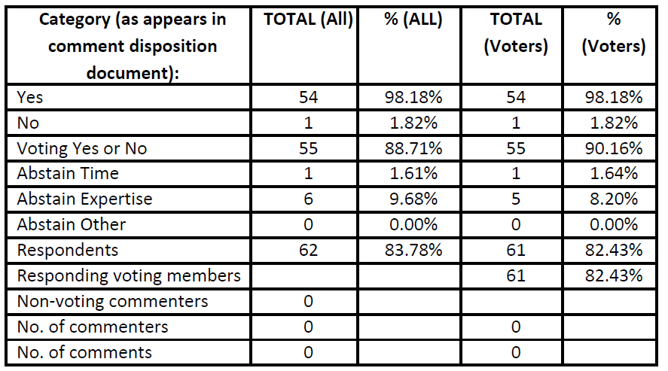
Supporting Information P802.1ASdr
WG ballot closed: 5 May 2023
All WG ballot requirements are met
The ballot resulted in
  1 outstanding Disapprove vote
  3 outstanding Must Be Satisfied (MBS) comments
Comment resolution available here: https://www.ieee802.org/1/files/private/dr-drafts/d1/802-1ASdr-d1-2-dis-V00.pdf.
Ballot results:

Slide 9
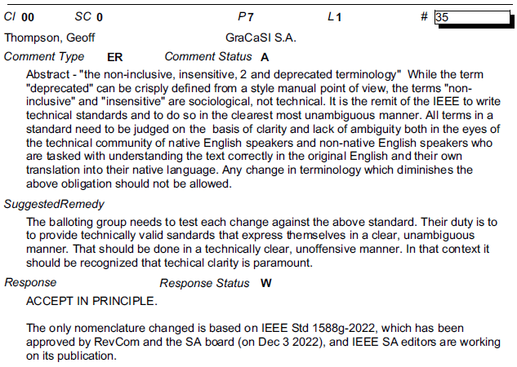
Supporting Information P802.1ASdr
The single disapprove vote is maintained from the initial WG ballot on D1.0
The disapprove vote is associated with 3 MBS comments on D1.0, see here and following slides
(https://www.ieee802.org/1/files/private/dr-drafts/d1/802.1ASdr-d1-0-dis-v00.pdf)

Slide 10
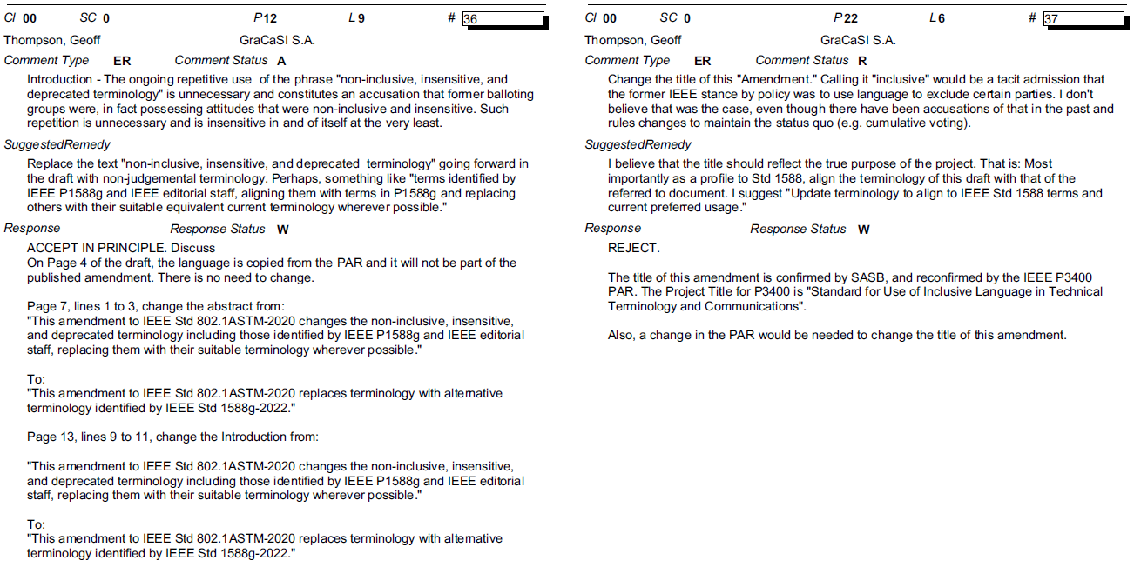
Supporting Information P802.1ASdr

Slide 11
Motion – 5.0xx
Approve sending P802.1CS-2020/Cor1 D2.0 to Standards Association ballot
  Note: there is no CSD statement since this maintenance project is not intended to provide any new functionality
P802.1CS-2020/Cor1 D1.3 had 100% approval at the end of the last WG ballot
In the WG, Proposed: Jessy Rouyer, Second: Norm Finn
  Sending draft (y/n/a): 50, 1, 1
In EC, mover: Glenn Parsons, Second: David Law
  (y/n/a): <y>,<n>,<a>

Slide 12
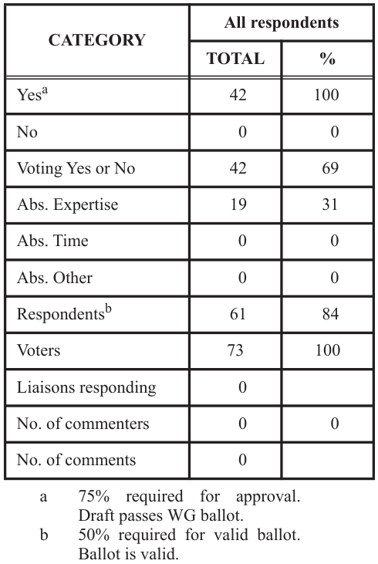
Supporting Information P802.1CS-2020/Cor1
WG ballot closed: 30 June 2023
All WG ballot requirements are met
The ballot resulted in
  0 outstanding Disapprove votes
  0 outstanding Must Be Satisfied (MBS) comments
Comment resolution available here: https://www.ieee802.org/1/files/private/cs-2020-cor-1-drafts/d1/802-1CS-2020-Cor1-d1-3-dis-v2.pdf.
Ballot results:

Slide 13
Motion – 5.0xx
Conditionally approve sending P802.1ASdn D2.0 to Standards Association ballot
Confirm the CSD for P802.1ASdn in https://mentor.ieee.org/802-ec/dcn/20/ec-20-0202-00-ACSD-p802-1asdn.pdf
P802.ASdn D1.1 had 98% approval at the end of the last WG ballot
In the WG, Proposed: János Farkas, Second: Ludwig Winkel
  Sending draft (y/n/a): 51, 2, 1
  CSD (y/n/a): 50, 1, 2 (1 unexercised)
In EC, mover: Glenn Parsons, Second: David Law
  (y/n/a): <y>,<n>,<a>

Slide 14
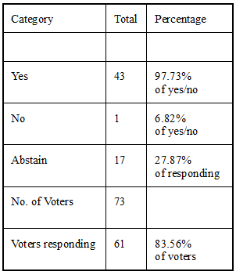
Supporting Information P802.1ASdn
WG ballot closed: 5 May 2023
All WG ballot requirements are met
The ballot resulted in
  1 outstanding Disapprove votes
  1 outstanding Must Be Satisfied (MBS) comments
Comment resolution available here: https://ieee802.org/1/files/private/asdn-drafts/d1/802-1ASdn-d1-1-dis-v01.pdf
Recirculation ballot will be conducted during July/August with comment resolution in TSN TG meetings. A possible final recirculation in September/October if required with comment resolution in TSN TG meetings.
Ballot results:

Slide 15
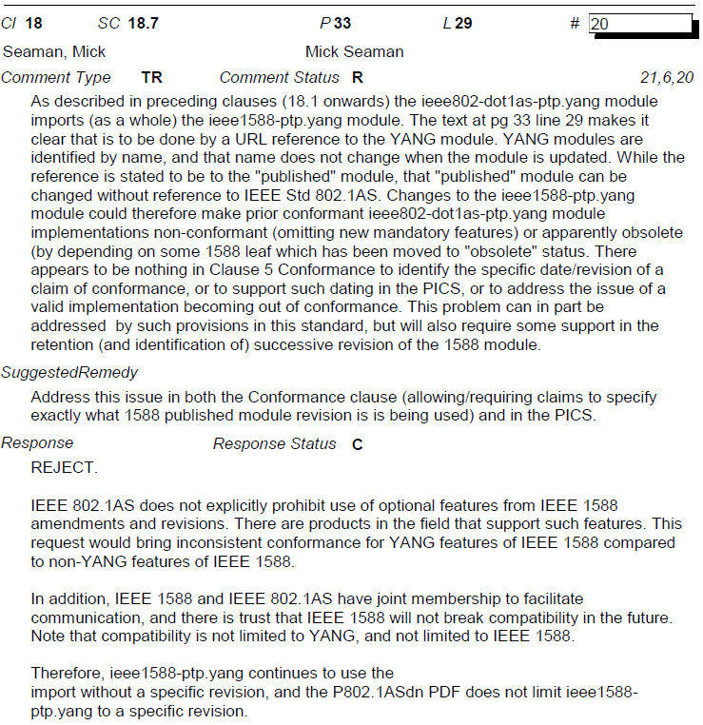
Supporting Information P802.1ASdn
1 disapprove vote associated with 1 MBS comment is maintained from the initial WG ballot on D1.0
https://ieee802.org/1/files/private/asdn-drafts/d1/802-1ASdn-d1-0-dis.pdf

Slide 16
Motion – 5.0xx
Conditionally approve sending P802.1DC D3.0 to Standards Association ballot
Confirm the CSD for P802.1DC in https://mentor.ieee.org/802-ec/dcn/18/ec-18-0091-00-ACSD-802-1dc.pdf
P802.1DC D2.2 had 98% approval at the end of the last WG ballot
In the WG, Proposed: Norm Finn, Second: János Farkas
  Sending draft (y/n/a): 51, 2, 1
  CSD (y/n/a): 48, 2, 3 (1 unexercised)
In EC, mover: Glenn Parsons, Second: David Law
  (y/n/a): <y>,<n>,<a>

Slide 17
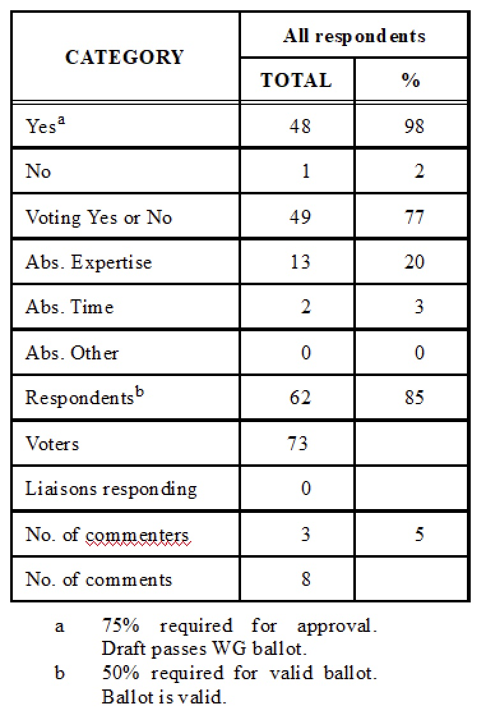
Supporting Information P802.1DC
WG ballot closed: 12 July 2023
All WG ballot requirements are met
The ballot resulted in
  1 outstanding Disapprove votes
  4 outstanding Must Be Satisfied (MBS) comments
Comment resolution available here: https://www.ieee802.org/1/files/private/dc-drafts/d2/802-1DC-d2-2-dis-v01.pdf
Recirculation ballot will be conducted during July/August with comment resolution in TSN TG meetings. A possible final recirculation in September/October if required with comment resolution in TSN TG meetings.
Ballot results:

Slide 18
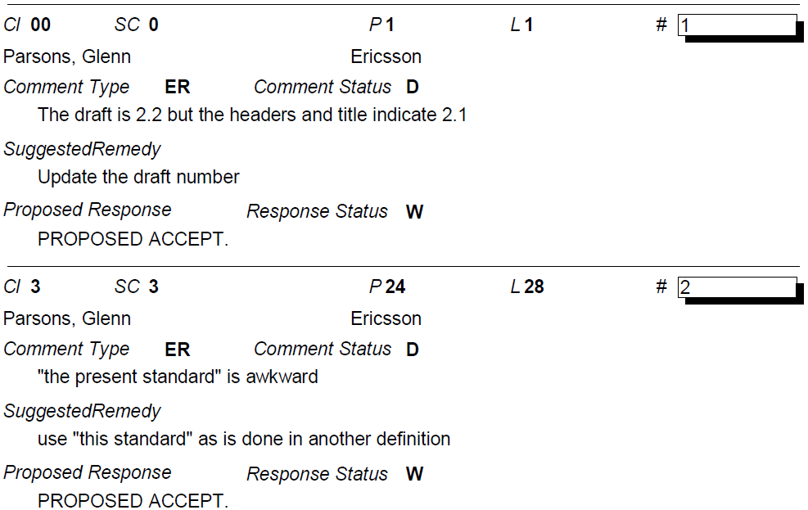
Supporting Information P802.1DC
Outstanding MBS comments
(the commenter wants to see the next draft)

Slide 19
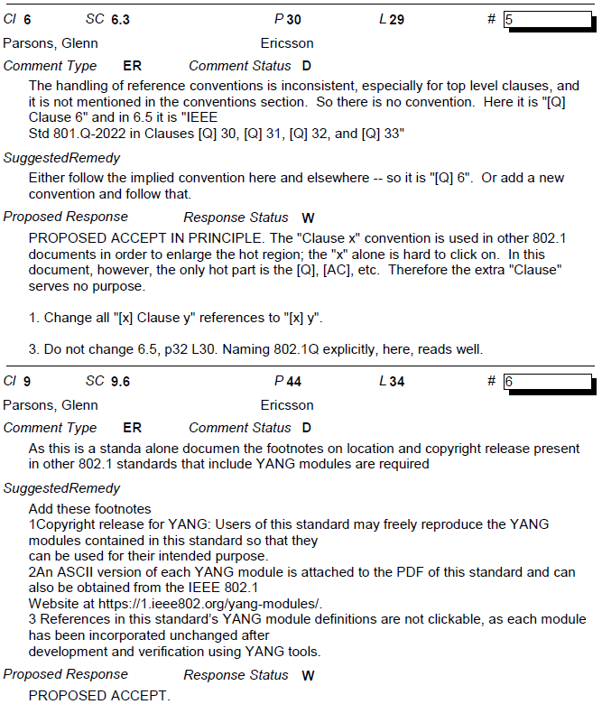
Supporting Information P802.1DC
Outstanding MBS comments
(the commenter wants to see the next draft)

Slide 20
802.1 Motions
2023-07
Consent Agenda
Drafts to RevCom

Slide 21
Motion – 5.0xx
Approve sending P802.1Qcj to RevCom
Approve CSD documentation in https://mentor.ieee.org/802-ec/dcn/21/ec-21-0195-00-ACSD-p802-1qcj.pdf
P802.1Qcj D2.5 had 100% approval at the end of the last SA ballot
In the WG, Proposed: Paul Bottorff, Second: János Farkas
  Sending draft (y/n/a): 46, 2, 5
  CSD (y/n/a): 44, 1, 5 (1 unexercised)
In EC, mover: Glenn Parsons, Second: David Law
  (y/n/a): <y>,<n>,<a>

Slide 22
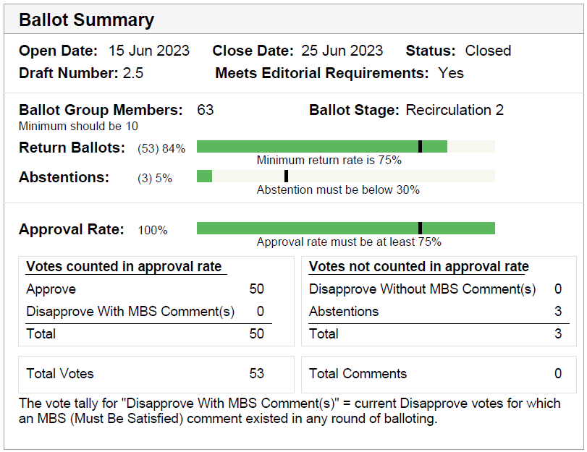
Supporting Information P802.1Qcj
SA ballot closed:
  25 June 2023
All SA ballot requirements
are met
The ballot resulted in
  0 Disapprove votes
  0 comments
Disposition: https://www.ieee802.org/1/files/private/cj-drafts/d2/802-1Qcj-d2-5-dis-v01.pdf

Slide 23
Motion – 5.0xx
Approve sending P802.1Qcw to RevCom
Approve CSD documentation in https://mentor.ieee.org/802-ec/dcn/21/ec-21-0196-01-ACSD-p802-1qcw.pdf
P802.1Qcw D2.2 had 98% approval at the end of the last SA ballot
In the WG, Proposed: Marina Gutiérrez, Second: János Farkas
  Sending draft (y/n/a): 49, 2, 2
  CSD (y/n/a): 50, 0 ,3
In EC, mover: Glenn Parsons, Second: David Law
  (y/n/a): <y>,<n>,<a>

Slide 24

Supporting information P802.1Qcw
SA ballot closed:
  7 May 2023
All SA ballot requirements
are met
The ballot resulted in
  1 outstanding Disapprove
  vote
  0 comments from last
  SA recirculation ballot
  2 outstanding Must Be Satisfied (MBS)
  comments from initial SA ballot
Disposition: https://www.ieee802.org/1/files/private/cw-drafts/d2/802-1Qcw-d2-2-dis-v00.pdf

Slide 25
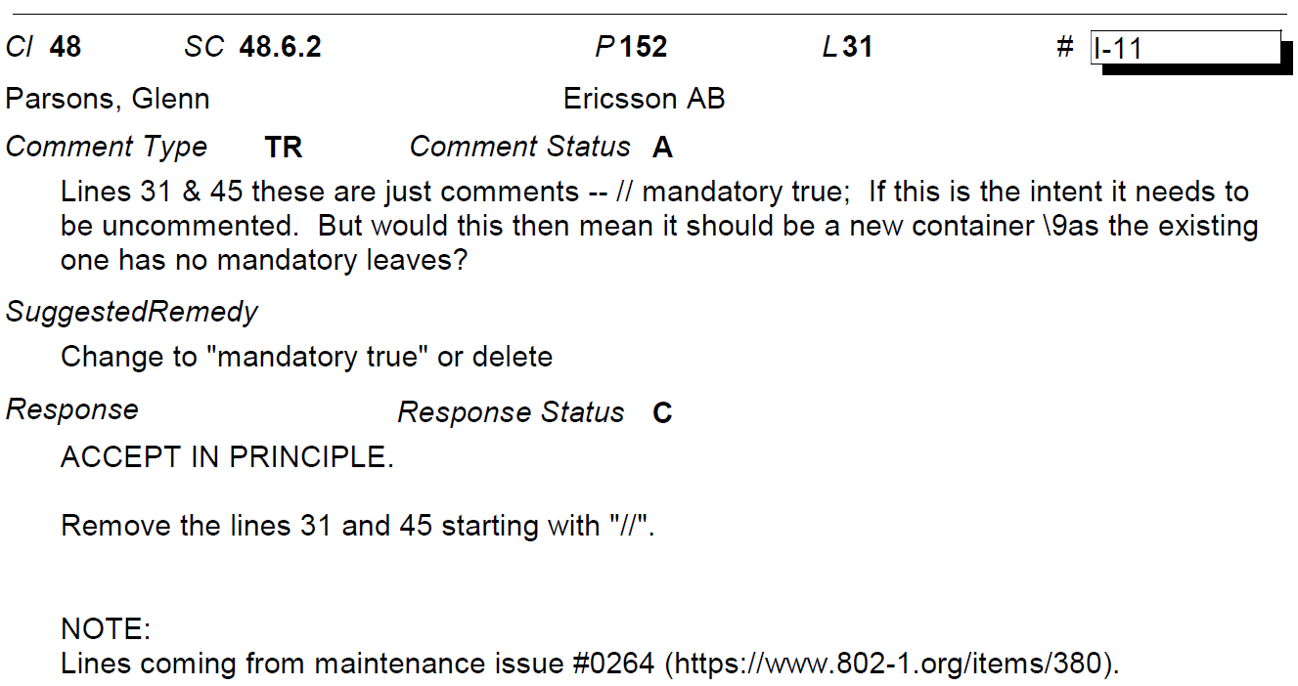
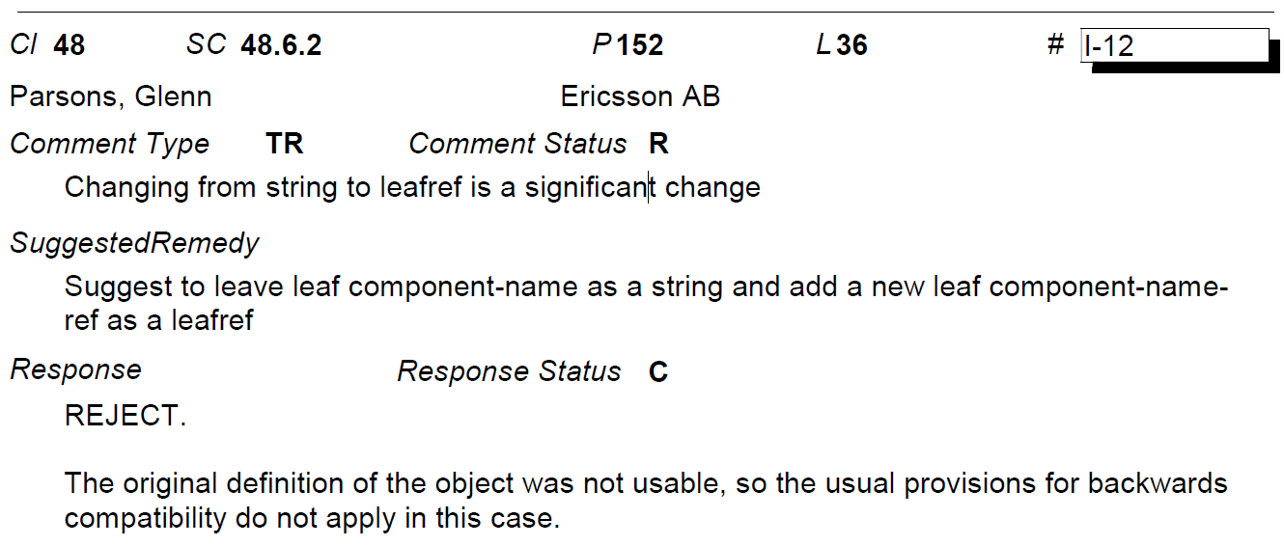
Supporting Information P802.1Qcw
The single disapprove vote is maintained from the initial SA ballot on D2.0
The disapprove vote is associated with 2 MBS comments on D2.0
(https://www.ieee802.org/1/files/private/cw-drafts/d2/802-1Qcw-d2-0-dis-v00.pdf)

Slide 26
Motion – 5.0xx
Conditionally approve sending P802f to RevCom
Approve CSD documentation in https://mentor.ieee.org/802-ec/dcn/19/ec-19-0217-00-ACSD-p802f.pdf
P802f D2.1 had 94% approval at the end of the last SA ballot
In the WG, Proposed: Jessy Rouyer, Second: János Farkas
  Sending draft (y/n/a): 47, 3, 5
  CSD (y/n/a): 44, 3, 6 (1 unexercised)
In EC, mover: Glenn Parsons, Second: David Law
  (y/n/a): <y>,<n>,<a>

Slide 27
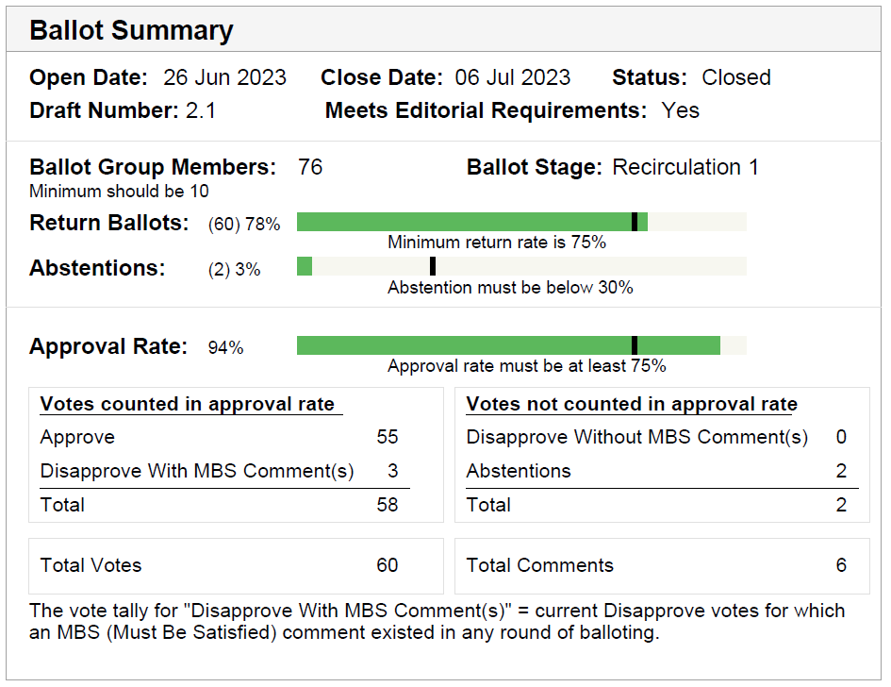
Supporting Information P802f
SA ballot closed: 6 July 2023
All SA ballot requirements
are met
The ballot resulted in
  2 Disapprove votes with 4
  Must Be Satisfied (MBS)
  comments
  1 outstanding Disapprove
  vote with 2 outstanding MBS
  comments from initial SA
  ballot
Disposition:
https://www.ieee802.org/1/files/private/802-f-drafts/d2/802f-d2-1-dis-v01.pdf
Recirculation ballot will be conducted during July/August with comment resolution in TSN TG meetings. A possible final recirculation in September/October if required with comment resolution in TSN TG meetings.

Slide 28
Supporting Information P802f
Initial SA ballot on D2.0
  1 disapprove vote is maintained (R K Rannow)
  2 MBS comments
  https://www.ieee802.org/1/files/private/802-f-drafts/d2/802f-d2-0-dis-v01.pdf
First SA recirculation ballot on D2.1
  2 disapprove votes
  4 MBS comments
  https://www.ieee802.org/1/files/private/802-f-drafts/d2/802f-d2-1-dis-v01.pdf
Non-ballot comments added by LMSC Representative
  12 editorial
  2 technical

Slide 29
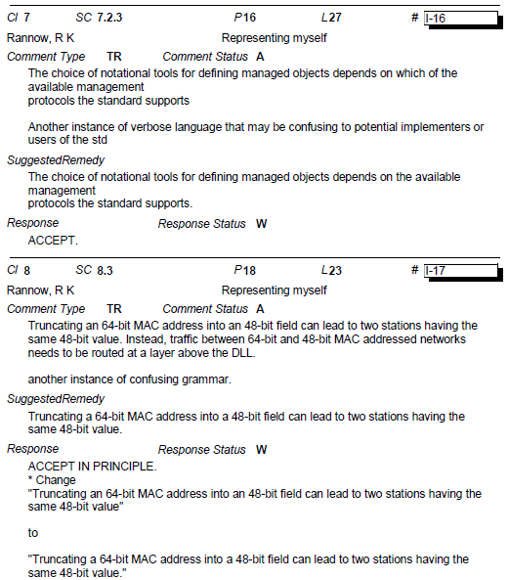
Supporting Information P802f
MBS comments associated with the outstanding Disapprove vote maintained from initial SA ballot on D2.0
https://www.ieee802.org/1/files/private/802-f-drafts/d2/802f-d2-0-dis-v01.pdf

Slide 30
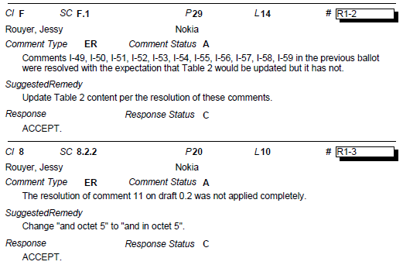
Supporting Information P802f
MBS comments associated with the Disapprove votes on D2.1 (see next slide too)
https://www.ieee802.org/1/files/private/802-f-drafts/d2/802f-d2-1-dis-v01.pdf

Slide 31
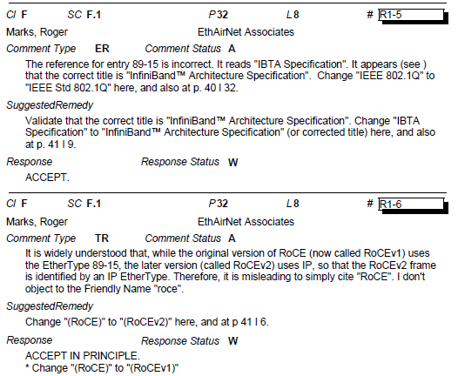
Supporting Information P802f
MBS comments associated with the Disapprove votes on D2.1 (see previous slide too)
https://www.ieee802.org/1/files/private/802-f-drafts/d2/802f-d2-1-dis-v01.pdf

Slide 32
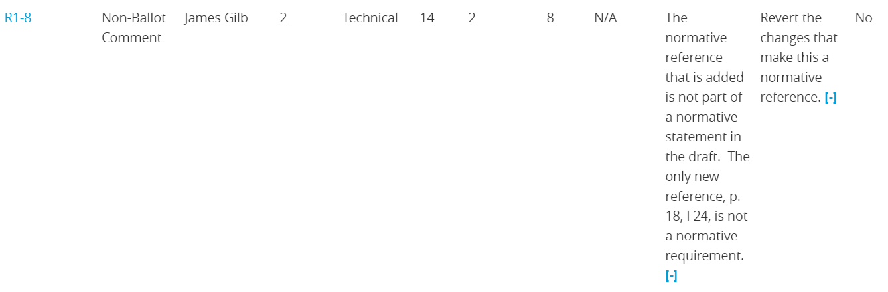
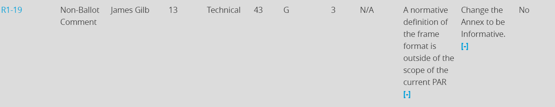
Supporting Information P802f
LMSC Representative technical non-ballot comments

Slide 33
802.1 Motions
2023-07
Consent Agenda
PARs to NesCom

Slide 34
Motion – 5.0xx
Approve forwarding P802.1DG PAR extension documentation in https://www.ieee802.org/1/files/public/docs2023/dg-PAR-extension-0723-v01.pdf to NesCom
Approve (unmodified) CSD documentation in https://mentor.ieee.org/802-ec/dcn/18/ec-18-0242-00-ACSD-p802-1dg.pdf
In the WG, Proposed: Max Turner, Second: János Farkas
  PAR (y/n/a): 47, 1, 3
  CSD (y/n/a): 43, 1, 4 (3 unexercised)
In EC, mover: Glenn Parsons, Second: David Law
  (y/n/a): <y>,<n>,<a>

Slide 35
Motion – 5.0xx
Approve forwarding P802.1Qdj PAR extension documentation in https://www.ieee802.org/1/files/public/docs2023/dj-PAR-extension-0723-v01.pdf to NesCom
Approve (unmodified) CSD documentation in https://mentor.ieee.org/802-ec/dcn/19/ec-19-0139-00-ACSD-p802-1qdj.pdf
In the WG, Proposed: Stephan Kehrer, Second: János Farkas
  PAR (y/n/a): 51, 1, 0 (1 unexercised)
  CSD (y/n/a): 51, 1, 1
In EC, mover: Glenn Parsons, Second: David Law
  (y/n/a): <y>,<n>,<a>

Slide 36
Motion – 5.0xx
Approve forwarding P60802 PAR modification documentation in https://www.ieee802.org/1/files/public/docs2023/60802-PAR-modification-0723-v01.pdf to NesCom
Approve (unmodified) CSD documentation in https://mentor.ieee.org/802-ec/dcn/18/ec-18-0088-01-ACSD-p60802.pdf
In the WG, Proposed: Martin Mittelberger, Second: Ludwig Winkel
  PAR (y/n/a): 51, 2, 1 (1 unexercised)
  CSD (y/n/a): 49, 1, 3 (1 unexercised)
In EC, mover: Glenn Parsons, Second: David Law
  (y/n/a): <y>,<n>,<a>

Slide 37
Motion – 5.0xx
Approve forwarding P802.1Qdy PAR documentation in https://www.ieee802.org/1/files/public/docs2023/dy-PAR-0723-v01.pdf to NesCom
Approve CSD documentation in https://www.ieee802.org/1/files/public/docs2023/dy-CSD-0723-v01.pdf
In the WG, Proposed: Josef Dorr, Second: János Farkas
  PAR (y/n/a): 51, 1, 2
  CSD (y/n/a): 48, 1, 2 (1 unexercised)
In EC, mover: Glenn Parsons, Second: David Law
  (y/n/a): <y>,<n>,<a>

Slide 38
802.1 Motions
2023-07
Consent Agenda
Liaisons and external communications (ME)

Slide 39
Motion – 7.0xx
Approve submission of the following draft(s) to ISO/IEC JTC1/SC6 for information under the PSDO agreement, once SA balloting begins.
  IEEE P802.1ASdn, IEEE P802.1ASdr, IEEE P802.1DC
In the WG, Proposed: Jessy Rouyer Second: Karen Randall
  Sending draft (y/n/a): 50, 1, 2
In EC, mover: Glenn Parsons Second: David Law
  (y/n/a): <y>,<n>,<a>

Slide 40
Motion – 7.0xx
Approve submission of the following draft(s) to ISO/IEC JTC1/SC6 for adoption under the PSDO agreement, once approved and published.
  IEEE 802.1Qcj, IEEE 802.1Qcw, IEEE 802f
In the WG, Proposed: Jessy Rouyer Second: Karen Randall
  Sending draft (y/n/a): 50, 2, 2
In EC, mover: Glenn Parsons Second: David Law
  (y/n/a): <y>,<n>,<a>

Slide 41
Motion – 7.0xx
Approve submission of the following comment responses to ISO/IEC JTC1/SC6 for information under the PSDO agreement:
  IEEE 802.1ACct-2021
    https://www.ieee802.org/1/files/public/docs2023/liaison-randall-SC6CommentResponseACct-0723.pdf
  IEEE 802.1BA-2021
    https://www.ieee802.org/1/files/public/docs2023/liaison-randall-SC6CommentResponseBA-0723.pdf
  IEEE 802.1Q-2022
    https://www.ieee802.org/1/files/public/docs2023/liaison-randall-SC6CommentResponseQRev-0723.pdf
In the WG, Proposed: Jessy Rouyer Second: Karen Randall
  Sending draft (y/n/a): 46, 1, 3
In EC, mover: Glenn Parsons Second: David Law
  (y/n/a): <y>,<n>,<a>

Slide 42
802.1 Motions
2023-07
Consent Agenda
Liaisons and external communications (II)

Slide 43
Motion – 7.0xx
Approve https://www.ieee802.org/1/files/public/docs2023/liaison-response-itu-t-jca-IMT2020-0723.pdf as communication to ITU-T JCA on LS13: IMT-2020 RoadMap, granting the IEEE 802.1 WG chair (or his delegate) editorial license.
  This approval is under LMSC OM “Procedure for public statements to government bodies”
In the WG, Proposed: Jessy Rouyer Second: Karen Randall
  Sending draft (y/n/a): 44, 1, 4
In EC, for information (or motion to block)

Slide 44
Motion – 7.065
Approve https://www.ieee802.org/1/files/public/docs2023/liaison-response-itu-t-sg15-otnt-swp-0723.pdf as communication to ITU-T SG15 on LS58: OTNT Standardization Work Plan Issue 32, granting the IEEE 802.1 WG chair (or his delegate) editorial license.
  This approval is under LMSC OM “Procedure for public statements to government bodies”
In the WG, Proposed: Jessy Rouyer Second: Karen Randall
  Sending draft (y/n/a): 46, 1, 3
In EC, for information (or motion to block)

Slide 45
Motion – 7.0xx
Approve https://www.ieee802.org/1/files/public/docs2023/liaison-response-itu-t-SG13-DetermNetworkingandCommunics-0723-v01.pdf as communication to ITU-T SG13 granting the IEEE 802.1 WG chair (or his delegate) editorial license.
  This approval is under LMSC OM “Procedure for public statements to government bodies”
In the WG proposed: János Farkas, Second: Karen Randall
            (y/n/a): 45, 1, 4
In EC, for information (or motion to block)

Slide 46
Motion – 7.0xx
Approve https://www.ieee802.org/1/files/public/docs2023/liaison-BBF-ONUManagementYANG-0723-v01.pdf as communication to the Broadband Forum (BBF), granting the IEEE 802.1 WG chair (or his delegate) editorial license.
Proposed: Scott Mansfield
Second: János Farkas
In the WG (y/n/a): 46, 1, 4
In the EC, for information

Slide 47
Motion – 7.0xx
Approve https://www.ieee802.org/1/files/public/docs2023/liaison-IEEE1588-draft-sharing-and-terminology-0723-v01.pdf as communication to IEEE 1588 WG, granting the IEEE 802.1 WG chair (or his delegate) editorial license.
Proposed: Silvana Rodrigues
Second: János Farkas
In the WG (y/n/a): 48, 0, 1
In the EC, for information

Slide 48
Motion – 7.0xx
Approve https://www.ieee802.org/1/files/public/docs2023/liaison-IEEEP3400-terminology-0723-v01.pdf as communication to IEEE P3400, granting the IEEE 802.1 WG chair (or his delegate) editorial license.
Proposed: János Farkas
Second: Jessy Rouyer
In the WG (y/n/a): 48, 1, 4
In the EC, for information

Slide 49
Motion – 7.0xx
Approve sharing the latest revision of the IEEE P802.1Qdd and IEC/IEEE 60802 drafts with Labs Networks Industrie 4.0 (LNI 4.0).
Proposed: János Farkas
Second: Josef Dorr
In the WG (y/n/a): 46, 3, 3
In the EC, for information

