Slide 1

IEEE 802 LMSC
133rd Plenary Session
(4th mixed mode Plenary Session)
10-14 July 2023
DCN ec-23-0117-01-00EC

Slide 2
3.0 Participant behavior in IEEE-SA activities is guided by the IEEE Codes of Ethics & Conduct
All participants in IEEE-SA activities are expected to adhere to the core principles underlying the:
  IEEE Code of Ethics
  IEEE Code of Conduct
The core principles of the IEEE Codes of Ethics & Conduct are to:
  Uphold the highest standards of integrity, responsible behavior, and ethical and professional conduct
  Treat people fairly and with respect, to not engage in harassment, discrimination, or retaliation, and to protect people's privacy.
  Avoid injuring others, their property, reputation, or employment by false or malicious action
The most recent versions of these Codes are available at
  http://www.ieee.org/about/corporate/governance

Slide 3
3.0 Participants in the IEEE-SA “individual process” shall act independently of others, including employers
The IEEE-SA Standards Board Bylaws require that “participants in the IEEE standards development individual process shall act based on their qualifications and experience”
This means participants:
  Shall act & vote based on their personal & independent opinions derived from their expertise, knowledge, and qualifications
  Shall not act or vote based on any obligation to or any direction from any other person or organization, including an employer or client, regardless of any external commitments, agreements, contracts, or orders
  Shall not direct the actions or votes of other participants or retaliate against other participants for fulfilling their responsibility to act & vote based on their personal & independently developed opinions
By participating in standards activities using the “individual process”, you are deemed to accept these requirements; if you are unable to satisfy these requirements then you shall immediately cease any participation

Slide 4
3.0 IEEE-SA standards activities shall allow the fair & equitable consideration of all viewpoints
The IEEE-SA Standards Board Bylaws (clause 5.2.1.3) specifies that “the standards development process shall not be dominated by any single interest category, individual, or organization”
  This means no participant may exercise “authority, leadership, or influence by reason of superior leverage, strength, or representation to the exclusion of fair and equitable consideration of other viewpoints” or “to hinder the progress of the standards development activity”
This rule applies equally to those participating in a standards development project and to that project’s leadership group
Any person who reasonably suspects that dominance is occurring in a standards development project is encouraged to bring the issue to the attention of the Standards Committee or the project’s IEEE-SA Program Manager

Slide 5
3.02 Fee Waivers
Motion: Approve waiving this LMSC plenary session registration fee for the following individuals:
Mover: tbd Seconder: tbd
Participant | Affiliation | Rationale
Daniele Medda | International Hellenic University | Student support, a PhD student, AR/VR and cloud applications, interest in 802.11/802.1
Liangxiao Xin | Self/Zeku | Support for one meeting for affiliation transition. He is the AIML TIG Secretary

Slide 6
4.00 IEEE Staff
In Person
Jodi Haasz role: 802 lead, supports dot03 and dot18 groups
title: Operational Program Management Senior Manager
Ron Hotchkiss role: supports dot01group
title: Operational Program Management Program Manager
Christy Bahn role: supports dot11, dot15, dot19 and, dot24 groups
title: Operational Program Management Senior Program Manager
Catherine Berger role: 802 editorial support
title: Senior Program & Special Project Manager
Lisa Perry role: 802 editorial support
title: Manager Content Production & Management
Remote
Christian Orlando role: assist Jodi, Ron and Christy
title: Operational Program Management Program Manager
Available for editorial guidance questions via email
Michelle Turner role: 802 lead editorial support
title: Senior Manager, Content Production and Management
NOTE additional staff support:
Erin Morales, Director, Operational Program Management (e.spiewak@ieee.org)

Slide 7
5.01 Chair’s Announcements

Slide 8
5.01 Chair’s Announcements
  Reminder #1: Please use IMAT to log your attendance
  Reminder #2: Interim EC meeting scheduled for 19:00-21:00 UTC Tuesday 01 August (15:00-17:00 ET).
  Reminder #3:
  closing EC consent agenda items due 11:00 UTC Wednesday 12 July 2023 (1300 CEST)
  -- 48 hours prior to the start of the closing EC meeting.
  vote tallies in support of consent agenda items due 09:00 UTC Friday 14 July 2023 (11:00 CEST)
  -- 2 hours prior to the start of the closing EC plenary meeting.
  Reminder #4: 802.19 WG Vice Chair, Tuncer Baykas, Ofinno, is representing the 802.19 WG at the plenary session
  Reminder #5:
  2022-2024 is Paul Nikolich’s final term as 802 Chairman.
  Candidates for 802 Chair and the 802 EC Appointed positions are sought as soon as possible. Candidates should contact the holder of the position they seek to enable them to fully understand the responsibilities of the positions (Vice Chairs, Treasure, Recording Secretary, Executive Secretary and Chair). Please announce this at your opening meetings.

Slide 9
5.01 Chair’s Announcements
  Reminder #6: Please vote in upcoming IEEE Elections: BoD, Computer Society, Standards Association, etc.
  Balloting begins 15 August 2023, closes 02 October 2023
  (Communication Society BoG elections closes 20 July 2023)
  A partial list of positions and candidates:
  2024 IEEE President-Elect candidates
  Roger U. Fujii and Kathleen A. Kramer
  2024 IEEE Standards Association President-Elect candidates
  Mark Epstein, Gary R. Hoffman, and Robby Robson
  2024-2025 IEEE Standards Association Board of Governors Member-at-Large candidates
  Position 1: Mehmet Ulema and Douglas N. Zuckerman
  Position 2: Kishik Park and Joseph S. Levy
  2024 IEEE Technical Activities Vice President-Elect candidates
  Maciej J. Ogorzalek, Dalma Novak, and Rakesh Kumar
  A full list of positions and candidates is available at https://www.ieee.org/about/corporate/election/candidates.html

Slide 10
5.02 IEEE SA BoG Update
SA BoG May/July 2023
  The BOG approved that the IEEE SA contribute $50K per year for the next five years (2023-2027) to the IEEE MOVE program. The contribution should be allocated as 50% to U.S. MOVE and 50% to MOVE International.
  The BOG approved a virtual candidate forum to be scheduled and conducted in accordance with IEEE election policies. A recording of such forum shall be made available on the IEEE SA web site for the entirety of the election period.
  SA is hosting a 25/50/60/135 year anniversary celebration in Shenzhen, China 6-8 NOV 2023
  https://standards.ieee.org/featured/25th-anniversary/
  Plans to endorse the major Organizational Unit name “IEEE SA” and identify necessary updates to IEEE Bylaws, Policies and SA OpsMan
802 EC members that are members of the 2023 SA BoG
  Paul Nikolich IEEE SA Treasurer, David Law, SASB Chair, Glenn Parson MaL, and Dorothy Stanley MaL,

Slide 11
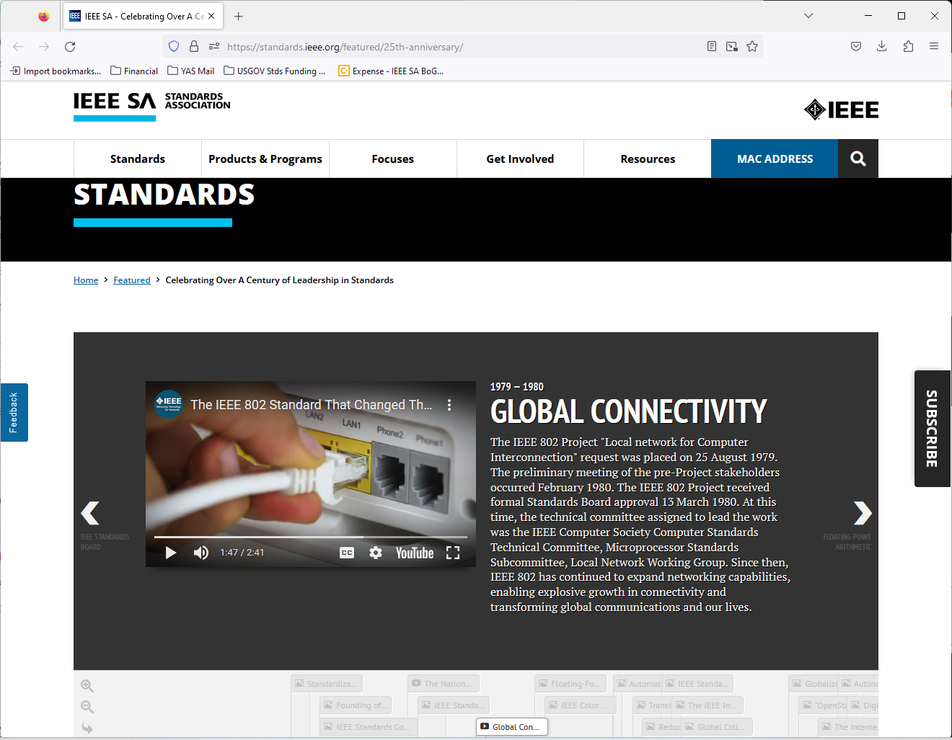

Slide 12
5.02 IEEE Boards Updates
Standards Association Standards Board March & June 2023
  No resolutions
  802 Members on SASB:
  David Law, Joseph Levy, Guido Hiertz, Andrew Myles, Lei Wang, Karl Weber, Paul Nikolich
Computer Society BoG & Stds Activity Board
  No update
IEEE Technical Activities and BoD meetings June 2023
  Technical Activities Board (TAB) Committee on Standards (CoS) encourages initiation of standards activities across all TAB Societies and Councils. It is developing/curating Standards Process Education materials, developing a OpsMan, and participating in IEEE Strategic Planning. Please contact Edward Au, 2023 TAB CoS chair for details.
  IEEE New Initiatives Committee (NIC) considers proposals for new initiatives and seed grants, reviews continuing initiatives, and manages the IEEE New Initiatives Process. NIC is a potential source of funding – check it out.
  IEEE has a new President & CEO, Saifur Rahman, and Executive Director & COO, Sophie Muirhead, as of 01 January 2023

Slide 13
5.03 SA Standards Board Actions
802 Project Authorization SASB Approvals March 2023
802.3.1 Ethernet Structure of Management Information version 2 (SMIv2) Data Model Definitions Revision
802.3.2 Ethernet - YANG Data Model Definitions Revision
802.3cx MAC for Support Improved Precision Time Protocol (PTP) Timestamping Accuracy
802.3cz PHY for Multi-Gigabit Glass Optical Fiber Automotive Ethernet
802 Standards SASB Approved in June 2023
802.1DU Cut-Through Forwarding Bridges and Bridged Networks
802.1Qdt Priority-based Flow Control Enhancements
802.1ASdm Timing Synchronization for Time-Sensitive Applications Amendment: Hot Standby Clock Drift Error Reduction
802.1Qdx YANG Data Models for the Credit-Based Shaper
802.1Q Standard for Local and Metropolitan Area Networks--Bridges and Bridged Networks Revision
802.1AS Timing and Synchronization for Time-Sensitive Applications Revision
802.3cy 25 Gb/s Electrical Automotive Ethernet PHY
802.15.4ac Low-Rate Wireless Networks Amendment: Privacy Enhancements
Corrigenda: P802.1CS-2020/Cor 1 Link-local Registration Protocol - Corrigendum 1
PAR Modifications: none

Slide 14
5.04
LMSC Email Ballot Recap
open date topic yes/no/abs/dnv* result
11APR USA NTIA consultation approval 08/00/01/04 pass
16APR Australia ACMA consultation approval 10/00/00/03 pass
20JUN China MIIT consultation approval 11/00/01/02 pass
23JUN UAE TDRA consultation approval 08/00/00/05 pass
* 802 chair is counted as DNV unless his vote is required

Slide 15
5.05 EC Affiliation Update
IEEE 802 Executive Committee Members
Position | Name | Affiliation
Chair | Paul Nikolich | Self, HPE, YAS BBV, Origin Wireless, Wyebot, Huawei
First Vice Chair | James P. K. Gilb | General Atomics Aeronautical Systems Inc.
Second Vice Chair | Roger Marks | EthAirNet Associates
Treasurer | George Zimmerman | CME Consulting/APL Group, On Semi, Marvell, Cisco Systems, SenTekse LLC
Recording Secretary | John D'Ambrosia | Futurewei, a U.S. subsidiary of Huawei
Executive Secretary | Jon Rosdahl | Qualcomm Technologies, Inc.
P802.1 High Level Interface (HILI) | Glenn Parsons | Ericsson
P802.3 Ethernet | David Law | Hewlett Packard Enterprise
P802.11 Wireless Local Area Network (WLAN) | Dorothy Stanley | Hewlett Packard Enterprise
P802.15 Wireless Specialty Networks | Clint Powell | Powell Wireless Consulting, Meta.
P802.18 Radio Regulatory TAG | Edward Au | Huawei
P802.19 Wireless Coexistence | Steve Shellhammer Tunce Baykas, Chair Pro-Tem | Qualcomm Technologies, Inc. Offino
P802.24 Vertical Network Applications TAG | Tim Godfrey | Electric Power Research Institute
Member Emeritus Member Emeritus | Geoff Thompson Clint Chaplin | Self, GraCaSI Standards Advisors Self, Samsung Research America
Hibernating Working Groups
P802.16 Broadband Wireless Access | Roger Marks | EthAirNet Associates
P802.21 Media-independent Handover | Subir Das | Peraton Labs
P802.22 Wireless Regional Area Networks | Apurva Mody | A5 Systems, AiRANACULUS, White Space Alliance

Slide 16
5.05 EC Affiliation Update
Changes in affiliation among EC members from previous slide?

Slide 17
5.06 Drafts to SA Ballot
802.01: P802.1DC (conditional), P802.1Qdj (conditional), P802.1ASdn (conditional), P802.1ASdr,P802.1CS/Cor1,
802.03: P802.3df (conditional).
802.11: P802.11REVme (conditional).
802.15: none
802.19: none

Slide 18
5.07 Drafts to RevCom
802.01: P802.1Qcw, P802f
802.03: none.
802.11: none.
802.15: P802.15.3 TG3mb (revision project).
802.19: none
Note: the total number of pages published by the 802 LAN/MAN Standards Committee is 29,834, the largest

Slide 19
5.08 Draft Documents or Actions for EC to consider
802.EC: tbd
802.01: report on 802 O&A revision status, Liaisons to: JTC1/SC6, 1588 WG
802.03: tbd
802.11: tbd
802.15: tbd
802.18: Liaison to APG23-6 and Liaison reply to ETSI ISG THz
802.19: none
802.24: none
802/JTC1 SC: report
802/ITU SC: report
802/IETF SC: report
802/Wireless Chairs SC: none
802 Public Visibility Standing Committee: verbal update
19

Slide 20
5.09 Draft PARs to NesCom
P60802 - Standard - Time-Sensitive Networking Profile for Industrial Automation, PAR modification
P802.1Qdy - Amendment: YANG for the Multiple Spanning Tree Protocol, PAR
P802.1DG - Standard: Time-Sensitive Networking Profile for Automotive In-Vehicle Ethernet Communications, PAR Extension
P802.1Qdj - Amendment: Configuration Enhancements for Time-Sensitive Networking PAR extension
P802.11bn Ultra High Reliability, PAR and CSD.
48 hour maintenance policy PARs: None currently.
PAR withdrawal requests: None
ICAID Renewals to Industry Connections: 802.1 Nendica

Slide 21
5.10 Pre-PAR activity
Group | New | Existing
dot01 | none | SG: none IC: Nendica: IEEE 802 Network Enhancements for the Next Decade
dot03 | Ethernet for Automotive Imaging Sensors (call for interest) | SG: none IC: New Ethernet Applications (NEA)
dot11 | None | SG: Ultra High Reliability Recharter, and Ambient Power SC: WNG TIG: AI/ML
Legend:
IC – Industry Connection, SC – Standing Committee,
SG – Study Group, TIG – Topic Interest Group, WNG -- Wireless Next Gen, and
AI/ML – Artificial Intelligence/Machine Learning

Slide 22
5.10 Pre-PAR activity
Group | New | Existing
dot15 | Study Group on SUN PHYs | SG: Privacy SC: IETF, Industry Activities in Terahertz, and WNG
dot19 | none | none
dot24 | none | none
dot ECSG | none | none
Legend:
IC – Industry Connection, IG – Interest Group, SC – Standing Committee,
SG – Study Group, TIG – Topic Interest Group, WNG Wireless Next Gen

Slide 23
5.11 802/SA Task Force Topics
802/SA Task Force Electronic Meeting
Monday 17 April 2023 16:00-17:00 ET was canceled due to lack of agenda items
Next 802/SA Task Force Electronic Meeting
Tentatively scheduled for 16:00-17:00 ET Monday 14 August 2023
Please submit agenda items to the 802 EC Reflector as appropriate

Slide 24
5.12 802 IEEE Milestone Project Status Update
Geoff Thompson

Slide 25
11.0 Cross 802 Activities EC Meeting Schedule
(all times/days CEST)
LMSC Rules 19:30- 20:30 Sun
Opening EC Meeting 08:00- 10:15 Mon
Tutorial #1 Reliable & Available Wireless at the IETF 18:15- 19:35 Mon
Tutorial #2 none 19:30- 20:50 Mon
Tutorial #3 none 21:00- 22:30 Mon
802/JTC1 Stdng Cmte 16:00- 18:00 Tues
802 Public Visibility Stdng Cmte none
802/IETF Stdng Cmte none
802/ITU Stdng Cmte 16:00- 18:00 Wed
802rev O&A revision comment resolution 08:00- 10:00 Wed
Future Venues Ad Hoc 07:30- 08:30 Thu
Long Term 802 Session structure discussion 08:30- 09:00 Thu
802 Chair Open Office Hours 09:00-10:00 Thu
Closing EC Meeting 13:00- 18:00 Fri

Slide 26
End of Opening EC Meeting

Slide 27
Parking Lot Items

Slide 28
Future 802 meeting ad hoc updates
Future 802 meeting ad hoc update; tbd.
We are also considering alternative mechanisms to make progress on this topic.

