Slide 1
Executive Secretary Agenda Items 2023 April EC Telecon
Jon Rosdahl IEEE 802 Executive Secretary jrosdahl@ieee.org

Slide 2
IEEE 802 EC Telecon – April 4
Agenda Item 3.02 – MI Future Meeting Structure 60 mins
Data Comparison
Discussion Future Plan
Motions for Future
Agenda Item 3.03 – MI Current / Future venues 7 Mins
Future Venue Contract Status
Other Future Sessions - RFP
Berlin Registration Reminder

Slide 3
Agenda Item 3.02 – MI Future Meeting Structure 60 mins Data Comparison Discussion Future Plan Motions for Future

Slide 4
4.04 IEEE 802 Restructuring Ad Hoc Status Update
Discussion on Ad Hoc Status.
There are several Questions that have bogged the AdHoc down in discussion in the past.
In Order to close this item out, we have 3 basic Questions that need to be addressed.
For the 802 LMSC (802 EC)Telecon on April 4th, we would like to Address Question #1
Future Session Structure:
Mixed-mode vs In-Person vs Virtual Plenary Sessions?
History of the raw numbers of attendance
How Many Plenary Sessions per year?
Location rotation?
Notes:
Future Meeting Structure:
Mixed-mode vs In-Person vs Virtual?
History of the raw numbers of attendance
Meeting needs of membership
Successful meetings are possible in any mode possible
How Many per year?
Location rotation?
Lunches at Plenary?

Slide 5
Data Items to bring to EC Telecon:
What is the number of Members over the last 6 years?.
What is the Attendance number for last 6 years?
What is the poll numbers that we have collected last 6 years.
What is the velocity of drafts? –
Average time per project. –
From SASB Project Approval to SASB Standard approval.
Need comparison over 6 years.
What considerations for addressing the question?
Notes:
The numbers are to show prior to pandemic and what we have since.

Slide 6
Voter and Attendance Comparison
 | Voter Start of | Total | Attendance
Date | Session | Attendance | in person | remote | Registration Fees
Mar-23 | 1082 | 973 | 481 | 492 | $600/800/1000 Mixed-mode
Nov-22 | 1009 | 932 | 397 | 535 | $600/800/1000 Mixed-mode
Jul-22 | 1030 | 964 | 417 | 547 | $500/700/900 Mixed-mode
Mar-22 | 1002 | 884 | 0 | 884 | $400/600/800 Electronic
Nov-21 | 1000 | 1103 | 0 | 1103 | $50/75/125 Electronic
Jul-21 | 919 | 1080 | 0 | 1080 | $50/75 Electronic
Mar-21 | 839 | 1127 | 0 | 1127 | $0 Electronic
Nov-20 | 859 | 1001 | 0 | 1001 | $0 Electronic
Jul-20 | 788 | 939 | 0 | 939 | $0 Electronic
Mar-20 | 759 | NA | 0 | NA | $0 Electronic
Nov-19 | 786 | 657 | 657 | 0 | $600/700/900 In Person
Jul-19 |  | 722 | 722 | 0 | $600/700/900 In Person
Mar-19 |  | 708 | 708 | 0 | $500/600/800 In Person
Nov-18 |  | 669 | 669 | 0 | $600/700/900 In Person
Jul-18 |  | 780 | 780 | 0 | $450/550/750 In Person
Mar-18 |  | 715 | 715 | 0 | $450/550/750 In Person
Notes:
Raw data file is here: https://mentor.ieee.org/802-ec/dcn/23/ec-23-0080-00-00EC-membership-and-polling-comparisons-2023-march.xlsx

Slide 7
Polling Comparisons

Slide 8
Future Session AdHocs
All potential New Future Venues not already approved are on hold.
Negotiations on Madrid (2025 July) on Hold
Negotiations on Chicago (2026 March) expect to complete by year end.
Future Venue AdHoc: Next Plenary
Thursday 13 July 2023 7:30am
Review Resources for 2023 July Plenary
Review requirement expectations/actuals for this week
Future Venue Ad-Hoc: Futures
Thursday 16 March 2023 8:00 am Room 202 - 2nd FL
Review requirements for future sessions.

Slide 9
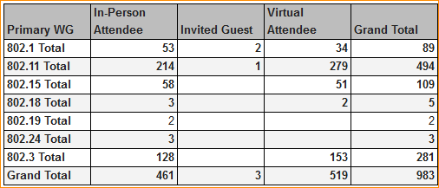
2023 March 802 Plenary Registration report as of 04/4/23 – 12:00 ET

Slide 10
Basic Room Resource Allocation
Big meetings
(≥ 100, e.g., WG plenaries)
Medium meetings
(35-100, e.g., Task Forces)
Smaller meetings
(30 or less)
Head table (5)
1 projector/screen
2 tables mics
1 or 2 floor mics
Sound system
(speakers, sound board, etc.)
Ethernet/HDMI/USB
Scarlett Audio Interface
Head table (3)
1 projector/screen
1 table mic
1 floor mic
Sound system
(speakers, sound board, etc.)
Ethernet/HDMI/USB
Scarlett Audio Interface
U-shaped or board meeting setup
1 room microphone
Portable or speakerphone-type
Sound system
(speakers, sound board, etc.)
Ethernet/HDMI/USB
Scarlett Audio Interface

Slide 11
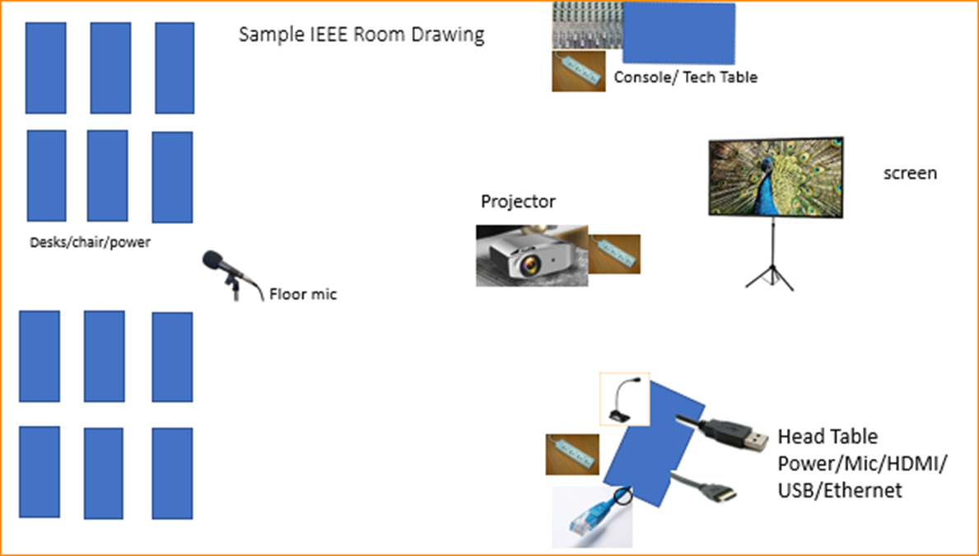
Scarlett
Notes:
This Photo by Unknown Author is licensed under CC BY-NC
This Photo by Unknown Author is licensed under CC BY-SA-NC
This Photo by Unknown Author is licensed under CC BY-SA

Slide 12
Motion-1 – Plenary Mixed Mode
Move to prepare and conduct IEEE 802 Plenary Sessions in a mixed-mode format continuing through at least the November 2024 plenary, inclusive.
Move: Rosdahl
2nd: Zimmerman
Results: no objection – Unanimous – Motion is approved.

Slide 13
Agenda Item 3.03 – MI Current / Future venues 7 Mins Future Venue Contract Status Other Future Sessions - RFP Berlin Registration Reminder

Slide 14
Future Venue Contract Status
2023 July 9-14 – Estrel Berlin, Berlin, Germany
2023 Nov 12-17 – Hawaiian Village, Oahu, Hawaii, United States
2024 March 10-15 – Hyatt Regency Denver at Colorado Convention Center, Denver, CO, (March 2021)
2024 July 14-19 – Sheraton Le Centre Montreal, Montreal, Quebec, Canada (July 2020)
2024 Nov 10-15 –Hyatt Regency Vancouver, Vancouver, Canada (Nov 2021)
2025 March 9-14 –Hilton Atlanta, Atlanta, GA, United States (2 of 2 – March 2020).
2025 July 13-18 –Marriott Madrid Auditorium, Madrid, Spain (July 2021)
2025 Nov 9-24 – Open
2026 March 8-13 - Hyatt Regency Chicago, Chicago, IL, United States (March 2024)
2026 July 13-18 – Le Centre Sheraton Montreal, Montreal (July 2022 attrition offset)
2026 Nov 8-13 - Open
2027 March –Hilton Atlanta, Atlanta, GA, United States ( offset potential shortfall 2023/2025)
2027 July 11-16 - Open -
2027 Nov 14-19 – Hawaiian Village, Oahu, Hawaii, United States
802 EC Approved – Contract is being Negotiated.
Notes:
Yellow Highlight – Potential deferral identified.
Blue Highlight – replacement dates for venues deferred.
Light Green highlight – potential targets for possible deferrals or offset penalties.
Dark Green Highlight – rebooked due to COVID
Red – Cancelled – Electronic Plenary
No highlight – pre Covid assigned dates/venues. Note: 2026 March - RFP -2019 - Hyatt Regency Chicago selected for March 2023, Contract not signed due to PSAV - Moved to 2024 March - then moved to 2026 due to agreement with rebooking Denver 2024.
Executed Contract
items are Venues approved by IEEE 802 EC, but Contract not complete.
These are open Calendar items I am working with potential venues.
Calendar open
https://mentor.ieee.org/802-ec/dcn/20/ec-20-0001-05-00EC-802-plenary-future-venue-contract-status.xlsx

Slide 15
Approve RFP Action
Move to approve the Executive Secretary to proceed with requesting an RFP to complete the calendar for 2025-2027.
Move: Rosdahl
2nd: Powell
Result: No Objection – Unanimous – Motion Passes

Slide 16
Registration For Berlin
Plan to open registration site ASAP.
Potential week of April 10th or Week of April 24th
Final items to work out:
Visa invitation letters.
Website final testing
Hotel Website final test

Slide 17
IEEE 802 University Outreach Program for Berlin July 2023
Student Outreach Program for Berlin July 2023
The purpose of our Student Outreach program is to give students a chance to see firsthand how the Standards process works. We realize it is like getting a drink from a fire-hose, but it does give a good first look into the process.
It is a one-day event Tuesday of the Plenary Week:
7:30-9:00 – sign in and get badge
9:00am Start with an introduction meeting with a couple of the 802 Leadership members to orient the students to what activities may be of most interest to them that day
10:30am (AM2) the students attend actual working meetings and can meet and participate in the discussions.

Slide 18
Student Outreach Program for Berlin July 2023 (2)
17:00 (5pm) Debrief:
A short debrief meeting at the end of the day is provided to answer questions and help provide closure to the experience.
The Outreach Student fee is USD$25 per student
The program is limited to 25 Students.
Note that membership attendance credit is not granted for student activities.
The Students are invited to join for Lunch and breaks as our guests.
Previous material prepared for 2015 and 2017 programs:
https://www.ieee802.org/Univ_Outreach.shtml
A motion to approve program for July 2023 will be made during the 802 Closing Plenary Nov 17.

Slide 19
Future Venue AdHocs --
Slides from March 2023

Slide 20
Next Venue Meeting planning – Thurs 7:30 am
Proposed Agenda:
Start time 7:30 am
Review meeting space plan for 2023 July Plenary
Estrel, Berlin
Adjourn 8:00am

Slide 21
Notes from Discussion
Berlin Social:
Beer Garden - 5
River Trip - 3
In hotel Eat and Talk – 1
Night off - 3

Slide 22
Future Venues AdHoc – Thurs 8 am
Proposed Agenda:
Start time – 8:00 am
Review Contract Status
Review requirements for future sessions.
Review requirement expectations/actuals for this week.
End time – 9:00am

Slide 23
Notes
Request for Lunch in Plenary if possible.
Sound Quality is improved when in-house
Future Meeting Structure:
Mixed-mode vs In-Person vs Virtual?
History of the raw numbers of attendance
Meeting needs of membership
Successful meetings are possible in any mode possible
How Many per year?
Location rotation?
Lunches at Plenary?
Notes:
The option to have Mixed mode reduces the number of In Person attendance.
We want to determine #1 as a priority.
Many Companies are indicating that virtual is viable, so you don’t need to travel.
There is a challenge in the consensus building with the Mixed-mode setting.
The quality of meeting is at different level depending on the Mode.
Remote Consensus is more difficult in virtual mode or mixed-mode. In Person is a more efficient method.
Concern that the constituents are looking for more of a mixed-mode.
Not considering Virtual only at 802 level. – 100% In-Person or 100% Mixed-mode.
What Data can we collect to give the 802 for the April Telecon. –
What is the Data that we should collect – what is the rate of delivery before and after pandemic.

Slide 24
Notes (cont)
The option to have Mixed mode reduces the number of In Person attendance.
We want to determine #1 as a priority.
Many Companies are indicating that virtual is viable, so you don’t need to travel.
There is a challenge in the consensus building with the Mixed-mode setting.
The quality of meeting is at different level depending on the Mode.
Remote Consensus is more difficult in virtual mode or mixed-mode. In Person is a more efficient method.
Concern that the constituents are looking for more of a mixed-mode.
Not considering Virtual only at 802 level. – 100% In-Person or 100% Mixed-mode.
What Data can we collect to give the 802 for the April Telecon. –
What is the Data that we should collect – what is the rate of delivery before and after pandemic.
What do we really need to be successful as a group.

Slide 25
Items to bring for April 4th Telecon:
What is the Attendance number for last 6 years.
What is the poll numbers that we have collected last 6 years.
What is the velocity of drafts? –
Average time per project.
Need 6 years.
What considerations for addressing the question?
What is the number of Members over the last 6 years.
Notes:
The numbers are to show prior to pandemic and what we have since.

Slide 26
Scarlett Solo – Audio Interface by Focusrite
Thanks to Linespeed for obtaining a set of Scarlett Solo Audio Interface boxes to help provide a more consistent experience in our Sessions.

Slide 27
Suggested best practices
One central laptop/computer per meeting connects at head table.
Local speakers queue/speak only at a microphone when called on.
Remote speakers request to speak via chat window and only speak when called on.
Presenters have chair (central laptop) share the presentation
Local attendees when logged into WebEx SHALL NOT connect Audio.
When Starting a meeting the host should do the following:
Select “Meeting” -> “Meeting Options” -> [Disable] “Allow Participant to turn on Video”
Select “Participant” -> [Enable] “Mute on Entry”.
For the Host and Remote Attendees connecting to Webex, Configure Webex Audio to use “Music Mode”.

Slide 28
Mixed-mode Meeting Protocol
Sample Intro Meeting Slide
In-room Attendees:
In Webex choose connect without audio before you join
Use the Webex queue to indicate you want to speak
Wait to be called on while standing/holding a microphone to make a comment
Repeat any questions that are inadvertently asked away from the microphone
Remote Attendees:
Join Webex and set Webex audio as ‘music’
Use the Webex chat window to indicate you want to speak (“q”)
Wait to be called on to speak

