Slide 1
2023 March IEEE 802 Mixed-mode Plenary
AV Training
Date: 2023-03-12
Authors:

Slide 2
Abstract
The 2023 March IEEE 802 Mixed-mode Interim Session will be the third time that IEEE 802 Plenary has provided for remote attendance to the Plenary session. This Training deck is to help with the discussion on what to expect when running a meeting in this fashion.
A Training session is planned for March 12 (13:30 ET), 2023 to be held in Room 211 - 2nd Floor of the Hilton Atlanta Hotel and online:
– WebEx Mtg Number: 2340 575 0370
– WebEx Password: training
– WebEx Link: https://ieeesa.webex.com/ieeesa/j.php?MTID=mcb99212e80fb184efa9d37424e75fe75

Slide 3
Summary of Key Points
Meetings are to be run as an in-person meeting.
  Local time zone schedule for meetings
  Local participants attend as an in-person meeting
  Remote access is provided to remote participants to view/present/interact similarly to on-line meetings (best effort)
In-person participants are admonished (stronger than encouraged) to stay OFF the Audio interface from the Webex/zoom/teams/conference tool of your choice –
Presentation/room computer is logged into conference tool (ideally from a volunteer-supplied PC), and the web-conferencing tool is presenting what is being presented by the local projector.
A chair, vice-chair, or designate, is logged into the conference tool and monitoring the queue (based on experience this is probably a second room log in, since monitoring the queue doesn’t work well when presenting) – this person manages the online queue for the chair to integrate with the floor queue. Fairness for local and remote attendees is responsibility of the officer.
Audio comes from a floor mic or the chair/dias mic which is mixed into room speakers and outgoing sound by the sound board is then connected to the local computer that shares to the remote conference tool.
Working groups need to decide voting rules, etc. for subgroups (some use different rules for electronic meetings than in person)

Slide 4
Mixed Mode Meeting requirements - (1)
1. Local room requirements:
  Hear local participants
  (the number of microphones required is determined by the size of room).
  See Local presentations
    (projection of a central laptop or chair’s laptop for local presentation on local screen).
  Local Queue management is facilitated by lining up to or passing a microphone.
  Hear remote participants
  (audio from remote should seamlessly be injected in the local room.)
  Remote Queue management to be integrated with local participants queueing
  (Chair may need a VP to watch and manage fair queue access)
  Remote presentations need to be presented in Local room.
  (central laptop or chair’s laptop to project remote shared screen).
  Provide local audio and screen presentation to remote participants
  (WebEx, Zoom, Teams, or other proprietary conferencing program)

Slide 5
Mixed Mode Meeting requirements- (2)
2. Remote access requirements:
  Hear local participants
  (Local participants need to speak into microphone to ensure injected into remote system)
  Speak - Need to be able to speak to the Local and remote participants
  (Remote Audio is shared on conference system and locally.)
  Request remote queue
  (Need to indicate desire to speak and respond when called on as appropriate)
  (This can be done by electronic hand raise or indicate in chat window).
  See Local or Remote presentations
  (projection of central laptop or chair’s laptop into remote access tool).
  Present - Need to be able to have a remote presenter
  (this can be done by the central laptop or chair’s laptop or sharing of remote screen).

Slide 6
Mixed Mode Meeting requirements - (3)
3. General requirements
  Local room to have sound mixer to integrate local and remote audio
  Local room to have a method of sharing remote info to local screen
  No requirement for local participants to login to "see" remote information.
  Explicitly preclude local participants from connecting audio to prevent audio feedback loop.
  Hardware connection expectations:
    4 Connections at head table to controlling laptop
      Power
      Ethernet (Wi-Fi alternative)
      HDMI to local projector
      USB cable from Scarlett Audio Interface
        2 XLR cables for Audio in/out to local Sound mixer board.

Slide 7
Draft Room Resource Allocation
Big meetings
(≥ 100, e.g., WG plenaries)
Medium meetings
(35-100, e.g., Task Forces)
Smaller meetings
(30 or less)
Head table (5) Schoolroom
1 projector & screen
2 tables mics
1 or 2 floor mics
Sound system
(speakers, sound board, etc.)
Ethernet/HDMI/USB
Scarlett Audio Interface
Head table (3) Schoolroom
1 projector & screen
1 table mic
1 floor mic
Sound system
(speakers, sound board, etc.)
Ethernet/HDMI/USB
Scarlett Audio Interface
U-shaped/boardroom setup
1 projector & screen
2 Wireless microphone
Sound system
(speakers, sound board, etc.)
Ethernet/HDMI/USB
Scarlett Audio Interface

Slide 8
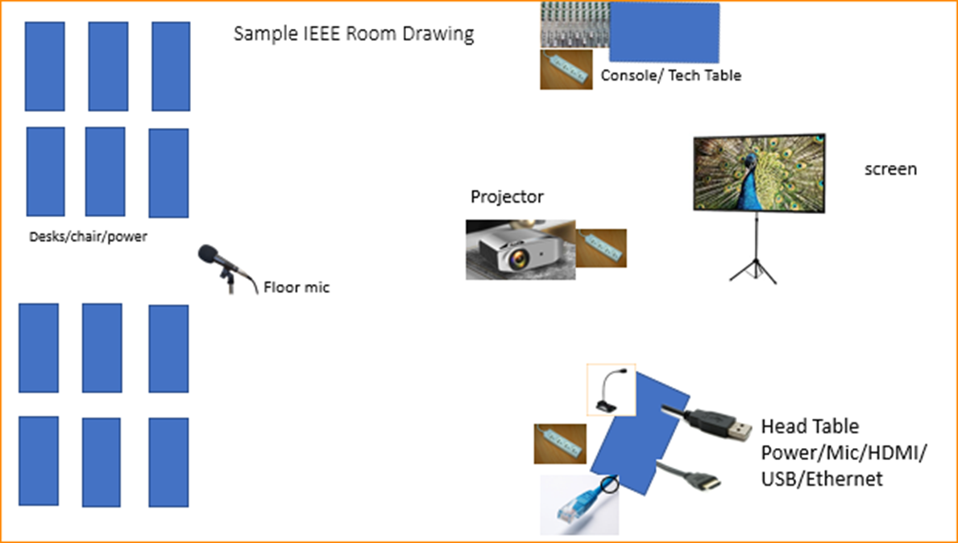

Scarlett
Notes:
This Photo by Unknown Author is licensed under CC BY-NC
This Photo by Unknown Author is licensed under CC BY-SA-NC
This Photo by Unknown Author is licensed under CC BY-SA

Slide 9
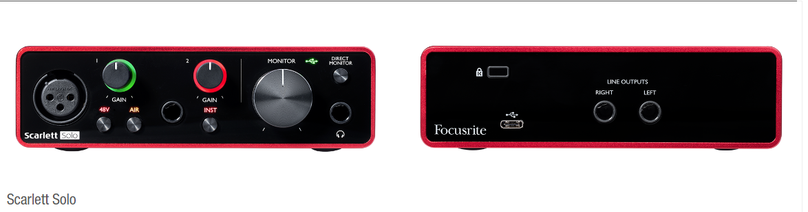
Focusrite Scarlett Solo – Audio Interface

Slide 10
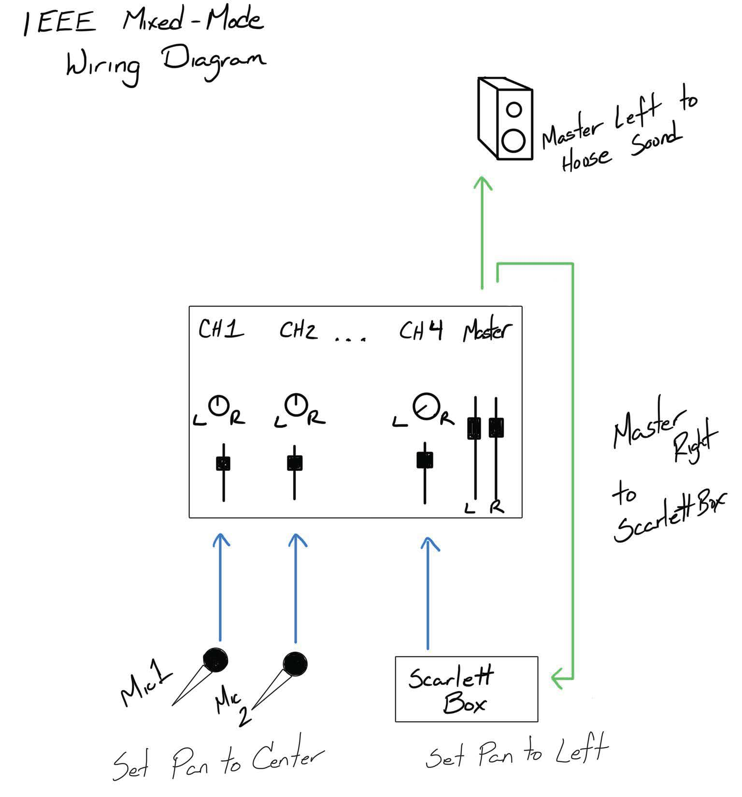
This wiring diagram is provided to assist the AV Engineer at the venue.
Attendees should not adjust the sound mixing panel settings.

Slide 11
Suggested Best Practices
One central laptop/computer per meeting connects at head table.
Local speakers queue/speak only at a microphone when called on.
Remote speakers request to speak via chat window and only speak when called on.
Presenters share the presentation via conferencing tool or have chair (central laptop) present for them.
Local attendees when logged into WebEx SHALL NOT connect Audio.
When Starting a meeting the host should do the following:
  Select “Meeting” -> “Meeting Options” -> [Disable] “Allow Participant to turn on Video”
  Select “Participant” -> [Enable] “Mute on Entry”.
For those Remote Attendees connecting to Webex, Configure Webex Audio to use “Music Mode”.

Slide 12
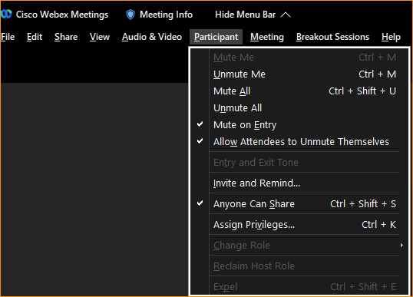
Webex Meeting Options
Select “Participant” -> [Enable] “Mute on Entry”.

Slide 13
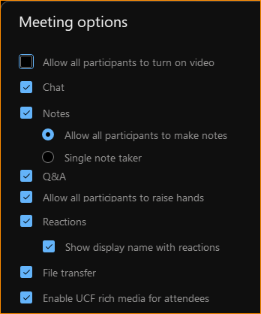
Webex Meeting options
Select “Meeting” -> “Meeting Options” -> [Disable] “Allow Participant to turn on Video”
This conserves bandwidth.

Slide 14
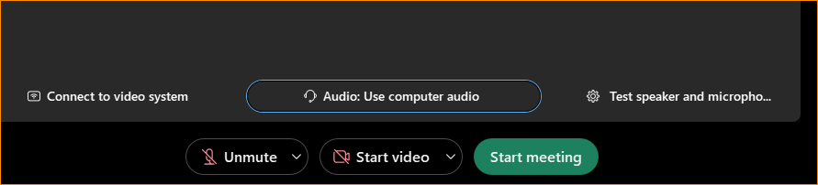
WebEx Settings
Before starting/joining the meeting, you can set up the audio.

Slide 15
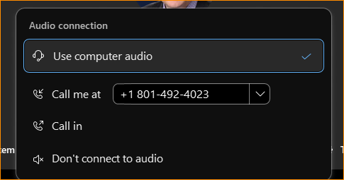
Webex Settings
If you are the Meeting Facilitator (Main Laptop) select “Use computer audio.
If you are a local participant, PLEASE, select “Don’t connect to audio”

Slide 16
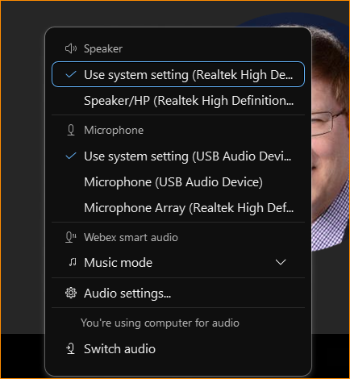
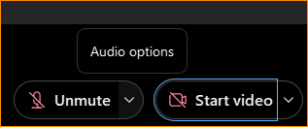
Webex Audio Settings
Next to the “Unmute” text is a drop down arrow.
It will give you “Audio options”

Slide 17
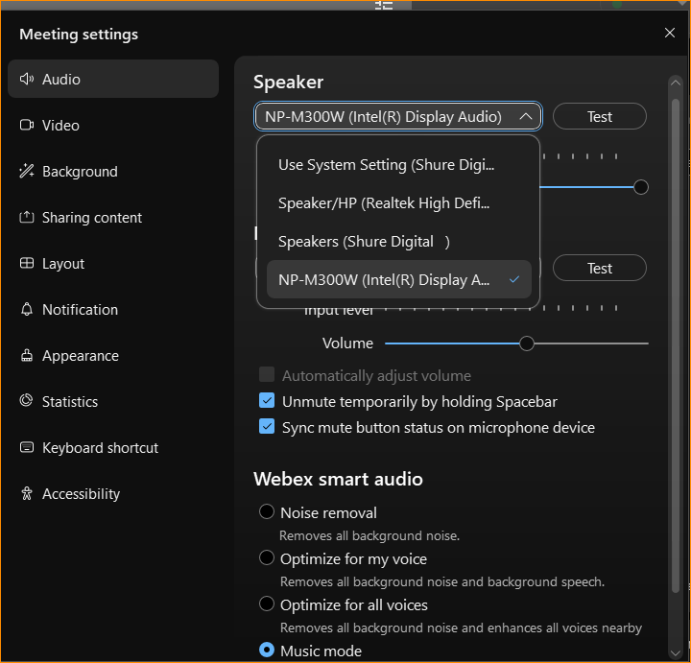
Audio Options in Waikoloa
For Atlanta, the option will be USB speaker

Slide 18
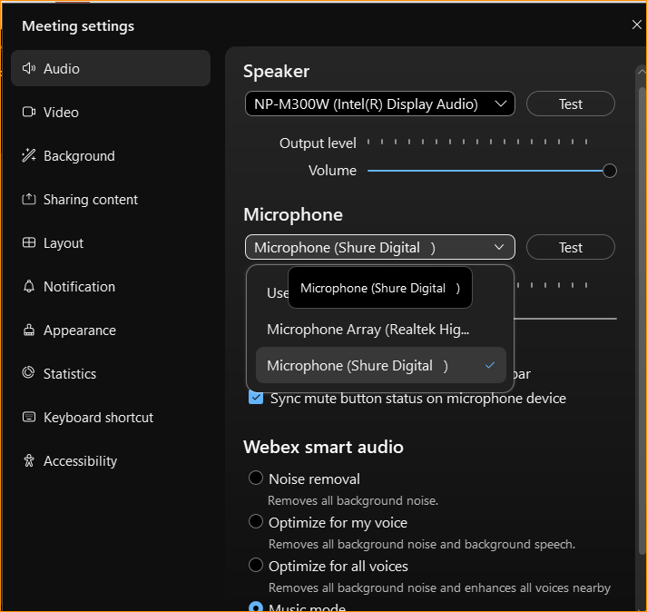
Audio Options in Waikoloa
For Atlanta, select USB Microphone.

Slide 19
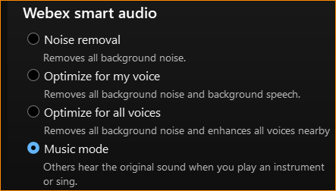
WebEx Settings: Select Music Mode
We observed that when in other modes, the audio from the remote attendee would be distorted or clipped. But when we selected music mode, the audio from the remote attendee was better.

Slide 20
Apple – MAC Settings
The next slides show the setup for the MAC laptops specifically for the Waikoloa Interim, but the settings are similar.

Slide 21
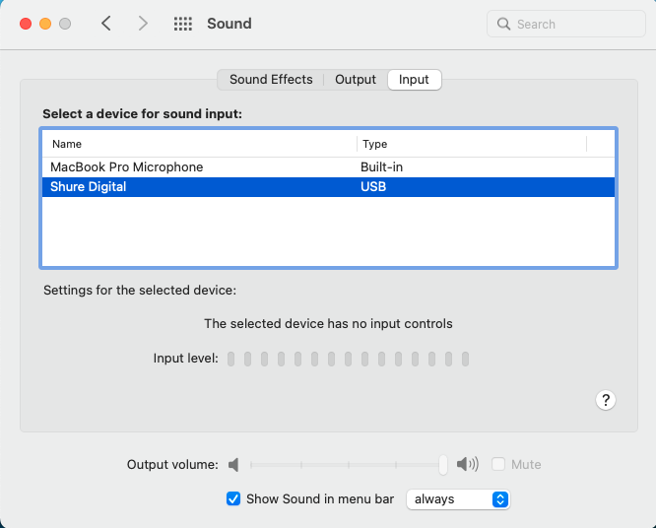

Slide 22
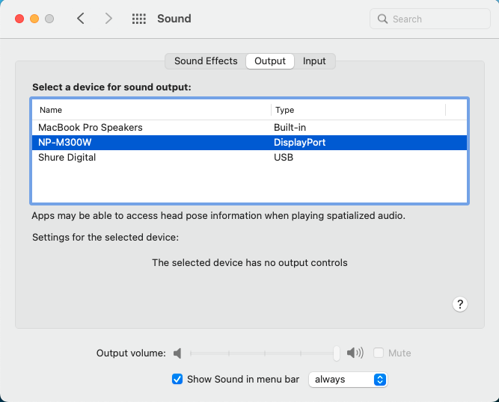

Slide 23
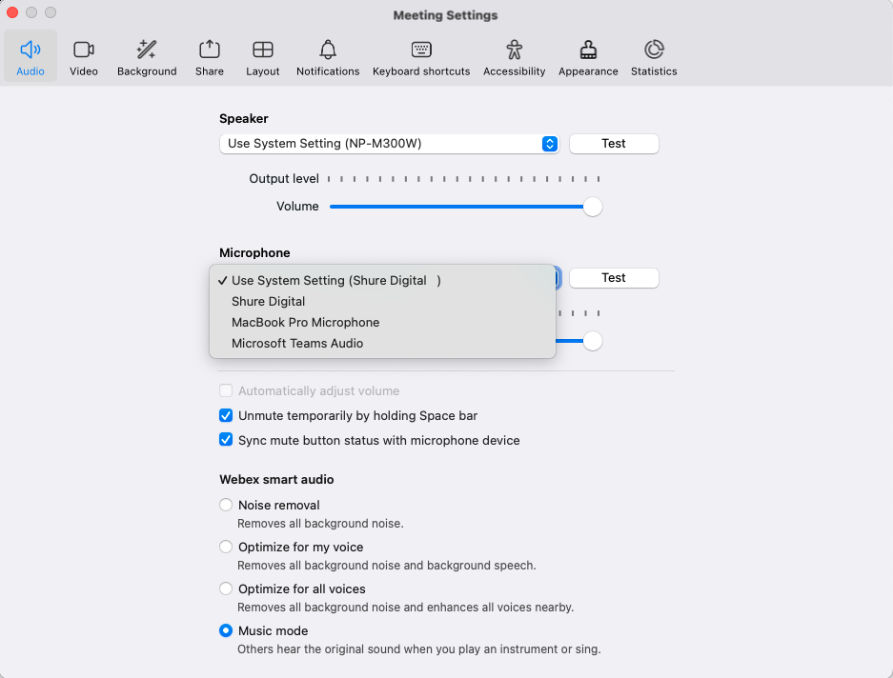

Slide 24
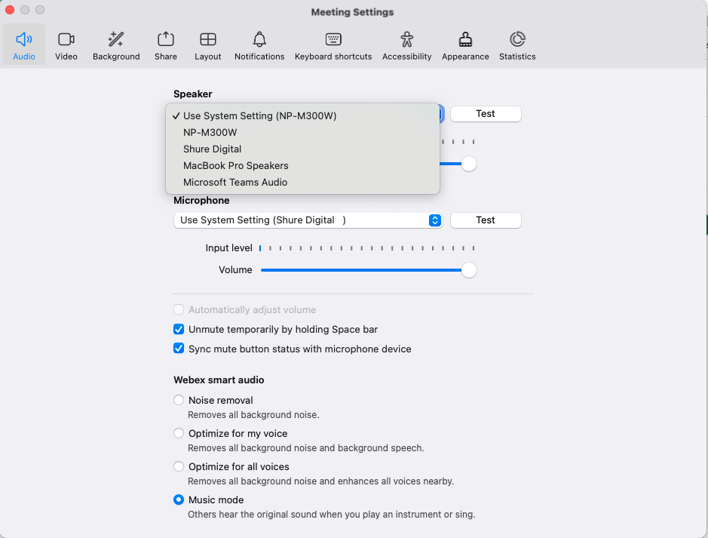

Slide 25
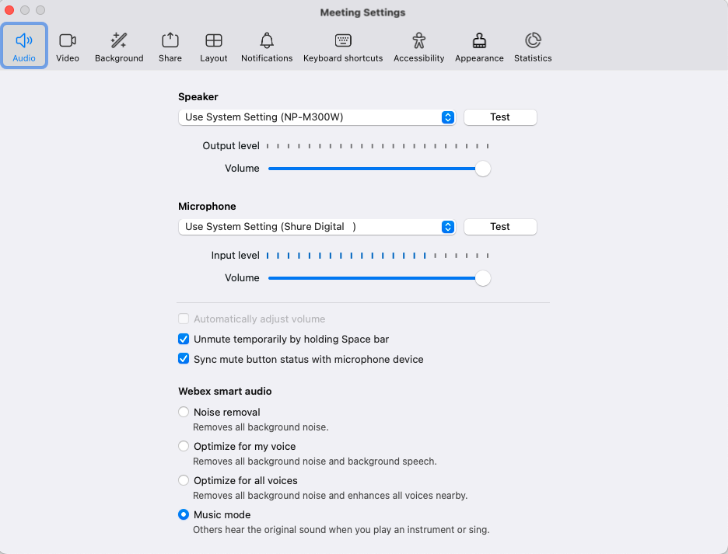

Slide 26
References
Calendar shows meeting room schedule/assignments:
https://ieee802.org/802tele_calendar.html

Slide 27
Instructions for Meeting Facilitator
Host:
  Set Disable Video for participants
    Select “Meeting” -> “Meeting Options” -> [Disable] “Allow Participant to turn on Video”
  Set participants to mute on entry
    Select “Participant” -> [Enable] “Mute on Entry”.
  Set Audio Options:
  Microphone -> USB, Speaker -> USB, Smart Audio -> Music
  Use a designated person to monitor speaking requests (manage the queue).
  Present the next slide to help attendees.

Slide 28
Successful Mixed-mode Meeting Protocol
Sample Intro Meeting Slide
In-room Attendees:
  In Webex choose connect “without audio” before you join meeting
  Use the Webex chat window to indicate you want to speak or queue at microphone.
  Wait to be called on while standing/holding a microphone to make a comment
  Repeat any questions that are inadvertently asked away from the microphone
Remote Attendees:
  Join Webex and set Webex Smart Audio as ‘music mode’
  Use the Webex chat window to indicate you want to speak (“q”)
  Wait to be called on to speak
  Share your presentation in full presentation mode for better viewing quality

