Slide 1
802.1 consent agenda items for LMSC Closing Plenary
November 2022
(V4 – 802.1 version #)

Slide 2
Agenda
Drafts to SA Ballot
5.051 – P802f conditional
5.052 – P802.Qcj
5.053 – P802.1Qcw
Drafts to RevCom
5.054 – P802.1Qcz

Slide 3
Agenda
Liaisons and external communications (ME)
7.071 – Approve liaison of comment responses to ISO/IEC JTC1/SC6 under the PSDO agreement
7.072 – Approve liaison of drafts for information to ISO/IEC JTC1/SC6 under the PSDO agreement
7.073 – Approve 802.1 communication to ITU-T JCA IMT 2020
Liaisons and external communications (II)
7.074 – Approve draft sharing with LNI 4.0

Slide 4
802.1 Motions 2022-11 Consent Agenda Drafts to SA Ballot

Slide 5
5.051 - Motion
Conditionally approve sending P802f D2.0 to Standards Association ballot
Confirm the CSD for P802f in https://mentor.ieee.org/802-ec/dcn/19/ec-19-0217-00-ACSD-p802f.pdf
P802f D1.4 had 100% approval at the end of the last WG ballot
In the WG, Proposed: Jessy Rouyer Second: János Farkas
Sending draft (y/n/a): 43, 0, 1
CSD (y/n/a): 42, 0, 1
In EC, mover: Glenn Parsons, Second: Roger Marks
(y/n/a): <y>,<n>,<a>

Slide 6
Supporting Information P802f
WG ballot closed: 14 October 2022
All WG ballot requirements are met
The ballot resulted in
0 Disapprove votes
0 Must Be Satisfied (MBS) comments
Comment resolution available here: https://www.ieee802.org/1/files/private/802-f-drafts/d1/802f-d1-4-dis-v01.pdf Recirculation ballot will be conducted during December with comment resolution in TSN TG meetings. A possible final recirculation in January/February if required with comment resolution in TSN TG meetings.
Ballot results:
Category | All respondents
 | Total | %
Yes | 52 | 100
No | 0 | 0
Voting Yes or No | 52
Abs. Time | 0
Abs. Expertise | 20
Abs. Other | 0
Voting Members | 79
Respondents (Voting) | 72 | 91.1
Respondents (non-Voting) | 0
Liaisons responding | 0
No. of commenters | 2
No. of comments | 8
TR | 0 | 0
T | 3 | 37.5
ER | 0 | 0
E | 5 | 62.5

Slide 7
5.052 - Motion
Approve sending P802.1Qcj D2.0 to Standards Association ballot
Confirm the CSD for P802.1Qcj in https://www.ieee802.org/1/files/public/docs2015/new-autoattach-romascanu-csd-0315-v01.pptx
P802.1Qcj D1.7 had 100% approval at the end of the last WG ballot
In the WG, Proposed: Paul Bottorff Second: János Farkas
Sending draft (y/n/a): 43, 1, 3
CSD (y/n/a): 42, 0, 5
In EC, mover: Glenn Parsons, Second: Roger Marks
(y/n/a): <y>,<n>,<a>

Slide 8
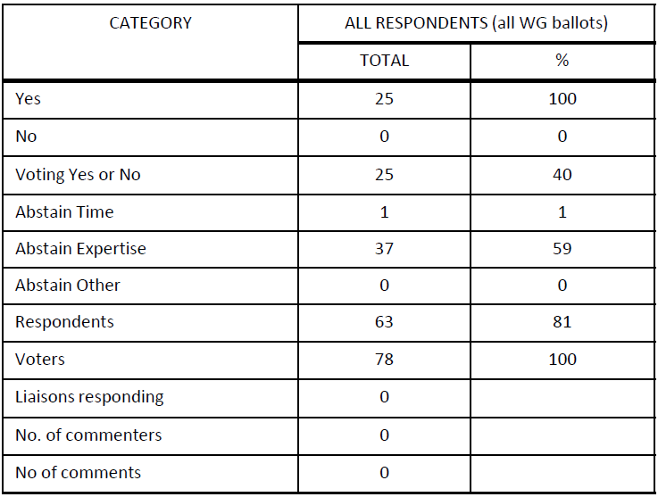
Supporting Information P802.1Qcj
WG ballot closed: 10 November 2022
All WG ballot requirements are met
The ballot resulted in
0 Disapprove votes
0 comments
Disposition is available here: https://www.ieee802.org/1/files/private/cj-drafts/d1/802-1Qcj-d1-7-dis-v1.pdf
Ballot results:

Slide 9
5.053 - Motion
Approve sending P802.1Qcw D2.0 to Standards Association ballot
Confirm the CSD for P802.1Qcw in https://ieee802.org/1/files/public/docs2017/cw-draft-CSD-0517-v02.pdf
P802.1Qcw D1.5 had 100% approval at the end of the last WG ballot
In the WG, Proposed: Marina Gutiérrez Second: János Farkas
Sending draft (y/n/a): 42, 1, 1
CSD (y/n/a): 42, 0, 2
In EC, mover: Glenn Parsons, Second: Roger Marks
(y/n/a): <y>,<n>,<a>

Slide 10
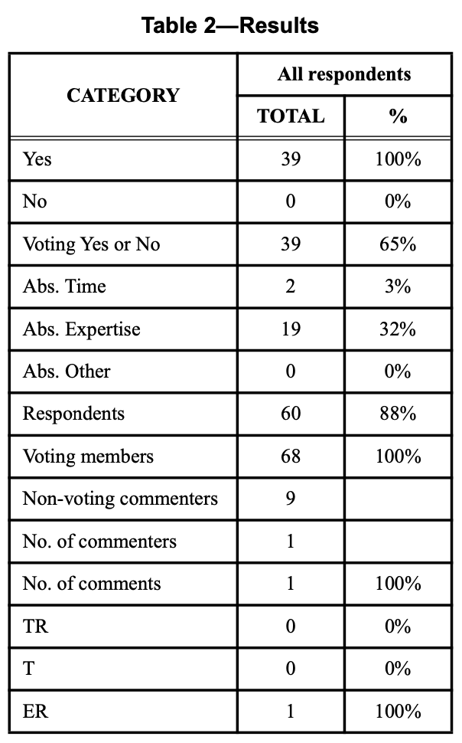
Supporting Information P802.1Qcw
WG ballot closed: 29 September 2022
All WG ballot requirements are met
The ballot resulted in
0 Disapprove votes
0 comments (the single comment has been withdrawn)
Disposition is available here: https://www.ieee802.org/1/files/private/cw-drafts/d1/802-1Qcw-d1-5-dis-v01.pdf
Ballot results:

Slide 11
802.1 Motions 2022-11 Consent Agenda Drafts to RevCom

Slide 12
5.054 - Motion
Conditionally approve sending P802.1Qcz to RevCom
Approve CSD documentation in https://mentor.ieee.org/802-ec/dcn/18/ec-18-0160-00-ACSD-802-1qcz.pdf
P802.1Qcz D2.3 had 100% approval at the end of the last SA ballot
In the WG, Proposed: Paul Congdon Second: János Farkas
Sending draft (y/n/a): 45, 2, 2
CSD (y/n/a): 44, 0, 5
In EC, mover: Glenn Parsons, Second: Roger Marks
(y/n/a): <y>,<n>,<a>

Slide 13
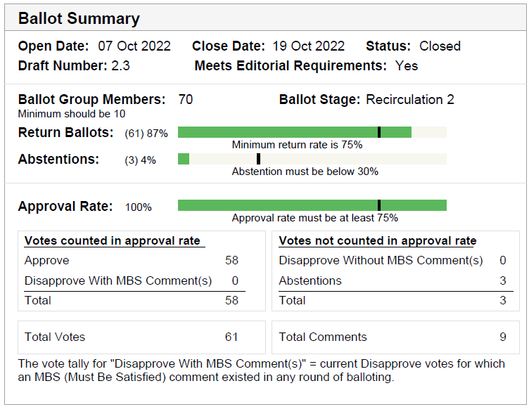
Supporting information P802.1Qcz
SA ballot closed:
19 October 2022
All SA ballot requirements are met
The ballot resulted in
0 Disapprove votes
0 outstanding Must Be Satisfied (MBS) comments
Disposition: https://www.ieee802.org/1/files/private/cz-drafts/d2/802-1Qcz-d2-3-dis-v01.pdf
Recirculation ballot will be conducted during December with comment resolution in TSN TG meetings. A possible final recirculation in January/February if required with comment resolution in TSN TG meetings.

Slide 14
802.1 Motions 2022-11 Consent Agenda Liaisons and external communications (ME)

Slide 15
7.071 - Motion
Approve liaison of the following comment responses to ISO/IEC JTC1/SC6 under the PSDO agreement:
IEEE 802.1AS-2020/Cor-1
https://www.ieee802.org/1/files/public/docs2022/liaison-SC6CommentResponse1ASCor1-1122.pdf
In the WG, Proposed: Paul Congdon Second: Karen Randall
Sending draft (y/n/a): 46, 0, 3
In EC, mover: Glenn Parsons Second: Roger Marks
(y/n/a): <y>,<n>,<a>

Slide 16
7.072 - Motion
Approve submission of the following draft(s) to ISO/IEC JTC1/SC6 for information under the PSDO agreement, once the SA Ballot starts
P802.1Qcj
In the WG, Proposed: Paul Congdon
Second: Karen Randall
Sending draft (y/n/a): 41, 0, 4
In EC, mover: Glenn Parsons Second: Roger Marks
(y/n/a): <y>,<n>,<a>

Slide 17
7.073 - Motion
Approve https://www.ieee802.org/1/files/public/docs2022/liaison-itu-t-JCA-RoadmapIMT2020Response-1122.pdf as communication to ITU-T JCA IMT-2020: regarding Invitation to update the information in the IMT 2020 roadmap, granting the IEEE 802.1 WG chair (or his delegate) editorial license.
This approval is under LMSC OM “Procedure for public statements to government bodies”
In the WG, Proposed: Paul Congdon Second: Karen Randall
Sending draft (y/n/a): 45, 0, 2
In EC, mover: Glenn Parsons Second: Roger Marks
(y/n/a): <y>,<n>,<a>

Slide 18
802.1 Motions 2022-11 Consent Agenda Liaisons and external communications (II)

Slide 19
7.074 - Motion
Approve https://www.ieee802.org/1/files/public/docs2022/liaison-response-LNI40-accessto8021drafts-1122.pdf as communication to LNI 4.0, granting the IEEE 802.1 WG chair (or his delegate) editorial license.
Proposed: János Farkas
Second: Ludwig Winkel
In the WG (y/n/a): 43, 0, 5
In the EC, for information

