Slide 1
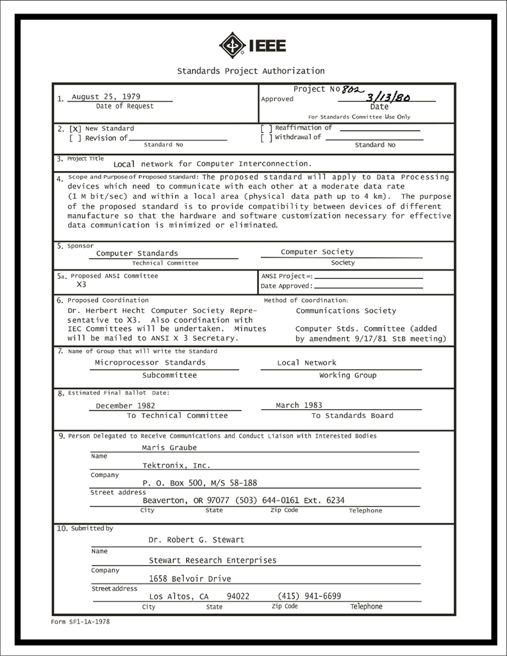
IEEE 802 LMSC Executive Committee 04 October 2022 Electronic Meeting 19:00-21:00 UTC 15:00-17:00 ET
DCN ec-22-209-00-00EC

Slide 2
1.00 Meeting called to order/roll call
2.00 Review/modify/approve agenda
2.01 Participation Slide Set URLs:
https://ieee802.org/sapolicies.shtml
https://standards.ieee.org/content/dam/ieee-standards/standards/web/documents/other/Participant-Behavior-Individual-Method.pdf
Participant behavior is guided by IEEE Code of Ethics & Conduct
Participants shall act independently of others, including employers
Standards activities shall allow the fair & equitable consideration of all viewpoints

Slide 3
3.00 Chair’s Announcements
Proforma:
Use IMAT to log your attendance
Please enable mute when you are not speaking
Please use the chat function to request being put in the queue
Reminders
Next 802/SA Task Force meeting scheduled for Monday 24 October 2022 4-5pm ET
Contact 802 chair with potential agenda items

Slide 4
3.00 Chair’s Announcements
802 Chair will remotely participate in the November Plenary Session
802 plenary (13-18NOV) overlaps with the IEEE Meeting Series (15-21NOV)
I need to attend the IEEE Meeting series in person (Vancouver BC)
Fortunately due to time zone differences, I will be able to participate in the opening/closing EC meetings, other 802 meetings and tutorials as needed.
Opening EC meeting: James appointed to chair in order to eliminate the possibility of an Internet outage disrupting the meeting
Closing EC meeting: James, Roger and I will be remote. Tentatively I will chair remotely. I am checking if the rules allow me to appoint another EC member that is present in-person to chair the meeting.
EC members – please let me know if you plan on participating in the Plenary in-person or remote via email

Slide 5
6.0 EC Any Other Business?
Any other business?
tbd

Slide 6
9.0 EC Action Item Status Review
Review Action Items from this meeting
tbd

Slide 7
Adjourn EC Meeting

