Slide 1
Executive Secretary Agenda Items
2022 November Plenary
Jon Rosdahl
IEEE 802 Executive Secretary
jrosdahl@ieee.org

Slide 2
Event Conduct and Safety Statement
IEEE believes that science, technology, and engineering are fundamental human activities, for which openness, international collaboration, and the free flow of talent and ideas are essential. Its meetings, conferences, and other events seek to enable engaging, thought-provoking conversations that support IEEE’s core mission of advancing technology for humanity. Accordingly, IEEE is committed to providing a safe, productive, and welcoming environment to all participants, including staff and vendors, at IEEE-related events.

Slide 3
Event Conduct and Safety Statement
IEEE has no tolerance for discrimination, harassment, or bullying in any form at IEEE-related events. All participants have the right to pursue shared interests without harassment or discrimination in an environment that supports diversity and inclusion. Participants are expected to adhere to these principles and respect the rights of others.
IEEE seeks to provide a secure environment at its events. Participants should report any behavior inconsistent with the principles outlined here, to onsite staff, security or venue personnel, or toeventconduct@ieee.org.

Slide 4
IEEE 802 Opening EC Mtg – November 14
Agenda Item 6.02 - II
  Current / Future venues 10 Mins
    Event Summary and Important Information
    Registration Reminder
    Straw Poll for WGs
    Future Venue Contract Status
    March 2023 – Hilton Atlanta – 40th Anniversary Celebration
    Other Future Sessions
Agenda Item 6.06 – II 10 Mins
  Student Outreach Program for Berlin July 2023

Slide 5
November 2022 IEEE 802 Plenary Session
Event Summary and Important Information
Prepared By: Face to Face Events, November 1, 2022

Slide 6
Meeting Planner and Network Contacts
Meeting Planner: Face to Face Events
Dawn Slykhouse
Mobile: +1 (408) 594-1342
Email: dawns@facetoface-events.com
Lisa Ronmark
Mobile: +1 (604) 316-4947
Email: lisa@facetoface-events.com
Network Provider: Linespeed Events
Richard Alfvin
Mobile: +1 (585) 781-0952
Email: rick@linespeed.com
Meeting Planner and Network Office
Thai Chakraphat 1

Slide 7
In Person Registration Times and Location
Registration and Information Desk
Grand Ballroom Foyer, Level 2
Sunday 3:30 PM - 6:30 PM
Monday 7:30 AM - 5:00 PM
Tuesday, Wednesday, Thursday 7:30 AM - 1:30 PM

Slide 8
Food and Beverage Breaks
Monday –Thursday Nov 15 - 17
Arrival Break 7:30 AM - 8:30 AM
Grand Ballroom Foyer
Great Hall Pre-Function Area (Tues-Thur)
AM Break 9:45 AM - 10:45 AM
Grand Ballroom Foyer
Great Hall Pre-Function Area
PM Break 3:00 PM - 4:00 PM
Grand Ballroom Foyer
Great Hall Pre-Function Area
Lunch 12:00 PM - 2:00 PM
Gogi Kitchen (Lobby Level)
Wear your event name badge for complimentary access.

Slide 9
Schedule of Sessions and Attendance
In Person Room Assignments: Schedule QR codes posted on each meeting floor and on your badge hand out. http://schedule.802world.com/schedule/schedule/show
Virtual Participation: https://ieee802.org/802tele_calendar.html
ATTENDANCE TOOL (IMAT) : https://imat.ieee.org/my-site/home
REGISTRATION FEE REQUIREMENT REMINDER
Payment of the session registration fee is required for all individuals who participate in any session associated with the November 2022 IEEE 802 Plenary Session.
Registration Link: https://cvent.me/ePrBDG

Slide 10
Audio Visual Support - In Person Sessions
WHO TO CONTACT IF AUDIO VISUAL EQUIPMENT ISN’T WORKING IN YOUR ONSITE MEETING ROOM
Please contact the Meeting Planner directly if you have any issues with the audio visual equipment in your meeting room. The Meeting Planner will contact support and the appropriate technician will be sent to assist as soon as possible.
Meeting Planner can be reached at:
Registration and Information Desk: Grand Ballroom Foyer
Event Office: Thai Chakraphat 1
Via Text or Call: Dawn Slykhouse: +1 (408) 594-1342 or Lisa Ronmark +1 (604) 316-4947
WEBEX AUDIO IN THE ONSITE MEETING ROOM
If you are a local participant, PLEASE, select “Don’t connect to audio” when joining the WebEx session. Connecting to the audio, may cause an audio feedback loop that prevents the meeting from proceeding

Slide 11
Network Access Information and Support
IEEE 802 Wireless Secure Network Access
Wireless Encryption Protocol: WPA2/WPA3
SSIDS: IEEE802
Password: ieeeieee
Onsite Network Support
  The November 2022 IEEE 802 Plenary Session Network Provider is Linespeed.
  Members of the Linespeed team will be available in Thai Chakraphat 1.

Slide 12

‘Tastes of Thailand Street Food’
Networking Social
WHO
Registered In-Person attendees* and their guests*.
*Please confirm your planned attendance with the Meeting Planner at the event Registration Desk.
Guest Badges available until 1:30 PM Tuesday.
WHEN
Wednesday November 16th , 6:30 PM - 9:00 PM
WHERE
Sala Thai – 5th Floor.
WHAT
Food, Drinks, Entertainment

Slide 13
Airport Transfers
Airport Transportation
Transportation to the BKK Airport can be arranged directly with the Marriott hotel. Please speak with a representative at the front desk should you wish to hire a car to the airport.

Slide 14

Acknowledgement of Support
On behalf of the IEEE 802 Executive Committee, and the Working Groups they represent we would like to take this opportunity to thank the
Thailand Conventions and Exhibitions Bureau (TCEB)
for supporting the November 2022 IEEE 802 Plenary Session.
Their support has helped make our session a success.

Slide 15

Letter from Simon Bell, General Manager
Dear Valued Guest,
We are looking forward welcoming you in Bangkok Marriott Marquis Queen’s Park.
Please be advised that during 16th – 20th November the Asia-Pacific Economic Cooperation (APEC) Summit will take place in Bangkok.
During 12th - 20th November 2022, heightened security measures will be in place across multiple venues in Bangkok.
To ensure a smooth stay with us, there will be some special guidelines that need to be followed according to The Royal Thai Police as mentioned below:
From 12th- 20th November 2022:
      Please carry your passport or Thai National ID card (or a copy of your passport on your mobile phone) with you at all times.
  (Continued next Slide)

Slide 16
Continued from Previous slide
From 14th-19th November 2022:
      The main entrance at the lobby shall be the only point to enter or exit the hotel
      Gate Access from Benchasiri Park will be closed.
      Shuttle bus service to Emporium Tower (Phrom Phong BTS station) will be available every 30 minutes from 07.00–22.00 hrs.
We apologize for the inconvenience, and we hope you will enjoy your stay with us.
Should you require any further assistance, please feel free to contact us via +66 2 059 5555.
Best Regards,
Simon Bell
General Manager

Slide 17
Thanks for helping us make this session a success, we look forward to working with you again!
The next IEEE 802 Plenary Session will be March 12-17, 2023.
The session will be a Mixed Mode with In-Person participation at the Hilton Atlanta, in Atlanta Georgia.
Session Information and Registration
will be available in Mid-December 2022.
If you have any questions about the current session or the March 2023 IEEE 802 Plenary please contact us:
Face to Face Events
IEEE 802 Meeting Planner
Email: 802info@facetoface-events.com

Slide 18
Request for information from local 802 Plenary WG Attendees
We need to try to get an accurate count to prepare for the Breaks and Lunch on Friday.
During your WG Opening Plenary, we need to determine how many will be staying to attend the 802 EC Closing Plenary, the 802.11 Closing Plenary and/or the 802.1 " IEC/IEEE 60802" meetings on Friday Nov 15.
Please report back to Jon by Monday Nov 14 by 2 pm ET (14:00 ET)
Questions to Ask:
  If you will be at one of the three meetings on Friday ( 802 EC Closing Plenary, the 802.11 Closing Plenary or the 802.1 " IEC/IEEE 60802" meeting ) will you participate (eat/drink) :
  With breakfast?
  with the AM Break?
  With the lunch?
  with the PM Break?
Please report all three numbers as it will affect our guarantees for F&B expenses for Friday.

Slide 19
2022 November 802 Plenary Registration report as of 11/13/22 – noon ICT
WG | In-Person Attendee | Virtual Attendee | Grand Total
802.1 | 36 | 45 | 81
802.11 | 185 | 259 | 444
802.15 | 62 | 46 | 108
802.18 | 3 | 2 | 5
802.19 | 1 |  | 1
802.24 | 2 |  | 2
802.3 | 95 | 175 | 270
(blank) | 6 | 2 | 8
Grand Total | 390 | 529 | 919

Slide 20
Basic Room Resource Allocation
Big meetings
(≥ 100, e.g., WG plenaries)
Medium meetings
(35-100, e.g., Task Forces)
Smaller meetings
(30 or less)
Head table (5)
1 projector/screen
2 tables mics
1 or 2 floor mics
Sound system
(speakers, sound board, etc.)
Ethernet/HDMI/USB
Scarlett Audio Interface
Head table (3)
1 projector/screen
1 table mic
1 floor mic
Sound system
(speakers, sound board, etc.)
Ethernet/HDMI/USB
Scarlett Audio Interface
U-shaped or board meeting setup
1 room microphone
  Portable or speakerphone-type
Sound system
(speakers, sound board, etc.)
Ethernet/HDMI/USB
Scarlett Audio Interface

Slide 21
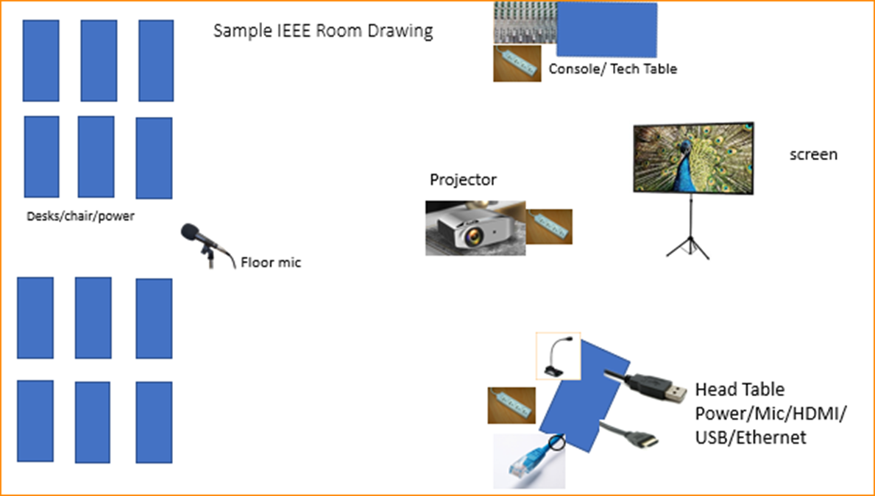

Scarlett
Notes:
This Photo by Unknown Author is licensed under CC BY-NC
This Photo by Unknown Author is licensed under CC BY-SA-NC
This Photo by Unknown Author is licensed under CC BY-SA

Slide 22
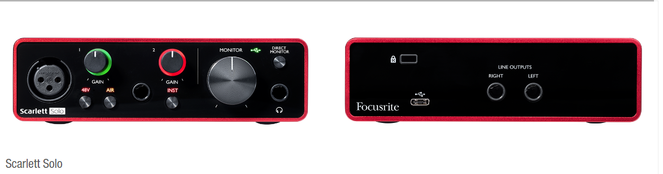
Scarlett Solo – Audio Interface by Focusrite
Thanks to Linespeed for obtaining a set of Scarlett Solo Audio Interface boxes to help provide a more consistent experience in our Sessions.

Slide 23
Suggested best practices
One central laptop/computer per meeting connects at head table.
Local speakers queue/speak only at a microphone when called on.
Remote speakers request to speak via chat window and only speak when called on.
Presenters have chair (central laptop) share the presentation
Local attendees when logged into WebEx SHALL NOT connect Audio.
When Starting a meeting the host should do the following:
  Select “Meeting” -> “Meeting Options” -> [Disable] “Allow Participant to turn on Video”
  Select “Participant” -> [Enable] “Mute on Entry”.
For the Host and Remote Attendees connecting to Webex, Configure Webex Audio to use “Music Mode”.

Slide 24
Mixed-mode Meeting Protocol
Sample Intro Meeting Slide
In-room Attendees:
  In Webex choose connect without audio before you join
  Use the Webex queue to indicate you want to speak
  Wait to be called on while standing/holding a microphone to make a comment
  Repeat any questions that are inadvertently asked away from the microphone
Remote Attendees:
  Join Webex and set Webex audio as ‘music’
  Use the Webex chat window to indicate you want to speak (“q”)
  Wait to be called on to speak
Host:
  Disable Video for participants
  Set up participants to mute on entry
  Set up Audio Options:
  Microphone -> USB, Speaker -> USB, Smart Audio -> Music
  Use a designated person to monitor speaking requests (manage the queue).

Slide 25
Request for 802 WG Straw Polls -1
802 WG Chairs, Please Straw Poll your membership:
  1.If the 2023 March Plenary Session were held at the Hilton Atlanta, GA as an in-person only session, would you attend?
    Yes/No
  2. If the 2023 March Plenary Session is held in as a mixed-mode session, will you attend:
    Attend In-person
    Attend Virtually (remotely)
    Will not attend plenary
802 Wireless WGs and 802.1 are asked to ask similar question for the 2023 January 802 Wireless Interim in Baltimore:
  3. If the 2023 January Interim Session is held in Baltimore, Maryland, as a mixed-mode session, will you attend:

Slide 26
Request for 802 WG Straw Polls -1
Request for WG SP about current Venue
  How many people would like to come back to this venue?
    Yes/No
  Did you go to the social?
    Yes/No
  Did you like the social?
    Yes/No

Slide 27
Future Venue Contract Status
2022 – Nov 13-18 – Marriott Marquis Queen’s Park, Bangkok, Thailand (Nov 2020)
2023 – March 12-17 –Hilton Atlanta, Atlanta, GA, United States (1 of 2 – March 2020)
2023 – July 9-14 – Estrel Berlin, Berlin, Germany
2023 – Nov 12-17 – Hawaiian Village, Oahu, Hawaii, United States
2024 – March 10-15 – Hyatt Regency Denver at Colorado Convention Center, Denver, CO, United States (March 2021)
2024 – July 14-19 – Sheraton Le Centre Montreal, Montreal, Quebec, Canada (July 2020)
2024 – Nov 10-15 –Hyatt Regency Vancouver, Vancouver, Canada (Nov 2021)
2025 – March 9-14 –Hilton Atlanta, Atlanta, GA, United States (2 of 2 – March 2020).
2025 – July 13-18 –Marriott Madrid Auditorium, Madrid, Spain (July 2021)
2025 – Nov 9-24 – Possible need for penalty offset- Le Centre Sheraton Montreal, Montreal (July 2022)
2026 March 8-13 - Hyatt Regency Chicago, Chicago, IL, United States (March 2024) – (Contract pending)
2027 – Nov 14-19 – Hawaiian Village, Oahu, Hawaii, United States
https://mentor.ieee.org/802-ec/dcn/20/ec-20-0001-05-00EC-802-plenary-future-venue-contract-status.xlsx
Notes:
Yellow Highlight – Potential deferral identified.
Blue Highlight – replacement dates for venues deferred.
Light Green highlight – potential targets for possible deferrals or offset penalties.
Dark Green Highlight – rebooking due to COVID
Red – Cancelled – Electronic Plenary
No highlight – pre Covid assigned dates/venues.
Note: 2026 March - RFP -2019 - Hyatt Regency Chicago selected for March 2023, Contract not signed due to PSAV - Moved to 2024 March - then moved to 2026 due to agreement with rebooking Denver.

Slide 28
2023 March 12-17 – Hilton Atlanta, Atlanta, Georgia USA
2023 March 12-17- Hilton Atlanta, Atlanta, Georgia USA rebooked from March 2020 (1 of 2 Sessions).
Expectations:
  Meeting Fees to be confirmed this week (Nov 18).
  nominal rate: $500 (Early-bird rate)
  open Registration Mid December
Treasurer/Mtg Planner/Exec Sec to have proposal for Closing plenary.
Notes:
$400+$100 = $500

Slide 29
Future Session AdHocs
All potential New Future Venues not already approved are on hold.
Negotiations on Madrid (2025 July) on Hold
Negotiations on Chicago (2026 March) expect to complete by year end.
Future Venue AdHoc: Next Plenary
  Thursday 17 November 2022 7:30am Thai Chakkraphat 2 - 2nd FL
    Review Resources for 2023 March Plenary
    Review requirement expectations/actuals for this week
Future Venue Ad-Hoc: Futures
  Thursday 17 November 2022 8:00 am Thai Chakkraphat 2 - 2nd FL
    Review requirements for future sessions.

Slide 30
6.06 IEEE 802 University Outreach Program for Berlin July 2023
  Student Outreach Program for Berlin July 2023
The purpose of our Student Outreach program is to give students a chance to see firsthand how the Standards process works. We realize it is like getting a drink from a fire-hose, but it does give a good first look into the process.
It is a one-day event Tuesday of the Plenary Week:
  7:30-9:00 – sign in and get badge
  9:00am Start with an introduction meeting with a couple of the 802 Leadership members to orient the students to what activities may be of most interest to them that day
  10:30am (AM2) the students attend actual working meetings and can meet and participate in the discussions.

Slide 31
Student Outreach Program for Berlin July 2023 (2)
17:00 (5pm) Debrief:
  A short debrief meeting at the end of the day is provided to answer questions and help provide closure to the experience.
The Outreach Student fee is USD$25 per student
The program is limited to 25 Students.
Note that membership attendance credit is not granted for student activities.
The Students are invited to join for Lunch and breaks as our guests.
Previous material prepared for 2015 and 2017 programs:
  https://www.ieee802.org/Univ_Outreach.shtml
A motion to approve program for July 2023 will be made during the 802 Closing Plenary Nov 17.

Slide 32
Future Venue AdHocs --

Slide 33
Next Venue Meeting planning – Thurs 7:30 am
Proposed Agenda:
  Start time 7:30 am
  Review meeting space plan for 2023 March Plenary
    Hilton Atlanta, GA, USA
  Adjourn 8:00am

Slide 34
Notes from Discussion
Order Shirts anew. Limited quantities.
Expect fees to be $600/$800/$1000

Slide 35
Future Venues AdHoc – Thurs 8 am
Proposed Agenda:
  Start time – 8:00 am
    Review Contract Status
    Review requirements for future sessions.
    Review requirement expectations/actuals for this week.
  End time – 9:00am

Slide 36
Future Venue Contract Status
2022 – Nov 13-18 – Marriott Marquis Queen’s Park, Bangkok, Thailand (Nov 2020)
2023 – March 12-17 –Hilton Atlanta, Atlanta, GA, United States (1 of 2 – March 2020)
2023 – July 9-14 – Estrel Berlin, Berlin, Germany
2023 – Nov 12-17 – Hawaiian Village, Oahu, Hawaii, United States
2024 – March 10-15 – Hyatt Regency Denver at Colorado Convention Center, Denver, CO, United States (March 2021)
2024 – July 14-19 – Sheraton Le Centre Montreal, Montreal, Quebec, Canada (July 2020)
2024 – Nov 10-15 –Hyatt Regency Vancouver, Vancouver, Canada (Nov 2021)
2025 – March 9-14 –Hilton Atlanta, Atlanta, GA, United States (2 of 2 – March 2020).
2025 – July 13-18 –Marriott Madrid Auditorium, Madrid, Spain (July 2021)
2025 – Nov 9-24 – Possible need for penalty offset- Le Centre Sheraton Montreal, Montreal (July 2022)
2026 March 8-13 - Hyatt Regency Chicago, Chicago, IL, United States (March 2024) – (Contract pending)
2027 – Nov 14-19 – Hawaiian Village, Oahu, Hawaii, United States
https://mentor.ieee.org/802-ec/dcn/20/ec-20-0001-05-00EC-802-plenary-future-venue-contract-status.xlsx
Notes:
Yellow Highlight – Potential deferral identified.
Blue Highlight – replacement dates for venues deferred.
Light Green highlight – potential targets for possible deferrals or offset penalties.
Dark Green Highlight – rebooking due to COVID
Red – Cancelled – Electronic Plenary
No highlight – pre Covid assigned dates/venues.
Note: 2026 March - RFP -2019 - Hyatt Regency Chicago selected for March 2023, Contract not signed due to PSAV - Moved to 2024 March - then moved to 2026 due to agreement with rebooking Denver.

Slide 37
Notes
AI: Jon to update Contract slide – July 2026
Remember the Straw Polls in WG closing plenary.
Positives for coming here – Venue was nice, F&B, Staff
Negatives for coming here - Network infrastructure is a bit of a challenge. Cabling out of specification. (550 ft way out of spec).
Plan to have a plan in March to provide Guidance for locations/frequencies/types going forward to make creating an RFP in the Spring Reasonable for future venue bookings.
Discussion on hosting ITU SG5 for July 2024 in Montreal, Canada.
  Proposed Motion to EC on Friday.
  Expectation is to have revenue neutral, but 802 would provide the overhead to collect fees, pay bills and guarantee contract.

Slide 38
IEEE 802 Closing EC Mtg – November 17
802 Closing EC Agenda Items:
  4.02 MI Future Meetings 10 mins
  4.03 MI IEEE 802 March 2023 Meeting Fee 10 mins
  4.06 MI Student Outreach Program July 2023 10 mins
  8.033 II Executive Secretary Report 0 mins
  8.04 MI Announcement of 802 EC Interim Telecon 5 mins
    Change of Dec and January date
  8.05 II Call for Tutorials for March 2023 Plenary 3 mins

Slide 39
Future Venue Contract Status
2022 – Nov 13-18 – Marriott Marquis Queen’s Park, Bangkok, Thailand (Nov 2020)
2023 – March 12-17 –Hilton Atlanta, Atlanta, GA, United States (1 of 2 – March 2020)
2023 – July 9-14 – Estrel Berlin, Berlin, Germany
2023 – Nov 12-17 – Hawaiian Village, Oahu, Hawaii, United States
2024 – March 10-15 – Hyatt Regency Denver at Colorado Convention Center, Denver, CO, United States (March 2021)
2024 – July 14-19 – Sheraton Le Centre Montreal, Montreal, Quebec, Canada (July 2020)
2024 – Nov 10-15 –Hyatt Regency Vancouver, Vancouver, Canada (Nov 2021)
2025 – March 9-14 –Hilton Atlanta, Atlanta, GA, United States (2 of 2 – March 2020).
2025 – July 13-18 –Marriott Madrid Auditorium, Madrid, Spain (July 2021)
2025 – Nov 9-24 – Possible need for penalty offset- Le Centre Sheraton Montreal, Montreal (July 2022)
2026 March 8-13 - Hyatt Regency Chicago, Chicago, IL, United States (March 2024) – (Contract pending)
2027 – Nov 14-19 – Hawaiian Village, Oahu, Hawaii, United States
https://mentor.ieee.org/802-ec/dcn/20/ec-20-0001-05-00EC-802-plenary-future-venue-contract-status.xlsx
Notes:
Yellow Highlight – Potential deferral identified.
Blue Highlight – replacement dates for venues deferred.
Light Green highlight – potential targets for possible deferrals or offset penalties.
Dark Green Highlight – rebooking due to COVID
Red – Cancelled – Electronic Plenary
No highlight – pre Covid assigned dates/venues.
Note: 2026 March - RFP -2019 - Hyatt Regency Chicago selected for March 2023, Contract not signed due to PSAV - Moved to 2024 March - then moved to 2026 due to agreement with rebooking Denver.

Slide 40
2022 July WG Attendee Summary
Primary WG includes | 802.1 | 802.3 | 802.11 | 802.15 | 802.18, 19, or 24 only |  | total | Individuals | Dups
In-Person | 59 | 144 | 166 | 57 | 3 |  | 429 | 417 | 12
Virtual | 48 | 149 | 295 | 64 | 3 |  | 559 | 547 | 12
Student | 3 | 1 | 2 | 1 | 0 |  | 7 | 7 | 0
total | 110 | 294 | 463 | 122 | 6 |  | 995 | 971 | 2

Slide 41
Nov 2022 – Bangkok, Thailand - WG Attendee Summary
2022 November
  Originally Booked prior to Covid-19 Pandemic
  2020 Nov instance rebooked to 2022 Nov.

Slide 42
Straw Poll #1 for 2023 January 802W Interim
1. If the 203 January 802W Interim Session is held in Baltimore, MD, USA as an in-person only session, will you attend?
Yes No Minimum Viable
802.1 - - 90
802.11 59 48 175
802.15 - - 45
802.18 20
802.19 27 5 10
802.24 7
Totals 497
Notes:
Minimum Attendance for Viable Meeting:
WG Chairs reported 2020-11-20:
802.1 90
802.3 150
802.11 175
802.15 45
802.18 20
802.19 10
802.24 7
Total: 497

Slide 43
Straw Poll #2 for 2023 January 802W Interim
2. If the 2023 January 802W Interim Session is held in Baltimore, MD, USA as a mixed-mode session, will you attend:
Attend In-person Attend Virtually (remotely) Will not attend plenary
802.1 21 25 2
802.11 49 57 4
802.15 21 23 2
802.18 - - -
802.19 - - -
Totals: 91 105 8
Notes:
20% drop.

Slide 44
Straw Poll #3 for 2023 March
3. If the 2023 March Plenary Session is held in Atlanta, GA, USA as an in-person only session, will you attend?
Yes No Minimum Viable
802.1 32 17 90
802.3 76 66 150
802.11 68 43 175
802.15 27 19 45
802.18 15 3 20
802.19 24 8 10
802.24 7
Totals 276 156 497
Notes:
Minimum Attendance for Viable Meeting:
WG Chairs reported 2020-11-20:
802.1 90
802.3 150
802.11 175
802.15 45
802.18 20
802.19 10
802.24 7
Total: 497

Slide 45
Straw Poll #4 for 2023 March
4. If the 2023 March Plenary Session is held in Atlanta, GA, USA as a mixed-mode session, will you attend:
Attend In-person Attend Virtually (remotely) Will not attend plenary
802.1 25 24 0
802.3 65 75 2
802.11 64 59 0
802.15 24 22 0
802.18 14 5 1
802.19 23 7 2
Totals 215 192 5
Notes:
20% drop.

Slide 46
Straw Poll #5 Nov 2022
How many people would like to come back to this venue?
          Yes No N/A
    1 28 7 19
    3 70 27
    11 43 2
    15 25 0
    Totals 166 36

Slide 47
Straw Poll #6 November 22 Attend Social
6. Did you go to the social?
          Yes No N/A
    1 19 9 27
    3 41 11
    11 40 5
    15 27 - -
    18
    19
Poll total 127 25
Total Attendance counted at the door 314

Slide 48
Straw Poll #7 November 22 Like social
7. Did you like the social?
          Yes No N/A
    1 14 3 39
    3 35 2
    11 33 0
    15 21 - -
    18
    19
Poll Total 103 5

Slide 49
4.03 2023 March Mixed-mode Plenary Fee Motion
Motion to approve fees/dates for 2023 March IEEE 802 Mixed Mode Plenary for either in person or remote attendance:
  $600 until Friday, January 27, 2023
  $800 through Friday, March 3, 2023
  $1000 after Friday, March 3, 2023
  Cancellation Policy:
    fully refundable until January 27, 2023
    refundable with $150 cancellation fee after January 27 until March 3, 2023
    non-refundable after March 4, 2023
Moved: Rosdahl
2nd: Zimmerman
Results: No Objection – Motion passes.
Notes:
Room Rate Approx us$160 ++
Expected registration opens August 1, 2022
Attritions cost would be about $60K for lack of 500 nights.

Slide 50
4.03 Motion to Approve Exec Site Visit
Site Visits are included in the SOW for the Meeting Planner and Network Service Providers, the IEEE 802 Executive Secretary is requesting approval to attend potential Site visit Dec/January.
Move to approve Atlanta Site Visit for IEEE 802 Executive Secretary not to exceed $2,000.
Move: Rosdahl
Second: Zimmerman
Results: No Objection – Motion passes.
Notes:
Airfare = $700
Transfers = $250
Food = $250
Hotel = $800
Total = $2,000 per person

Slide 51
ITU hosting
For discussion at the EC Closing Plenary.

Slide 52
ITU-T SG15 & IEEE 802
There has been a cordial liaison relationship and mutual participation for decades
IEEE 802 plenary was hosted in Geneva by ITU in July 2013
  There was no registration fee and no network fee
  Facility was ITU HQ building and adjacent CICG convention centre
  The session was followed by an ITU-T SG15 plenary
802.1 & 802.3 interims have been hosted as well
  May 2007, May 2010, January 2018 and January 2020
A joint workshop between SG15 and 802 was held on the weekend
  This event that has been repeated many times, most recently in January 2020

Slide 53
ITU new building project
ITU buildings will be closed for hosting meetings from mid-2023 until at least 2026.
  Demolish the oldest building (Varembé) and sell the second oldest (Tower).
  Construct new building adjoining remaining building (Montbrillant)
New building opening in early 2028
  Hosts are invited for all ITU meetings
Given good relationship with ITU-T SG15, the ITU hosting of IEEE 802 sessions, and the alignment of sessions in 2024, IEEE 802 should consider hosting ITU-T SG15 in conjunction with our July 2024 session
  Sheraton Montreal has space available, and this could be included in 802 contract amendment
  Network & meeting planning provided by IEEE 802 service providers
  Workshop hosted by IEEE 802
  Cost recovery through meeting fee (and possibly sponsorships) with net even or positive result

Slide 54
Motion
Approve negotiating hosting of ITU-T SG15 July 2024 Plenary Session adjacent to IEEE 802 plenary including the hosting of a joint workshop.
Move: Jon Rosdahl
2nd: Glenn Parsons
Results: No Objection – Motion passes.

Slide 55
4.06 – Consent Agenda
Approve a University Outreach program for the 2023 July 802 Plenary Session with a limit of 25 students and with a one-day meeting fee of USD$25 per student as outlined in 802 EC-22/203r1 slides 30-31.
Move: Jon Rosdahl
2nd: James Gilb
Results: Consent Agenda item - Approved with Agenda.
Notes:
Last time we did the outreach was July 2017

Slide 56
8.033 – Executive Secretary Report
Meetings efficiency
  Network Report
Meeting venue management
Assist Chair as requested

Slide 57
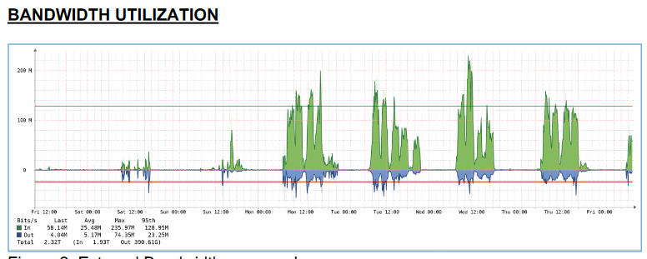
Network Report – Linespeed
Network Report posted to mentor: :
FINAL STATISTICS (as of 9AM 11/16/22)
• Total Internet data: 2.32 TB
• Total Internet data inbound: 1.93 TB
• Total Internet data outbound: 0.391 TB
• Inbound Internet bandwidth utilization
o Peak: 235.97 Mb/s
o 95th Percentile: 128.95 Mb/s
• Outbound Internet bandwidth utilization
o Peak: 74.35 Mb/s
o 95th Percentile: 23.25 Mb/s
• Wireless network associations: 894 unique devices
o WiFi 6 – 414
o WiFi 5 – 401
o WiFi 4 – 79
• Wired network clients:
o 47 unique devices

Slide 58
8.04 Monthly IEEE 802 EC Telecons
Announcement of 802 EC Interim Telecon
Tuesday 13 Dec 2022, 19:00-21:00 UTC
Tuesday 10 Jan 2023, 19:00-21:00 UTC
Tuesday 07 Feb 2023, 19:00-21:00 UTC
Call Time: 3:00 PM - 5:00 PM Tuesday, (UTC-04:00) Eastern Time (US & Canada)
Recurrence: Occurs Generally the first Tuesday of every month.
From 7:00 PM to 9:00 PM, (UTC+00:00) Monrovia, Reykjavik time zone.
Calls after March to be Scheduled during 2023 March IEEE 802 EC Closing Plenary meeting.
Notes:
Dec 6 conflicts with the IEEE SA BOG (4 members included )
Jan 3 is first day back from holiday – May decide to just skip.
Proposal to move Dec to Dec 13
Proposal to move Jan to January 10

Slide 59
8.05 Call for Tutorials for March 2023
Tutorials may be held electronic: March 6 or 7
In person/Mixed-mode Tutorials: March 13 or 14 (Mon/Tues)
Tutorial Request form:
  Generic: http://www.ieee802.org/802_tutorials/802_Tutorial_Request_Form.doc
As a reminder, please refer to Chair's Guidelines section 2.5 Tutorials for the logistics for participating in sponsoring/presenting a Tutorial.
Note that Tutorial times are limited to 80 minutes with 10 minutes to allow for presenters to setup and depart.
All requests for Tutorials must be made by 27January 2023
Notes:
All official tutorial request forms must be submitted no later than 45 days in advance of the Plenary Session.
Approved Tutorial Requests will be assigned a time slot based on the order in which they were received.
The Final Tutorial Schedule will be posted at http://802world.org/plenary and http://ieee802.org no less than 30 days in advance of the Plenary Session.

