Slide 1
Executive Secretary Agenda Items
2022 September Telecon
Jon Rosdahl
IEEE 802 Executive Secretary
jrosdahl@ieee.org

Slide 2
Event Conduct and Safety Statement
IEEE believes that science, technology, and engineering are fundamental human activities, for which openness, international collaboration, and the free flow of talent and ideas are essential. Its meetings, conferences, and other events seek to enable engaging, thought-provoking conversations that support IEEE’s core mission of advancing technology for humanity. Accordingly, IEEE is committed to providing a safe, productive, and welcoming environment to all participants, including staff and vendors, at IEEE-related events.

Slide 3
Event Conduct and Safety Statement
IEEE has no tolerance for discrimination, harassment, or bullying in any form at IEEE-related events. All participants have the right to pursue shared interests without harassment or discrimination in an environment that supports diversity and inclusion. Participants are expected to adhere to these principles and respect the rights of others.
IEEE seeks to provide a secure environment at its events. Participants should report any behavior inconsistent with the principles outlined here, to onsite staff, security or venue personnel, or toeventconduct@ieee.org.

Slide 4
IEEE 802 EC Telecon – September 6
Agenda Item 3.01 - MI
  Future Venue Update
    Nov 2022 – Bangkok, Thailand
      Registration Reminder
      Things to know about November Plenary
      Exec Site Visit Update
      Tutorial #2 slot Granted – “Wi-Fi Meets ML: Re-thinking Next-generation Wi-Fi Networks”
    Future Venue Contract Status
    Other Future Sessions
      Motion to approve 2026 July Venue
    2023 March Plenary – 40 43rd Anniversary Celebration
      Motion to approve updating shirts.

Slide 5
2022 Nov 13-18 – Marriott Marquis Queen’s Park, Bangkok, Thailand
2022 Nov 13-18 – Marriott Marquis Queen’s Park, Bangkok, Thailand rebooked from Nov 2020.
  The November 2022 IEEE 802 Plenary is scheduled to take place in Bangkok, Thailand at the Marriott Marquis Queen's Park, located at 199 Sukmvit Soi 22 Klong Ton, Klong Toey.
Registration Fees and Deadlines:
  Early US$ 600.00 until September 16, 2022
  Standard US$ 800.00 Sept 17 until October 31, 2022
  Late/Onsite US$ 1000.00 after October 31, 2022
    In-Person and Virtual participation will be available for this session.
    If you are required to change your registration type after registration please contact the Meeting Planner, Face to Face Events at 802info@facetoface-events.com
Session Registration Website
https://cvent.me/0Vk4Qq
Notes:
$400+$100+$100 = $600
Here is the link with most up to date info:
https://www.tatnews.org/2022/06/thailands-entry-requirements/

Slide 6
Basic Room Resource Allocation
Big meetings
(≥ 100, e.g., WG plenaries)
Medium meetings
(35-100, e.g., Task Forces)
Smaller meetings
(30 or less)
Head table (4)
1 projector/screen
2 tables mics
1 or 2 floor mics
Sound system
(speakers, sound board, etc.)
Ethernet-HDMI-USB
Head table (2)
1 projector/screen
1 table mic
1 floor mic
Sound system
(speakers, sound board, etc.)
Ethernet-HDMI-USB
U-shaped or board meeting setup
1 room microphone
  Portable or speakerphone-type
Sound system
(speakers, sound board, etc.)
Ethernet-HDMI-USB

Slide 7

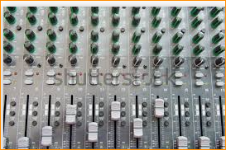
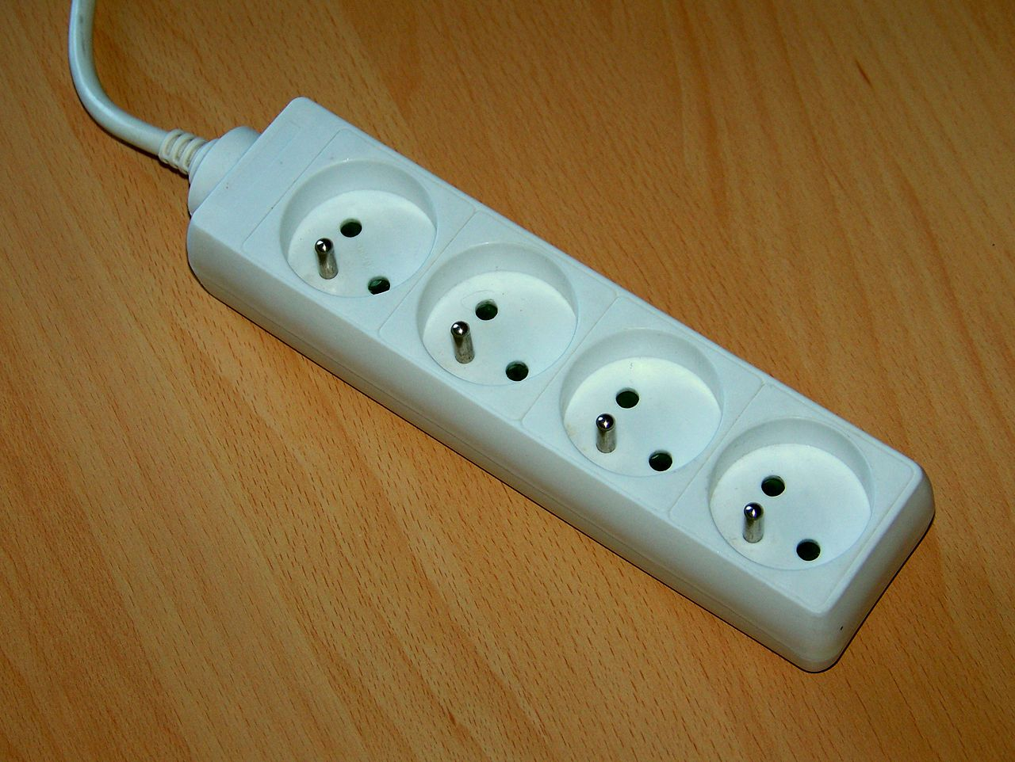
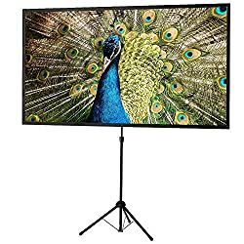
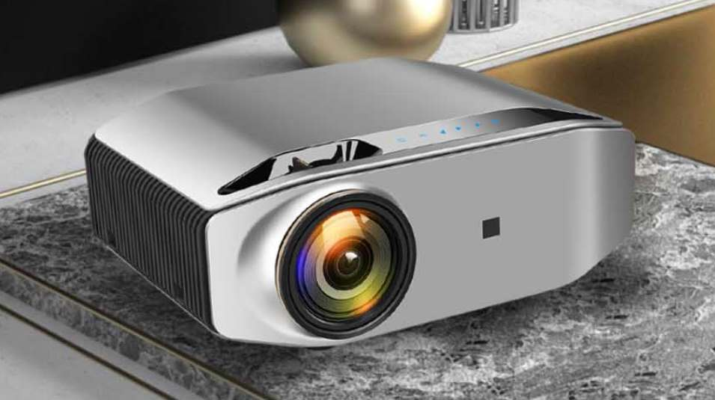
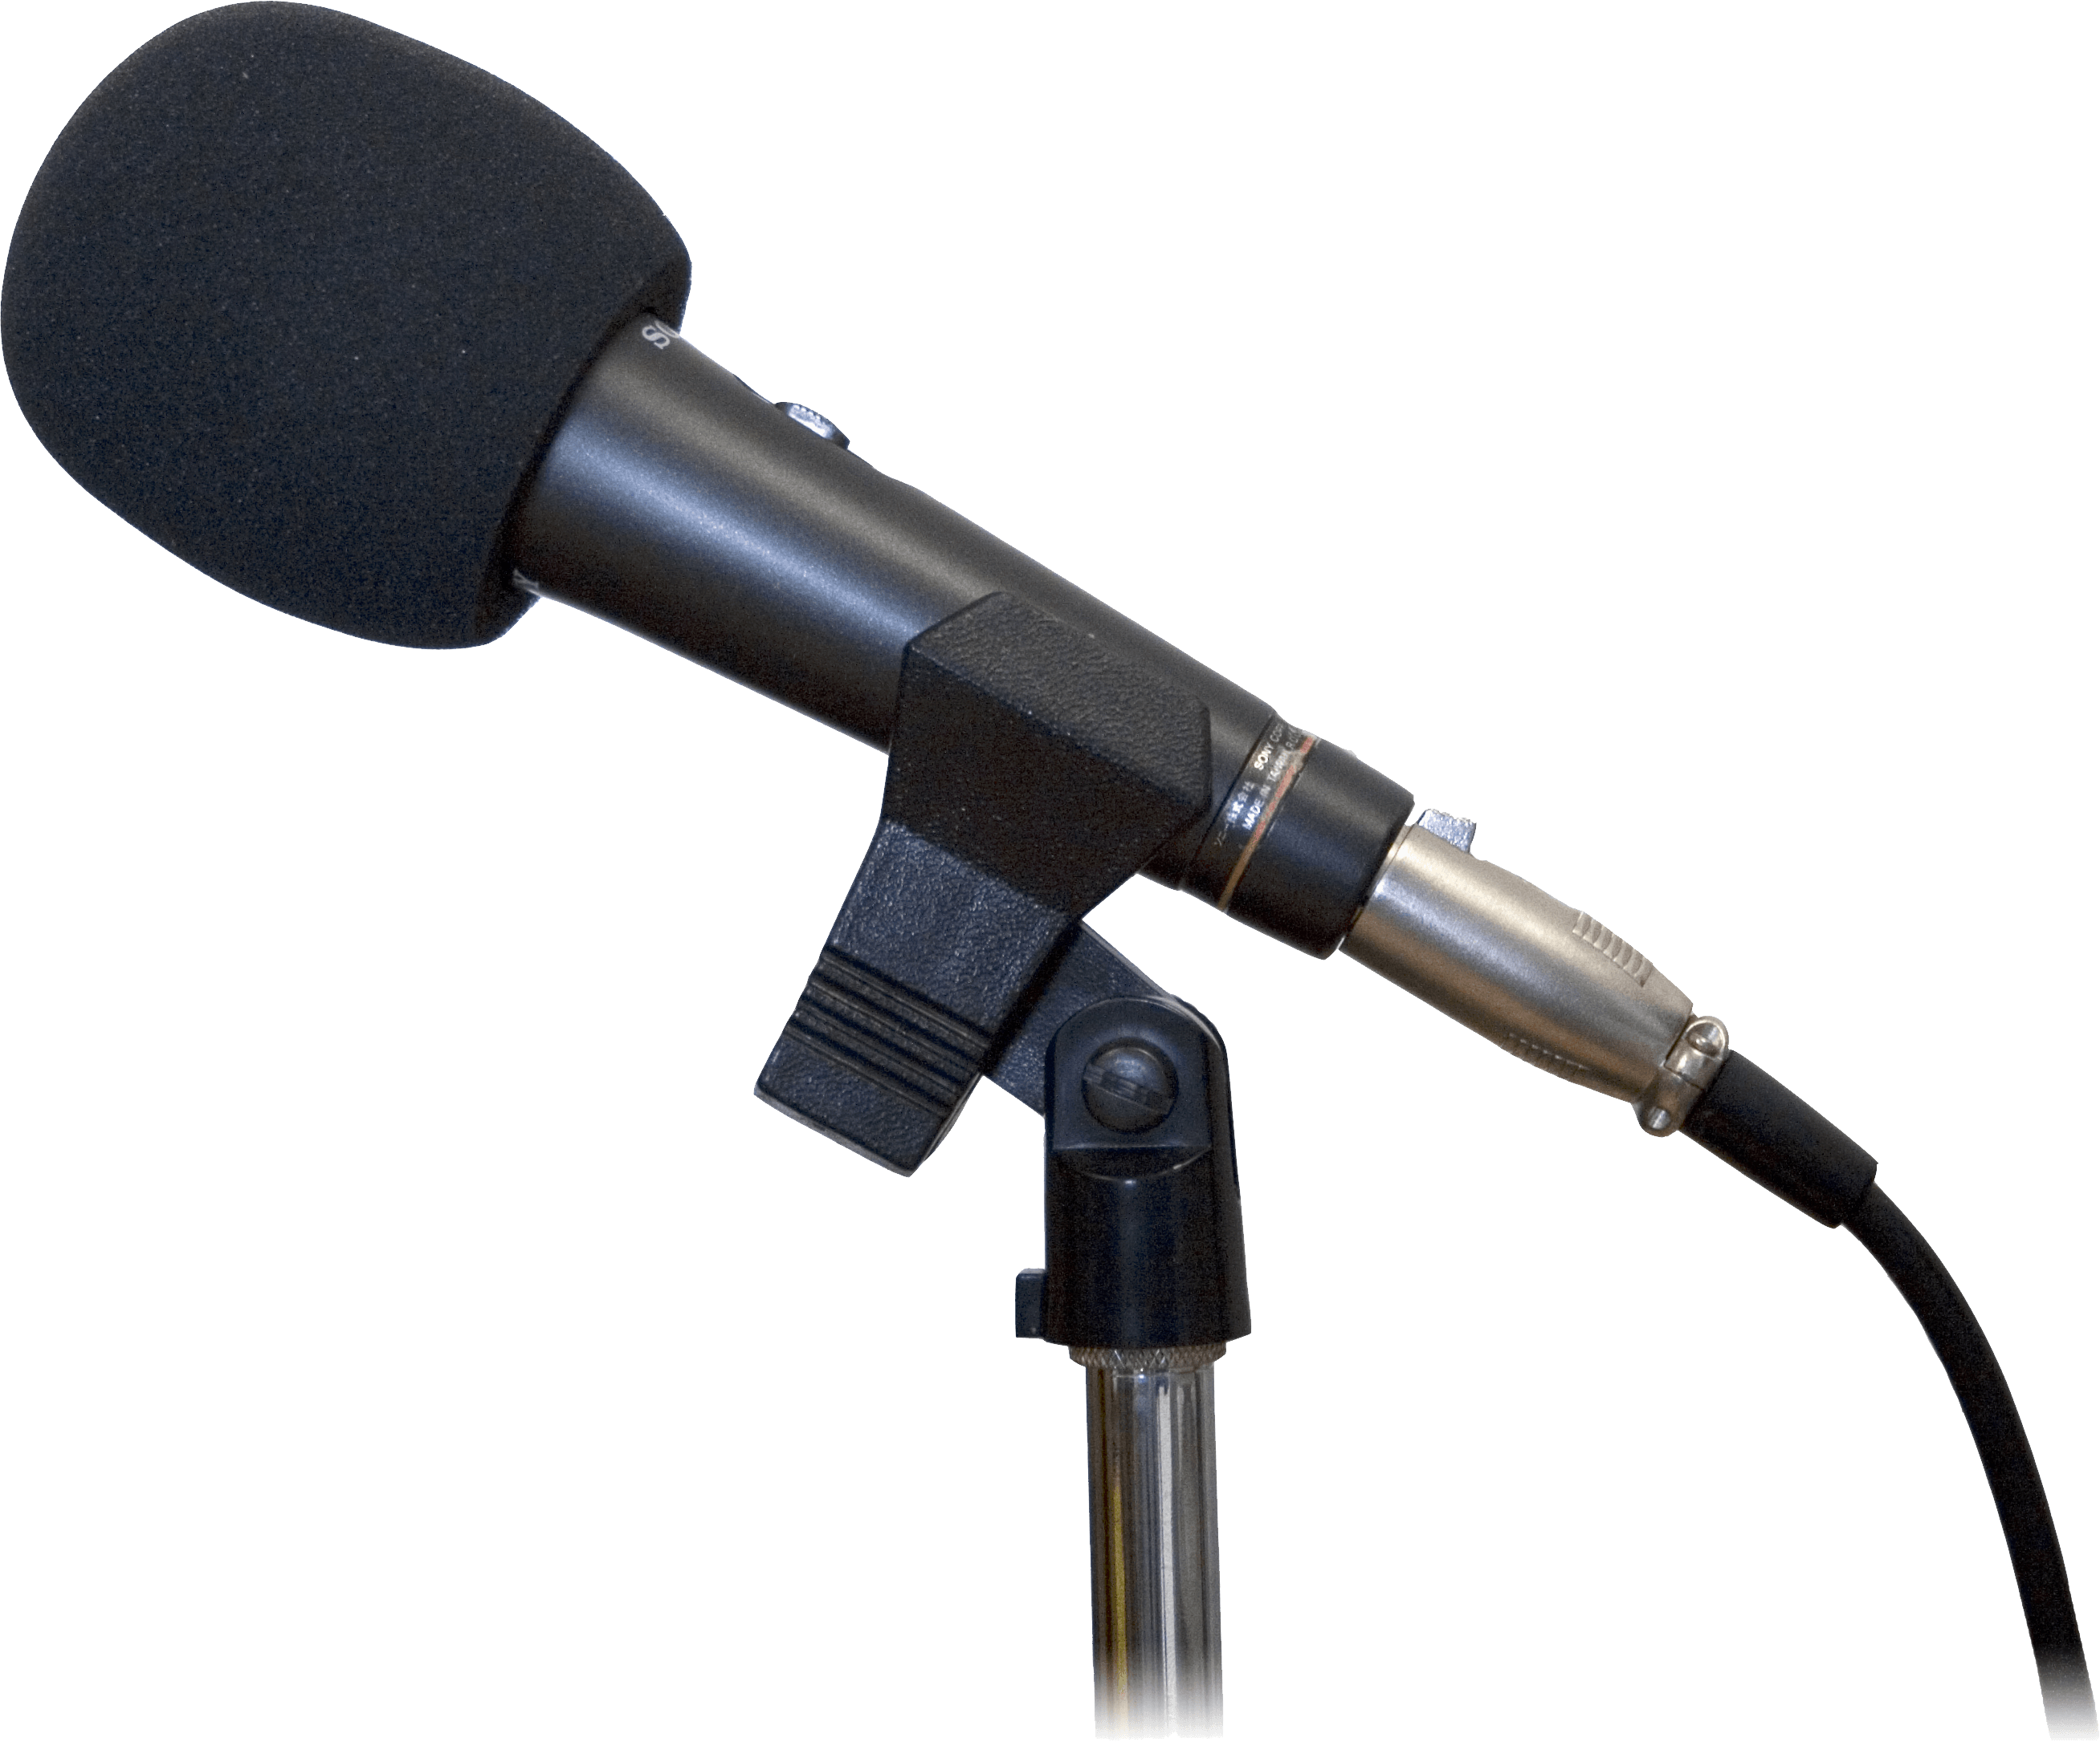
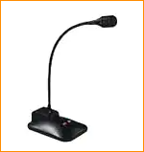
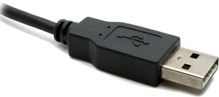
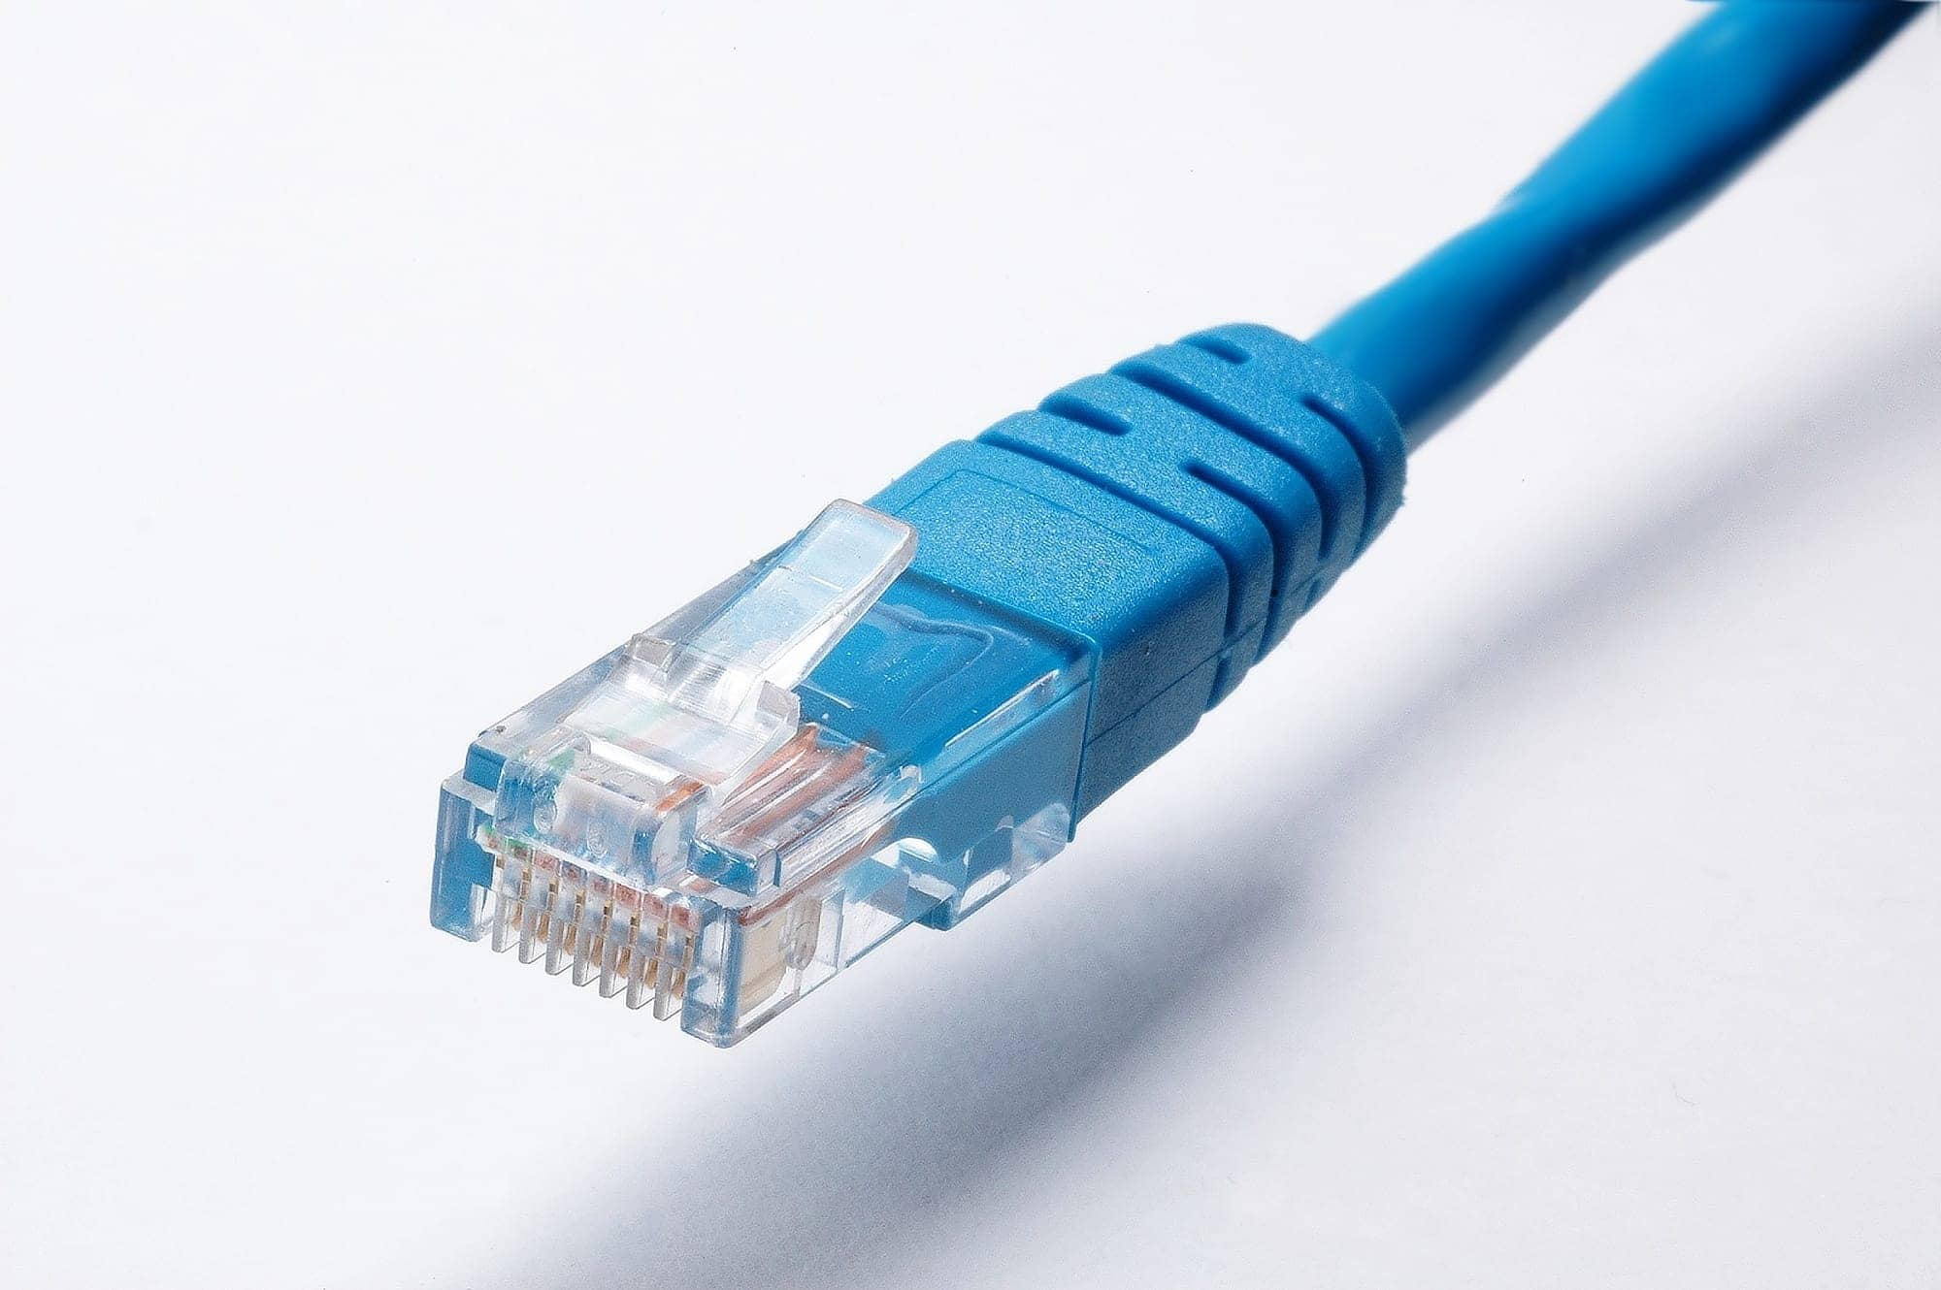
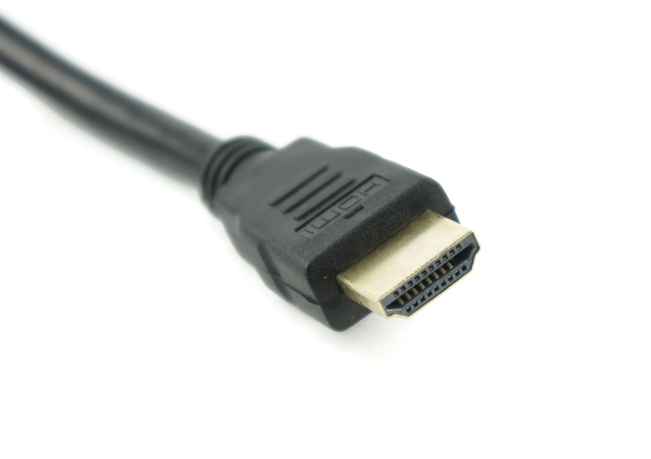

Sample IEEE Room Drawing
Console/ Tech Table
screen
Projector
Desks/chair/power
Floor mic
Head Table
Power/Mic/HDMI/
USB/Ethernet
Notes:
This Photo by Unknown Author is licensed under CC BY-NC
This Photo by Unknown Author is licensed under CC BY-SA-NC
This Photo by Unknown Author is licensed under CC BY-SA

Slide 8
Suggested best practices
One central laptop/computer per meeting connects at head table.
Local speakers queue/speak only at microphone
Presenters have chair (central laptop) share the presentation
Local attendees when logged into WebEx SHALL NOT connect Audio.
When Starting a meeting the host should do the following:
  Select “Meeting” -> “Meeting Options” -> [Disable] “Allow Participant to turn on Video”
  Select “Participant” -> [Enable] “Mute on Entry”.
For those Remote Attendees Connecting to Webex, Configure Webex Audio to use “Music Mode”.
See Training slides: 802 EC-22/183r1:

Slide 9
a) iii. Exec Sec Bangkok Site Visit Status
Purchased airline ticket – under $4k.
Site visit meet with hotel Sept 28- 29
Meeting with Tourist board, DNC, Oct 1
Travel Sept 27-Oct 3
Scheduled test of Mixed mode
  Friday, September 30, 2022:
    1. 8:30am - 9:15am: Hotel to set-up a mock meeting room to try the AV on-site/hybrid arrangements
    - more details to follow
    2. 9:15 -10:15am: IEEE 802 to host a 30-60 minute with IEEE 802EC in USA.
    - will need access to hotel network
    *Mixed-Mode Meeting will be held on Thursday, Sept. 29 at 9:30am Bangkok Time and 7:30pm PT (USA)

Slide 10
a) iii. 802 EC Test Mixed-mode Telecon- Bangkok
Test Mixed-mode- 802 EC Site Visit - Bangkok
Thursday, September 29⋅8:30 – 9:30pm
https://ieeesa.webex.com/ieeesa/j.php?MTID=meba81385a1b37e981d8ee392b3886f8d
Simple test of Marriott Queen's Park Hotel Mixed-mode capabilities.
Please join to test if you are available.
-~-~-~-~-~-~-~-~-~-~-~-~-~-~-~-~-~-~-~-~-~-~-
JOIN WEBEX MEETING: https://ieeesa.webex.com/ieeesa/j.php?MTID=meba81385a1b37e981d8ee392b3886f8d
Meeting number (access code): 2330 754 9881
Meeting password: test

Slide 11
a) iv. Tutorial #2: Granted
Tutorial #2 Slot Granted – “Wi-Fi Meets ML: Re-thinking Next-generation Wi-Fi Networks”
  Sponsored by Dorothy Stanley, 802.11 Chair
  Abstract: ABSTRACT:
    This tutorial introduces the key Artificial Intelligence/Machine Learning (AI/ML) concepts that are essential to understanding the application of AI/ML, concisely presenting the basics of Supervised Learning, Unsupervised Learning, and Reinforcement Learning techniques. We also describe network architectural aspects to support ML, such as centralized and distributed model training and deployment. The second part of the tutorial describes representative use cases where AI/ML techniques are used to improve IEEE 802.11 performance, covering several examples in detail. Finally, to end the tutorial, we discuss a list of open challenges to adopting AI/ML in IEEE 802.11.
Allocated Slot: Tutorial #2 – November 14 at 7:30-8:50pm

Slide 12
b) Future Venue Contract Status
2022 – Nov 13-18 – Marriott Marquis Queen’s Park, Bangkok, Thailand (Nov 2020)
2023 – March 12-17 –Hilton Atlanta, Atlanta, GA, United States (1 of 2 – March 2020)
2023 – July 9-14 – Estrel Berlin, Berlin, Germany
2023 – Nov 12-17 – Hawaiian Village, Oahu, Hawaii, United States
2024 – March 10-15 – Hyatt Regency Denver at Colorado Convention Center, Denver, CO, US (March 2021)
2024 – July 14-19 – Sheraton Le Centre Montreal, Montreal, Quebec, Canada (July 2020)
2024 – Nov 10-15 –Hyatt Regency Vancouver, Vancouver, Canada (Nov 2021)
2025 – March 9-14 –Hilton Atlanta, Atlanta, GA, United States (2 of 2 – March 2020).
TBC - 2025 – July 13-18 –Marriott Madrid Auditorium, Madrid, Spain (July 2021)
2025 – Nov 9-24 –
TBC - 2026 March 8-13 - Hyatt Regency Chicago, Chicago, IL, United States (March 2024) (Rebook for Denver)
TBC - 2026 – July 12-17 – Sheraton Le Centre Montreal, Montreal, Quebec, Canada (July 2022 penalty offset)
2027 – Nov 14-19 – Hawaiian Village, Oahu, Hawaii, United States
https://mentor.ieee.org/802-ec/dcn/22/ec-22-0003-00-00EC-future-802-plenary-venue-contract-status.xlsx
Notes:
Yellow Highlight – Potential deferral identified.
Blue Highlight – replacement dates for venues deferred.
Light Green highlight – potential targets for possible deferrals or offset penalties.
Dark Green Highlight – rebooking due to COVID
Red – Cancelled – Electronic Plenary
No highlight – pre Covid assigned dates/venues.
Note: 2026 March - RFP -2019 - Hyatt Regency Chicago selected for March 2023, Contract not signed due to PSAV - Moved to 2024 March - then moved to 2026 due to agreement with rebooking Denver.

Slide 13
c) Other Future Sessions
All potential New Future Venues not already approved are on hold.
  TBC Negotiations on Madrid (2025 July) and Chicago (2026 March) on hold.
  To avoid Penalties for July 2022, we agreed to negotiate for July 2026.
    Need to confirm with 802 EC for approval.

Slide 14
c) i. Motion – Approve 2026 July Plenary Venue
Move to approve Sheraton Le Centre Montreal, Montreal, Canada as the venue location for the 2026 July 802 Plenary.
Moved: Rosdahl
2nd: Powell
Results: Unanimous – motion passes

Slide 15

d) 2023 March Plenary –
40th 43rd Anniversary Celebration
Deposit for Atlanta Aquarium still being held.
496 Polo Shirts – In my garage
  Plan to update logo
  Add “Celebrating after Covid 2023”
  Additional charge about $2,500
Other options:
  Still Crushing it in 2023
  Finally Celebrating in 2023
Finally Celebrating in 2023

Slide 16
Straw Poll
Should we update the logo on the Polo Shirt.
  1 – A) Celebrating after Covid 2023
  4 – B) Still Crushing it in 2023
  3 – C) Finally Celebrating in 2023
  6 – D) Leave as is.
  Result – just ship and distribute as is.

Slide 17
Nov 2022 – Bangkok, Thailand
2022 November
  Booked prior to Covid-19 Pandemic
  2020 Nov instance rebooked to 2022 Nov.
  Currently working on Logistic details.
    Have shared A/V requirements with hotel and vendors.
    Site visit to gather specific
  Target Registration open on August 1 (pending Hotel Reg Link)
  Here is a link with most up to date info on entry requirements:
    >> https://www.tatnews.org/2022/06/thailands-entry-requirements/

Slide 18
Straw Poll for 2022 Nov - 1
1. If the 2022 Nov Plenary Session is held in Bangkok, Thailand as an in-person only session, will you attend?
Yes No Minimum Viable
802.1 36 22 90
802.3 89 136 150
802.11 83 58 175
802.15 33 29 45
802.18 18 5 20
802.19 19 11 10
802.24 7
Totals 278 261 497
Notes:
Minimum Attendance for Viable Meeting:
WG Chairs reported 2020-11-20:
802.1 90
802.3 150
802.11 175
802.15 45
802.18 20
802.19 10
802.24 7
Total: 497

Slide 19
2022 November Mixed Mode Plenary Fee Motion
Motion to approve fees/dates for 2022 Nov IEEE 802 Mixed Mode Plenary for either in person or remote attendance:
  $600 until Friday, Sept 16, 2022
  $800 through Friday, Oct 31, 2022
  $1000 after Friday, Oct 31, 2022
  Cancellation Policy:
    fully refundable until September 16
    refundable with $150 cancellation fee after September 16 until October 31, 2022
    non-refundable after October 31, 2022
Moved: Rosdahl
2nd: Zimmerman
Results: Unanimous – Motion passes.
Notes:
Room Rate Approx. us$160 ++
Expected registration opens August 1, 2022
Attritions cost would be about $60K for lack of 500 nights.

Slide 20
Motion to Approve Bangkok Exec Site Visit
Site Visits are included in the SOW for the Meeting Planner and Network Service Providers, the IEEE 802 Executive Secretary is requesting approval to attend potential Site visit 3Qtr (3 days/2 nights).
Move to approve Bangkok, Thailand Site Visit for IEEE 802 Executive Secretary not to exceed $5,500.
Move: Rosdahl
Second: Zimmerman
Results: unanimous- motion passes
Notes:
Airfare = $4000
Transfers = $250
Food = $325
Hotel = $550
Total = $5500 per person

Slide 21
8.04 Monthly IEEE 802 EC Telecons
Announcement of 802 EC Interim Telecon
Tuesday 02 Aug 2022, 19:00-21:00 UTC
Tuesday 06 Sept 2022, 19:00-21:00 UTC
Tuesday 04 Oct 2022, 19:00-21:00 UTC
Call Time: 3:00 PM - 5:00 PM Tuesday, (UTC-04:00) Eastern Time (US & Canada)
Recurrence: Occurs the first Tuesday of every month effective 05 Aug 2022 to 04 Oct 2022 from 7:00 PM to 9:00 PM, (UTC+00:00) Monrovia, Reykjavik time zone.
New Calls to be Scheduled during 2022 Nov IEEE 802 EC Closing Plenary meeting.

Slide 22
8.05 Call for Tutorials for Nov 2022
Tutorials may be held electronic:
In person Tutorials:
Tutorial Request form:
  Generic: http://www.ieee802.org/802_tutorials/802_Tutorial_Request_Form.doc
As a reminder, please refer to Chair's Guidelines section 2.5 Tutorials for the logistics for participating in sponsoring/presenting a Tutorial.
Note that Tutorial times are limited to 80 minutes with 10 minutes to allow for presenters to setup and depart.
All requests for Tutorials must be made by 30 Sept 2022
Notes:
All official tutorial request forms must be submitted no later than 45 days in advance of the Plenary Session.
Approved Tutorial Requests will be assigned a time slot based on the order in which they were received.
The Final Tutorial Schedule will be posted at http://802world.org/plenary and http://ieee802.org no less than 30 days in advance of the Plenary Session.

Slide 23
July Future Mtgs AdHoc Notes
Request to WG Chairs to ask how attendees liked the venue this week? (Would you like to return to this venue?)
Attrition Penalties analyzed
  Projected attrition for July possible 674 nights = CA$140k
  Projected Attrition November of 60k per 500 rm nights
  With projected income for Nov will pay fee rather than add $300 to reg fee
Peak Hotel nights in Montreal = 300 vs 415 in person attendees.
Requirements on A/V to be prescribed.
Badges and Check-in discussed –
  Return to previous badge and check-in for registration.
Discussion of 2023 March Anniversary Celebration Discussion.
  Shirts, Aquarium, buses, nominal event.

