Slide 1
802.1 consent agenda items for LMSC Closing Plenary
July 2022
(V6 – 802.1 version #)

Slide 2
Agenda
PARs to NesCom
  5.0101 – P802.1Qdv
  5.0102 – P802.1Qdw
  5.0103 – P60802 modification
  5.0104 – P60802 extension
  5.0105 – P802.1CQ extension
  5.0106 – P802.1DC extension
  5.0107 – P802.1Qcz extension
  5.0108 – P802.1Qdd extension
  5.0109 – P802.1CS-2020/Cor1
Drafts to SA Ballot
  5.0110 – P802.1AEdk
  5.0111 – P802f

Slide 3
Agenda
Drafts to RevCom
  5.0112 – P802.1Q-rev
Liaisons and external communications (ME)
  7.09 – Approve liaison of comment responses to ISO/IEC JTC1/SC6 under the PSDO agreement
  7.10 – Approve liaison of drafts for information to ISO/IEC JTC1/SC6 under the PSDO agreement
  7.11 – Approve 802.1 communication to ITU-T SG15
Liaisons and external communications (II)
  7.12 – Approve draft sharing with IETF NETMOD

Slide 4
802.1 Motions
2022-07
Consent Agenda
PARs to NesCom

Slide 5
5.0101 - Motion
Approve forwarding P802.1Qdv PAR documentation in https://www.ieee802.org/1/files/public/docs2022/dv-PAR-0722-v01.pdf to NesCom
Approve CSD documentation in https://www.ieee802.org/1/files/public/docs2022/dv-CSD-0722-v01.pdf
In the WG, Proposed: Norman Finn, Second: János Farkas
  PAR (y/n/a): 36, 3, 4
  CSD (y/n/a): 37, 2, 4
In EC, mover: Glenn Parsons, Second: Roger Marks
  (y/n/a): <y>,<n>,<a>

Slide 6
5.0102 - Motion
Approve forwarding P802.1Qdw PAR documentation in https://www.ieee802.org/1/files/public/docs2022/dw-PAR-0722-v01.pdf to NesCom
Approve CSD documentation in https://www.ieee802.org/1/files/public/docs2022/dw-CSD-0722-v01.pdf
In the WG, Proposed: Paul Congdon, Second: Paul Bottorff
  PAR (y/n/a): 39, 5, 6
  CSD (y/n/a): 38, 5, 7
In EC, mover: Glenn Parsons, Second: Roger Marks
  (y/n/a): <y>,<n>,<a>

Slide 7
5.0103 - Motion
Approve forwarding P60802 PAR modification documentation in https://www.ieee802.org/1/files/public/docs2022/60802-PAR-modification-0722-v01.pdf to NesCom
Approve CSD modification documentation in https://www.ieee802.org/1/files/public/docs2022/60802-CSD-modification-0722-v01.pdf
In the WG, Proposed: János Farkas, Second: Ludwig Winkel
  PAR (y/n/a): 46, 1, 4
  CSD (y/n/a): 46, 1, 4
In EC, mover: Glenn Parsons, Second: Roger Marks
  (y/n/a): <y>,<n>,<a>

Slide 8
5.0104 - Motion
Approve forwarding P60802 PAR extension documentation in https://www.ieee802.org/1/files/public/docs2022/60802-PAR-extension-0722-v01.pdf to NesCom
Approve CSD documentation in https://www.ieee802.org/1/files/public/docs2022/60802-CSD-modification-0722-v01.pdf
In the WG, Proposed: János Farkas, Second: Ludwig Winkel
  PAR (y/n/a): 45, 2, 5
  CSD (y/n/a): 45, 2, 5
In EC, mover: Glenn Parsons, Second: Roger Marks
  (y/n/a): <y>,<n>,<a>

Slide 9
5.0105 - Motion
Approve forwarding P802.1CQ PAR extension documentation in https://www.ieee802.org/1/files/public/docs2022/cq-PAR-extension-0722-v01.pdf to NesCom
Approve (unmodified) CSD documentation in https://mentor.ieee.org/802-ec/dcn/15/ec-15-0105-01-ACSD-802-1cq.pdf
In the WG, Proposed: Roger Marks, Second: János Farkas
  PAR (y/n/a): 41, 4, 6
  CSD (y/n/a): 42, 4, 5
In EC, mover: Glenn Parsons, Second: Roger Marks
  (y/n/a): <y>,<n>,<a>

Slide 10
5.0106 - Motion
Approve forwarding P802.1DC PAR extension documentation in https://www.ieee802.org/1/files/public/docs2022/dc-PAR-extension-0722-v01.pdf to NesCom
Approve (unmodified) CSD documentation in https://mentor.ieee.org/802-ec/dcn/18/ec-18-0091-00-ACSD-802-1dc.pdf
In the WG, Proposed: Norman Finn, Second: János Farkas
  PAR (y/n/a): 38, 7, 7
  CSD (y/n/a): 39, 6, 6
In EC, mover: Glenn Parsons, Second: Roger Marks
  (y/n/a): <y>,<n>,<a>

Slide 11
5.0107 - Motion
Approve forwarding P802.1Qcz PAR extension documentation in https://www.ieee802.org/1/files/public/docs2022/cz-PAR-extension-0722-v01.pdf to NesCom
Approve (unmodified) CSD documentation in https://mentor.ieee.org/802-ec/dcn/18/ec-18-0160-00-ACSD-802-1qcz.pdf
In the WG, Proposed: Paul Congdon, Second: János Farkas
  PAR (y/n/a): 45, 0, 7
  CSD (y/n/a): 45, 0, 6
In EC, mover: Glenn Parsons, Second: Roger Marks
  (y/n/a): <y>,<n>,<a>

Slide 12
5.0108 - Motion
Approve forwarding P802.1Qdd PAR extension documentation in https://www.ieee802.org/1/files/public/docs2022/dd-PAR-extension-0722-v01.pdf to NesCom
Approve (unmodified) CSD documentation in https://mentor.ieee.org/802-ec/dcn/18/ec-18-0161-00-ACSD-802-1qdd.pdf
In the WG, Proposed: Feng Chen, Second: János Farkas
  PAR (y/n/a): 46, 3, 5
  CSD (y/n/a): 46, 3, 4
In EC, mover: Glenn Parsons, Second: Roger Marks
  (y/n/a): <y>,<n>,<a>

Slide 13
5.0109 - Motion
Approve forwarding P802.1CS-2020/Cor1 PAR documentation in https://www.ieee802.org/1/files/public/docs2022/cs-cor1-PAR-0722-v01.pdf to NesCom
  No CSD; Maintenance PAR not intended to provide any new functionality
In the WG, Proposed: Paul Congdon, Second: Norm Finn
  PAR (y/n/a): 44, 2 , 4
In EC, mover: Glenn Parsons, Second: Roger Marks
  (y/n/a): <y>,<n>,<a>

Slide 14
802.1 Motions
2022-07
Consent Agenda
Drafts to SA Ballot

Slide 15
5.0110 - Motion
Approve sending P802.1AEdk D2.1 to Standards Association Ballot
Confirm the CSD for P802.1AEdk in
  https://mentor.ieee.org/802-ec/dcn/19/ec-19-0218-00-ACSD-p802-1aedk.pdf
In the WG, Proposed: Mick Seaman Second: Don Fedyk
  Sending draft (y/n/a): 47, 0, 5
  CSD (y/n/a): 46, 0 , 5
In the EC, mover: Glenn Parsons Second: Roger Marks
  (y/n/a): <y> , <n> , <a>

Slide 16
Supporting information P802.1AEdk
P802.1AEdk D2.1 had 100% approval at the end of the last WG ballot
WG ballot closed: 3 July 2022
All WG ballot requirements
are met
The ballot resulted in
  0 Disapprove votes
  6 Comments (rejected)
Ballot results available here:
  https://www.ieee802.org/1/files/private/dk-drafts/d2/802-1AEdk-d2-1-dis.pdf

Slide 17
5.0111 - Motion
Conditionally approve sending P802f D2.0 to Standards Association ballot
Confirm the CSD for P802f in https://mentor.ieee.org/802-ec/dcn/19/ec-19-0217-00-ACSD-p802f.pdf
  P802f D1.3 had 100% approval at the end of the last WG ballot
In the WG, Proposed: Marc Holness Second: János Farkas
  Sending draft (y/n/a): 44, 2, 4
  CSD (y/n/a): 42, 1, 5
In EC, mover: Glenn Parsons, Second: Roger Marks
  (y/n/a): <y>,<n>,<a>

Slide 18
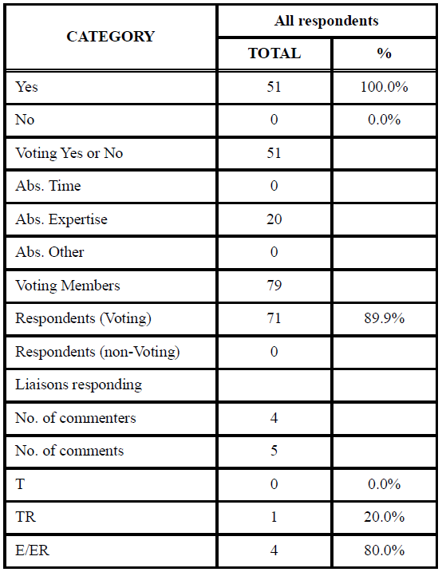
Supporting Information P802f
WG ballot closed: 4 July 2022
All WG ballot requirements are met
The ballot resulted in
  0 outstanding Disapprove votes
  0 outstanding Must Be Satisfied (MBS) comments
Comment resolution available here: https://www.ieee802.org/1/files/private/802-f-drafts/d1/802f-d1-3-dis-v03.pdf
Recirculation ballot will be conducted during July/August with comment resolution in TSN TG meetings. A possible final recirculation in September/October if required with comment resolution in TSN TG meetings.
Ballot results:

Slide 19
802.1 Motions
2022-07
Consent Agenda
Drafts to RevCom

Slide 20
5.0112 - Motion
Approve sending P802.1Q-Rev D1.2 to RevCom
  No CSD; Revision PAR not intended to provide any new functionality
In the WG, Proposed: Paul Congdon Second: Mick Seaman
  Sending draft (y/n/a): 48, 2, 2
In EC, mover: Glenn Parsons, Second: Roger Marks
  (y/n/a): <y>,<n>,<a>

Slide 21
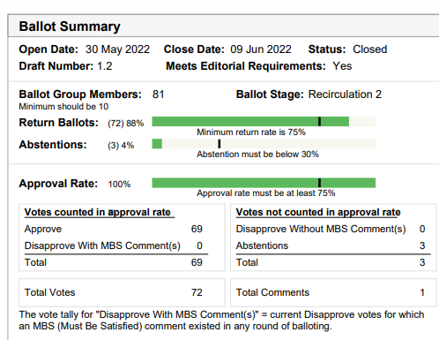
Supporting information for P802.1Q-Rev
SA ballot closed:
  9 June 2022
All SA ballot requirements
are met
P802.1Q-Rev D1.2 had 100% approval, 88% return rate at the end of the SA ballot
The ballot resulted in
  0 Disapprove votes
  0 comments
Disposition: https://www.ieee802.org/1/files/private/q-rev-drafts/d1/802-1Q-rev-d1-2-dis.pdf

Slide 22
802.1 Motions
2022-03
Consent Agenda
Liaisons and external communications (ME)

Slide 23
7.09 - Motion
Approve liaison of the following comment responses to ISO/IEC JTC1/SC6 under the PSDO agreement:
  IEEE 802.1ACct-2021
    https://www.ieee802.org/1/files/public/docs2022/liaison-SC6CommentResponseACct-0722.pdf
  IEEE 802.1BA-2021
    https://www.ieee802.org/1/files/public/docs2022/liaison-SC6CommentResponse1BA-0722.pdf
In the WG, Proposed: Paul Congdon Second: Karen Randall
  Sending draft (y/n/a): 43, 1, 6
In EC, mover: Glenn Parsons Second: Roger Marks
  (y/n/a): <y>,<n>,<a>

Slide 24
7.10 - Motion
Approve submission of the following draft(s) to ISO/IEC JTC1/SC6 for information under the PSDO agreement, once the SA Ballot starts
  P802.1AEdk
  P802f
  P802.1Qcw
In the WG, Proposed: Paul Congdon Second: Karen Randall
  Sending draft (y/n/a): 38, 2, 6
In EC, mover: Glenn Parsons Second: Roger Marks
  (y/n/a): <y>,<n>,<a>

Slide 25
7.11 - Motion
Approve https://www.ieee802.org/1/files/public/docs2022/liaison-response-itu-t-sg15-otnt-swp-0722.pdf as communication to ITU-T SG15 on LS351: OTNT Standardization Work Plan Issue 30, granting the IEEE 802.1 WG chair (or his delegate) editorial license.
  This approval is under LMSC OM “Procedure for public statements to government bodies”
In the WG, Proposed: Paul Congdon Second: Karen Randall
  Sending draft (y/n/a): 43, 1, 7
In EC, mover: Glenn Parsons Second: Roger Marks
  (y/n/a): <y>,<n>,<a>

Slide 26
802.1 Motions
2022-03
Consent Agenda
Liaisons and external communications (II)

Slide 27
7.12 - Motion
Approve sharing the latest revision of the P802f draft with the IETF Network Modeling (netmod) Working Group.
Proposed: János Farkas
Second: Stephan Kehrer
In the WG (y/n/a): 41, 2, 6
In the EC, for information

