Slide 1
Executive Secretary Agenda Items 2022 July Plenary
Jon Rosdahl IEEE 802 Executive Secretary jrosdahl@ieee.org

Slide 2
Event Conduct and Safety Statement
IEEE believes that science, technology, and engineering are fundamental human activities, for which openness, international collaboration, and the free flow of talent and ideas are essential. Its meetings, conferences, and other events seek to enable engaging, thought-provoking conversations that support IEEE’s core mission of advancing technology for humanity. Accordingly, IEEE is committed to providing a safe, productive, and welcoming environment to all participants, including staff and vendors, at IEEE-related events.

Slide 3
Event Conduct and Safety Statement
IEEE has no tolerance for discrimination, harassment, or bullying in any form at IEEE-related events. All participants have the right to pursue shared interests without harassment or discrimination in an environment that supports diversity and inclusion. Participants are expected to adhere to these principles and respect the rights of others.
IEEE seeks to provide a secure environment at its events. Participants should report any behavior inconsistent with the principles outlined here, to onsite staff, security or venue personnel, or toeventconduct@ieee.org.

Slide 4
IEEE 802 Opening EC Mtg – July 10
Agenda Item 6.02 - II
Current / Future venues
Things to know about this week!
Registration Reminder
Straw Poll for WGs
Future Venue Contract Status
Nov 2022 – Bangkok, Thailand
Other Future Sessions

Slide 5
Things to Know about this week!
2022 July IEEE 802
Mixed Mode Plenary
Montreal, QC Canada

Slide 6
Meeting Information
In-Person Schedule of Meeting Times and Rooms:
https://schedule.802world.com/schedule/schedule/show
802 LAN/MAN Standards Committee - composite calendar:
https://www.ieee802.org/802tele_calendar.html
Le Center Montreal Meeting Space Map
http://802world.org/plenary/meeting-map
Opening EC Meeting:
Monday July 11th 8:00 AM Drummond Ouest L3
Closing EC Meeting:
Friday July 15th 1:00 PM Drummond Ouest L3

Slide 7
Local Attendee Food & Beverage
Light Breakfast
7:30 AM - 8:30 AM
AM Coffee and Tea
10:00 AM - 11:00 AM
PM Coffee and Tea and Snacks
3:00 PM - 4:00 PM
Monday – Thursday:
Served in the Ballroom Foyer, Level 4
Friday Service Location:
TBC

Slide 8
Social Networking Event
Wednesday July 13, 2022
6:30 - 8:30 PM
Ballroom Foyer
Refreshments, Bar Service, Music

Slide 9
Lunch Options
Cafe Bar, Lobby Level
Monday – Thursday 11:30am to 1:30pm.
Menu changes daily and includes salads, sandwiches items fresh off the grill plus more.
Food Court at CIBC Building (Across the Street from the hotel),
1155 Boulevard René-Lévesque O, B1,.
Food Court located in the VIA Rail train station
below the Fairmont Queen Elizabeth hotel.
URL: https://garecentrale.ca/en/halles-de-la-gare
Time Out (Le Centre Montreal), 30 Sainte-Catherine West, Montreal
https://lecentral.ca/en/
Bar and Restaurant near Bell Centre | Le Centre Sheraton Montreal Hotel (marriott.com)

Slide 10
Request for information from local 802 Plenary WG Attendees
We need to try to get an accurate count to prepare for the Breaks and Lunch on Friday.
During your WG Opening Plenary, we need to determine how many will be staying to attend the 802 EC Closing Plenary, the 802.11 Closing Plenary and/or the 802.1 " IEC/IEEE 60802" meetings on Friday Nov 15.
Please report back to Jon by Monday July 10 by 2 pm ET (14:00 ET)
Questions to Ask:
If you will be at one of the three meetings on Friday ( 802 EC Closing Plenary, the 802.11 Closing Plenary or the 802.1 " IEC/IEEE 60802" meeting ) will you participate (eat/drink) :
With breakfast?
with the AM Break?
with the PM Break?
Please report all three numbers as it will affect our guarantees for F&B expenses for Friday.

Slide 11
Basic Room Resource Allocation
Big meetings
(≥ 100, e.g., WG plenaries)
Medium meetings
(35-100, e.g., Task Forces)
Smaller meetings
(30 or less)
Head table (4)
1 projector/screen
2 tables mics
1 or 2 floor mics
Sound system
(speakers, sound board, etc.)
Ethernet-HDMI-USB
Head table (2)
1 projector/screen
1 table mic
1 floor mic
Sound system
(speakers, sound board, etc.)
Ethernet-HDMI-USB
U-shaped or board meeting setup
1 room microphone
Portable or speakerphone-type
Sound system
(speakers, sound board, etc.)
Ethernet-HDMI-USB

Slide 12
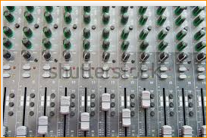
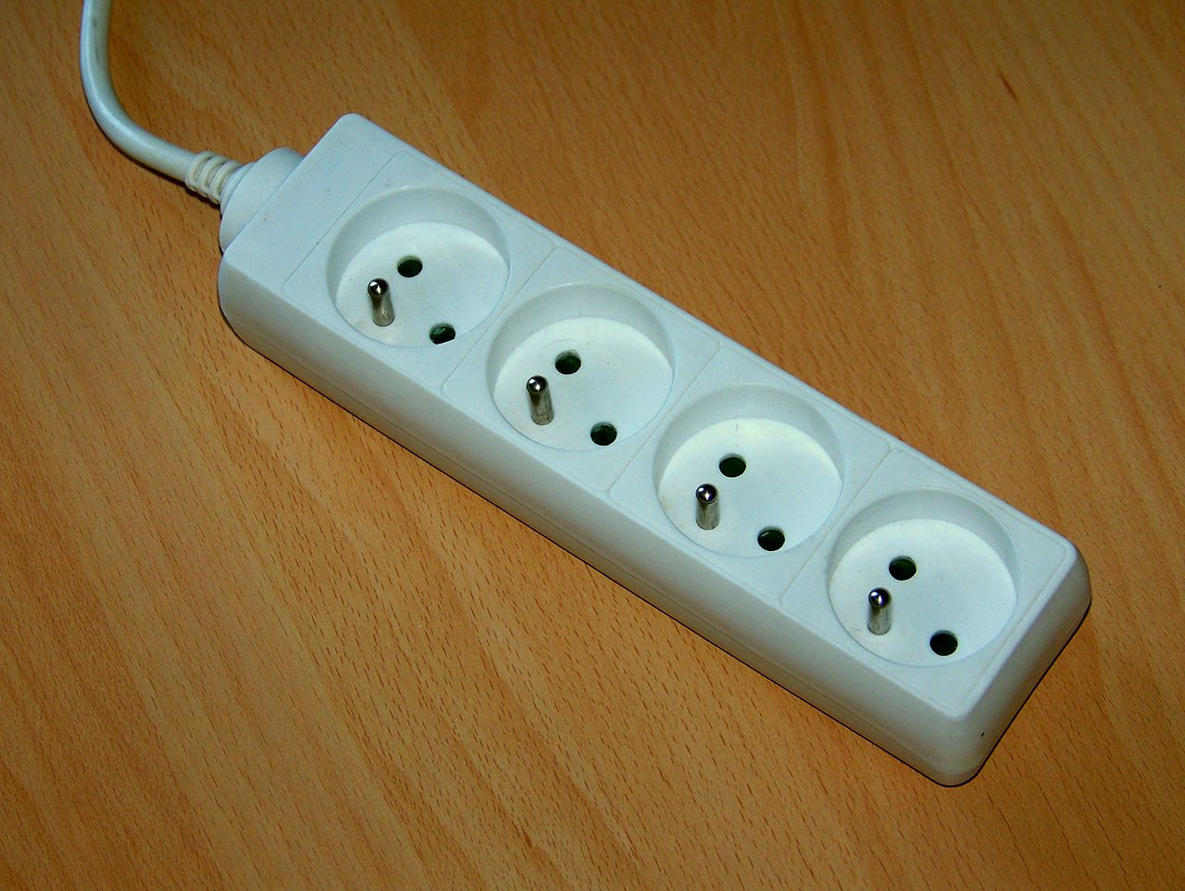
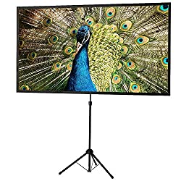
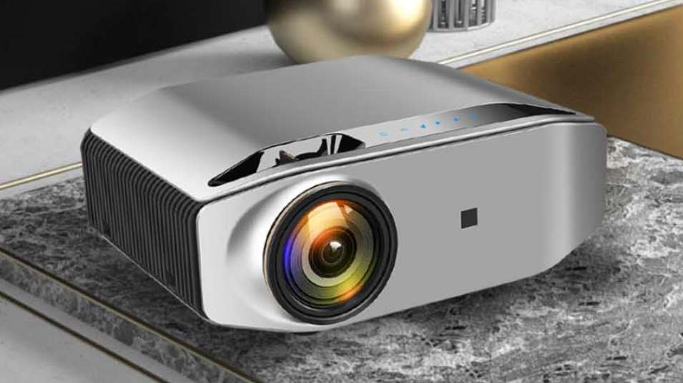
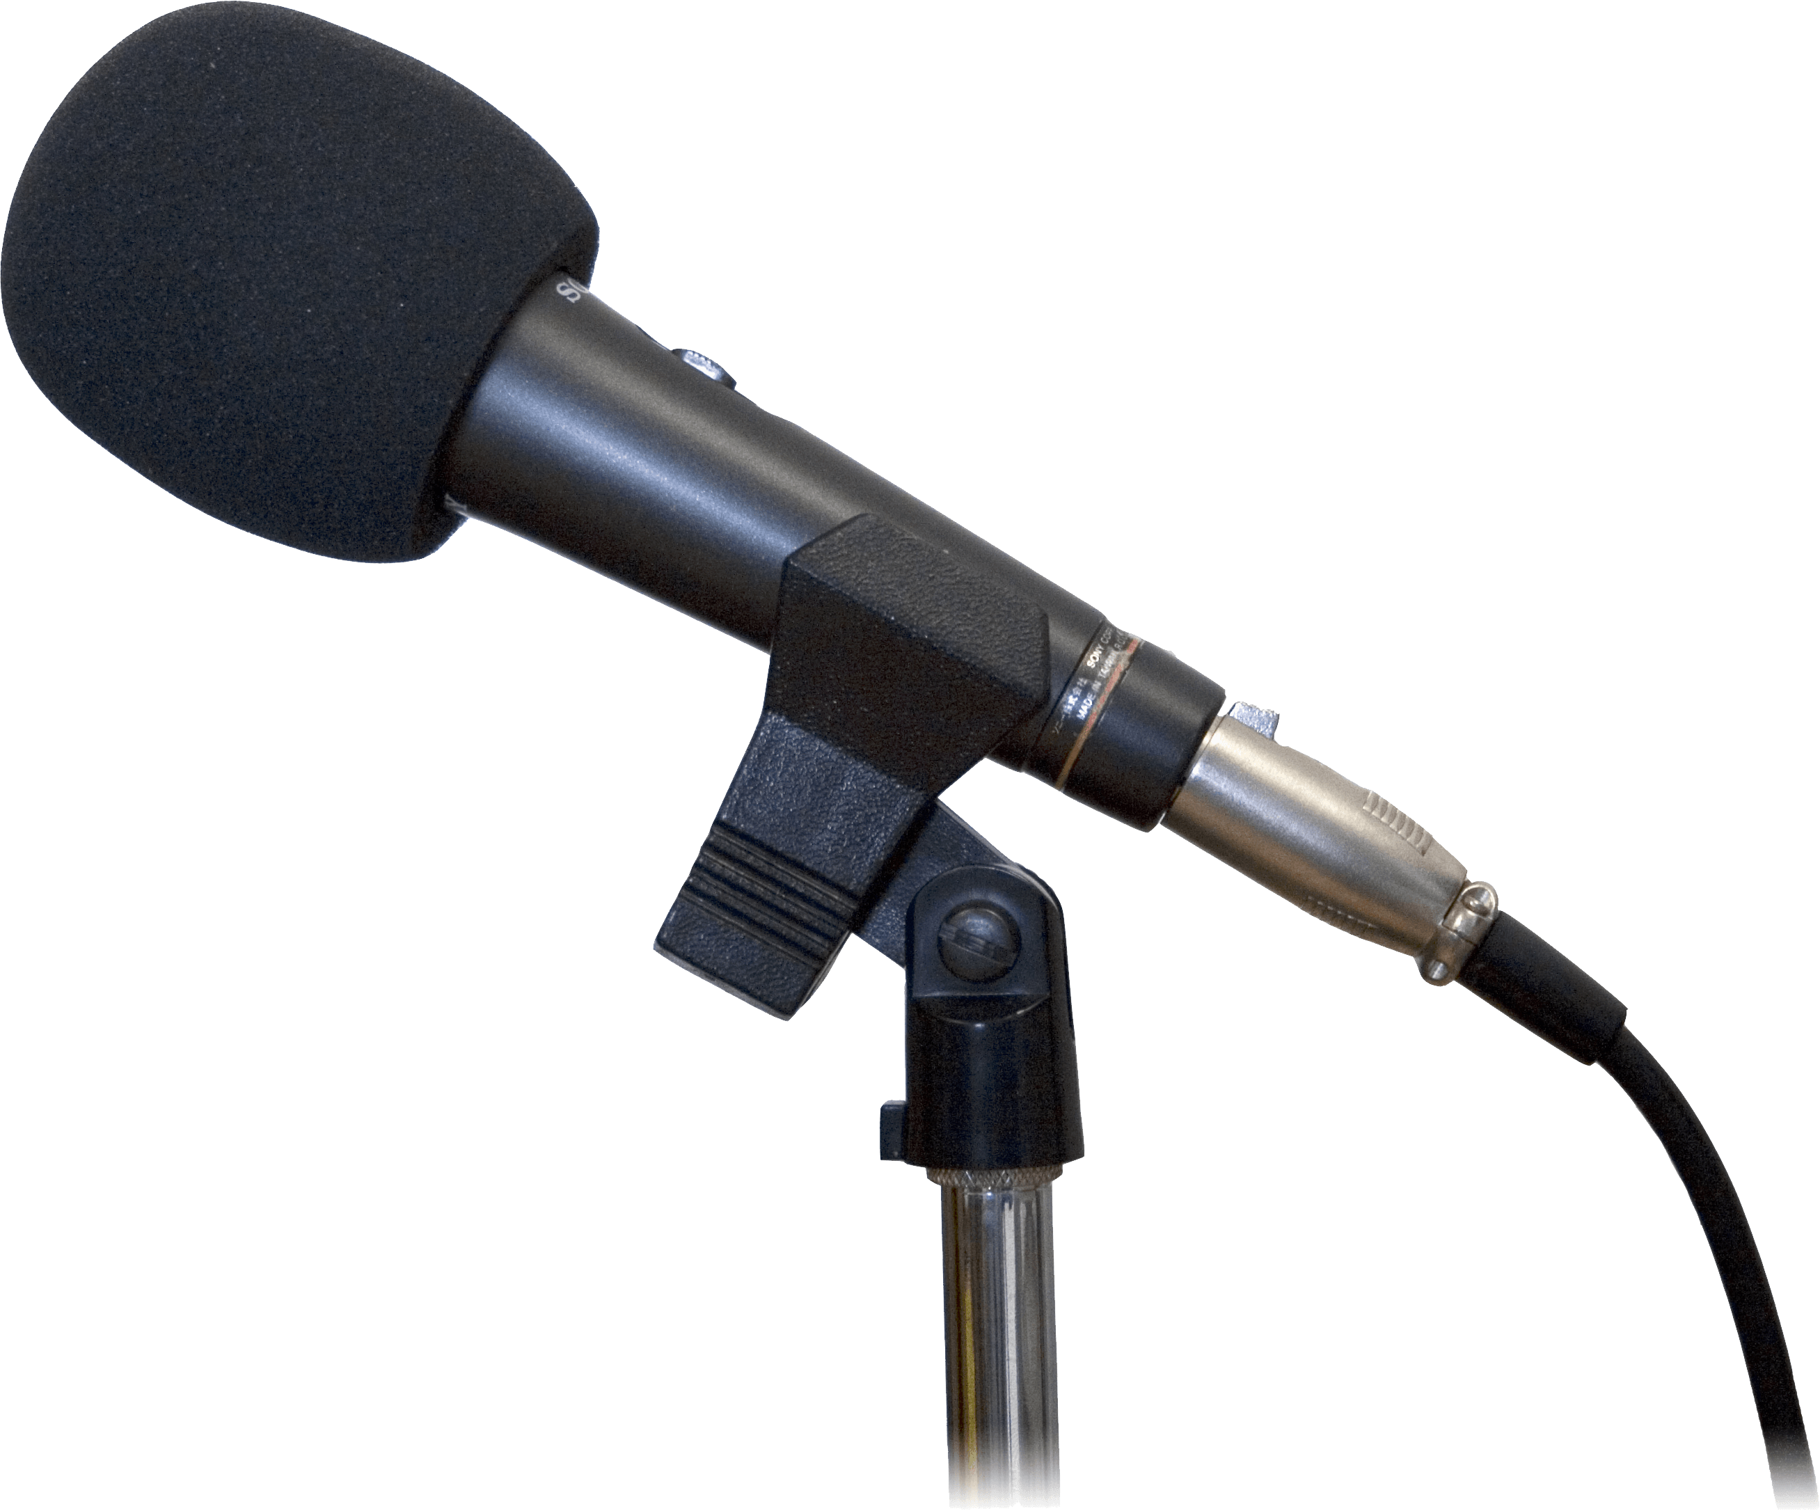
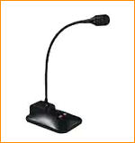
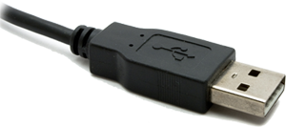
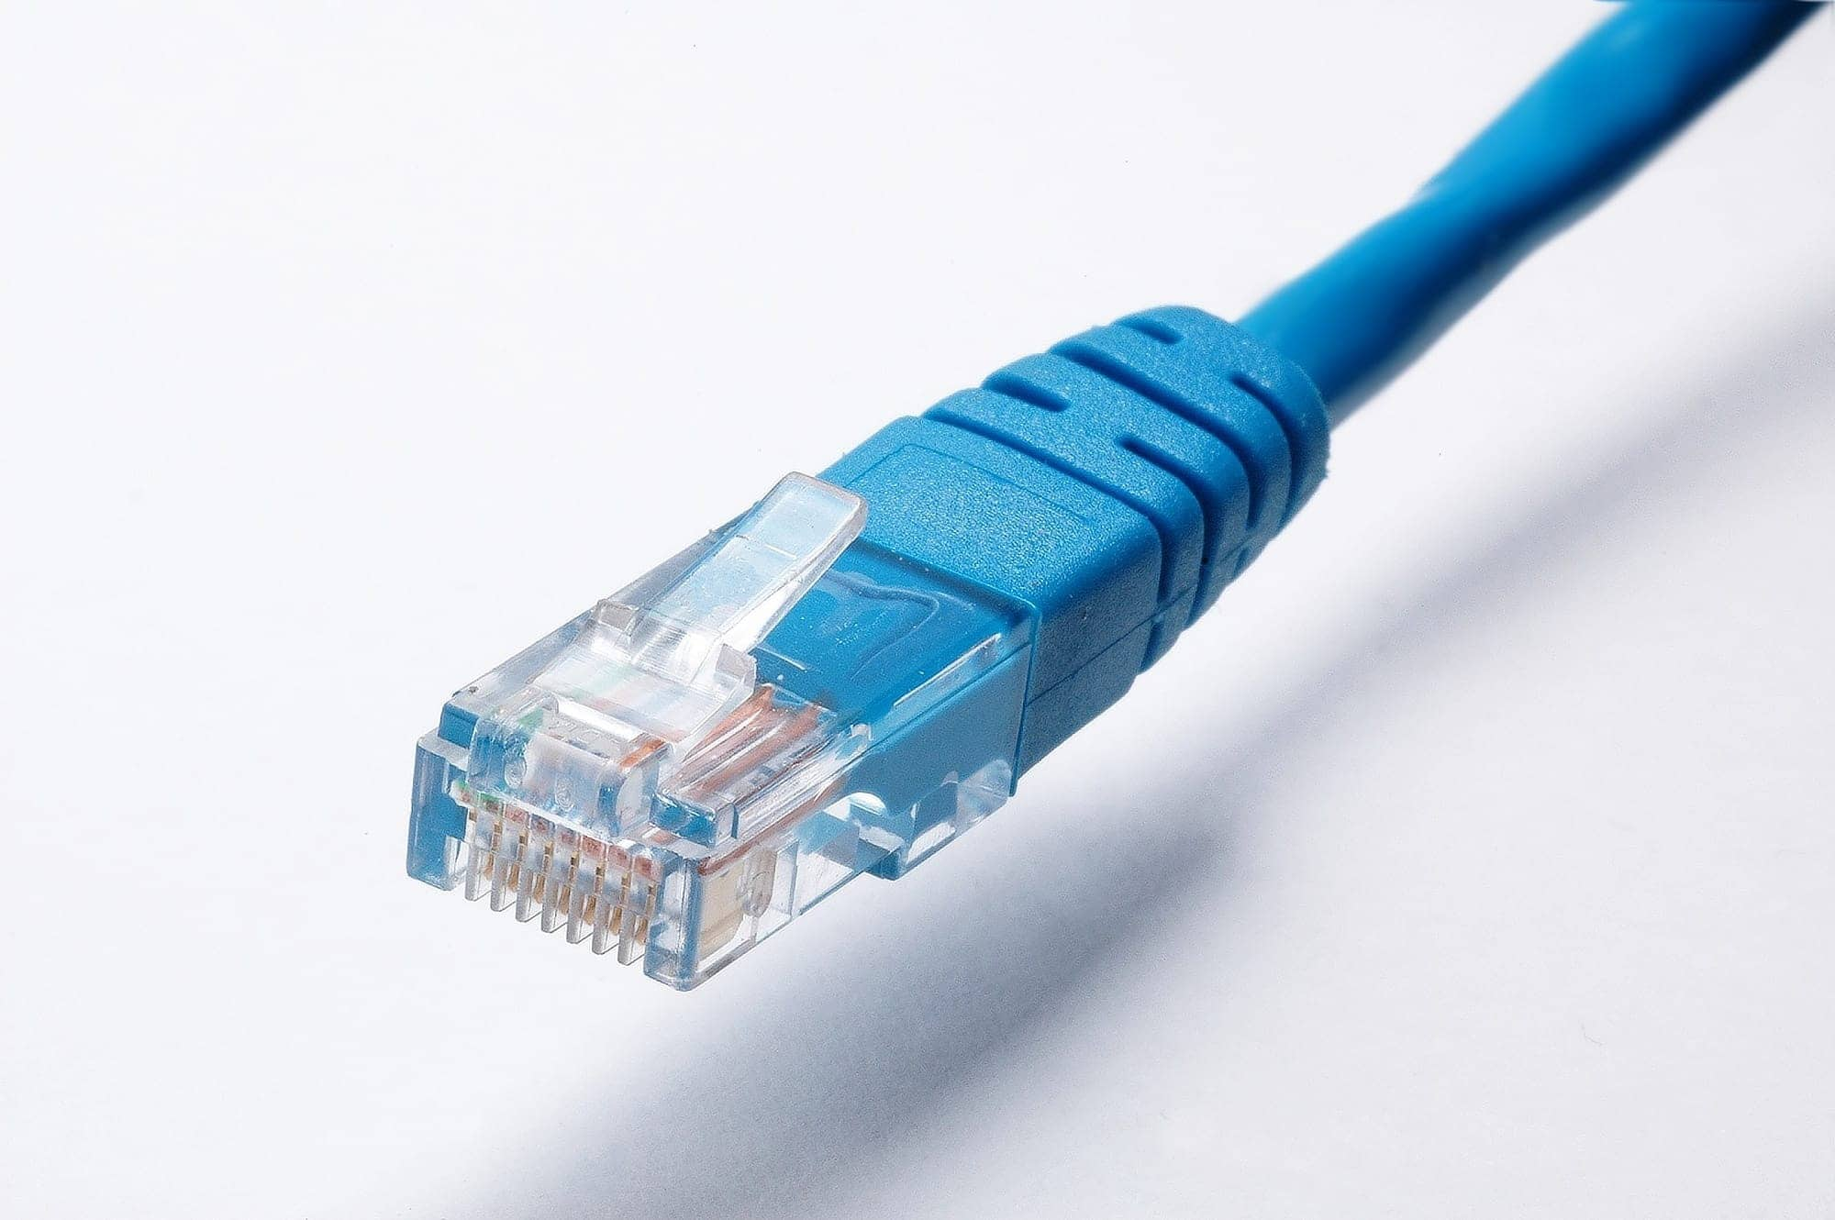
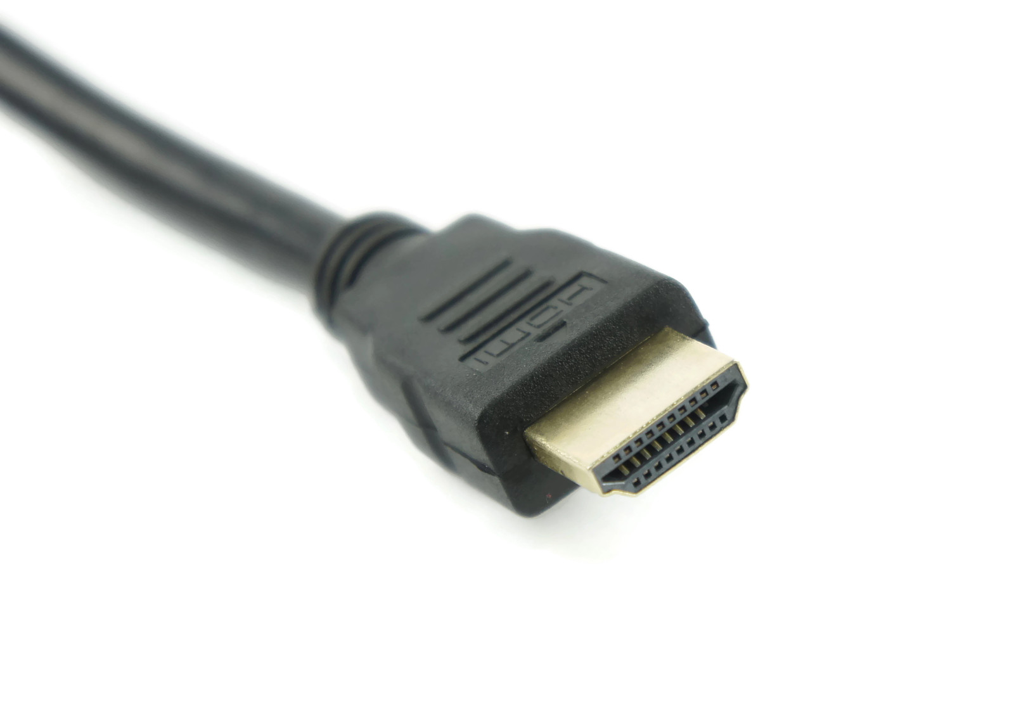
Sample IEEE Room Drawing
Console/ Tech Table
screen
Projector
Desks/chair/power
Floor mic
Head Table
Power/Mic/HDMI/
USB/Ethernet
Notes:
This Photo by Unknown Author is licensed under CC BY-NC
This Photo by Unknown Author is licensed under CC BY-SA-NC
This Photo by Unknown Author is licensed under CC BY-SA

Slide 13
Suggested best practices
One central laptop/computer per meeting connects at head table.
Local speakers queue/speak only at the microphone
Presenters have chair (central laptop) share the presentation
Local attendees when using WebEx SHOULD NOT connect Audio.
When Starting a meeting the host should do the following:
Select “Meeting” -> “Meeting Options” -> [Disable] “Allow Participant to turn on Video”
Select “Participant” -> [Enable] “Mute on Entry”.
Most rooms need only one USB port.
Some may also require an 1/8” speaker port (Aux out).

Slide 14
Audio Visual
Stage Vision (Le Centre Sheraton Montreal) manages the LCD projectors/cables/switch boxes & DA’s, audio & screens.
If you have any difficulty kindly contact:
Lisa Ronmark, Face to Face Events:
Email: lisa@facetoface-events.com or Text: +1 (604) 316-4947
or
Dawn Slykhouse
Email: dawns@facetoface-events.com or Text: +1 (408) 594-1342

Slide 15
Network Access
The IEEE 802 Plenary session secure network can be accessed using the following information.
Linespeed landing page…. ieee802.linespeed.io Wireless Encryption Protocol: WPA2-PSK
SSID: IEEE802
Password: ieeeieee
NETWORK SUPPORT
IEEE 802 Network provider Linespeed will be onsite to support In-Person participation. If you require assistance accessing the network, please stop by the event information desk in the Ballroom Foyer.

Slide 16
Tourism Montreal
We encourage you to check out the tourism Montreal website for great information about nearby restaurants, entertainment and services.
https://www.mtl.org/eng

Slide 17
Health & Safety
The health and safety of all attendees is a concern. To ensure the well-being of all event participants, we have assembled guidelines to provide a safe and enjoyable experience.
Health & Safety Guidelines and Comprehensive Listing of Nearby Services Online at https://web.cvent.com/event/5ab3e363-ef4b-45fe-b35d-cd88bf622491/websitePage:22085e89-487f-466f-ab24-c64cbd87aad4
Please be courteous and mindful of others.
Wash Hands often.

Slide 18
Meeting Planner
The July 2022 IEEE 802 Plenary Session Meeting Planner is
Face to Face Events.
Members of the team will be available as follows:
Office Hours (Eastern Time Zone, GMT-5):
Sunday July 10th 1:00 PM - 7:00 PM
Monday July 11th to Friday July 15th 7:30 AM to 5:00 PM
General Information Desk Location: East Ballroom Foyer – Level 4
Event Office: Salon 8 -Level 4
Meeting Planner Email: 802info@facetoface-events.com

Slide 19
Registration Reminder
This meeting is part of the 2022 July IEEE 802 Mixed Mode Plenary session
You must pay the registration fee whether attending in-person or remotely any of the 802 meetings (WG/TG/TF/SG/SC).
If you have not already done so, you can register here:
https://web.cvent.com/event/5ab3e363-ef4b-45fe-b35d-cd88bf622491/summary
Late/Onsite Registration Fee: $US900.00 After June 24, 2022

Slide 20
Request for 802 WG Straw Polls
802 WG Chairs, Please Straw Poll your membership:
1. If the 2022 November Plenary Session is held in Bangkok, Thailand as an in-person only session, will you attend?
Yes/No
2. If the 2022 November Plenary Session is held in Bangkok, Thailand as a mixed-mode session, will you attend:
Attend In-person
Attend Virtually (remotely)
Will not attend plenary
802 Wireless WGs are asked to ask similar question for the 2022 Sept 802 Wireless Interim in Waikoloa:
3. If the 2022 September Interim Session is held in Waikoloa, Hawaii as a mixed-mode session, will you attend:

Slide 21
Future Venue Contract Status
2022 – July 10-15 – Sheraton Le Centre Montreal, Montreal, Quebec, Canada
2022 – Nov 13-18 – Marriott Marquis Queen’s Park, Bangkok, Thailand (Nov 2020)
2023 – March 12-17 –Hilton Atlanta, Atlanta, GA, United States (1 of 2 – March 2020)
2023 – July 9-14 – Estrel Berlin, Berlin, Germany
2023 – Nov 12-17 – Hawaiian Village, Oahu, Hawaii, United States
2024 – March 10-15 – Hyatt Regency Denver at Colorado Convention Center, Denver, CO, United States (March 2021)
2024 – July 14-19 – Sheraton Le Centre Montreal, Montreal, Quebec, Canada (July 2020)
2024 – Nov 10-15 –Hyatt Regency Vancouver, Vancouver, Canada (Nov 2021)
2025 – March 9-14 –Hilton Atlanta, Atlanta, GA, United States (2 of 2 – March 2020).
2025 – July 13-18 –Marriott Madrid Auditorium, Madrid, Spain (July 2021)
2025 – Nov 9-24 – Possible need for penalty offset- Le Centre Sheraton Montreal, Montreal (July 2022)
2026 March 8-13 - Hyatt Regency Chicago, Chicago, IL, United States (March 2024) – (Contract pending)
2027 – Nov 14-19 – Hawaiian Village, Oahu, Hawaii, United States
https://mentor.ieee.org/802-ec/dcn/20/ec-20-0001-05-00EC-802-plenary-future-venue-contract-status.xlsx
Notes:
Yellow Highlight – Potential deferral identified.
Blue Highlight – replacement dates for venues deferred.
Light Green highlight – potential targets for possible deferrals or offset penalties.
Dark Green Highlight – rebooking due to COVID
Red – Cancelled – Electronic Plenary
No highlight – pre Covid assigned dates/venues. Note: 2026 March - RFP -2019 - Hyatt Regency Chicago selected for March 2023, Contract not signed due to PSAV - Moved to 2024 March - then moved to 2026 due to agreement with rebooking Denver.

Slide 22
2022 Nov 13-18 – Marriott Marquis Queen’s Park, Bangkok, Thailand
2022 Nov 13-18 – Marriott Marquis Queen’s Park, Bangkok, Thailand rebooked from Nov 2020.
Expectations:
Meeting Fees to be confirmed this week (July 15).
nominal rate: $600 (Early-bird rate)
open Registration first week of August.
Treasurer/Mtg Planner/Exec Sec to have proposal for Closing plenary.
Notes:
$400+$100+$100 = $600

Slide 23
Future Session AdHocs
All potential New Future Venues not already approved are on hold.
Negotiations on Madrid (2025 July) and Chicago (2026 March) on hold.
Future Venue AdHoc: Next Plenary
Thursday 14 July 2022 7:30am Salon 5 level 2
Review Resources for 2022 November Plenary
Future Venue Ad-Hoc: Futures
Thursday 14 July 2022 8:00 am Salon 5 Level 2
Review requirements for future sessions.
Review requirement expectations/actuals for this week.

Slide 24
Future Venue AdHocs --

Slide 25
Next Venue Meeting planning – Thurs 7:30 am
Proposed Agenda:
Start time 7:30 am
Review meeting space plan for 2022 November Plenary
Bangkok, Thailand
Adjourn 8:00am

Slide 26
Notes from Discussion
Remember Head Table audio – may need extra speaker
Head table size to accommodate extra laptop for Mixed-Mode.
Expectation is about the same or fewer in-person than Montreal.
Check what the Mixed-Mode accommodation will be.
What equipment will be used?
Site visit being evaluated – Phil B going to be there in August.

Slide 27
Future Venues AdHoc – Thurs 8 am
Proposed Agenda:
Start time – 8:00 am
Review Contract Status
Review requirements for future sessions.
Review requirement expectations/actuals for this week.
End time – 9:00am

Slide 28
Future Venue Contract Status
2022 – July 10-15 – Sheraton Le Centre Montreal, Montreal, Quebec, Canada
2022 – Nov 13-18 – Marriott Marquis Queen’s Park, Bangkok, Thailand (Nov 2020)
2023 – March 12-17 –Hilton Atlanta, Atlanta, GA, United States (1 of 2 – March 2020)
2023 – July 9-14 – Estrel Berlin, Berlin, Germany
2023 – Nov 12-17 – Hawaiian Village, Oahu, Hawaii, United States
2024 – March 10-15 – Hyatt Regency Denver at Colorado Convention Center, Denver, CO, United States (March 2021)
2024 – July 14-19 – Sheraton Le Centre Montreal, Montreal, Quebec, Canada (July 2020)
2024 – Nov 10-15 –Hyatt Regency Vancouver, Vancouver, Canada (Nov 2021)
2025 – March 9-14 –Hilton Atlanta, Atlanta, GA, United States (2 of 2 – March 2020).
2025 – July 13-18 –Marriott Madrid Auditorium, Madrid, Spain (July 2021)
2025 – Nov 9-24 – Possible need for penalty offset- Le Centre Sheraton Montreal, Montreal (July 2022)
2026 March 8-13 - Hyatt Regency Chicago, Chicago, IL, United States (March 2024) – (Contract pending)
2027 – Nov 14-19 – Hawaiian Village, Oahu, Hawaii, United States
https://mentor.ieee.org/802-ec/dcn/20/ec-20-0001-05-00EC-802-plenary-future-venue-contract-status.xlsx
Notes:
Yellow Highlight – Potential deferral identified.
Blue Highlight – replacement dates for venues deferred.
Light Green highlight – potential targets for possible deferrals or offset penalties.
Dark Green Highlight – rebooking due to COVID
Red – Cancelled – Electronic Plenary
No highlight – pre Covid assigned dates/venues. Note: 2026 March - RFP -2019 - Hyatt Regency Chicago selected for March 2023, Contract not signed due to PSAV - Moved to 2024 March - then moved to 2026 due to agreement with rebooking Denver.

Slide 29
Notes
Request to WG Chairs to ask how attendees liked the venue this week? (Would you like to return to this venue?)
Attrition Penalties analyzed
Projected attrition for July possible 674 nights = CA$140k
Projected Attrition November of 60k per 500 rm nights
With projected income for Nov will pay fee rather than add $300 to reg fee
Peak Hotel nights in Montreal = 300 vs 415 in person attendees.
Requirements on A/V to be prescribed.
Badges and Check-in discussed –
Return to previous badge and check-in for registration.
Discussion of 2023 March Anniversary Celebration Discussion.
Shirts, Aquarium, buses, nominal event.

Slide 30
Request for WG SP about current Venue
How many people would like to come back to this venue?
Yes/No
Did you go to the social?
Yes/No
Did you like the social?
Yes/No

Slide 31
IEEE 802 Closing EC Mtg – July 15
Agenda Items:
4.02 MI Future Meetings
4.03 MI IEEE 802 Nov 2022 Meeting Fee
8.033 Executive Secretary Report
8.04 Announcement of 802 EC Interim Telecon
8.05 Call for Tutorials for July 2022 Plenary

Slide 32
Future Venue Contract Status
2022 – July 10-15 – Sheraton Le Centre Montreal, Montreal, Quebec, Canada
2022 – Nov 13-18 – Marriott Marquis Queen’s Park, Bangkok, Thailand (Nov 2020)
2023 – March 12-17 –Hilton Atlanta, Atlanta, GA, United States (1 of 2 – March 2020)
2023 – July 9-14 – Estrel Berlin, Berlin, Germany
2023 – Nov 12-17 – Hawaiian Village, Oahu, Hawaii, United States
2024 – March 10-15 – Hyatt Regency Denver at Colorado Convention Center, Denver, CO, United States (March 2021)
2024 – July 14-19 – Sheraton Le Centre Montreal, Montreal, Quebec, Canada (July 2020)
2024 – Nov 10-15 –Hyatt Regency Vancouver, Vancouver, Canada (Nov 2021)
2025 – March 9-14 –Hilton Atlanta, Atlanta, GA, United States (2 of 2 – March 2020).
2025 – July 13-18 –Marriott Madrid Auditorium, Madrid, Spain (July 2021)
2025 – Nov 9-24 – Possible need for penalty offset- Le Centre Sheraton Montreal, Montreal (July 2022)
2026 March 8-13 - Hyatt Regency Chicago, Chicago, IL, United States (March 2024) – (Contract pending)
2027 – Nov 14-19 – Hawaiian Village, Oahu, Hawaii, United States
https://mentor.ieee.org/802-ec/dcn/20/ec-20-0001-05-00EC-802-plenary-future-venue-contract-status.xlsx
Notes:
Yellow Highlight – Potential deferral identified.
Blue Highlight – replacement dates for venues deferred.
Light Green highlight – potential targets for possible deferrals or offset penalties.
Dark Green Highlight – rebooking due to COVID
Red – Cancelled – Electronic Plenary
No highlight – pre Covid assigned dates/venues. Note: 2026 March - RFP -2019 - Hyatt Regency Chicago selected for March 2023, Contract not signed due to PSAV - Moved to 2024 March - then moved to 2026 due to agreement with rebooking Denver.

Slide 33
2022 July WG Attendee Summary
Primary WG includes | 802.1 | 802.3 | 802.11 | 802.15 | 802.18, 19, or 24 only |  | total | Individuals | Dups
In-Person | 59 | 144 | 166 | 57 | 3 |  | 429 | 417 | 12
Virtual | 48 | 149 | 295 | 64 | 3 |  | 559 | 547 | 12
Student | 3 | 1 | 2 | 1 | 0 |  | 7 | 7 | 0
total | 110 | 294 | 463 | 122 | 6 |  | 995 | 971 | 2

Slide 34
Nov 2022 – Bangkok, Thailand
2022 November
Booked prior to Covid-19 Pandemic
2020 Nov instance rebooked to 2022 Nov.
Currently working on Logistic details.
Have shared A/V requirements with hotel and vendors.
Site visit to gather specific
Target Registration open on August 1 (pending Hotel Reg Link)

Slide 35
Straw Poll for 2022 Nov - 1
1. If the 2022 Nov Plenary Session is held in Bangkok, Thailand as an in-person only session, will you attend?
Yes No Minimum Viable
802.1 36 22 90
802.3 89 136 150
802.11 83 58 175
802.15 33 29 45
802.18 18 5 20
802.19 19 11 10
802.24 7
Totals 278 261 497
Notes:
Minimum Attendance for Viable Meeting:
WG Chairs reported 2020-11-20:
802.1 90
802.3 150
802.11 175
802.15 45
802.18 20
802.19 10
802.24 7
Total: 497

Slide 36
Straw Poll for 2022 Nov – 2.
2. If the 2022 November Plenary Session is held Bangkok, Thailand as a mixed-mode session, will you attend:
Attend In-person Attend Virtually (remotely) Will not attend plenary
802.1 34 28 0
802.3 65 150 10
802.11 76 72 4
802.15 30 29 3
802.18 12 7 2
802.19 14 12 4
802.24
Totals 231 298 23
Notes:
20% drop.

Slide 37
Straw Poll - 3
How many people would like to come back to this venue?
Yes/No
.1 = 32y 1n .
.11 =83y 13n 92-NA
Did you go to the social?
Yes/No
.11=52y 7n
Did you like the social?
Yes/No
.11 = 43y 2n

Slide 38
2022 November Mixed Mode Plenary Fee Motion
Motion to approve fees/dates for 2022 Nov IEEE 802 Mixed Mode Plenary for either in person or remote attendance:
$600 until Friday, Sept 16, 2022
$800 through Friday, Oct 31, 2022
$1000 after Friday, Oct 31, 2022
Cancellation Policy:
fully refundable until September 16
refundable with $150 cancellation fee after September 16 until October 31, 2022
non-refundable after October 31, 2022
Moved: Rosdahl
2nd: Zimmerman
Results: Unanimous – Motion passes.
Notes:
Room Rate Approx us$160 ++
Expected registration opens August 1, 2022 Attritions cost would be about $60K for lack of 500 nights.

Slide 39
Motion to Approve Exec Site Visit
Site Visits are included in the SOW for the Meeting Planner and Network Service Providers, the IEEE 802 Executive Secretary is requesting approval to attend potential Site visit 3Qtr (3 days/2 nights).
Move to approve Bangkok, Thailand Site Visit for IEEE 802 Executive Secretary not to exceed $5,500.
Move: Rosdahl
Second: Zimmerman
Results: unimous- motion passes
Notes:
Airfare = $2000
Transfers = $250
Food = $325
Hotel = $550
Total = $3500 per person

Slide 40
802 EC Closing Meeting
F&B is in lobby on this level.
Break until 3:00pm ET

Slide 41
8.033 – Executive Secretary Report
Meetings efficiency
Network Report
Meeting venue management
Assist Chair as requested

Slide 42
Network Report
Network Report posted to mentor: 802 EC-22/0159r0:
FINAL STATISTICS (as of 4PM 7/14/22)
• Total Internet data: 2.05 TB
• Total Internet data inbound: 1.64 TB
• Total Internet data outbound: 0.404 TB
Inbound Internet bandwidth utilization
o Peak: 242.95 Mb/s
o 95th Percentile: 111.34 Mb/s
• Outbound Internet bandwidth utilization
o Peak: 175.26 Mb/s
o 95th Percentile: 23.26 Mb/s
Maximum wireless network associations: 1116 unique devices
o WiFi 6 – 475
o WiFi 5 – 481
o WiFi 4 – 160
Dropped packets: 0

Slide 43
8.04 Monthly IEEE 802 EC Telecons
Announcement of 802 EC Interim Telecon
Tuesday 02 Aug 2022, 19:00-21:00 UTC
Tuesday 06 Sept 2022, 19:00-21:00 UTC
Tuesday 04 Oct 2022, 19:00-21:00 UTC
Call Time: 3:00 PM - 5:00 PM Tuesday, (UTC-04:00) Eastern Time (US & Canada)
Recurrence: Occurs the first Tuesday of every month effective 05 Aug 2022 to 04 Oct 2022 from 7:00 PM to 9:00 PM, (UTC+00:00) Monrovia, Reykjavik time zone.
New Calls to be Scheduled during 2022 Nov IEEE 802 EC Closing Plenary meeting.

Slide 44
8.05 Call for Tutorials for Nov 2022
Tutorials may be held electronic:
In person Tutorials:
Tutorial Request form:
Generic: http://www.ieee802.org/802_tutorials/802_Tutorial_Request_Form.doc
As a reminder, please refer to Chair's Guidelines section 2.5 Tutorials for the logistics for participating in sponsoring/presenting a Tutorial.
Note that Tutorial times are limited to 80 minutes with 10 minutes to allow for presenters to setup and depart.
All requests for Tutorials must be made by 30 Sept 2022
Notes:
All official tutorial request forms must be submitted no later than 45 days in advance of the Plenary Session.
Approved Tutorial Requests will be assigned a time slot based on the order in which they were received.
The Final Tutorial Schedule will be posted at http://802world.org/plenary and http://ieee802.org no less than 30 days in advance of the Plenary Session.

Slide 45
Tutorials and 802 Technical Plenary
For the 2022 July IEEE 802 Plenary:
Tutorials
11 or 12 July (Mon/Tues) Mixed Mode
802 Technical Plenary – Electronic only
TBD (Tentative - depending on Agenda items provided – May 5 and July 7th).

